Slide 1
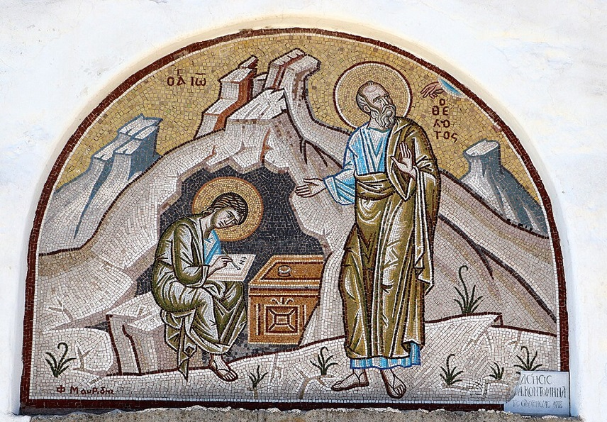
การวิเคราะห์พระธรรมวิวรณ์
สอนโดย อ.Tim จากคำบันทึกของ อ. Max Klein
REVELATION 52
2025 06 23

Slide 2
วิวรณ์ 2: 12-17
(การเขียนถึงคริสตจักรที่เมืองเปอร์กามัม)

Slide 3
2:12-13. “And to the messenger [the pastor] of the church in Pergamum write: The One who has the sharp two-edged sword [Rhomphaia] says this: I know where you dwell, where Satan’s throne is [possibly related to the altar of Zeus]; and you hold fast My name and did not deny My doctrine even in the days of Antipas [during the reign of Domitian], My witness [in the Angelic Appeal Trial], My faithful one [he remained faithful in his martyrdom] who was murdered among you, where Satan dwells.
วิวรณ์ 2:12-13 จงเขียนถึงทูตสวรรค์แห่งคริสตจักรที่เมืองเปอร์กามัมว่า `พระองค์ผู้ทรงถือดาบสองคมที่คมกริบตรัสดังนี้ว่า เรารู้จักแนวการกระทำของเจ้า เรารู้จักที่อยู่ของเจ้าคือเป็นที่นั่งของซาตาน เจ้ายึดนามของเราไว้มั่น และไม่ปฏิเสธความเชื่อในเรา แม้ในเวลาที่อันทีพาผู้เป็นพยานที่สัตย์ซื่อของเรา ต้องถูกฆ่าในท่ามกลางพวกเจ้าในที่ซึ่งซาตานอยู่

Slide 4
1. Demonism is always associated with idolatry and Pergamos was saturated with idolatry. So, Satan made his headquarters there. Satan, like all creatures, can only be at one place at one time.
2. Pergamos was a center for the phallic cult, as illustrated by the presence of the Nicolaitans, a cult which involved demon possession.
3. Furthermore, Satan worship or serpent worship was conducted in the Temple of Aesculapius.

Slide 5
4. Demon-motivated persecution of believers will be noted in the context.
5. Even so, most believers were safe in Pergamos, the headquarters of Satan. So, living in a dangerous place is not necessarily dangerous. What is dangerous for the believer is living in the cosmic system.
6. Believers were not only living under Satan’s nose but were advancing to maturity, right there. That gives us some idea of the tremendous power of God regarding His provision of logistical grace.

Slide 6
Antipas is a nickname for Antipater and refers here to a former pastor of Pergamos before John took over as the non-resident pastor. The reason John had to take over as the non-resident pastor of Pergamos is because Antipas was martyred.
The priests of the Temple of Aesculapius became antagonistic toward Antipas, and under the cover of the Domitian persecution they seized him and put him inside of a brass bull which they heated up and roasted him to death (92 A.D).
At the same time there were other believers in the church who were also murdered but only Antipas is mentioned here because he is the one who died so honorably.
Bible doctrine was so important and so real to him that the excruciating pain and the torture which he endured was completely set aside by the reality of the Word of God in his own soul.

Slide 7
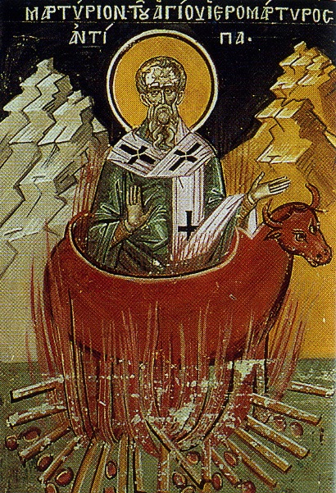
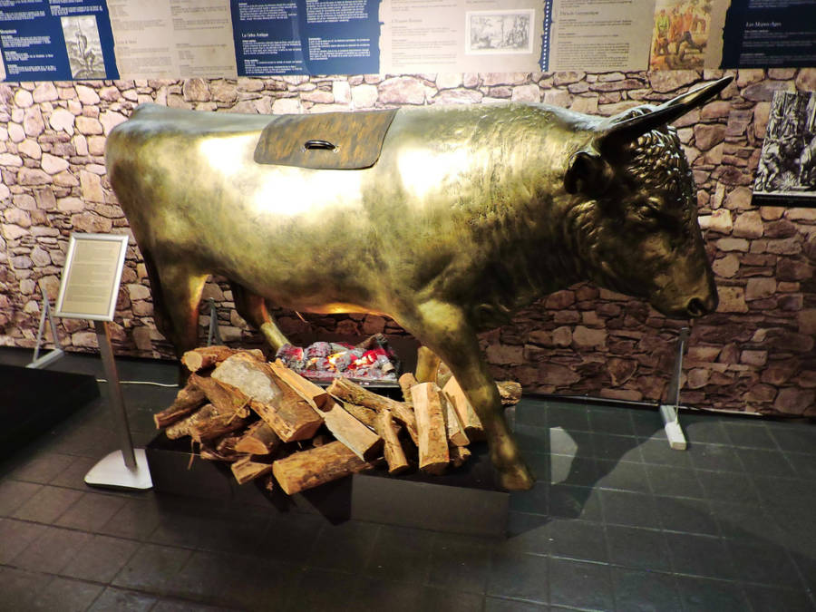
From Wikipedia: The traditional accounts go on to say Antipas was martyred during the reign of Nero (54-68) or Domitian, by burning in a brazen bull-shaped altar for casting out demons worshipped by the local population. For Catholics: “Saint Antipas is invoked for relief from toothache, and diseases of the teeth. On the calendars of Eastern Christianity, the feast day of Antipas is April 11”

Slide 8
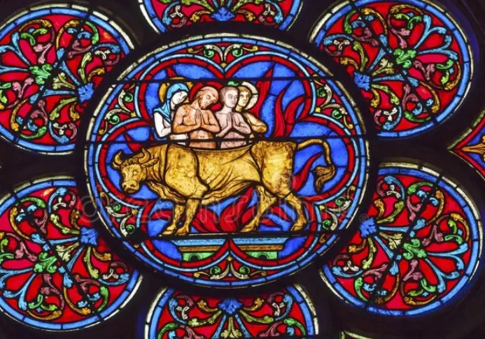
Stained glass window in the Church of Notre Dame, Paris, France.

Slide 9
Obviously, this was a Satan-inspired function to break the back of the church in Pergamos and at the same time to test Antipas as he did Job. The phrase “where Satan resides” implies that Satan took Antipas as a personal challenge. Not only that, but the Lord permitted Antipas to be tested by excruciating torture and ultimately death, again implying Evidence Testing.
The death of Antipas did not, however, intimidate believers whose scale of values placed Bible doctrine as number one. They continued faithful to the Word of God in spite of persecution. Some even followed Antipas to martyr’s graves for their spiritual integrity was stronger than the pain of torture and death.

Slide 10
This assassination undoubtedly worried Satan. He realized that throughout history he must do everything he can to distract believers so that they will never accumulate the doctrine which Antipas accumulated in his soul for the Christian with that amount of doctrine cannot even be shaken by the power of Satan.

Slide 11
By John Preston
https://www.keytovision.com/how-to-know-your-scale-of-values/
(The secular viewpoint)
1. Values ​​are defined as the fundamental pillars that guide our decisions, actions and behaviors in life.
2. These intrinsic principles act as a set of deeply held beliefs that shape our perception of the world and define everything we consider meaningful.
3. Values ​​provide us with an ethical and moral framework that influences our daily choices and the way we establish relationships with other people.
4. A central characteristic of ethical and moral values ​​is that they are not static; They vary from person to person, influenced by factors such as culture, education and personal experiences.

Slide 12
5 strategies to know your scale of values
1. Reflective self-assessment
Examine your achievements, challenges overcome, and moments of fulfillment. Ask yourself what underlying values were present in those experiences.
2. Identification of role models
Identify people you admire for their achievements, integrity, or positive impact on society. Role models act as mirrors that reflect qualities you value.
3. Prioritization of activities and time
The way you allocate your time and energy reveals fundamental clues about your priority values. Examine your daily routines and the activities you spend the most time doing. What aspects of your life receive your constant attention? Prioritizing activities and time not only reflects your external commitments, but also your personal choices. If much of your day focuses on family, career, or self-development, those are likely key values ​​for you.
Take an honest review of how you allocate your time and evaluate whether these choices are aligned with what you truly value.

Slide 13
4. Deep questioning
What is truly important to you in life? What are your fundamental principles? Deep questioning gives you the clarity needed to understand not only what you do, but why you do it.
5. Written record
A journal acts as a mirror of your mind, capturing your experiences and allowing you to analyze them carefully. By writing regularly, you will be able to identify recurring patterns in your thoughts and behaviors. Observe how you react to different situations and what aspects are consistent in your personal narratives.

Slide 14
2:14. ‘But I have a few things against you, because you have there some who hold the teaching of Balaam, who kept teaching Balak to put a stumbling block before the sons of Israel, to eat things sacrificed to idols [while worshipping them] and to commit acts of sexual immorality. ἀλλí ἔχω κατὰ σοῦ ὀλίγα, ὅτι ἔχεις ἐκεῖ κρατοῦντας τὴν διδαχὴν Βαλαάµ, ὃς ἐδίδασκεν τῷ Βαλὰκ βαλεῖν σκάνδαλον ἐνώπιον τῶν υἱῶν Ἰσραήλ, φαγεῖν εἰδωλόθυτα καὶ πορνεῦσαι·
แต่เรามีข้อที่จะต่อว่าเจ้าบ้างเล็กน้อย คือพวกเจ้าบางคนถือตามคำสอนของ
บาลาอัม ซึ่งสอนบาลาคให้ก่อเหตุเพื่อให้ชนชาติอิสราเอลสะดุด คือให้เขากินของที่ได้บูชาแก่รูปเคารพแล้วและให้เขาล่วงประเวณี

Slide 15
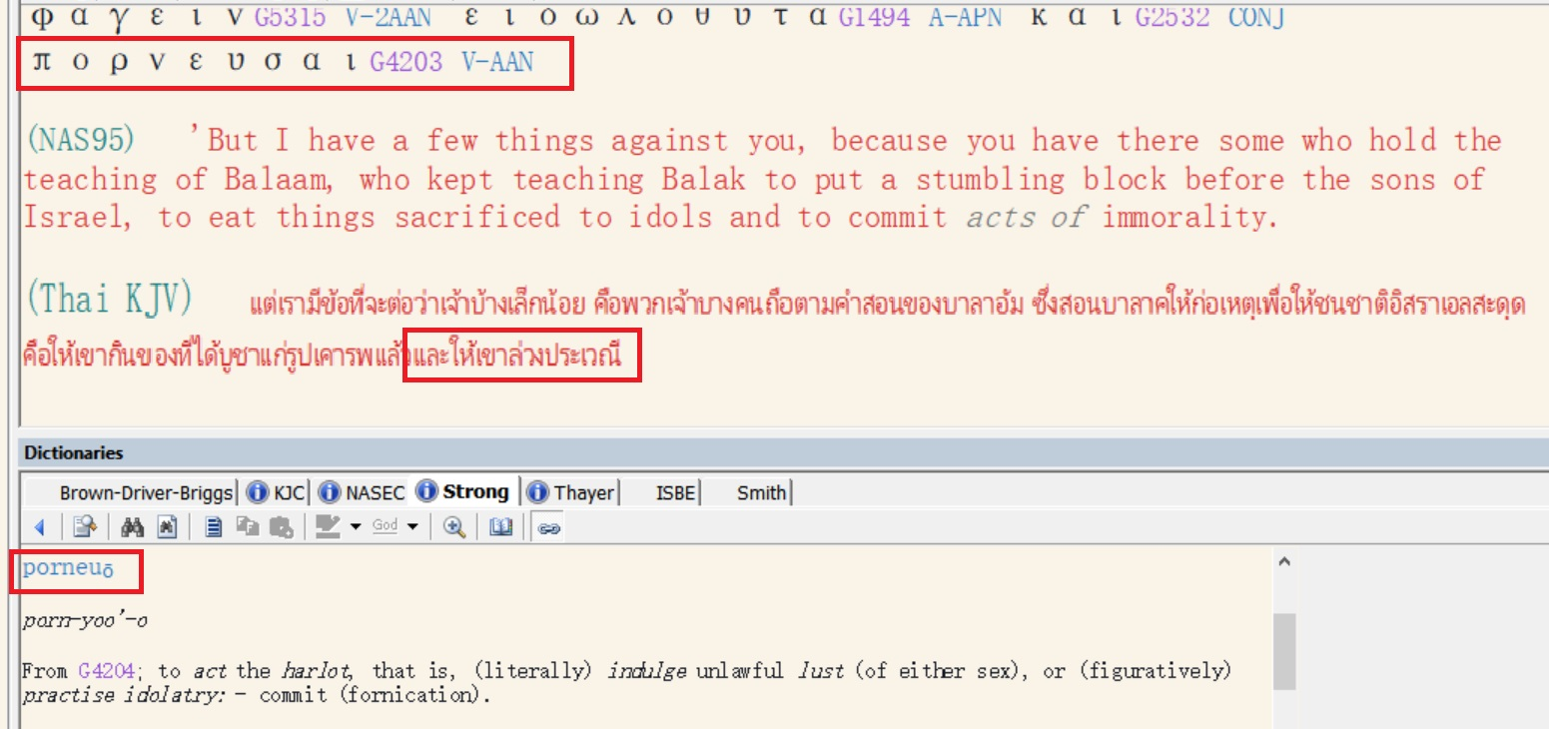

Slide 16
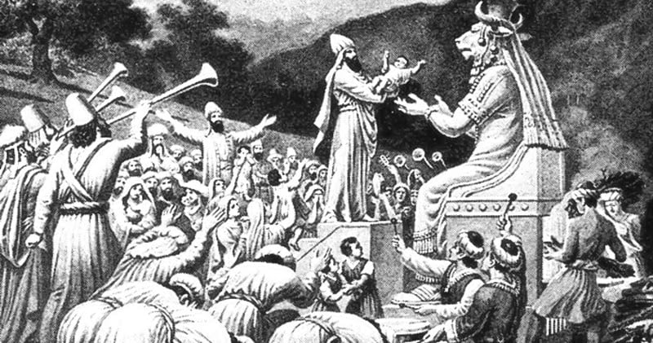

Slide 17
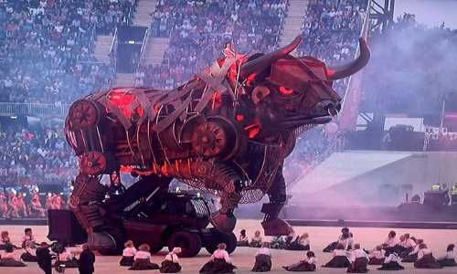
Commonwealth Games, Birmingham, England, 2022

Slide 18
วิวรณ์ 2:15. ‘So you also have some who in the same way hold the teaching of the Nicolaitans.
οὕτως ἔχεις καὶ σὺ κρατοῦντας τὴν διδαχὴν Νικολαϊτῶν ὁµοίως.
และมีพวกเจ้าบางคนที่ถือคำสอนของพวกนิโคเลาส์นิยมด้วยเหมือนกัน
ที่เราเองก็เกลียดชัง
What we have in the Nicolaitans is a combination of Gnosticism with the phallic cult, a licentious type of Gnosticism. It trapped believers into the cosmic system through the function of the phallic cult like the teaching of Balaam. Gnosticism would accept almost anything and amalgamate it into its system of pseudo spirituality. The word, ‘Nicolaitan’ was derived from two Greek words meaning to win over and defeat people. While the phallic cult of the Nicolaitans was rejected in Ephesus [Revelation 2:6] it was effective with many of the believers in Pergamos.

Slide 19
วิวรณ์ 2:16.
‘Therefore, change your thinking; or else I am coming to you quickly, and I will make war against them [reversionistic Christians] with the sword of My mouth.
µετανόησον οὖν· εἰ δὲ µή, ἔρχοµαί σοι ταχύ, καὶ πολεµήσω µετí αὐτῶν ἐν τῇ ῥοµφαίᾳ τοῦ στόµατός µου.
จงกลับใจเสียใหม่ [จงเปลี่ยนความคิด] มิฉะนั้นเราจะรีบมาหาเจ้า และจะสู้กับเขาเหล่านั้นด้วยดาบแห่งปากของเรา
The Romphaia, an ancient broadsword always represented divine punishment even military disaster.

Slide 20
The Romphaia, an ancient broadsword always represented divine punishment even military disaster.
At the 2nd Advent, Jesus Christ will strike down the invading armies with a Rhomphaia as per Revelation 19:15, “And [at the 2nd Advent] a sharp broadsword [Rhomphaia] comes out of His mouth, in order that with it He should strike down the gentile nations [the enemy armies of many nations invading Israel]. Then He will rule them with an iron scepter [crime will be punished by perfect jurisprudence]. And He treads the winepress of the wine [a metaphor for the bloody slaughter of all these soldiers] of the wrath even the anger of God, the Omnipotent One.”
วิวรณ์ 19:15 “มีพระแสงคมออกมาจากพระโอษฐ์ของพระองค์ เพื่อพระองค์จะได้ทรงฟันฟาดบรรดานานาประชาชาติด้วยพระแสงนั้น และพระองค์จะทรงครอบครองเขาด้วยคทาเหล็ก พระองค์จะทรงเหยียบบ่อย่ำองุ่นแห่งพระพิโรธอันเฉียบขาดของพระเจ้า ผู้ทรงฤทธานุภาพสูงสุด ”

Slide 21
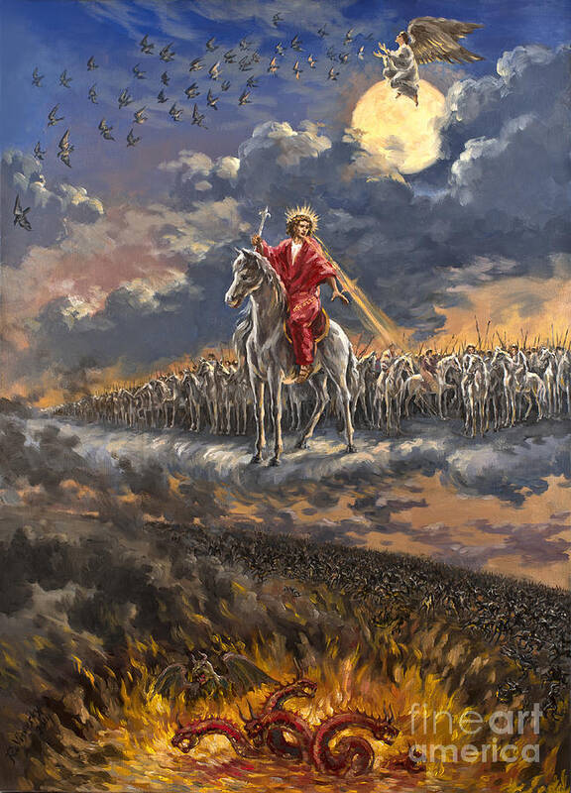
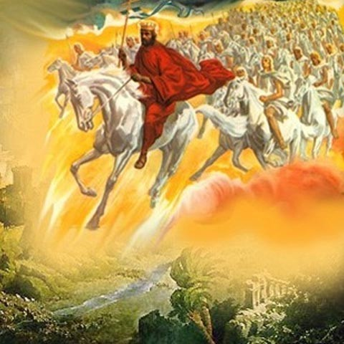

Slide 22
Rev. 2:17. ‘He who has an ear, must hear what the Spirit says to the churches. To him who overcomes [to the spiritual winner], to him [dative of advantage] I will give [blessing] from the hidden manna [metabolized doctrine hidden in the soul], and I will give him a white pebble, and a new title written on the pebble which no one knows but he who receives it [in time, but in eternity all will know].’
ὁ ἔχων οὖς ἀκουσάτω τί τὸ πνεῦµα λέγει ταῖς ἐκκλησίαις. τῷ νικῶντι δώσω αὐτῷ τοῦ µάννα τοῦ κεκρυµµένου, καὶ δώσω αὐτῷ ψῆφον λευκὴν καὶ ἐπὶ τὴν ψῆφον ὄνοµα καινὸν γεγραµµένον ὃ οὐδεὶς οἶδεν εἰ µὴ ὁ λαµβάνων.
วิวรณ์ 2:17 ใครมีหูก็ให้ฟังข้อความซึ่งพระวิญญาณตรัสไว้แก่คริสตจักรทั้งหลาย ผู้ที่มีชัยชนะ เราจะให้ผู้นั้นกินมานาที่ซ่อนอยู่ และจะให้หินขาวแก่ผู้นั้นด้วย ที่หินนั้นมีชื่อใหม่จารึกไว้ซึ่งไม่มีผู้ใดรู้เลยนอกจากผู้ที่รับเท่านั้น'

Slide 23
Ears become the analogy to the supernatural perceptive system our Lord has established for learning Bible doctrine, and from learning that Bible doctrine to grow in grace. The ears become the illustration for volition and motivation in learning.
R.B.Thieme: “Ear gate” and “Eye gate” are the entry ways for perception of academic information.

