Slide 1
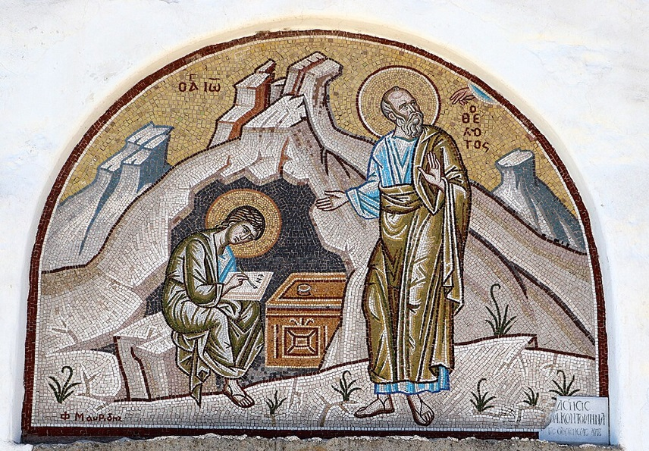
การวิเคราะห์พระธรรมวิวรณ์
สอนโดย อ.Tim จากคำบันทึกของ อ. Max Klein
REVELATION 045 2025 05 27

Slide 2
วิวรณ์ 2:8.
Καὶ τῷ ἀγγέλῳ τῆς ἐν Σµύρνῃ ἐκκλησίας γράψον· Τάδε λέγει ὁ πρῶτος καὶ ὁ ἔσχατος, ὃς ἐγένετο νεκρὸς καὶ ἔζησεν·
And to the messenger [a reference to the pastor] of the church in Smyrna write: The first and the last, who was dead, and has come to life, says this:
จงเขียนถึงทูตสวรรค์แห่งคริสตจักรที่เมืองสเมอร์นาว่า `พระองค์ผู้ทรงเป็นเบื้องต้นและเป็นเบื้องปลาย ผู้ซึ่งสิ้นพระชนม์แล้ว และกลับฟื้นขึ้นอีก ได้ตรัสดังนี้ว่า

Slide 3
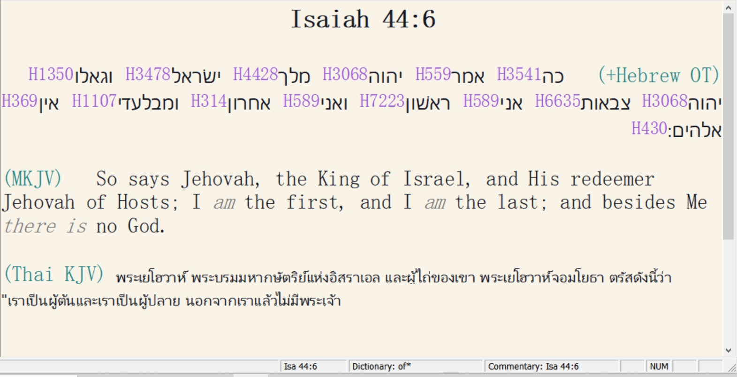

Slide 4
บทเรียนต่อไป :
ความหมายสีรูแบปของวลี “เบื้องต้นและเป็นเบื้องปลาย”
Four meanings to the phrase, “The first and the last”

Slide 5
1.
A. Jesus Christ as “the first” is eternal God, coequal and co-eternal with God the Father and God the Holy Spirit.
Even though history is the record of man’s thoughts, motives, decisions, and actions, it is Jesus Christ, the first and the last, who controls history.

Slide 6
2.
The second meaning has to do with the two great prophecies of history. They are the first and second advents.
The first and the last, then, is a title of our Lord Jesus Christ as the prophetical key to human history.

Slide 7
3.
The third meaning of our subject by application refers to the uptrends and downtrends of history depending upon the decisions of Christians.
As goes the believer in Christ so goes human history in any generation.
When the believer puts Christ first in his scale of values, it contributes to the uptrend of history; when the believer puts Christ last in his scale of values it contributes to the downtrend of history.
[The opposite of having Jesus first on scale of values, i.e. because you love the Lord, is not ignorance, but harboring hatred toward the Lord]
Therefore, “the First and Last” emphasizes the function of human volition in history especially that of the Christian.

Slide 8
4.
“First and last” also by application refers to the source of both temporal and eternal blessing for the believer.
Our first blessing relates to time while our last blessing relates to eternity.
“First and last” is the fulfilment of the Christian way of life resulting in our Lord distributing Escrow Blessings in time and eternal blessing and reward at the judgment seat of Christ.

Slide 9
พระธรรมวิวรณ์ 2:9.
‘I know your tribulation and your poverty, but you are rich [spiritually], and the blasphemy by those who say they are Jews and are not [true Jews as believers in Christ] but are a synagogue of Satan [These racial religious Jews were very antagonistic toward the believers in Smyrna].
Οἶδά σου τὴν θλῖψιν καὶ τὴν πτωχείαν, ἀλλὰ πλούσιος εἶ, καὶ τὴν βλασφηµίαν ἐκ τῶν λεγόντων Ἰουδαίους εἶναι ἑαυτούς, καὶ οὐκ εἰσὶν ἀλλὰ συναγωγὴ τοῦ Σατανᾶ.
เรา (ฉัน) รู้เรื่องความยากลำบากและความยากจนของเจ้า [เอกพจน์] แต่ว่าเจ้าก็มั่งมี [ด้านฝ่ายวิญญาณ] เรารู้ถึงการใส่ร้ายของพวกที่อ้างว่าตนเป็นชาวยิวทั้งที่ไม่ได้เป็น แต่กลับเป็นศาลาที่ประชุมของซาตาน

Slide 10
“I know” refers here to our Lord’s divine knowledge or omniscience regarding the status quo of this second church which contributed so much to the blessing of the Roman Empire as a client nation, where over several hundreds of years, millions of people were led to the Lord Jesus Christ and subsequently thousands advanced to spiritual maturity.
Smyrna was a wealthy city and many believers were, or had been, financially extremely prosperous. There was a wealthy Jewish coalition in Smyrna who delighted not only in eliminating job opportunities for these Christians, but also delighted in destroying Christians in business enterprise by using devious means to do so. All the same, under Logistical Grace Provision, these believers flourished spiritually, the only wealth that really matters.

Slide 11
พระธรรมวิวรณ์ 2:10
‘Stop fearing [They were aware of the pending persecution.] that which you are about to suffer. Note that the devil is about to cast some of you into prison in order that you may be tested, and you will have special persecution ten times [ten historical persecutions from 96-305 AD]. Keep on being faithful even until death, and I [Jesus Christ] will give you the Wreath of Life.
µηδὲν φοβοῦ ἃ µέλλεις πάσχειν. ἰδοὺ µέλλει βάλλειν ὁ διάβολος ἐξ ὑµῶν εἰς φυλακὴν ἵνα πειρασθῆτε, καὶ ἕξετε θλῖψιν ἡµερῶν δέκα. γίνου πιστὸς ἄχρι θανάτου, καὶ δώσω σοι τὸν στέφανον τῆς ζωῆς.
อย่ากลัว [หยัดกลัว!]ความทุกข์ทรมานต่างๆซึ่งเจ้ากำลังจะได้รับนั้น ดูเถิด พญามารจะขังพวกเจ้าบางคนไว้ในคุกเพื่อจะลองใจเจ้า และเจ้าทั้งหลายจะได้รับความทุกข์ทรมานถึงสิบวัน แต่เจ้าจงสัตย์ซื่อจนถึงความตาย และเราจะมอบมงกุฎแห่งชีวิตให้แก่เจ้า

Slide 12
TEN DAYS OF SUFFERING:
( ημερων δεκα )
Literal vs. Symbolic Interpretations
The phrase “tribulation for ten days” has prompted debate regarding whether the duration is literal or symbolic:
• Literal Interpretation: Some propose that this was a real, short-term imprisonment-likely around ten actual days-during which believers would suffer before receiving God’s deliverance or entering eternal reward. This aligns with narratives like Daniel 1:12, which mentions a ten-day test for Daniel and his companions, though that test was dietary rather than a life-threatening tribulation.
• Symbolic Interpretation: Others see “ten days” as symbolic of a complete yet limited period of intense trial. The number ten in Scripture can represent fullness (as with the Ten Commandments or the ten plagues in Exodus). Thus, “ten days” may highlight a short but complete season of testing.

Slide 13
5. Possible Historical Fulfillments
Some commentators have attempted to trace specific Roman emperors’ persecutions as tying into ten discrete periods or edicts, citing ten notable waves of persecution in the Roman Empire.
In this case, the ten days of tribulation refer to ten persecutions that began with Emperor Nero and ended with Diocletian in the third century. Some scholars exclude Nero and count from Domitian to Julian.

Slide 14
When John wrote this in 96 AD the persecution of Christians had begun under the Emperor Domitian. From Domitian in 96 A.D. to Diocletian in 305 A.D., there would be persecution of Christians 10 times
The Ten Persecutions:
1.Domitian: 81-96 A.D
2.Marcus Aurelius: 161-180
3.Commodus: 180-192
4.Septimius Severus: 193-211
5.Maximinus Thrax: 235-238
6.Decius: 249-251
7.Gallus: 251-253
8.Valerian: 253-260
9.Aurelian: 270-275
10. Diocletian: 284-305

Slide 15
These persecutions prepared the Christians to evangelize the world, especially the barbarians.
As Tertullian put it, “the blood of the martyrs is the seed of the Church”.
The greatest missionary movement of all time in history would be sown in the blood of martyrs throughout the entire Roman empire over a period of two hundred years.
Many of these people are going to die in the most horrible way, and yet they are the basis of one of the greatest counters to Satan’s administration of the rulership of this world that history has ever known.

Slide 16
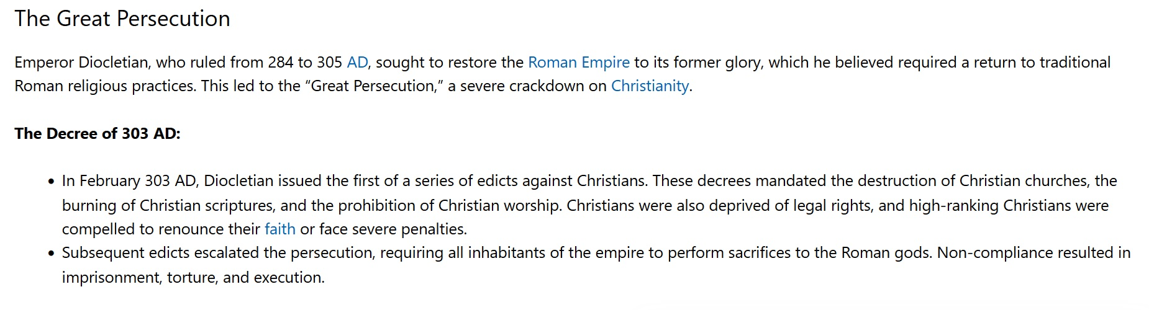
Example of government authorized persecution:

Slide 17
With the retirement of Diocletian, Galerius took his place and continued persecution of Christians until the pressure was too great and he issued reluctantly an edict of toleration which cancelled all persecutions of believers and pardoned all Christians who were still living.
In 313 A.D., Constantine issued at Milan the edict which terminated these ten special persecutions of our passage. “We grant,” he said, “to the Christians and all others free choice to follow their own mode of worship, whatever they wish ...”. These were the 10 periods of persecution of the Christians in the Roman Empire.

Slide 18
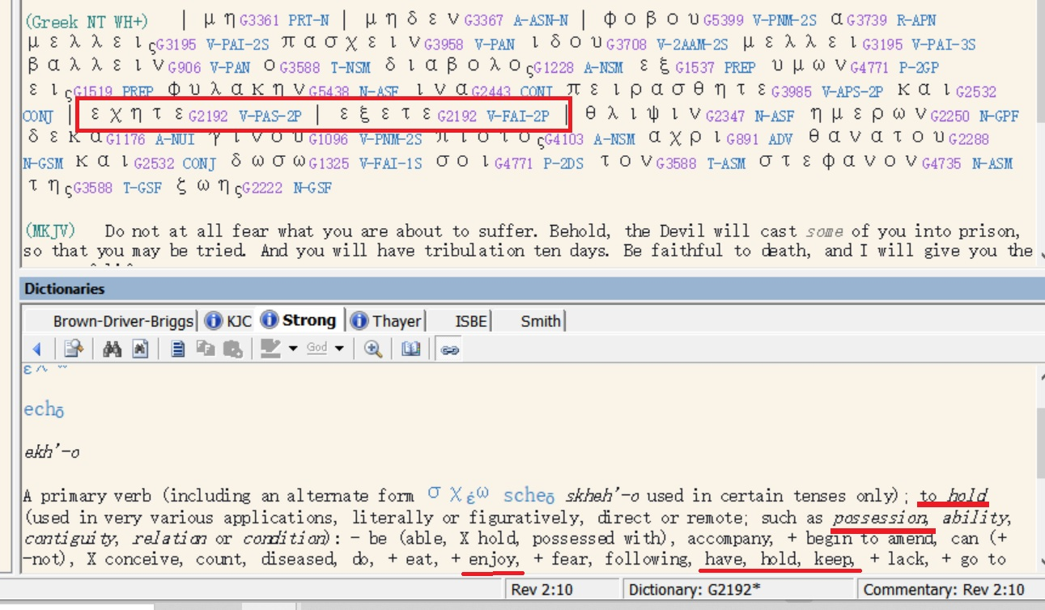

Slide 19
The imperative mood in this verse with the negative forbids the continuation of fear, their initial reaction to suffering, pressure, and disaster.
There is a principle which David enucleated in Psalm 56:3 when he said,
“What time I am afraid, I will trust in you [trusting in the Lord after recovery of fellowship].”
“Even though I walk through the valley of the shadow of death I will fear no evil, for you are with me.” )Psalms 23:3a
เมื่อข้าพระองค์กลัว ข้าพระองค์วางใจในพระองค์ (สดูดี 56:3)
แม้ข้าพระองค์จะเดินไปตามหุบเขาเงามัจจุราช ข้าพระองค์ไม่กลัวอันตรายใดๆ เพราะพระองค์ทรงสถิตกับข้าพระองค์ (สดูดี 23:4ก.)

Slide 20
Many times, rulers of Rome tried to wipe out Christianity in the empire not realizing that they were attempting to destroy themselves and their empire for as long as there was a pivot of mature believers, Rome would continue to be the client nation to God.
In the midst of these attempts to wipe out Christianity, Christianity not only grew in the Roman Empire, but it expanded beyond its borders.
Rome survived because believers in these seven churches made decisions to reside and function inside of God’s power system, and by making those decisions SPQR as an empire continued until 476 A.D. by which time there were too many cosmic believers in the empire, and missionary activity ceased to exist.

Slide 21
วิวรณ์ 2:11
‘He who has an ear, let him hear what the Spirit says to the churches. He who overcomes [through suffering] will not be hurt by the second death [Revelation 20:14; namely the Lake of Fire: knowing this should motivate the believers under great suffering to remain faithful to the Lord].’
ὁ ἔχων οὖς ἀκουσάτω τί τὸ πνεῦµα λέγει ταῖς ἐκκλησίαις. ὁ νικῶν οὐ µὴ ἀδικηθῇ ἐκ τοῦ θανάτου τοῦ δευτέρου.
ใครมีหูก็ให้ฟังข้อความซึ่งพระวิญญาณตรัสไว้แก่คริสตจักรทั้งหลาย ผู้ที่มีชัยชนะจะไม่ได้รับอันตรายจากความตายครั้งที่สองเลย

Slide 22
Whatever suffering the believer may experience in life, it cannot be compared to the suffering of the unbeliever in the Lake of Fire for all eternity.
Even if a person should suffer martyrdom, he must bring into remembrance that the Lord has delivered him from the eternal lake of fire.
This should motivate the believer to remain loyal to the Lord Jesus Christ and to endure whatever suffering God’s plan has for him. It amounts to a drop in the ocean compared with spending all eternity in the Lake of Fire.

Slide 23
How you live is determined by your attitude toward death.
Sooner or later death will become a reality and you will discover an amazing thing: things that you thought were important, things that you spent your life doing, the pleasures you sought, your ambition to succeed and to get ahead and become famous and great and to excel above your peers, all of these things when you face death as a reality will not give you one moment of peace or blessing or courage in time of your dying.

