Slide 1
神的道是活泼的、是有功效的、比一切两刃的剑更快、
甚至魂与灵、骨节与骨髓、都能刺入剖开、
连心中的思念和主意、都能辨明。
（希伯来书 4:12）
​
圣经都是神所默示的、（或作凡神所默示的圣经）於教训、
督责、使人归正、教导人学义、都是有益的。
叫属神的人得以完全、豫备行各样的善事。
（提摩太后书 3:16-17）
​
你当竭力、在神面前得蒙喜悦、作无愧的工人、
按着正意分解真理的道。
（提摩太后书 2:15）

Slide 2
系列：属灵生命概论
Series:
Outline of the Spiritual Life
09 / 2025 06 11 www.ibdoctrine.org

Slide 3
约翰一书 1：9 / 1 John 1:9
我们若认自己的罪，神是信实的，是公义的，因此必要赦免我们的罪，洗净我们一切的不义。
If we name our sins, He is faithful and just to forgive us our sins, and to cleanse us from all unrighteousness.

Slide 4

Romans 4:4,5 / 罗马书 4:4,5
Now to the one who works, wages are not credited as a gift but as an obligation. However, to the one who does not work but trusts God who justifies the ungodly, their faith is credited [ as righteousness.
做工的得工价，不算恩典，乃是该得的；
惟有不做工的，只信称罪人为义的神，
他的信就算为义。
[Imputed Righteousness / +R]

Slide 5
“And without faith [πίστις / pistis] it is impossible to please Him, for he who comes to God must believe that He is and that He is a rewarder of those who seek Him.”
人非有信，就不能得神的喜悦；因为到神面前来的人必须信有神，且信他赏赐那寻求他的人。
(Hebrews / 希伯来书 11:6 ）

Slide 6
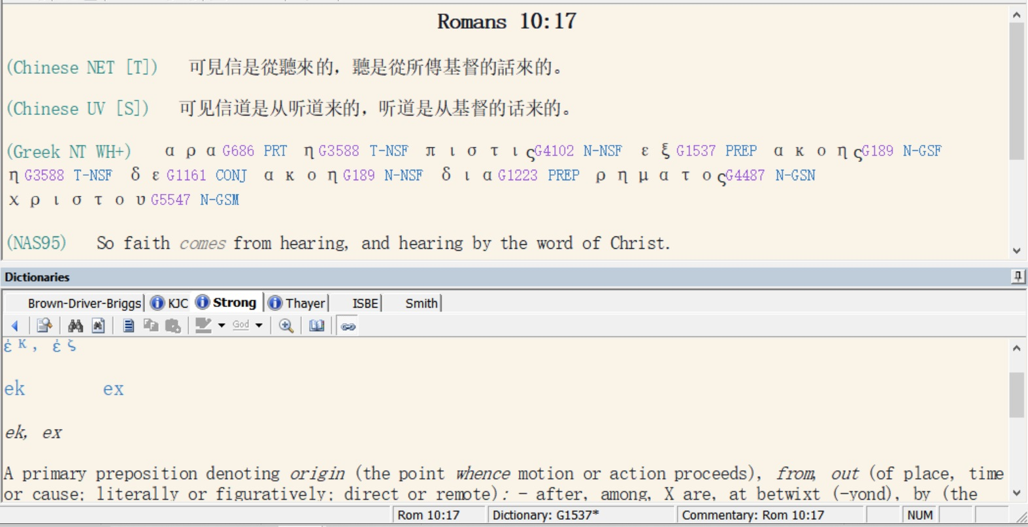

Slide 7
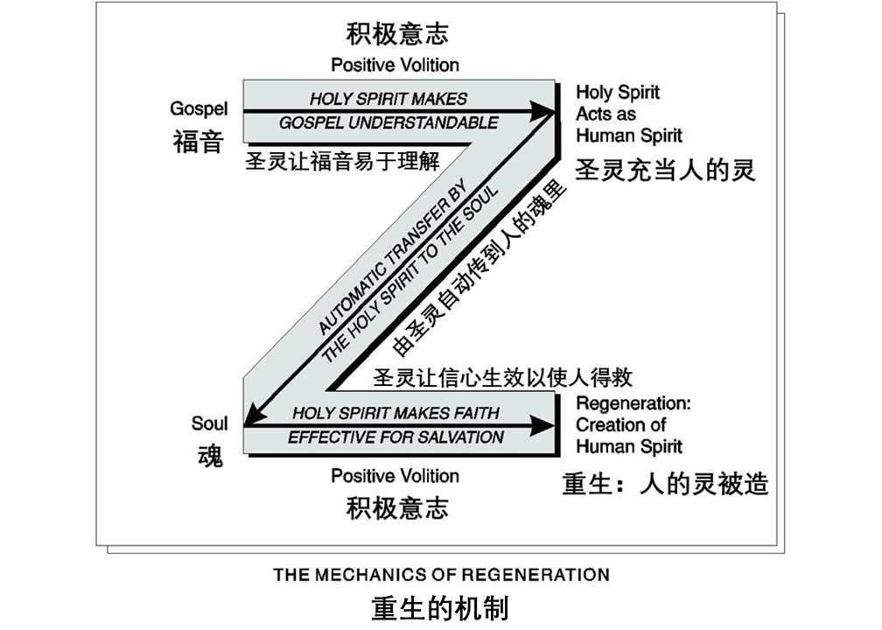

Slide 8
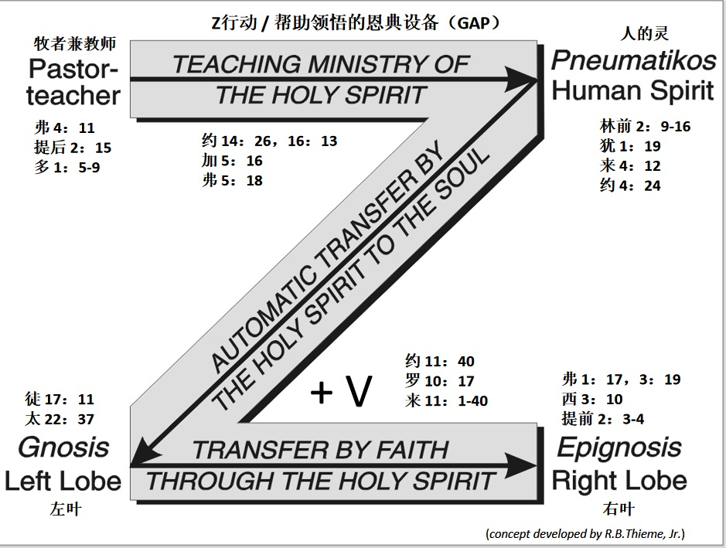

Slide 9
Salvation does not and cannot result from the Spiritual Life.
An unregenerate (unsaved) person cannot even begin to live the Spiritual Life, only the believer in Jesus Christ has the assets necessary (for example: A human spirit; filling of the Holy Spirit; the priesthood of all Church Age believers) to have a relationship with God and therefore learn about and live the spiritual life.
救恩不是也不能从属灵生活而来。
没有重生（得救）的人不能过属灵生活，只有相信耶稣基督的信徒具备所需的资产（如：人的灵、圣灵的充满、教会时代所有信徒的祭司职分）来与神建立关系，然后才能了解属灵生活并且过属灵的生活。

Slide 10
Three Phases of the Christian Life:
Phase | Description | Duration | Attained and Maintained by:
One | Salvation | 0.7 of a second (approx. time to make a ‘metanoeo’ decision) | Faith Alone in Christ Alone
Two | The Spiritual Life | From the moment of salvation to physical death or Rapture of Church | Consistent study and application of Bible doctrine under the power of the Holy Spirit.
Three | Eternity | Begins at the time of physical death or Rapture, continues forever. | Soul is first transferred into interim body then eternal body at Rapture.

Slide 11
基督徒生命的三个阶段
The Three Phases of the Christian Life
阶段 | 说明 | 持续时间 | 通过什么来得到并保持：
一 | 得救 | 0.7秒（大约需要0.7秒来做决定） | 单单信基督
二 | 属灵生活 | 从得救那一刻起直到肉体死亡或教会被提 | 在圣灵的力量之下，持续不断地学习和应用圣经教义
三 | 永生 | 从肉体死亡或教会被提一直到永远 | 魂首先进入过渡的身体，然后在教会被提时进入永恒的身体

Slide 12
We must make a clear distinction between being a [newborn, immature] “child of God” and a [mature, fully grown] “son of God.
child: young, immature, natural offspring:
teknon
son: mature,

Slide 13
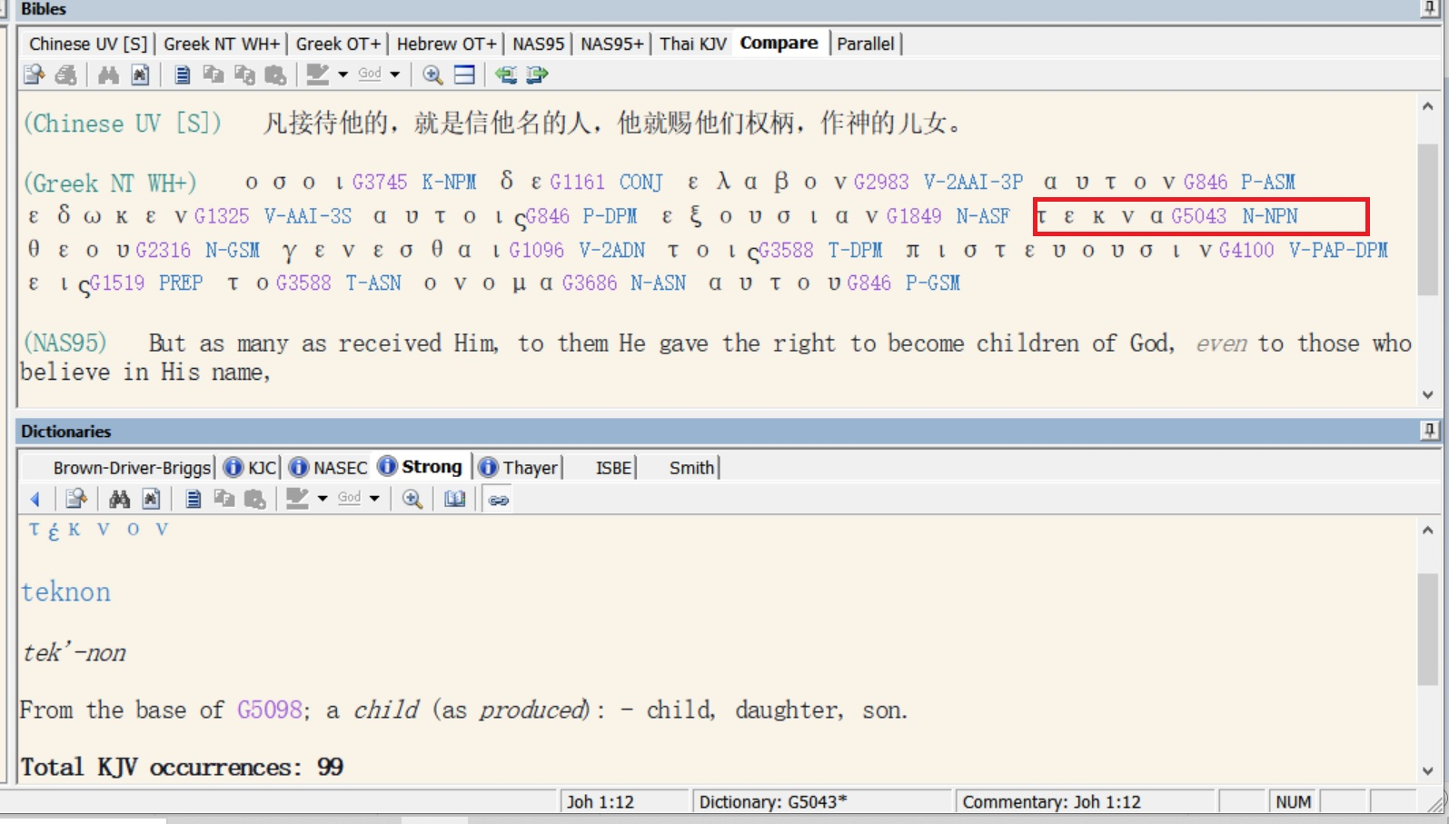

Slide 14
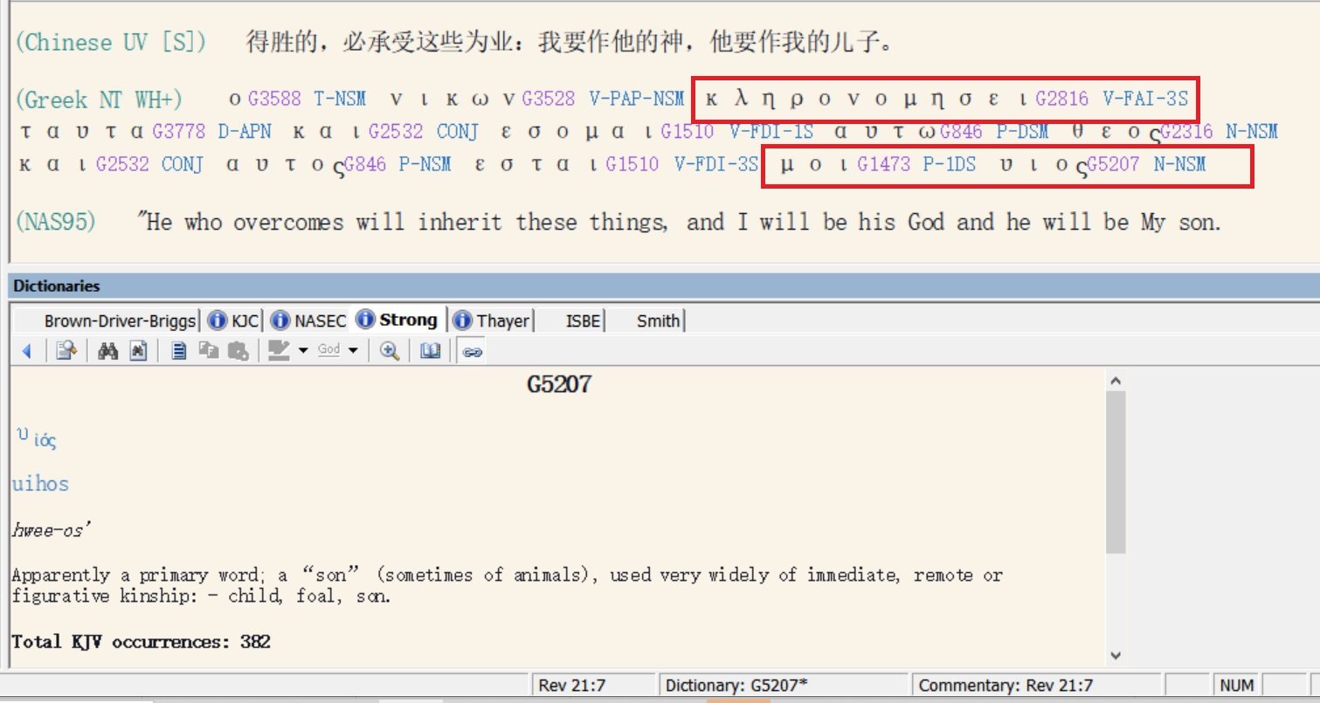

Slide 15
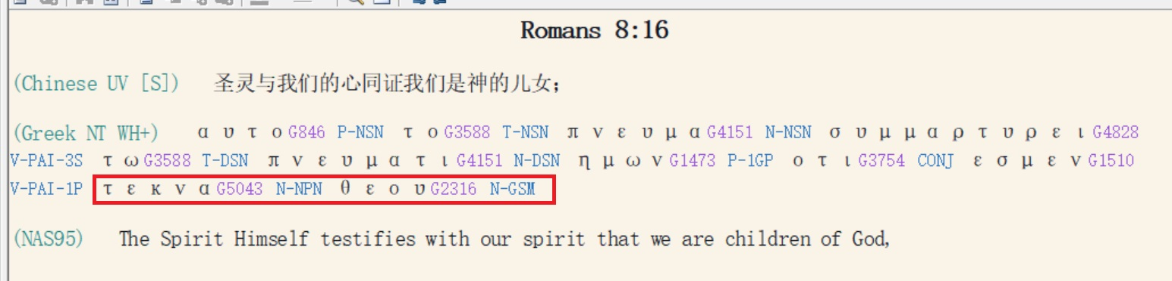
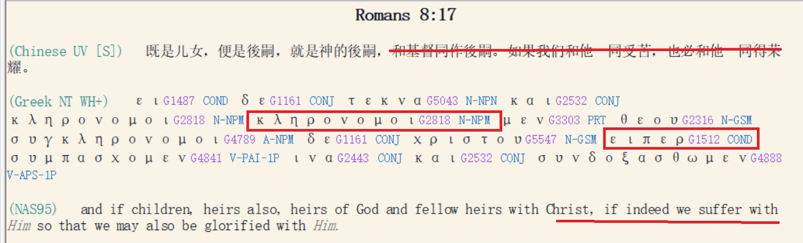

Slide 16
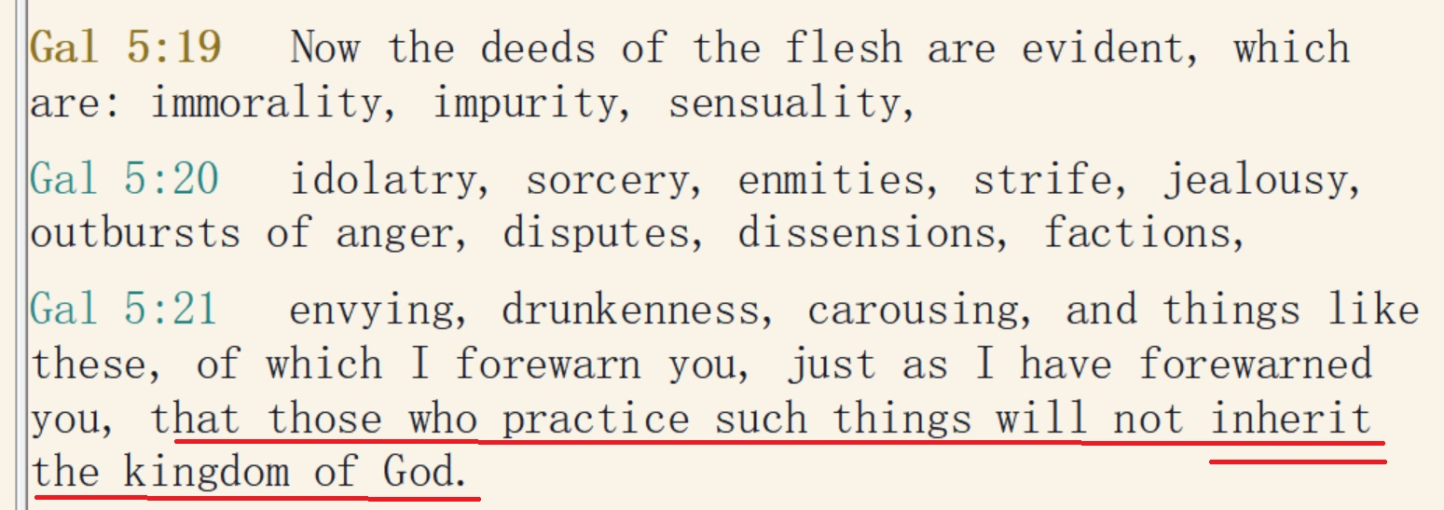
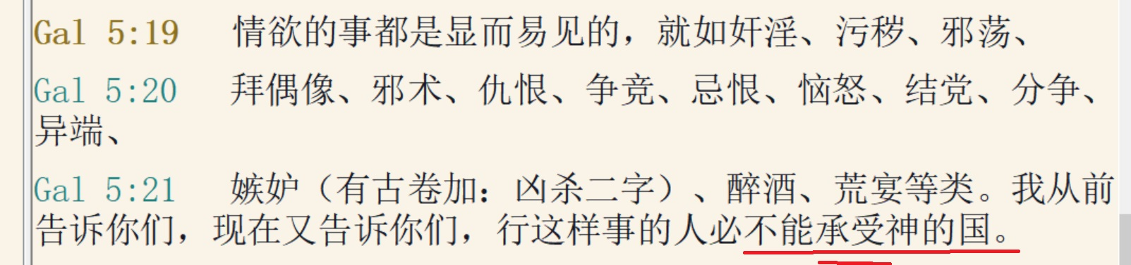
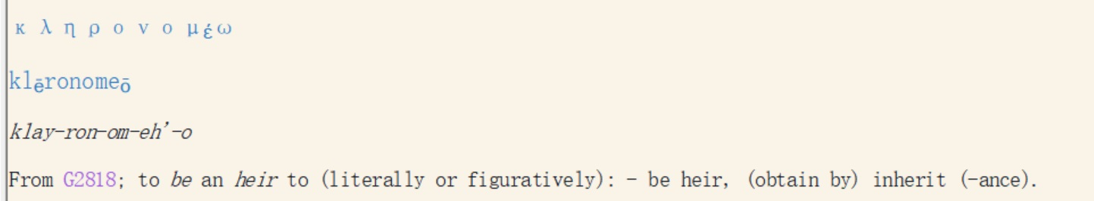

Slide 17
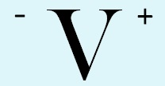
Life’s Important Decisions
Knowledge of God’s plan
+ (Greater) Arrogance
(i.e. refusal to apply)
= (Greater) Self Induced Misery
and Divine Discipline
Glorification of God
Escrow Blessings in Time and Eternity
(1 Cor. 3:12-14 /James 1:12)
Application of Doctrine
to Life and Circumstances
(James 3:18; 2:20-22)
Knowledge of God
and His Plan
(e.g. The 40 Absolutes / 10 Problem Solving Devices etc.)
Ignorance of God’s plan
+ Arrogance
= Self Induced Misery
and Divine Discipline
Study of Doctrine
(Rom 12:2; 2 Tim. 2:15)
Regenerate: Eternal Security
Unregenerate: Unsaved
40 Absolutes received at Salvation
Gospel Hearing
(John 3:16; Mar. 1:15; Acts 16:31)
God Consciousness
(Jer. 33:3; Ps. 14:1; Rom. 1:18-23; Acts 17:27)
The Great White
Throne Judgment
Cast into the lake of fire
(Matt. 25:41; Rev. 20:15)
“-V” = “Negative Volition”
“V+” = “Positive Volition”
Condemnation
(John 3:18/Rom. 3:23)
Physical Death /
Torments
www.ibdoctrine.org

Slide 18
人生中的重要决定
对神的计划一无所知
+ （更严重的）傲慢
= （更严重的）自我导致的痛苦和神的管教
荣耀神
世上的与永恒中的
由第三者代管的祝福
（哥林多前书 3:12-14/雅各书 1:12）
将教义应用至生命与境况中
（雅各书 3:18，2:20-22）
对神和神的计划的了解
（例如：40个绝对/10个问题解决方法等）
对神的计划一无所知 + 傲慢
= 自我导致的痛苦和神的管教
学习教义
（罗马书 12:2；提摩太后书 2:15）
重生：永恒的保障
未重生：未得救
在得救时所得的
四十个绝对
听见福音
（约翰福音 3:16；马太福音 1:15；使徒行传 16:31）
认识到神的存在的那一刻
（耶利米书 33:3；诗篇 14:1；
罗马书 1:18-23；使徒行传 17:27）
“-V” = “Negative Volition”
“-V” = “消极意志”
“V+” = “Positive Volition”
“V+” = “积极意志”
定罪
（约翰福音 3:18/罗马书 3:23）
身体死亡/
阴间
白色大宝座的审判
被扔在火湖里
（马太福音 25:42；启示录 20:15）
www.ibdoctrine.org

Slide 19
1. Salvation / 拯救
2. Eternal Security /永恒的保障
3. Rebound/Naming of Sins in order to maintain your relationship with God /反弹/认罪以求保持你与神的关系
4. The Goal of the Christian Life基督徒生命的目标
5. The 10 Problem Solving Devices /十个问题解决方法
6. The 40 Absolutes / 四十个绝对
7. The 10 Characteristics of God / 神的十个品性

Slide 20
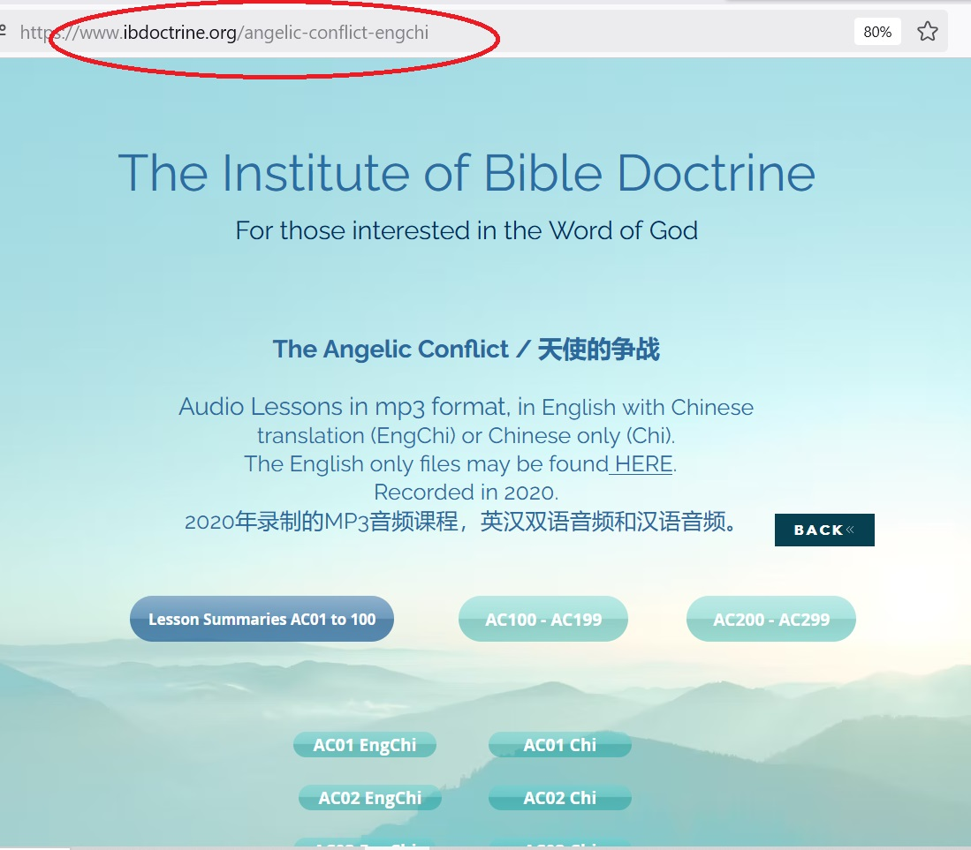

Slide 21
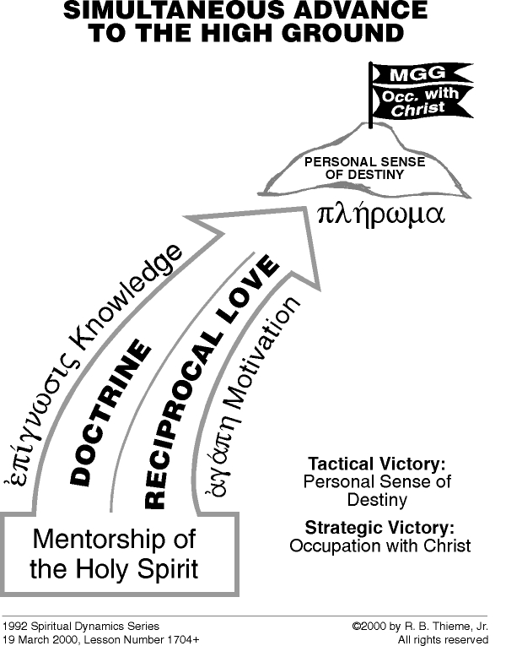

Slide 22
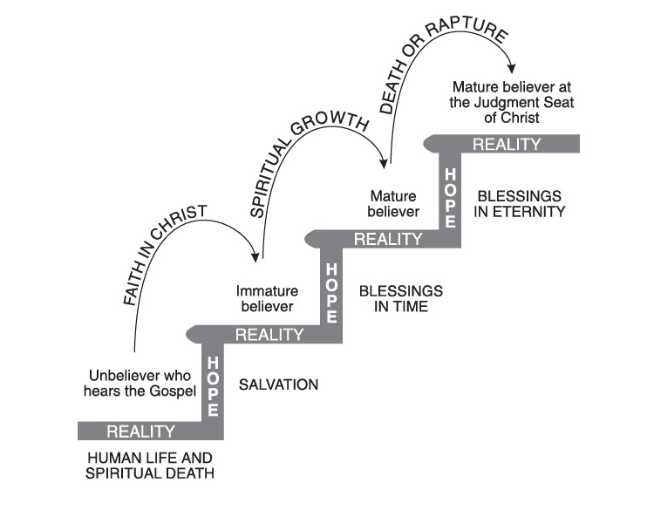

Slide 23
The doctrine of the Judgment Seat of Christ:
The judgment seat of Christ or the evaluation of believers occurs at the termination of the Church Age. It follows the receiving of a resurrection body. (Whether a believer succeeds or fails he will have a resurrection body)
If the believer lives his life inside the cosmic system what he accomplishes is worthless or evil or both.
On the other hand, if the believer lives his Christian life under the omnipotence of God namely:
1. The Word of God in his soul
2. The Filling of the Holy Spirit
...then what he does is divine good / spiritual fruit and is rewardable at the Judgment Seat of Christ [aka. the bema throne].

Slide 24
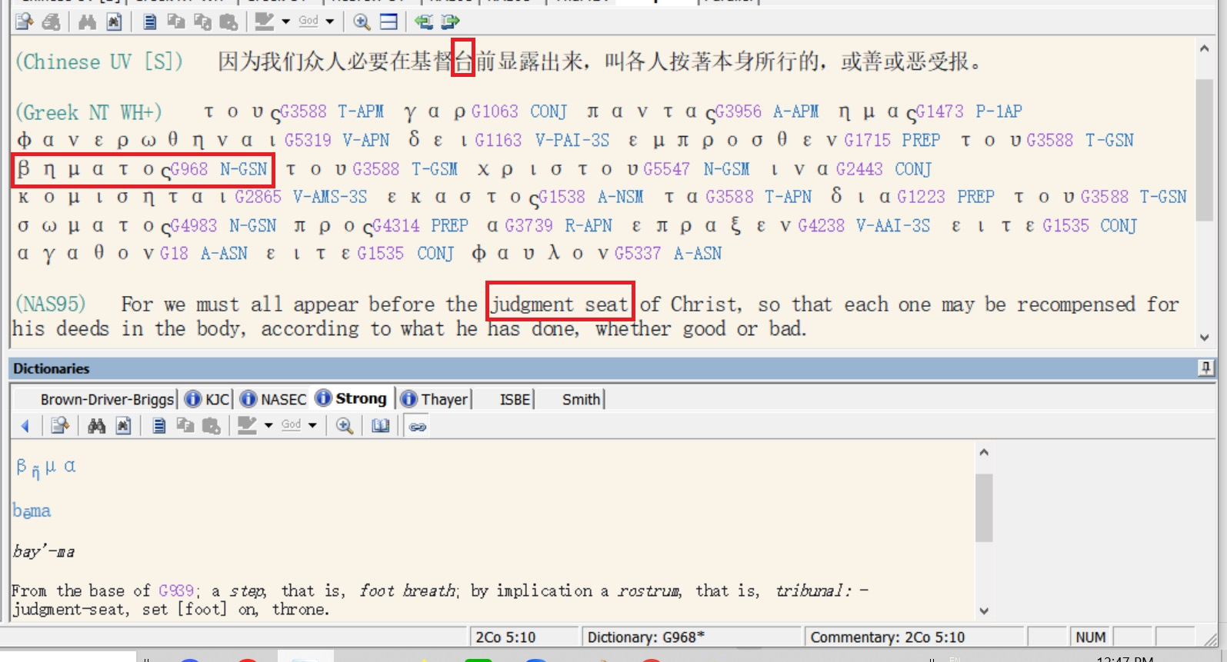

Slide 25
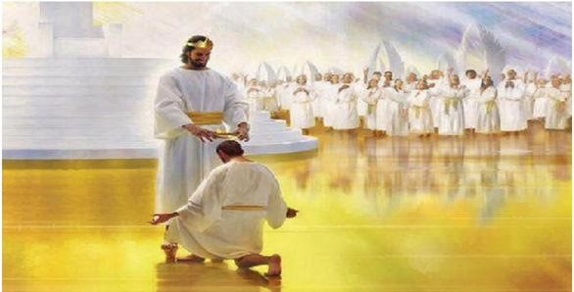

Slide 26
