Slide 1
四十种绝对恩赐
The 40 absolutes
Lesson One
2025 08 20

Slide 2
THE FORTY ABSOLUTES
四十种绝对恩赐
Also known as “The Forty Things”
也称为“四十件事物”
These are the spiritual assets that God grants to every Church Age believer at the moment of faith in Jesus Christ.
这些恩赐是上帝在教会时代的信徒信耶稣基督的那一刻就赐下的属灵资产。
They are spiritual resources, therefore they are invisible. We are unable to see, hear or feel these things, just as we are unable to see, hear or feel God. Yet, these things are very real, and very powerful, bearing much fruit for the believer who learns of these resources and applies his knowledge of them to his spiritual life.
这些恩赐是属灵的资源，因此都是不可见的。我们不能看见、听见或感觉这些事物，就像我们不能看见、听见或感觉上帝。但是，这些恩赐都是极其真实、富有力量的，并会给那些了解属灵资源并在属灵生命中应用属灵资源相关知识的信徒带来属灵的果实。

Slide 3
Some applications are universal – for example, every believer should have peace in his soul regarding eternal security. However, every believer also experiences his own unique pressures and circumstances. Therefore, while the Pastor–teacher can present application examples, ultimately it is up to the individual believer to apply the doctrine he is learning to his experience based on his own understanding from doctrine and the guidance of the Holy Spirit. (John 14:26; 1 Cor. 2:10-16)
一些应用具有普世性，例如，每一个信徒的魂里都应该有从永恒的保障而来的平安。不过，每一个信徒也要经历自己独有的压力和景况。因此，虽然牧师可以提供与应用有关的范例，但最终仍要由信徒自己决定是否要根据对教义的理解和圣灵的带领将所学的教义应用到经历当中。

Slide 4
Categories of Absolutes
绝对恩赐的类别
All of the 40 Absolutes may be classified into at least one of the following categories. However, all of the Absolutes are mutually cohesive - there are no contradictions in the Word of God!
这四十种绝对恩赐的每一种都可以归入下列至少一个类别。不过，所有的绝对恩赐都是相互关联的——上帝的话语不存在矛盾！
1. Absolutes related to regeneration (being born again)
与重生有关的绝对恩赐
2. Absolutes related to eternal security
与永恒的保障有关的绝对恩赐
3. Positional absolutes
与位分有关的绝对恩赐
4. Absolutes related to spiritual growth and living the spiritual life
与属灵成长和活出属灵生命有关的绝对恩赐
5. Absolutes related to Christian service
与基督徒服事有关的绝对恩赐

Slide 5
三十九种不可撤销的绝对恩赐
39 IRREVOCABLE Absolutes

Slide 6
The believer resides in the eternal plan of God and shares the destiny of Christ. The believer is:
信徒活在上帝的永恒计划中，并分享基督的命运。信徒是：
Foreknown (Acts 2:23; Rom. 8:29; 1 Pet. 1:2).
蒙预知的（使徒行传 2:23；罗马书 8:29；彼得前书 1:2）。
Elected (Rom. 8:33; Col. 3:12; 1 Thess. 1:4; Titus 1:1; 1 Pet. 1:2).
蒙拣选的（Elected）（罗马书 8:33；歌罗西书 3:12；帖撒罗尼迦前书 1:4；提多书 1:1；彼得前书 1:2）。
Predestined (Rom. 8:29–30; Eph. 1:5, 11).
蒙预定的（罗马书 8:29-30；以弗所书 1:5、11）。
Chosen (Matt. 22:14; 1 Pet. 2:4).
被拣选的（Chosen）（马太福音 22:14；彼得前书 2:4）。
Called (1 Thess. 5:24).
蒙召的（帖撒罗尼迦前书 5:24）。

Slide 7
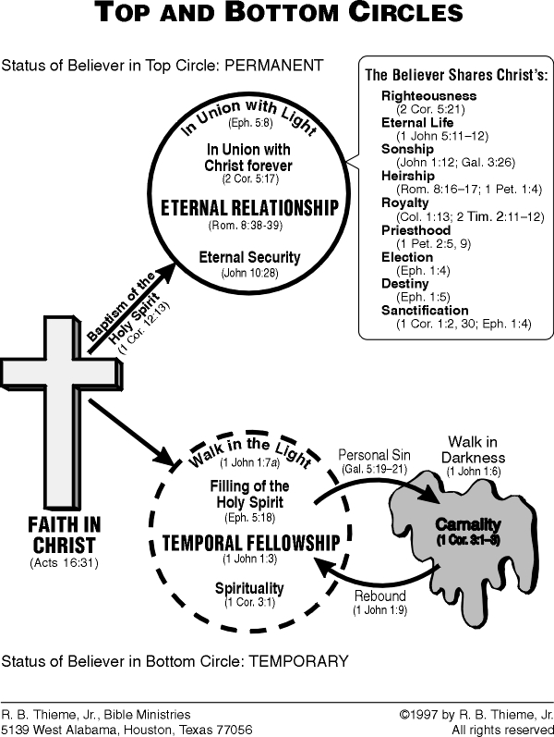

Slide 8
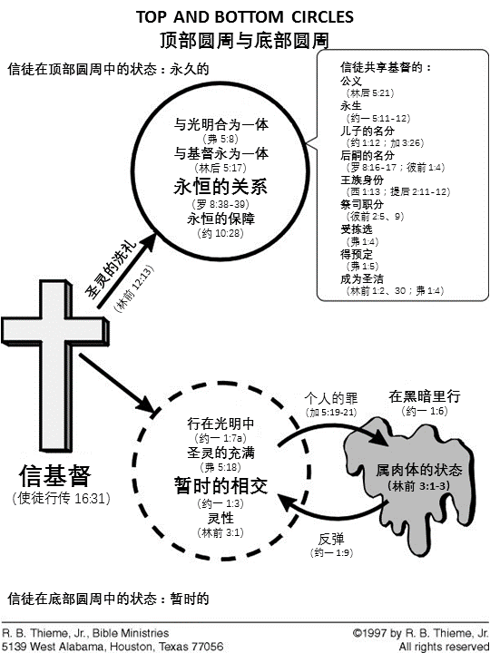

Slide 9
The believer is reconciled (removal of the barrier between man and God):
信徒得以和好（人与神之间的障碍被除去）：
By God (2 Cor. 5:18–19; Col. 1:20).
蒙神和好（哥林多后书 5:18-19；歌罗西书 1:20）。
To God (Rom. 5:10; 2 Cor. 5:20; Eph. 2:14–17).
与神和好（罗马书 5:10；哥林多后书 5:20；以弗所书 2:14-17）。

Slide 10
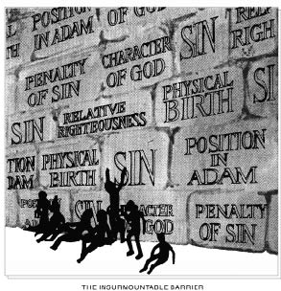

Slide 11
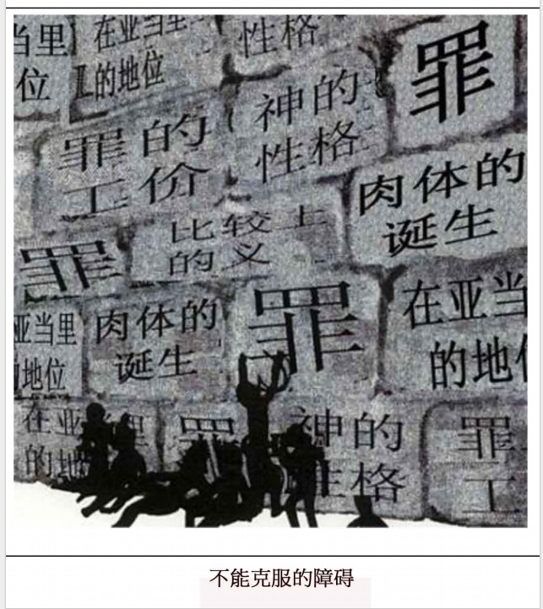

Slide 12
The believer is redeemed, purchased from the slave market of sin (Rom. 3:24; Col. 1:14; 1 Pet. 1:18).
信徒从罪的奴隶市场被赎回、买回 （罗马书 3:24；歌罗西书 1:14；彼得前书 1:18）。

Slide 13
The believer’s condemnation, or eternal judgment, is removed (John 3:18; 5:24; Rom. 8:1).
信徒的定罪或永恒的审判已被除去（约翰福音 3:18，5:24；罗马书 8:1）。

Slide 14
V. The substitutionary spiritual death of Christ on the cross paid the penalty for all sins (Rom. 4:25; Eph. 1:7; 1 Pet. 2:24).
基督在十架上的替代性属灵死亡付清了所有罪的惩罚（罗马书 4:25；以弗所书 1:7；彼得前书 2:24）。

Slide 15
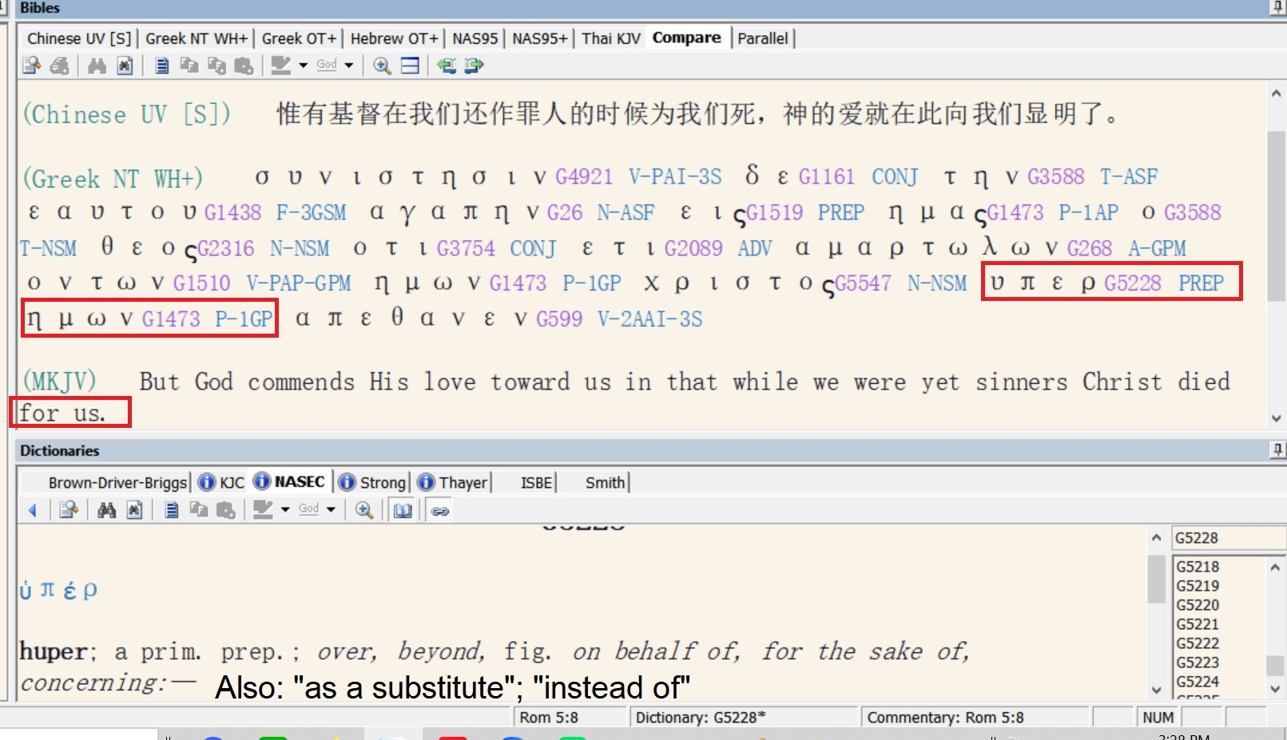

Slide 16
Every believer receives propitiation for sins; God is satisfied with the work of His Son (Rom. 3:25–26; 1 John 2:2; 4:10).
每个信徒都领受了罪的挽回祭；上帝对祂儿子的工作感到满意（罗马书 3:25-26；约翰一书 2:2，4:10）。

Slide 17
The believer is dead to old life, the sin nature, but alive to God, retroactive positional truth. He is:
信徒对旧生命、对罪性是死的，对上帝、对追溯性的位份真理则是活的。信徒是：
Crucified with Christ (Rom. 6:6; Gal. 2:20).
与基督同钉十字架（罗马书 6:6；加拉太书 2:20）。
Dead with Christ (Rom. 6:8; Col. 3:3; 1 Pet. 2:24).
与基督同死（罗马书 6:8；歌罗西书 3:3；彼得前书 2:24）。
Buried with Christ (Rom. 6:4; Col. 2:12).
与基督一同埋葬（罗马书 6:4；歌罗西书 2:12）。
Raised with Christ, current positional truth (Rom. 6:4; 7:4; Col. 2:12; 3:1).
与基督一同复活，这是当前的位份真理（罗马书 6:4，7:4；歌罗西书 2:12，3:1）。

Slide 18
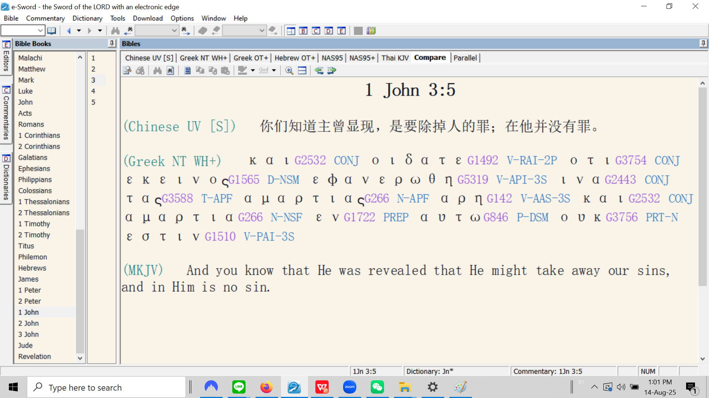

Slide 19
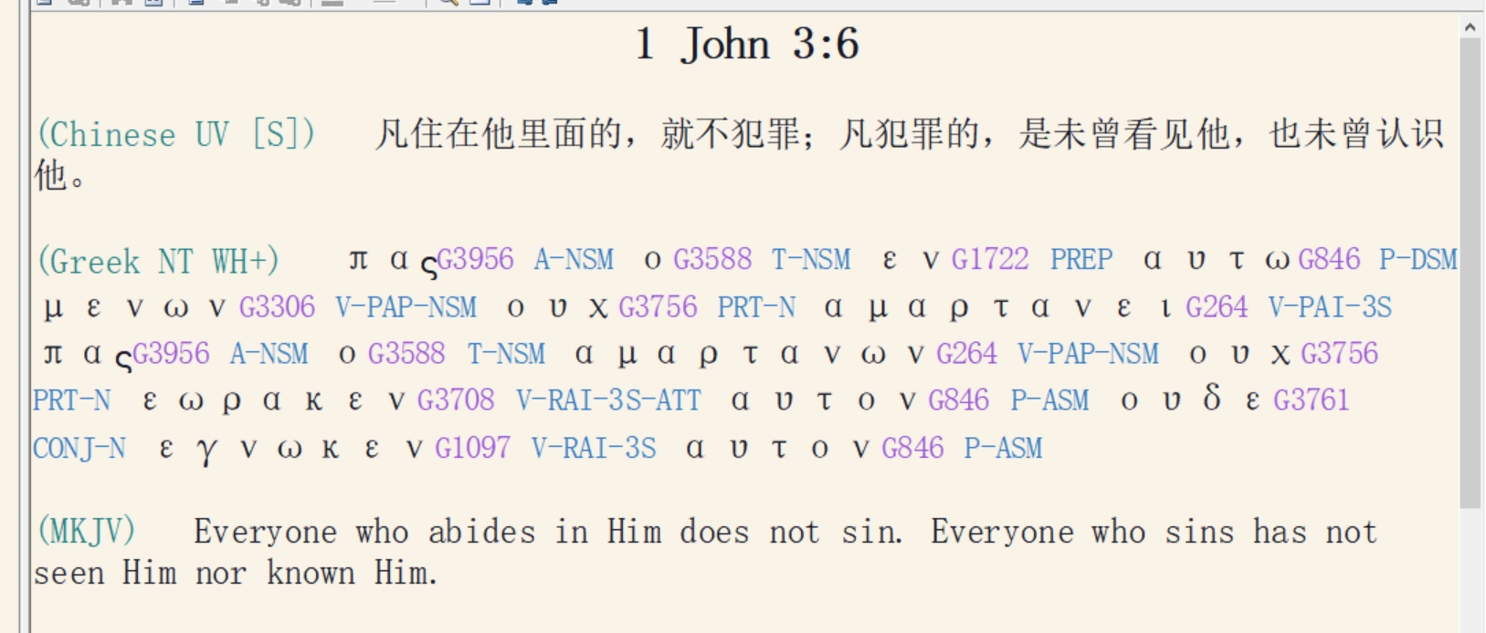

Slide 20
The believer is free from the Mosaic Law. He is:
信徒不再受摩西律法的约束。信徒是：
Dead to the Law (Rom. 7:4).
对律法是死的（罗马书 7:4）。
Delivered from the Law (Rom. 6:14; 7:6; 2 Cor. 3:6–11; Gal. 3:25).
得蒙拯救（罗马书 6:14，7:6；哥林多后书 3:6-11；加拉太书 3:25）。

