Slide 1
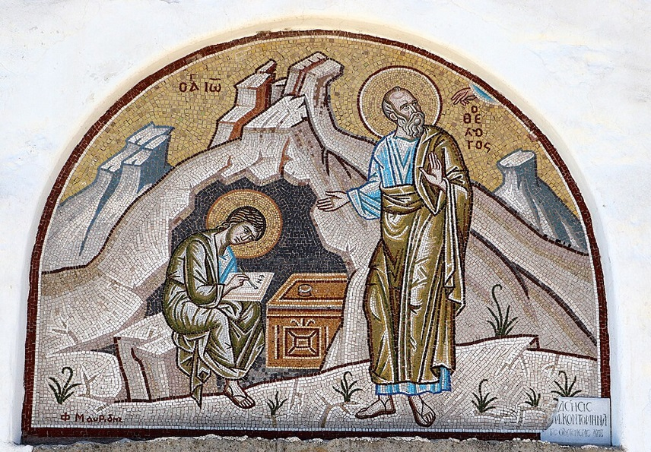
การวิเคราะห์พระธรรมวิวรณ์ สอนโดย อ.Tim จากคำบันทึกของ อ. Max Klein
REVELATION 62
2025 09 02

Slide 2
วิวรณ์ 2:24.
‘But I say to you, the rest who are in Thyatira, who do not hold this teaching [the revival of the Baal cult], who have not known the deep things of Satan [sarcasm], as they call them—I place no other burden on you.
ὑµῖν δὲ λέγω τοῖς λοιποῖς τοῖς ἐν Θυατίροις, ὅσοι οὐκ ἔχουσιν τὴν διδαχὴν ταύτην, οἵτινες οὐκ ἔγνωσαν τὰ βαθέα τοῦ Σατανᾶ, ὡς λέγουσιν, οὐ βάλλω ἐφí ὑµᾶς ἄλλο βάρος·
สำหรับพวกเจ้า และคนอื่นที่เหลืออยู่ที่เมืองธิยาทิรา ผู้ไม่ถือคำสอนนี้ [การสอนเกี่ยวกับลัทธิพระบาอัล ]และไม่รู้จักสิ่งที่เขาเรียกว่า ความล้ำลึกของซาตานนั้น เราขอบอกว่า เราจะไม่มอบภาระอื่นให้เจ้า

Slide 3
In Pergamum we noted that believers were advancing to maturity right under the nose of Satan where Satan’s headquarters was. Now in Thyatira we note that some believers were advancing to maturity in spite of the distraction of the phallic cult.
This advance to maturity took place in areas of special pressure and distraction. It makes no difference whether you live in a large city with many pressures or live in a quiet out-of-the-way place where pressures are relatively small and practically non-existent.
You can advance to maturity as easily in a pressure context as you can in a quiet, pleasant country area. You can advance under good government or you can advance under evil government. You can advance in a place of religious domination or much heathenism.

Slide 4

https://www.youtube.com/watch?v=5DjyBZdHoxY&ab_channel=TWR

Slide 5
Believers living inside the divine power system [the divine dynasphere] and learning doctrine on a daily basis do not succumb to false teaching.
No additional burden or mandate is given to these mature believers who lived and functioned inside the divine system for it isn’t necessary to emphasize the negatives with believers who are positive toward doctrine.

Slide 6
วิวรณ์ 2:25
‘Nevertheless [or: moreover] what you have, hold fast until I come [the Rapture of the Church].
πλὴν ὃ ἔχετε κρατήσατε ἄχρις οὗ ἂν ἥξω.
แต่สิ่งที่เจ้ามีอยู่แล้วนั้น จงยึดไว้ให้มั่นจนกว่าเราจะมา
You don’t have to tell a positive believer, “Don’t do this and Don’t do that.” Just give them the positive mandates and they will carry it out. However, great Christians need to be reminded that even though they may have reached the highest levels of spiritual growth, it is not over until it is over. The spiritual life continues until the Lord takes us out of this world.

Slide 7
2:26. ‘He who is victorious [in the spiritual life] and keeps My assignments until the end [of his life], To him I will give authority over the nations, [as a blessing in the Millennium]; 2:27. And he shall rule them with a rod of iron, as the vessels of the potter are broken to pieces [swift and just punishment of criminals], as I also have received authority from My Father; 2:28. Furthermore, I will give him [The Order of the] Morning Star.
2:26. καὶ ὁ νικῶν καὶ ὁ τηρῶν ἄχρι τέλους τὰ ἔργα µου, δώσω αὐτῷ ἐξουσίαν ἐπὶ τῶν ἐθνῶν (27) καὶ ποιµανεῖ αὐτοὺς ἐν ῥάβδῳ σιδηρᾷ, ὡς τὰ σκεύη τὰ κεραµικὰ συντρίβεται (28) ὡς κἀγὼ εἴληφα παρὰ τοῦ πατρός µου, καὶ δώσω αὐτῷ τὸν ἀστέρα τὸν πρωϊνόν.
ผู้ใดมีชัยชนะและถือรักษากิจการของเราไว้จนถึงที่สุด `เราจะให้ผู้นั้นมีอำนาจครอบครองบรรดาประชาชาติ 2:27 และผู้นั้นจะบังคับบัญชาคนทั้งหลายด้วยคทาเหล็ก เหมือนกับเมื่อหม้อดินของช่างหม้อที่แตกออกเป็นเสี่ยงๆ' ตามที่เราได้รับจากพระบิดาของเรา 2:28 และเราจะมอบดาวประจำรุ่งให้แก่ผู้นั้น

Slide 8
“Furthermore, I will give to him [the mature believer, the winner in time] the order of the morning star,” the highest decoration for life on this earth, the highest decoration for historical impact and for glorification of the Lord Jesus Christ.
The uniform of glory worn over the resurrection body as per Revelation 3:4, 5 and the decoration which goes with it, the Order of the Morning Star, means that there will be a presentation in the court of heaven before the Father and his angels for a few believers out of every generation (Revelation 3:5), those who make the pivot, those who advance to maturity, and pass Evidence Testing.

Slide 9
The person who is making the great contribution to history is the believer who advances to maturity. As goes the believer so goes the nation. The believer living according to God’s will has a positive effect on his nation, and the believer living in the cosmic system contributes to the downtrend of his nation.
So, at the second advent logically there will be a presentation to the entire population of the world of every person who has the Order of the Morning Star and the Uniform of Glory.
The authority of this particular decoration is phenomenal because for one thousand years of perfect environment on the earth namely the Millennial reign of our Lord Jesus Christ, the Christians who have the Order of the Morning Star on their Uniforms of Glory will rule nations with a rod of iron (perfect justice). And then in eternal state there will obviously be many unique privileges which will belong to the believer who wears the Order of the Morning Star on his Uniform of Glory.

Slide 10
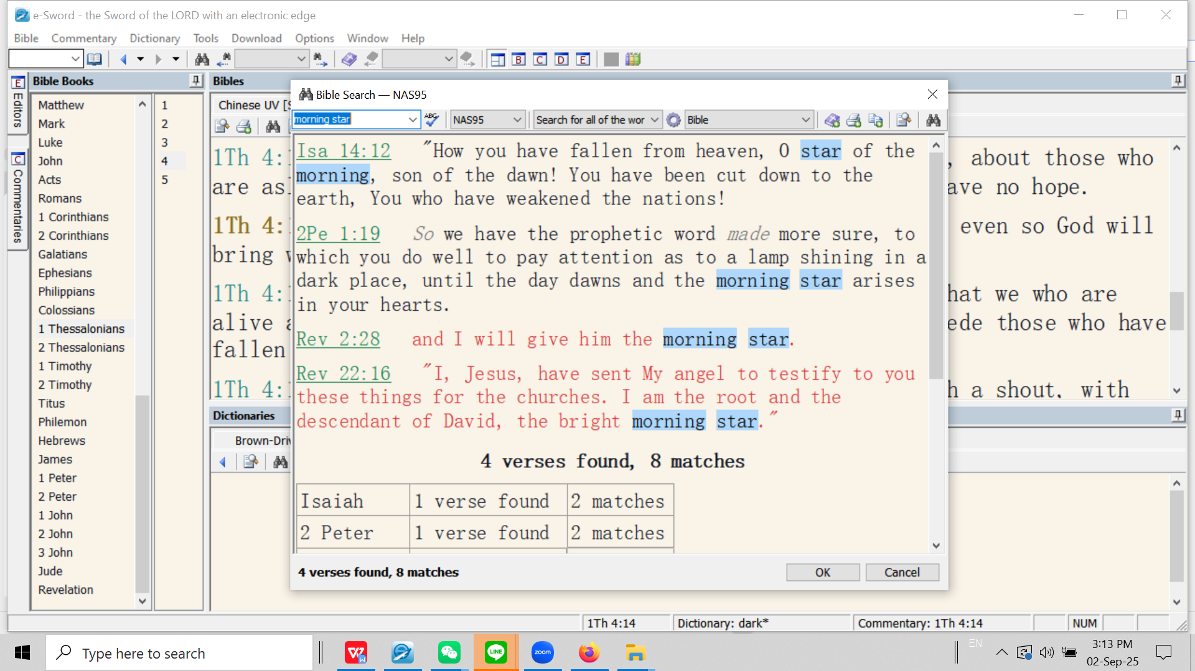
Note 2Pet. 1:19 “phosphoros” vs. Rev.2:28 and 22:16, also Rev. 6:13 stars falling to earth - fallen angels kicked out of heaven middle of Tribulation (cf. Rev. 12:9).

Slide 11
วิวรณ์ 2:29
‘He who has an ear, let him hear what the Spirit says to the churches.’
ὁ ἔχων οὖς ἀκουσάτω τί τὸ πνεῦµα λέγει ταῖς ἐκκλησίαις.
ใครมีหูก็ให้ฟังข้อความซึ่งพระวิญญาณตรัสไว้แก่คริสตจักรทั้งหลายเถิด
(This is a the same phrasing to what we saw in Rev. 2:7, 11, 17, and appears in Rev. 3:6, 13, 22)
We learn God’s word by listening to and obeying God the Holy Spirit. The Christian can only advance and glorify the members of the Trinity by putting himself under the authority of the teaching ministry of God the Holy Spirit.

Slide 12
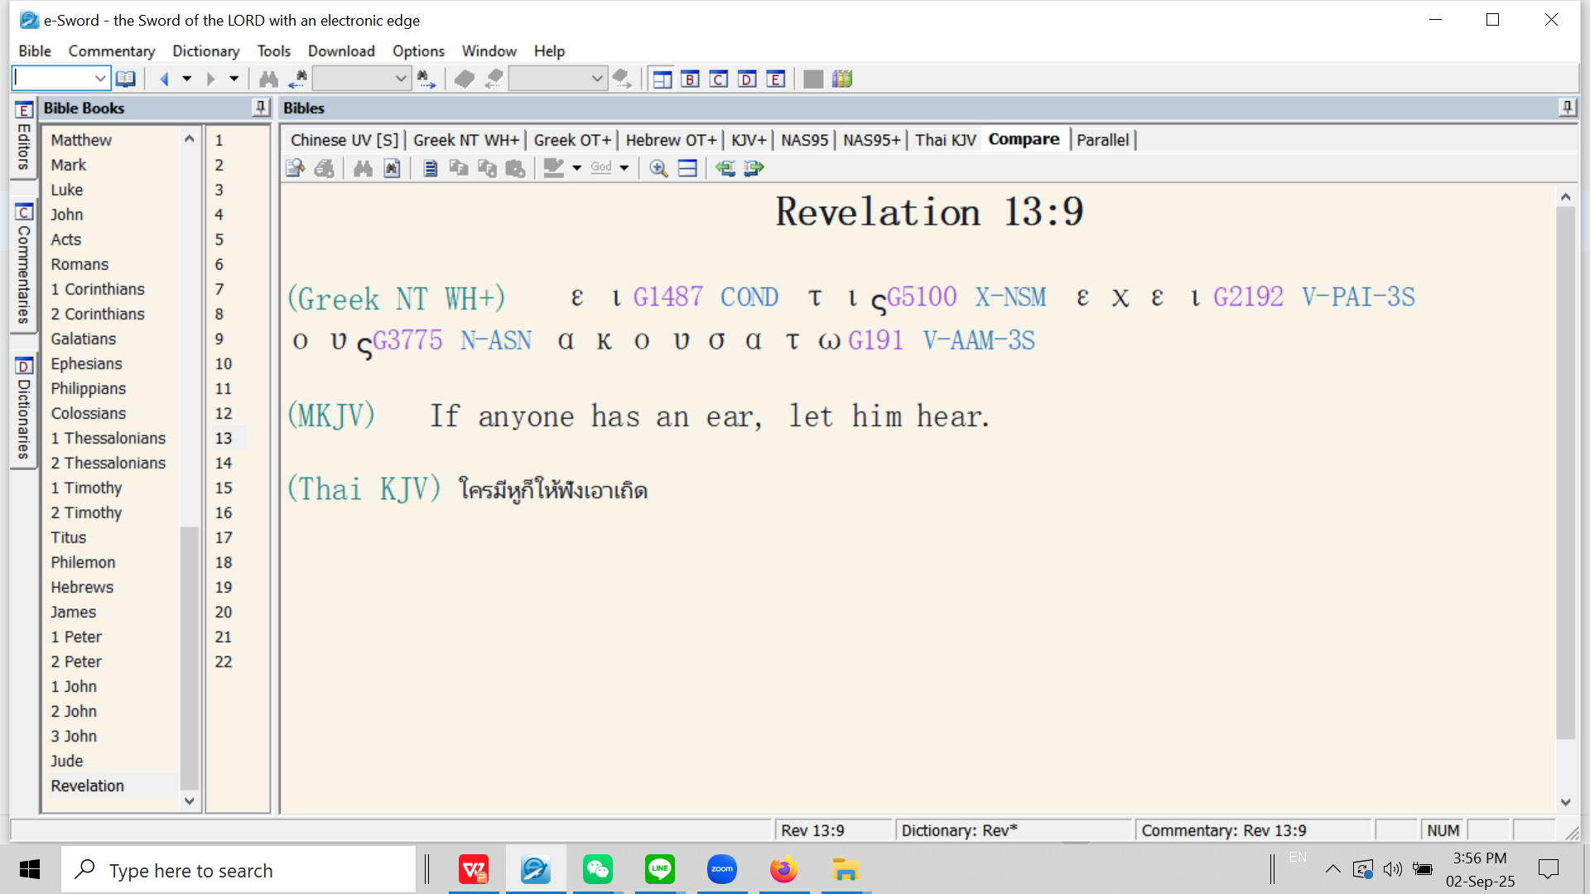
Here the writer changes from the participle “having ears” (used 7 times in Rev. already) to the first class conditional sentence “if you have an ear, and you do!” These are the saints who ‘persevere’ under the severe testing of persecution of the second half of the Tribulation (Rev. 13:10, the next verse).

Slide 13
วิวรณ์ 3:1
Message to Sardis
And to the messenger [future pastors] of the [local] church in Sardis write: He who has the seven Spirits of God [God the Holy Spirit who provided the prototype spiritual life for the humanity of Christ: Isaiah 11:2] and the seven stars [orthodox pastors], communicates these things: 'I have known your works namely that you have a reputation that you are alive [false reputation], but in spite of that reputation, you are dead [functioning in the cosmic system: cosmic or carnal death]
Καὶ τῷ ἀγγέλῳ τῆς ἐν Σάρδεσιν ἐκκλησίας γράψον· Τάδε λέγει ὁ ἔχων τὰ ἑπτὰ πνεύµατα τοῦ θεοῦ καὶ τοὺς ἑπτὰ ἀστέρας· Οἶδά σου τὰ ἔργα, ὅτι ὄνοµα ἔχεις ὅτι ζῇς, καὶ νεκρὸς εἶ.
จงเขียนถึงทูตสวรรค์แห่งคริสตจักรที่เมืองซาร์ดิสว่า `พระองค์ผู้ทรงมีพระวิญญาณทั้งเจ็ดของพระเจ้า และทรงมีดาราเจ็ดดวงนั้น ได้ตรัสดังนี้ว่า เรารู้จักแนวการกระทำของเจ้า เจ้าได้ชื่อว่ามีชีวิตอยู่ แต่ว่าเจ้าได้ตายเสียแล้ว

