Slide 1
四十种绝对恩赐
The 40 absolutes
Lesson Seven
2025 09 10

Slide 2

Charlie Kirk
(October 14, 1993 – September 10, 2025)

Slide 3
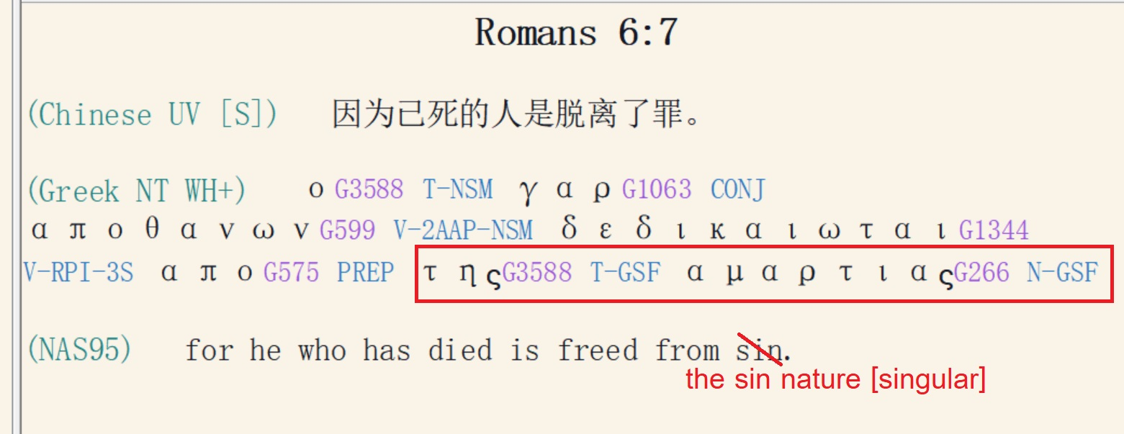

Slide 4
The believer is free from the Mosaic Law. He is:
信徒不再受摩西律法的约束。信徒是：
Dead to the Law (Rom. 7:4).
对律法是死的（罗马书 7:4）。
Delivered from the Law (Rom. 6:14; 7:6; 2 Cor. 3:6–11; Gal. 3:25).
得蒙拯救（罗马书 6:14，7:6；哥林多后书 3:6-11；加拉太书 3:25）。

Slide 5
The Purpose of the Law:
Rom. 3:20, “for through the Law comes the knowledge of sin.”
所以凡有血气的，没有一个因行律法能在神面前称义，因为律法本是叫人知罪。
Rom. 5:20, “And the Law came in that the transgression might increase; but where sin increased, grace abounded all the more,
律法本是外添的，叫过犯显多；只是罪在那里显多，恩典就更显多了。

Slide 6
The Purpose of the Law:
Romans 7:7
What shall we say then? Is the Law sin? May it never be! On the contrary, I would not have come to know sin except through the Law; for I would not have known about coveting if the Law had not said, "YOU SHALL NOT COVET."
这样，我们可说什麽呢？律法是罪吗？断乎不是！只是非因律法，我就不知何为罪。非律法说「不可起贪心」，我就不知何为贪心。
1 Tim. 1:8-9, “But we know that the law is good, if one uses it lawfully, realizing the fact that law is not made for a righteous man, but for those who are lawless and rebellious, for the ungodly and sinners, for the unholy and profane, for those who kill their fathers or mothers.”
我们知道律法原是好的，只要人用得合宜； 因为律法不是为义人设立的，乃是为不法和不服的，不虔诚和犯罪的，不圣洁和恋世俗的，弑父母和杀人的，

Slide 7
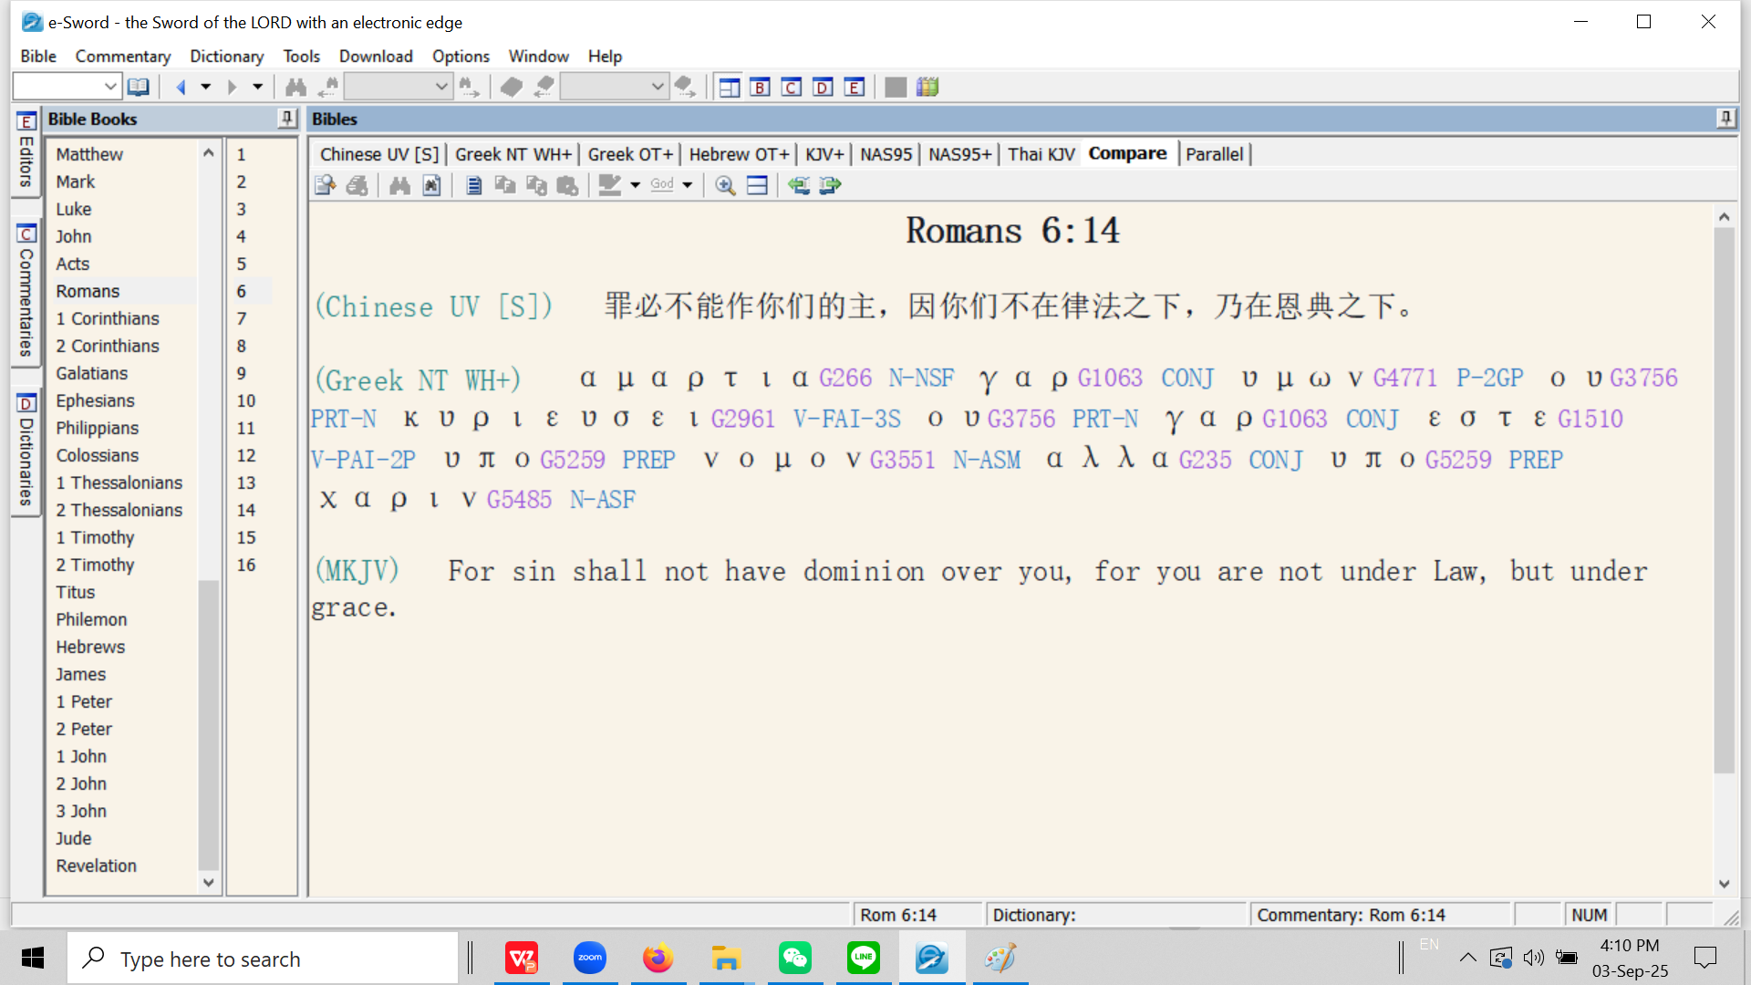

Slide 8
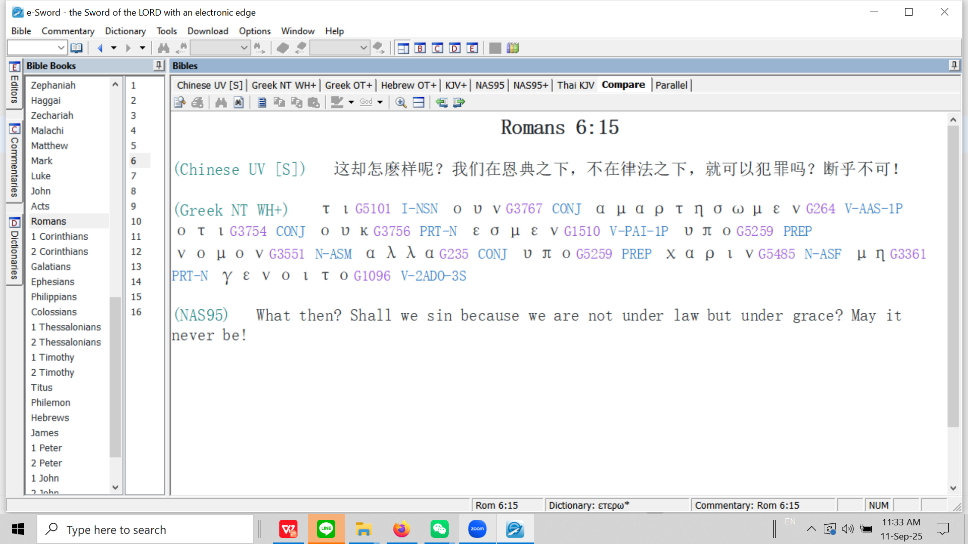
Now Paul reiterates (repeats) his question from Rom. 6:1

Slide 9
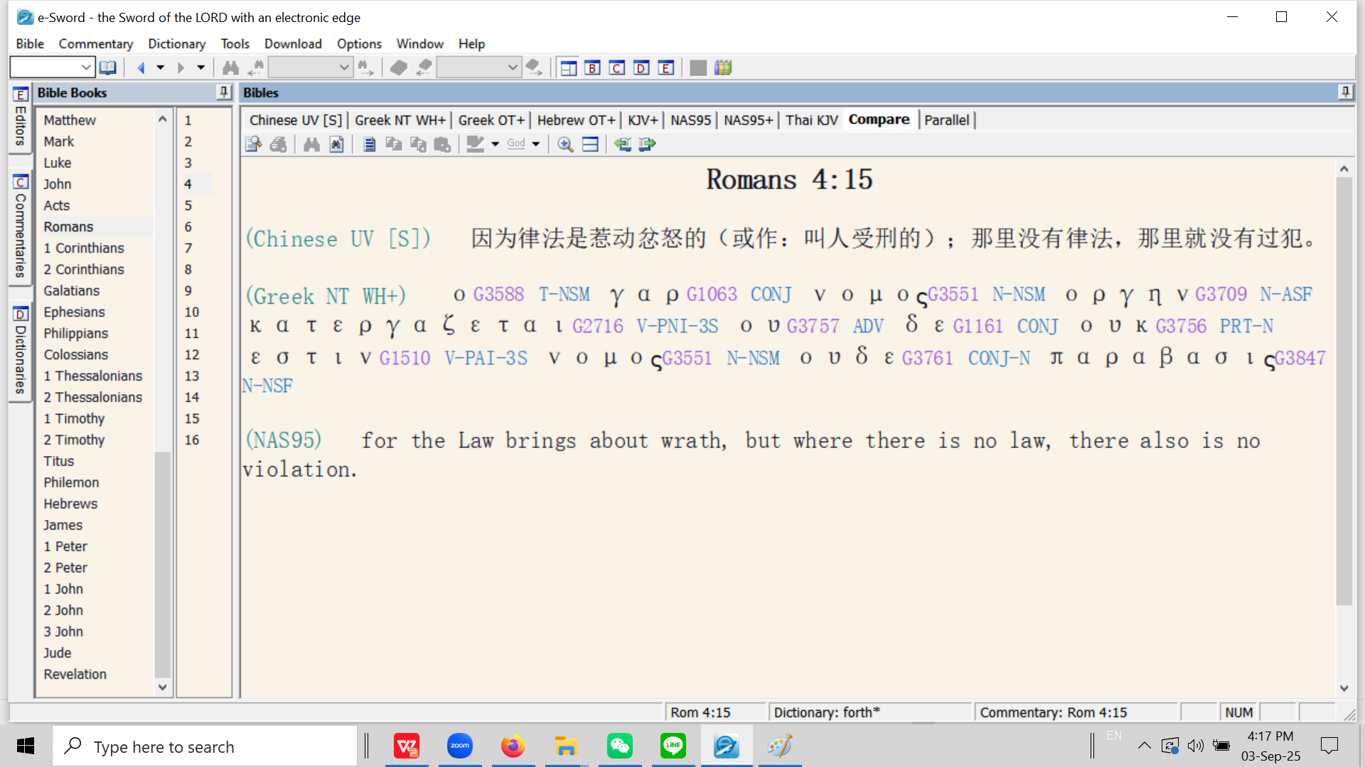
属灵生命概论
By analogy: “How can a wife be disobedient to her ex-husband if she is divorced from him?”

Slide 10
Romans 7 罗马书 7
Outline: four paragraphs. 大纲：分为4段
a) The key to interpretation: the two marriages, verses 1-6.
解读关键：第1-6节经文所提及的两段婚姻
b) The function of the law as a marriage counsellor, verses 7-14.
第7-14节经文所提及的律法充当婚姻咨询的作用
c) The attacks of the first husband, verses 15-21.
第15-21节经文所提及的来自第一任丈夫的攻击
d) The great inner conflict, verse 22-25.
第22-25节经文所提及的内在矛盾

Slide 11
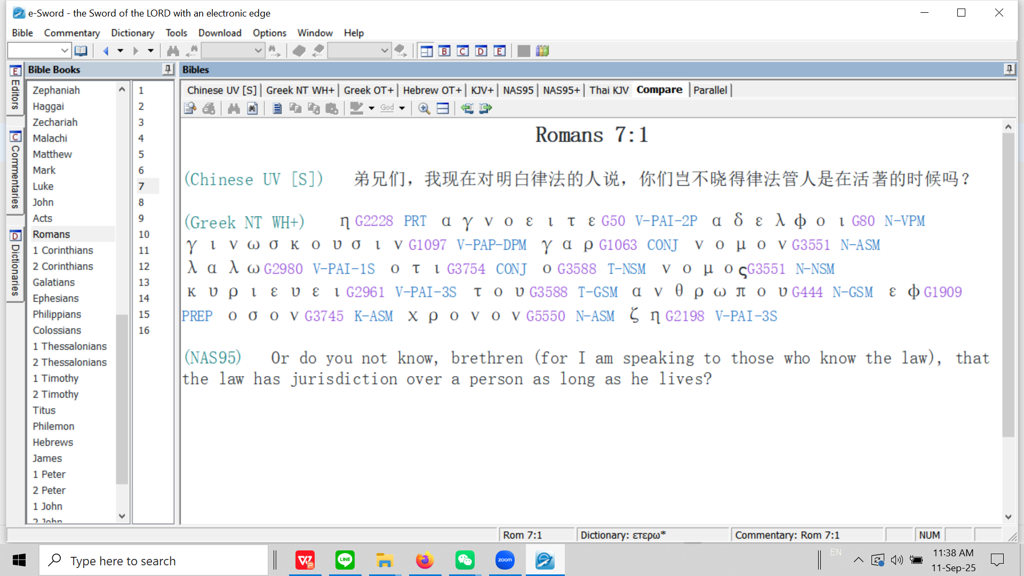

Slide 12
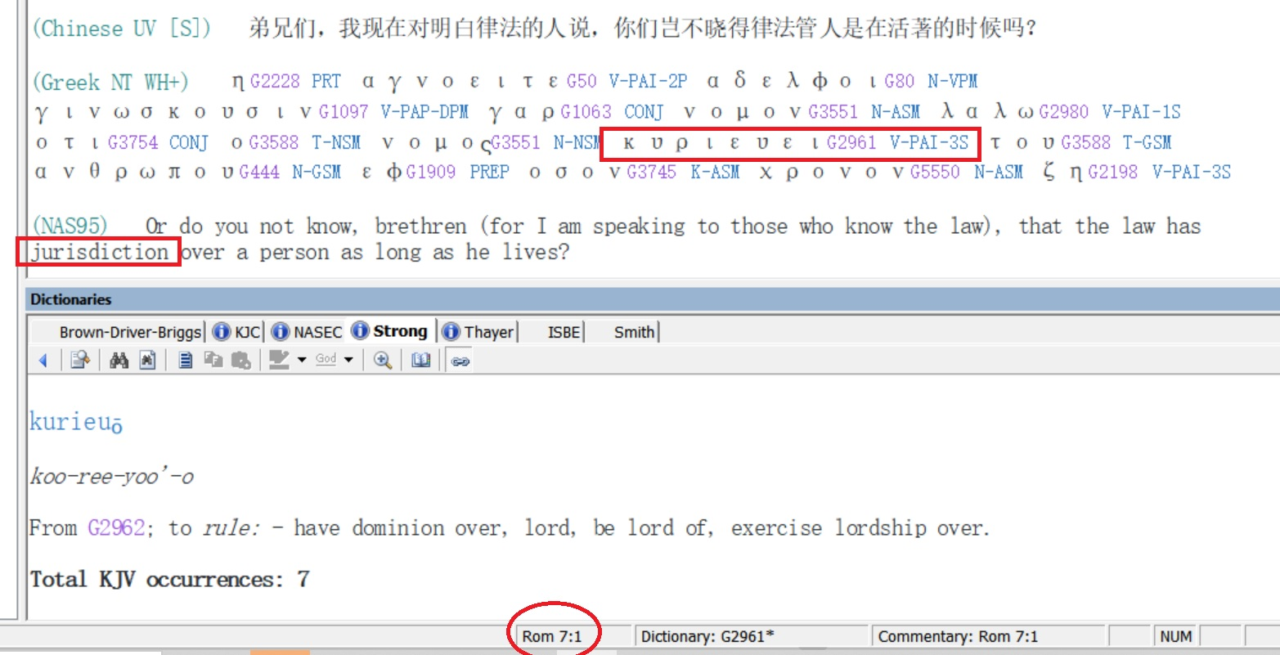

Slide 13
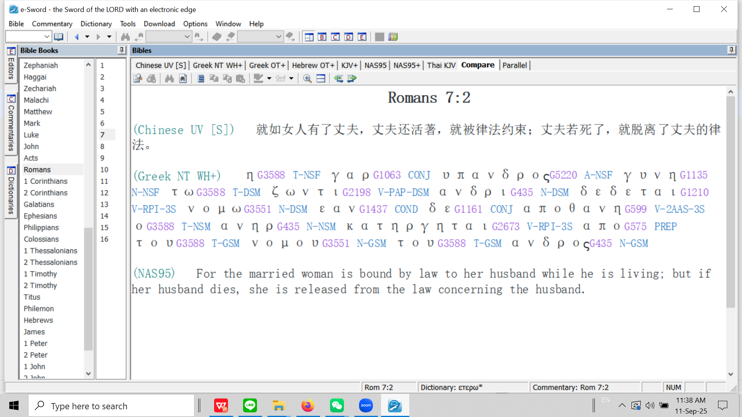

Slide 14
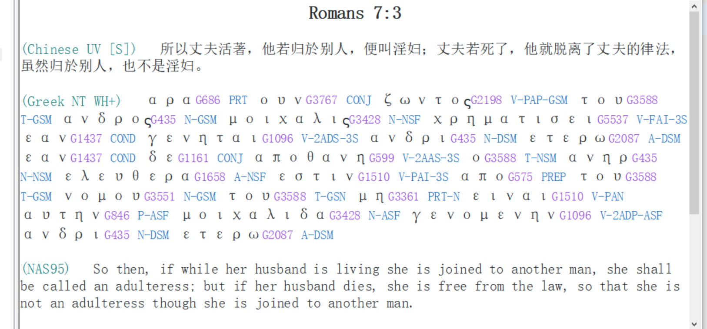

Slide 15
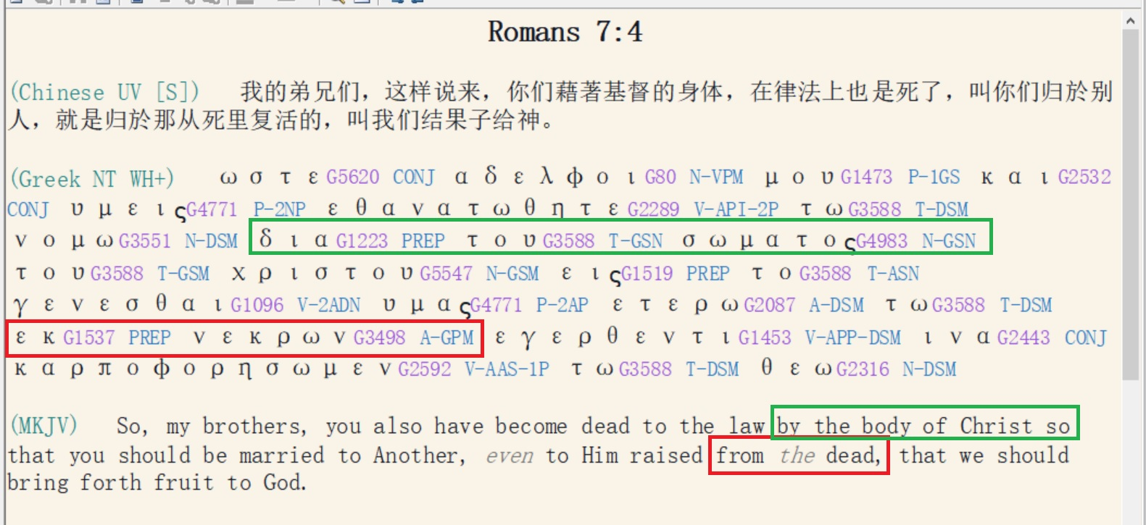

Slide 16
Because of the believer’s death in Christ (Retro-active positional truth - Romans 6:3-5) and the “crucifixion of the sin nature” (Romans 6:6) and our emancipation (freedom from the authority and rulership of the sin nature (Romans 6:6, 7) we are now free from the first husband (the sin nature).
This means the law (which, being our ‘tutor’ (Gal. 3:25), with the purpose of teaching us that we were sinners (Rom. 3:20; Rom. 5:20, Rom. 7:7; 1 Tim. 1:8) is no longer applicable, and now has ‘no jurisdiction’ over us (Romans 7:1) because we have died to the sin nature, have been sanctified (without sin) in Christ, and now have Christ as our new husband. We are now no longer under the Law, but Grace (Rom. 6:14).

Slide 17
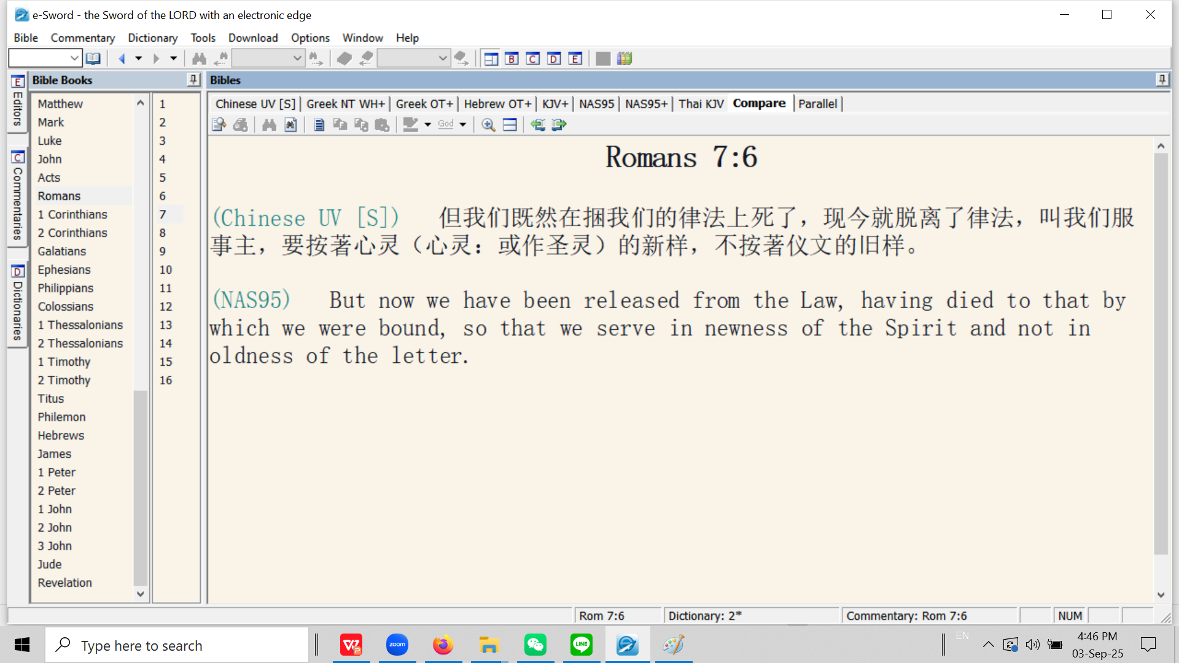

Slide 18
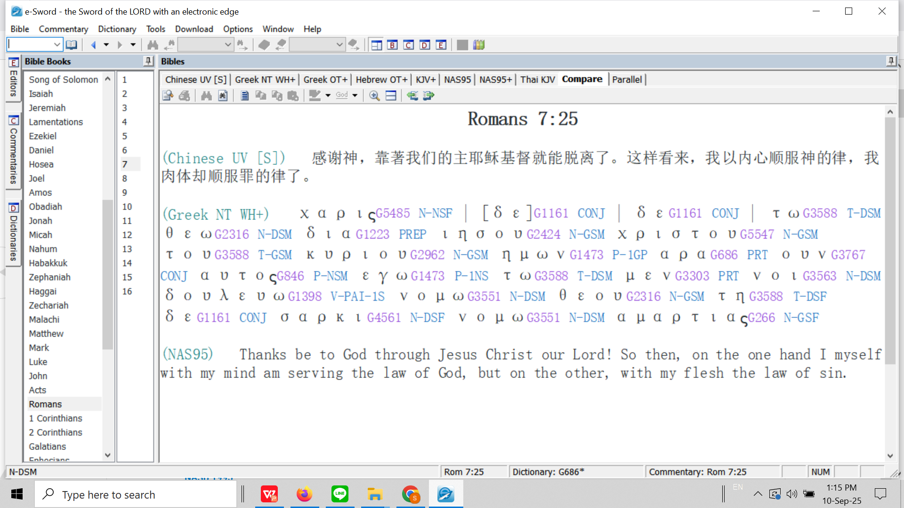

Slide 20
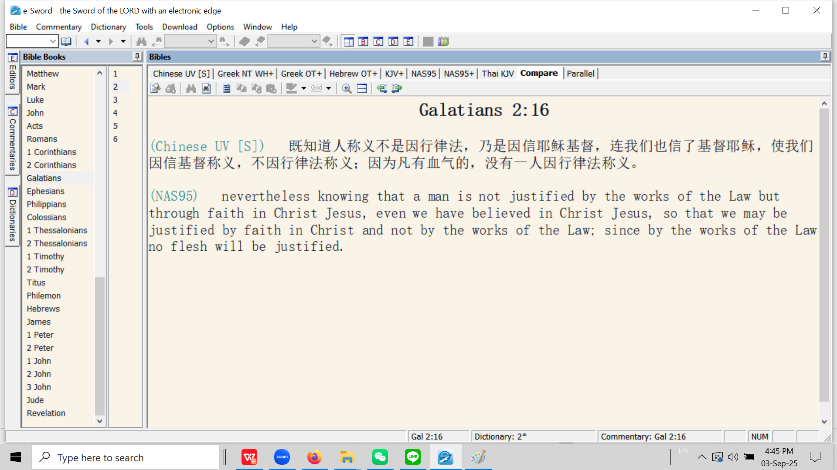

Slide 21
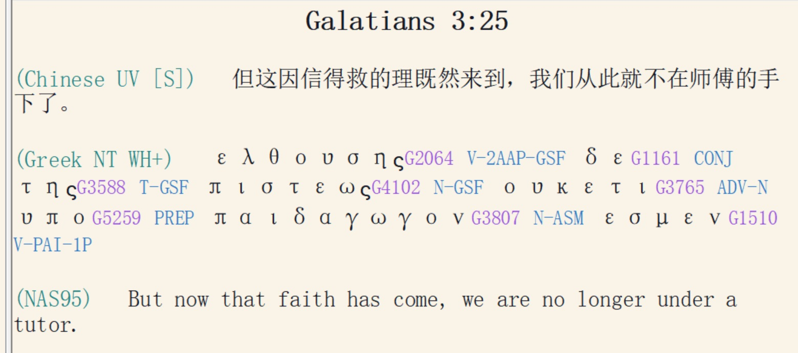

Slide 22
The believer is regenerated (John 13:10; 1 Cor. 6:11; Titus 3:5). He is:
信徒得以重生（约翰福音 13:10；哥林多前书 6:11；提多书 3:5）。信徒是：
Born again (John 3:7; 1 Pet. 1:23).
蒙了重生（约翰福音 3:7；彼得前书 1:23）。
A child of God (Rom. 8:16; Gal. 3:26).
神的孩子（罗马书 8:16；加拉太书 3:26）。
A son of God (John 1:12; 2 Cor. 6:18; 1 John 3:2).
神的儿子（约翰福音 1:12；哥林多后书 6:18；约翰一书 3:2）。
A new creation (2 Cor. 5:17; Gal. 6:15; Eph. 2:10).
新造的人（哥林多后书 5:17；加拉太书 6:15；以弗所书 2:10）。

Slide 23
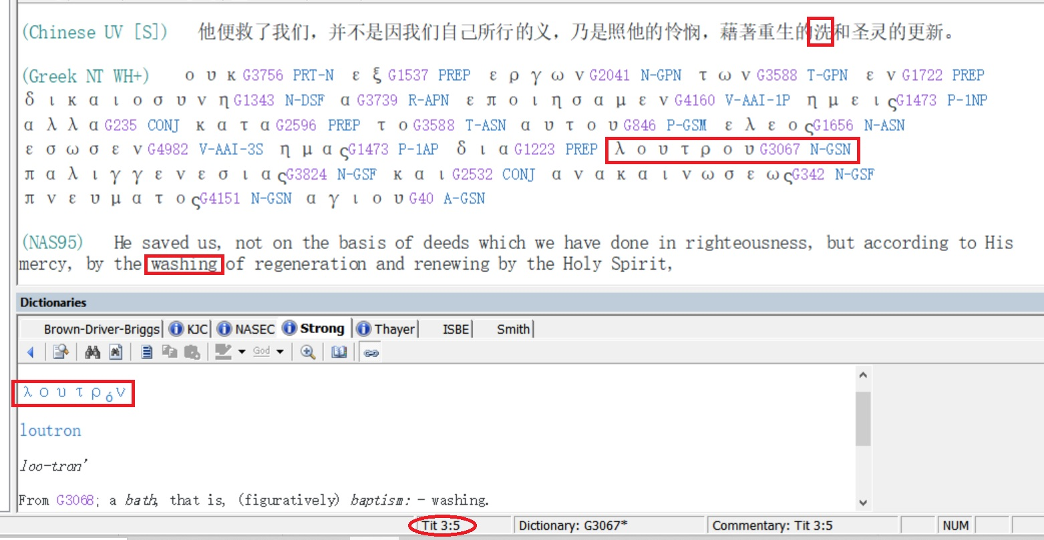

Slide 24
Without criticizing them, Jesus decided to clean their feet not only to solve the immediate problem of their filthy feet, but primarily to teach by analogy that his work on the cross would be the basis for the confession of sins.
1. All twelve disciples had bathed before departing from Bethany and coming to Jerusalem where the Last Supper would take place. This cleansing of the whole body is analogous to their salvation with emphasis on the forgiveness of pre-salvation-sins.
2. On the way to the location where the Last Supper would take place, they had to walk through a number of filthy streets, for in those times they did not have plumbing as we do now and people would just throw their bowls of excrement onto the street. The apostles should have washed their feet (as was custom) before entering the home where the supper would take place. Washing the filth (representing sins) from their feet would be analogous to the confession of their sins.
3. Dining at the table was fellowship with the Lord (Revelation 3:20). The believer cannot have fellowship with the Lord with filth on his feet! (in a state of sin and carnality).
4. The feet are analogous to service (Isaiah 52:7). One cannot serve the Lord with filthy feet (while in carnality).

Slide 25
John 13:6 挨到西门彼得，彼得对他说：「主啊，你洗 [νίπτω / nipto] 我的脚吗？」
So He *came to Simon Peter. He *said to Him, "Lord, do You wash [νίπτω / nipto] my feet?"
John 13:7 耶稣回答说：「我所做的，你如今不知道，後来必明白。」
Jesus answered and said to him, "What I do you do not realize now, but you will understand hereafter."
John 13.8 彼得说：「你永不可洗 [νίπτω / nipto] 我的脚！」耶稣说：「我若不洗 [νίπτω / nipto] 你，你就与我无分了。」
Peter *said to Him, "Never shall You wash my feet!" Jesus answered him, "If I do not wash you, you have no part with Me."

Slide 26
John 13:9 西门彼得说：「主啊，不但我的脚，连手和头也要洗。」
(NAS95) Simon Peter *said to Him, "Lord, then wash not only my feet, but also my hands and my head."
John 13:10 耶稣说：「凡洗过澡 [λούω / louo] 的人，只要把脚一洗 [νίπτω / nipto]，全身就乾净 [καθαρός / katharos]了。你们是乾净 [καθαρός / katharos]的，然而不都是乾净的。」
Jesus *said to him, "He who has bathed [λούω / louo] needs only to wash [νίπτω / nipto] his feet, but is completely clean [καθαρός / katharos]; and you are clean [καθαρός / katharos] , but not all of you."
1 John 1:9
我们若认自己的罪，神是信实的，是公义的，必要赦免我们的罪，洗净 [καθαρός / katharos] 我们一切的不义。
If we confess our sins, He is faithful and righteous to forgive us our sins and to cleanse [καθαρός / katharos] us from all unrighteousness.

Slide 27
John 3:4 尼哥底母说：「人已经老了，如何能重生呢？岂能再进母腹生出来吗？」
Nicodemus *said to Him, "How can a man be born when he is old? He cannot enter a second time into his mother's womb and be born, can he?"
John 3:5 耶稣说：「我实实在在的告诉你，人若不是从水和圣灵生的，就不能进神的国。
Jesus answered, "Truly, truly, I say to you, unless one is born of water [from amniotic fluid at physical birth] and the Spirit [spiritual birth] he cannot enter into the kingdom of God.
John 3:6 从肉身生的就是肉身；从灵生的就是灵。
"That which is born of the flesh [physical birth] is flesh, and that which is born of the Spirit [spiritual birth] is spirit.
John 3:7 我说：『你们必须重生』，你不要以为希奇。
"Do not be amazed that I said to you, 'You must be born again.'

