Slide 1
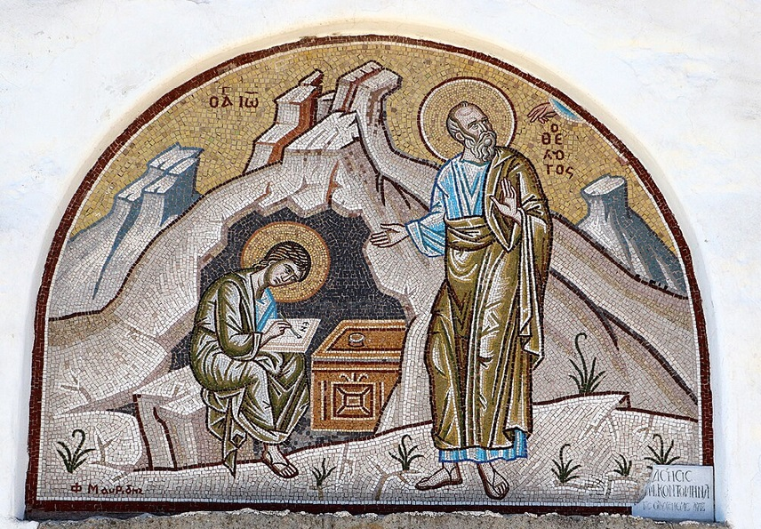
การวิเคราะห์พระธรรมวิวรณ์
สอนโดย อ.Tim จากคำบันทึกของ อ. Max Klein
REVELATION 55
2025 08 12

Slide 2
One of the great principles in the Word of God is living your life in the light of eternity, and able to have a wonderful time in time.
Oppositely, when you live your life in the light of the moment [i.e. NOT by faith or with a Personal Sense of Destiny, but living by sight /empiricism] then you are going to be totally miserable and disoriented to life [disconnected from reality]. (Rom. 8:29-30) Happiness occurs in eternity at the judgment seat of Christ when born again believers will face the dissapointment of being in a resurrection body forever without anything to show for this life.

Slide 3
วิวรณ์ 2:18.
“And to the messenger [the pastor] of the church in Thyatira write: The Son of God, who has eyes like a flame of fire [His integrity demands discipline for the believers who reject His spiritual life], and His feet are like burnished bronze, communicates this:
Καὶ τῷ ἀγγέλῳ τῆς ἐν Θυατίροις ἐκκλησίας γράψον· Τάδε λέγει ὁ υἱὸς τοῦ θεοῦ, ὁ ἔχων τοὺς ὀφθαλµοὺς αὐτοῦ ὡς φλόγα πυρός, καὶ οἱ πόδες αὐτοῦ ὅµοιοι χαλκολιβάνῳ·
จงเขียนถึงทูตสวรรค์แห่งคริสตจักรที่เมืองธิยาทิรา ว่า `พระองค์ผู้ซึ่งเป็นพระบุตรของพระเจ้า ผู้ทรงมีพระเนตรดุจเปลวไฟ และมีพระบาทดุจทองสัมฤทธิ์เงางาม ได้ตรัสดังนี้ว่า

Slide 4
The flame of fire speaks of individual judgment just as the feet of bronze represents national judgment.
Jesus Christ will not ever tolerate arrogance. When it says “a flame of fire” it means that our Lord personally is going to do a lot of judging. For example, John 5:22: เพราะว่าพระบิดามิได้ทรงพิพากษาผู้ใด แต่พระองค์ได้ทรงมอบการพิพากษาทั้งสิ้นไว้กับพระบุตร

Slide 5
วิวรณ์ 2:19
‘I know [The Lord provides an estimate of the situation regarding the church at Thyatira] your accomplishments namely your love and faith [faith-rest drill] and service [full time Christian service related to one’s priesthood and ambassadorship] and perseverance [through undeserved suffering], and that your accomplishments of late are greater than at first.
Οἶδά σου τὰ ἔργα καὶ τὴν ἀγάπην καὶ τὴν πίστιν καὶ τὴν διακονίαν καὶ τὴν
ὑποµονήν σου, καὶ τὰ ἔργα σου τὰ ἔσχατα πλείονα τῶν πρώτων.
เรารู้จักการกระทำของเจ้า ความรัก การปรนนิบัติ ความเชื่อ และความเพียรของเจ้า และ (เรารู้ว่า) การกระทำเบื้องปลายของเจ้ามีมากกว่าการเบื้องต้น

Slide 6
Regarding service or ministry, the Greek word in our passage is diakonia. There is no such thing as entering into full-time Christian service since every believer is already in full-time Christian service.
Everything the Christian does while Filled with the Spirit is rewardable production whether it falls under his royal priesthood or his royal ambassadorship and is a part of his ministry or service as unto the Lord.
Review: Colossians 3:23-25

Slide 7
As some of the Christians of Thyatira demonstrated perseverance (hupomone in the Greek), you must live (persevere) in the power system provided by God.
All of us are weak in this life and the ruler of this world is Satan who in his genius has provided a power system that is far stronger, far greater than we are.
When we reject the power of metabolized doctrine and the power of the Filling of the Spirit, we move into Satan’s system.

Slide 8
The greatest happiness comes to the believer who completes the spiritual life, because in doing so he obtains the happiness which God has designed for the mature believer.
The happiness of spiritual maturity is a system of integrity and thinking, a happiness not dependent upon people or things, but related to loving God the Father, the Lord Jesus Christ, and the Holy Spirit.
Because the mature believer has both enduring devotion and respect for God, he has the power, the inner strength to handle any test or suffering in life.
After the believer develops a personal love for Jesus Christ, he will receive his final test in life, then upon passing this test [hupermony] he will be approved by the Lord and receive “The Wreath of Life”.

Slide 9
วิวรณ์ 2:20.
‘But I have this against you namely that you tolerate the woman Jezebel, who calls herself a prophetess, and she teaches and leads My bond-servants astray so that they commit acts of immorality and eat things sacrificed to idols [the immorality and feasting is part of their worship of demons].
ἀλλὰ ἔχω κατὰ σοῦ ὅτι ἀφεῖς τὴν γυναῖκα Ἰεζάβελ, ἡ λέγουσα ἑαυτὴν προφῆτιν, καὶ διδάσκει καὶ πλανᾷ τοὺς ἐµοὺς δούλους πορνεῦσαι καὶ φαγεῖν εἰδωλόθυτα.
แต่เรามีข้อที่จะต่อว่าเจ้าบ้างเล็กน้อย คือพวกเจ้ายอมให้ผู้หญิงชื่อเยเซเบล ที่ยกตัวขึ้นเป็นผู้พยากรณ์หญิง หญิงนั้นสอนและล่อลวงพวกผู้รับใช้ของเรา ให้ล่วงประเวณีและให้กินของที่บูชาแก่รูปเคารพแล้ว

Slide 10
The present active indicative of the verb aphiemi means “to tolerate” Toleration can be a virtue when related to impersonal love, or it can be a sign of living in the cosmic system.
Remember that in the cosmic system there is a great deal of toleration for Satanic ideas and concepts and that is exactly what we have here. The Christians in Thyatira are tolerating Jezebel and her evil cult. Tolerating evil is supporting evil.
A smart woman who has great beauty can be quite dangerous or very magnificent. Now, the woman who calls herself Jezebel is a beautiful woman with brains and ambition.

Slide 11
There is nothing wrong with being beautiful and there is nothing wrong with being smart, but it is the word “prophetess” where we begin to find something very much amiss. She was alleging to have a gift from God that did not exist in 96 A.D. which brings her into focus as a very arrogant and ambitious woman.
Why did she call herself a prophetess? She knew that with a title she would gain the following of a segment of the Christians in the church at Thyatira. Titles mean everything to the idiot, but nothing to a person who can think.

Slide 12
A few points related to this woman who called herself, Jezebel.
1. Jezebel is not her real name. It is a pseudonym for a very smart and beautiful woman living in the city of Thyatira as the head of a phallic cult.
2. She had succeeded in luring believers away from doctrine into the phallic cult in a manner similar with the historical Jezebel.
3. Jezebel in Thyatira was controlling believers, luring them from the blessing of God’s plan into the cursing of the cosmic system. Many of these believers were like spiritually weak King Ahab who was led astray by his evil wife, Jezebel.
1 Corinthians 15:33, “Do not be deceived, evil companions corrupt good morals”.
“อย่าหลงเลย การคบกับคนชั่วย่อมทำให้นิสัยที่ดีเสียไป”

Slide 13
Man must be so inculcated with truth and doctrine that he will take the responsibility for his own decisions in life, and their consequences.
Consequently, recognition and evaluation of our own personal weaknesses is neither degrading nor demeaning, but the means of recognizing the principle of doctrine that God has an answer for every weakness in the human life.
He alone can convert weakness into strength.
Weakness of the alcoholic re. lifelong weakness...

Slide 14
2:21. ‘I gave her time to change her thinking, and she does not want to change her thinking [She refused to use the Recovery Procedure. Then to learn and execute the spiritual life] and depart from her immorality.
καὶ ἔδωκα αὐτῇ χρόνον ἵνα µετανοήσῃ, καὶ οὐ θέλει µετανοῆσαι ἐκ τῆς πορνείας αὐτῆς.
เราได้ให้โอกาสหญิงนั้นกลับใจจากการล่วงประเวณีของนาง แต่นางก็ไม่ได้กลับใจเลย

Slide 15
This is grace before judgment. Since Jezebel was a believer, she was given time to repent of her fornication and cultic function.
Fornication here means a great deal more than simply illicit sexual intercourse. It has to do with the entire phallic cult.
This woman had many opportunities to use her own free will and reject her lifestyle; but she liked what she was doing, it appealed to her arrogance.
She not only felt important but got her happiness out of controlling people.
The more arrogant one is the more he or she likes controlling others.

