Slide 1
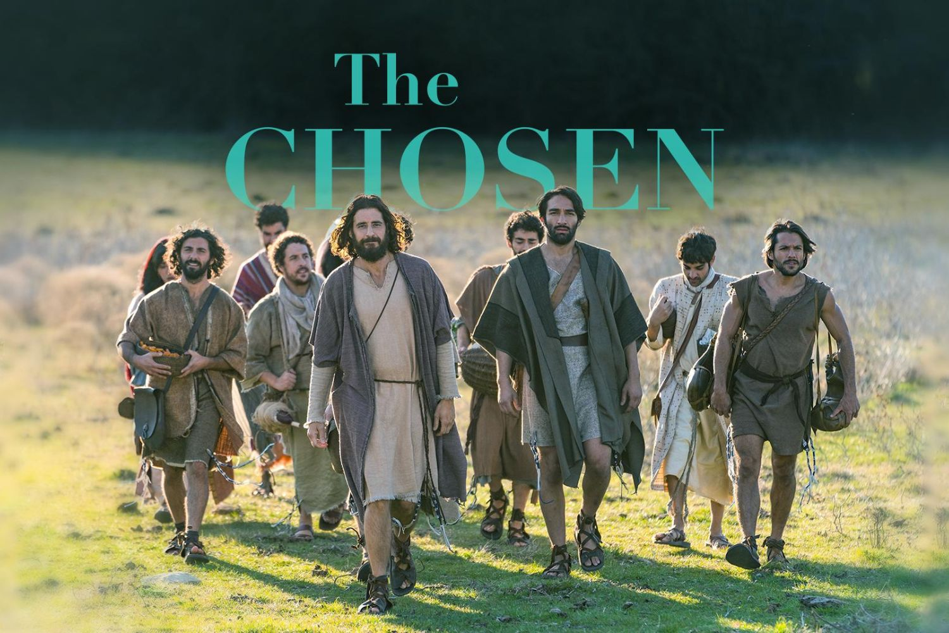

Slide 2
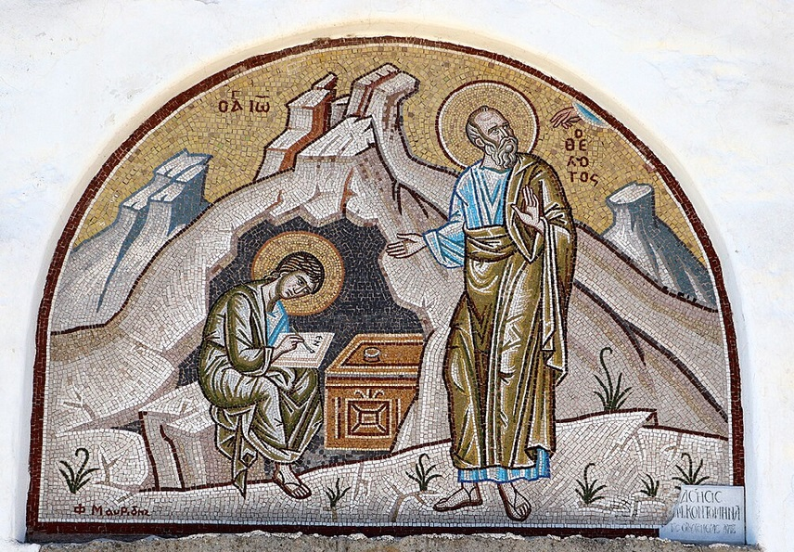
การวิเคราะห์พระธรรมวิวรณ์
สอนโดย อ.Tim จากคำบันทึกของ อ. Max Klein
REVELATION 044 2025 05 26

Slide 3
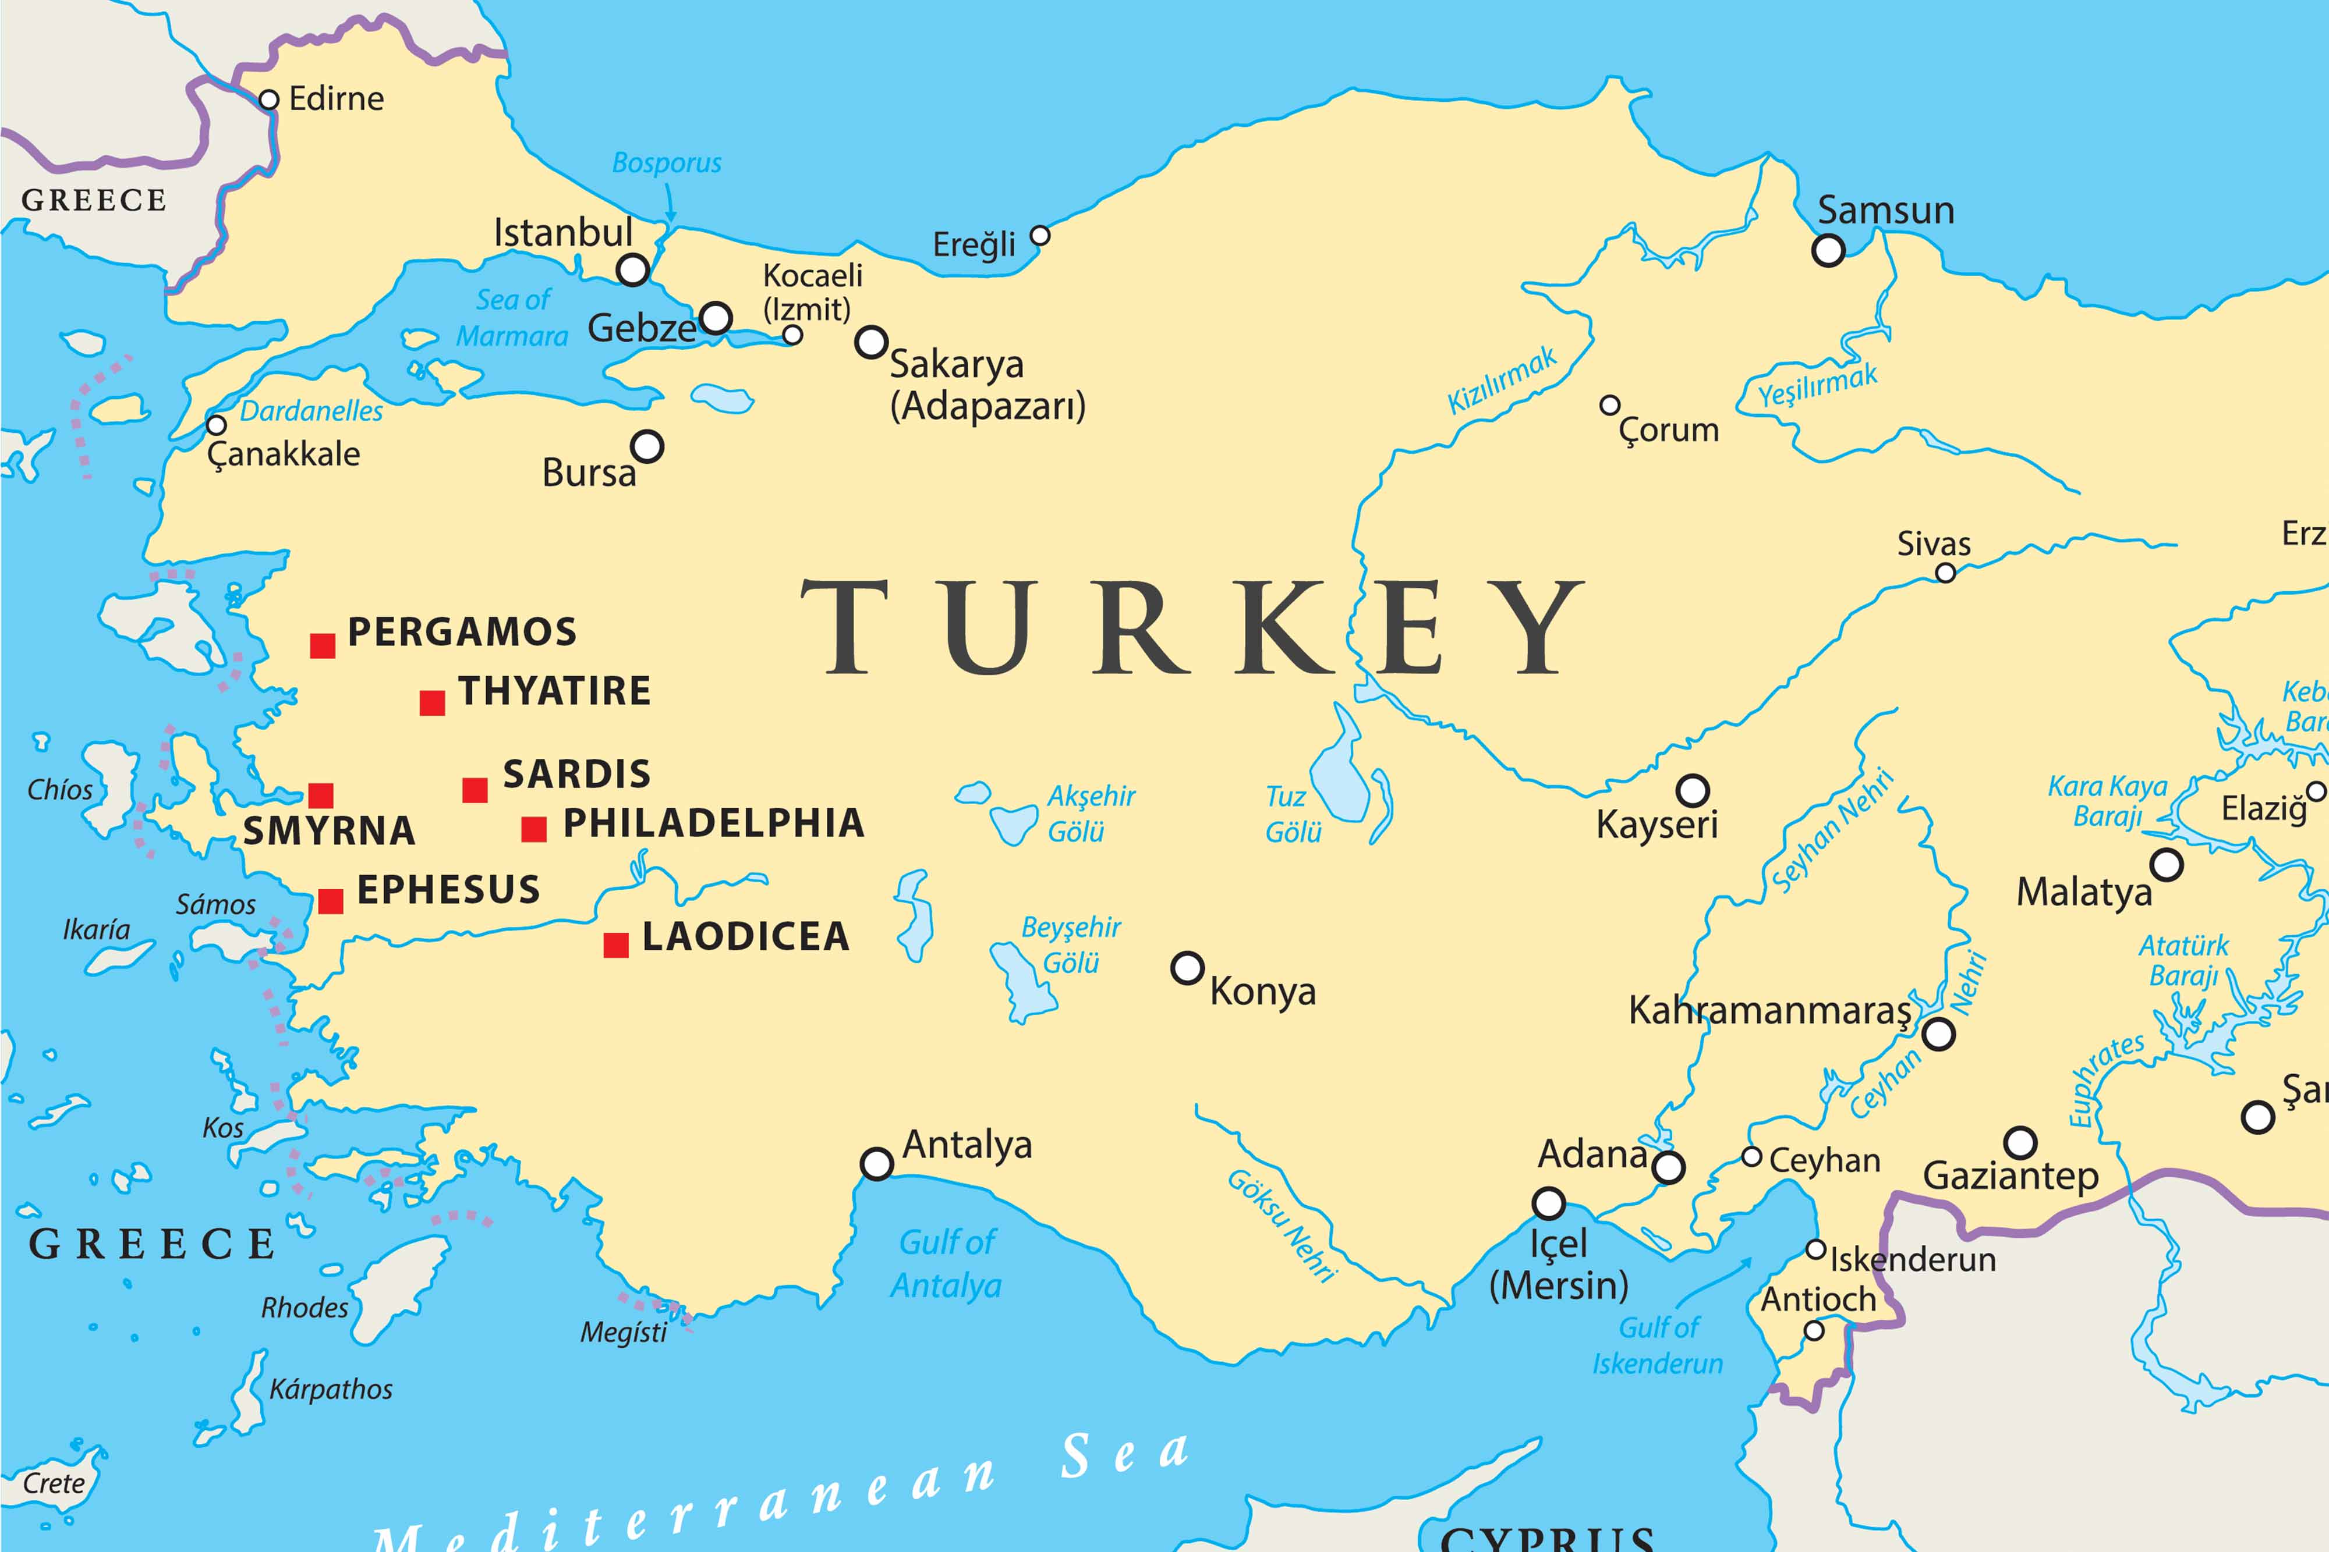

Slide 4
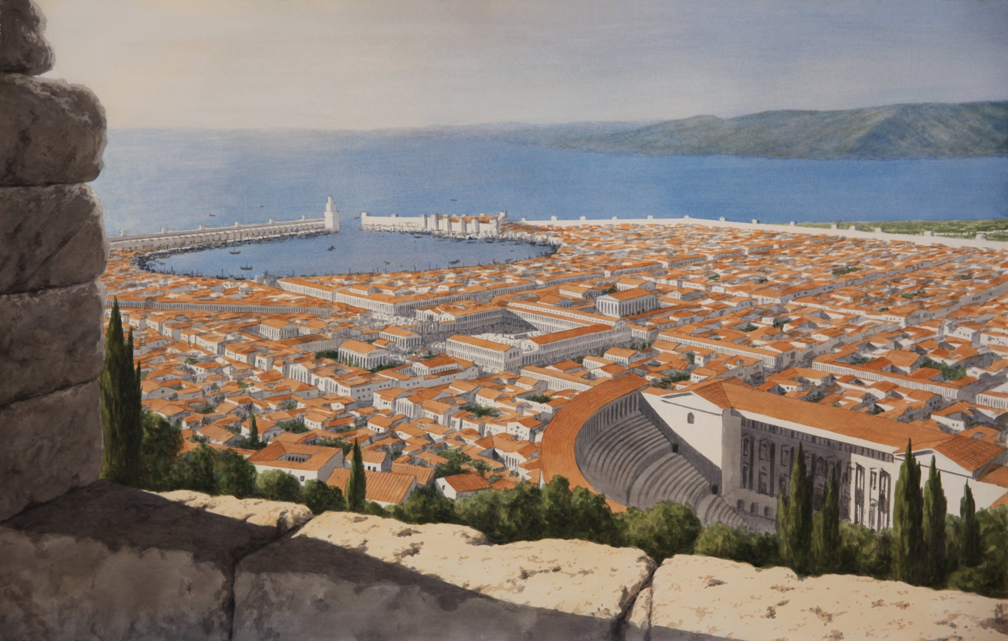

Slide 5
Smyrna (current day: “Izmir - the Pearl of the Aegean” ), a large Ionian city on the west coast of Asia Minor was at the head of the Gulf of Smyrna which reached 30 miles inland from the Aegean Sea, and just 40 miles north of Ephesus. Anciently, it was one of the finest cities of Asia and was called “the lovely—the crown of Ionia—the ornament of Asia.”
Because of its magnificent port, it became a prosperous trading center. Along with Ephesus and Pergamum, Smyrna became one of the most brilliant and prosperous cities of Anotalia (Asian Minor). The population of the city at the time that John wrote was about 200,000.
To its credit, it was the only one of the seven churches in Revelation 2 & 3 which received no word of reproach from the Lord.

Slide 6
วิวรณ์ 2:8.
Καὶ τῷ ἀγγέλῳ τῆς ἐν Σµύρνῃ ἐκκλησίας γράψον· Τάδε λέγει ὁ πρῶτος καὶ ὁ ἔσχατος, ὃς ἐγένετο νεκρὸς καὶ ἔζησεν·
And to the messenger [a reference to the pastor] of the church in Smyrna write: The first and the last, who was dead, and has come to life, says this:
จงเขียนถึงทูตสวรรค์แห่งคริสตจักรที่เมืองสเมอร์นาว่า `พระองค์ผู้ทรงเป็นเบื้องต้นและเป็นเบื้องปลาย ผู้ซึ่งสิ้นพระชนม์แล้ว และกลับฟื้นขึ้นอีก ได้ตรัสดังนี้ว่า

Slide 7
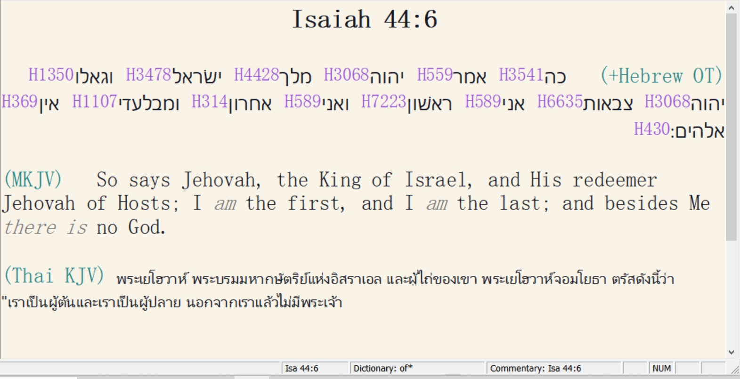

Slide 8
บทเรียนต่อไป :
ความหมายสีรูแบปของวลี “เบื้องต้นและเป็นเบื้องปลาย”
Four meanings to the phrase, “The first and the last”

Slide 9
1.
A. Jesus Christ as “the first” is eternal God, coequal and co-eternal with God the Father and God the Holy Spirit.
B. As eternal and infinite God, Jesus Christ pre-existed history and was the original creator of all things (John 1:3).
C. Jesus Christ in hypostatic union also concludes history as “the last”. He began history by personally creating man namely Adam. And as the last Adam He will personally conclude history with the destruction of the earth and stellar space.
D. Even though history is the record of man’s thoughts, motives, decisions, and actions, it is Jesus Christ, the first and the last, who controls history.
E. Therefore, there are two sources of judgements and disasters in history: the sovereign decisions of our Lord Jesus Christ and the erroneous decisions of mankind.

Slide 10
2.
A. The second meaning has to do with the two great prophecies of history. They are the first and second advents.
B. So, many prophecies in the Old Testament deal with the details of our Lord’s first advent, all of which are a part of “the first.”
C. Everything pertaining to the First Advent was fulfilled prior to the beginning of the Church Age namely the virgin birth, the incarnation, the hypostatic union, our Lord’s residence and function in the prototype spiritual life, His resultant impeccability, His saving work on the cross, His death on the cross, His physical resurrection, ascension, and session.
D. Therefore, Christ as the first is related to the first advent and the strategic victory of the cross. Christ as the last is related to His victory at the second advent. The first and the last, then, is a title of our Lord Jesus Christ as the prophetical key to human history.

Slide 11
3.
A. The third meaning of our subject by application refers to the uptrends and downtrends of history depending upon the decisions of Christians.
B. Christ is either first or last to every believer dependent upon whether the believer is executing the spiritual life or living in the Cosmic System.
C. In other words, as goes the believer in Christ so goes human history in any generation.
D. When the believer puts Christ first in his scale of values, it contributes to the uptrend of history; when the believer puts Christ last in his scale of values it contributes to the downtrend of history.
E. Therefore, “the First and Last” emphasizes the function of human volition in history especially that of the Christian.

Slide 12
4.
A. “First and last” also by application refers to the source of both temporal and eternal blessing for the believer.
B. Our first blessing relates to time while our last blessing relates to eternity.
C. “First and last” is the fulfilment of the Christian way of life resulting in our Lord distributing Escrow Blessings in time and eternal blessing and reward at the judgment seat of Christ.

Slide 13
พระธรรมวิวรณ์ 2:9.
‘I know your tribulation and your poverty, but you are rich [spiritually], and the blasphemy by those who say they are Jews and are not [true Jews as believers in Christ] but are a synagogue of Satan [These racial religious Jews were very antagonistic toward the believers in Smyrna].
Οἶδά σου τὴν θλῖψιν καὶ τὴν πτωχείαν, ἀλλὰ πλούσιος εἶ, καὶ τὴν βλασφηµίαν ἐκ τῶν λεγόντων Ἰουδαίους εἶναι ἑαυτούς, καὶ οὐκ εἰσὶν ἀλλὰ συναγωγὴ τοῦ Σατανᾶ.
เรา (ฉัน) รู้เรื่องความยากลำบากและความยากจนของเจ้า [เอกพจน์] แต่ว่าเจ้าก็มั่งมี [ด้านฝ่ายวิญญาณ] เรารู้ถึงการใส่ร้ายของพวกที่อ้างว่าตนเป็นชาวยิวทั้งที่ไม่ได้เป็น แต่กลับเป็นศาลาที่ประชุมของซาตาน

Slide 14
“I know” refers here to our Lord’s divine knowledge or omniscience regarding the status quo of this second church which contributed so much to the blessing of the Roman Empire as a client nation, where over several hundreds of years, millions of people were led to the Lord Jesus Christ and subsequently thousands advanced to spiritual maturity.
Smyrna was a wealthy city and many believers were, or had been, financially extremely prosperous. There was a wealthy Jewish coalition in Smyrna who delighted not only in eliminating job opportunities for these Christians, but also delighted in destroying Christians in business enterprise by using devious means to do so. All the same, under Logistical Grace Provision, these believers flourished spiritually, the only wealth that really matters.

Slide 15
พระธรรมวิวรณ์ 2:10
‘Stop fearing [They were aware of the pending persecution.] that which you are about to suffer. Note that the devil is about to cast some of you into prison in order that you may be tested, and you will have special persecution ten times [ten historical persecutions from 96-305 AD]. Keep on being faithful even until death, and I [Jesus Christ] will give you the Wreath of Life.
µηδὲν φοβοῦ ἃ µέλλεις πάσχειν. ἰδοὺ µέλλει βάλλειν ὁ διάβολος ἐξ ὑµῶν εἰς φυλακὴν ἵνα πειρασθῆτε, καὶ ἕξετε θλῖψιν ἡµερῶν δέκα. γίνου πιστὸς ἄχρι θανάτου, καὶ δώσω σοι τὸν στέφανον τῆς ζωῆς.
อย่ากลัว [หยัดกลัว!]ความทุกข์ทรมานต่างๆซึ่งเจ้ากำลังจะได้รับนั้น ดูเถิด พญามารจะขังพวกเจ้าบางคนไว้ในคุกเพื่อจะลองใจเจ้า และเจ้าทั้งหลายจะได้รับความทุกข์ทรมานถึงสิบวัน แต่เจ้าจงสัตย์ซื่อจนถึงความตาย และเราจะมอบมงกุฎแห่งชีวิตให้แก่เจ้า

Slide 16
TEN DAYS OF SUFFERING:
( ημερων δεκα )
Literal vs. Symbolic Interpretations
The phrase “tribulation for ten days” has prompted debate regarding whether the duration is literal or symbolic:
• Literal Interpretation: Some propose that this was a real, short-term imprisonment-likely around ten actual days-during which believers would suffer before receiving God’s deliverance or entering eternal reward. This aligns with narratives like Daniel 1:12, which mentions a ten-day test for Daniel and his companions, though that test was dietary rather than a life-threatening tribulation.
• Symbolic Interpretation: Others see “ten days” as symbolic of a complete yet limited period of intense trial. The number ten in Scripture can represent fullness (as with the Ten Commandments or the ten plagues in Exodus). Thus, “ten days” may highlight a short but complete season of testing.

Slide 17
5. Possible Historical Fulfillments
Some commentators have attempted to trace specific Roman emperors’ persecutions as tying into ten discrete periods or edicts, citing ten notable waves of persecution in the Roman Empire.
In this case, the ten days of tribulation refer to ten persecutions that began with Emperor Nero and ended with Diocletian in the third century. Some scholars exclude Nero and count from Domitian to Julian.

Slide 18
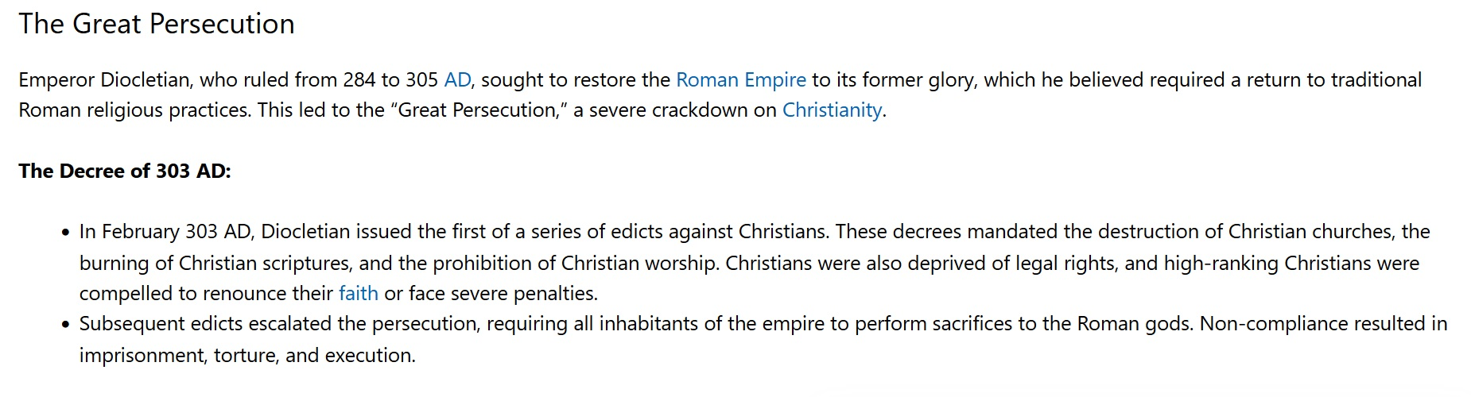
Example of government authorized persecution:

Slide 19
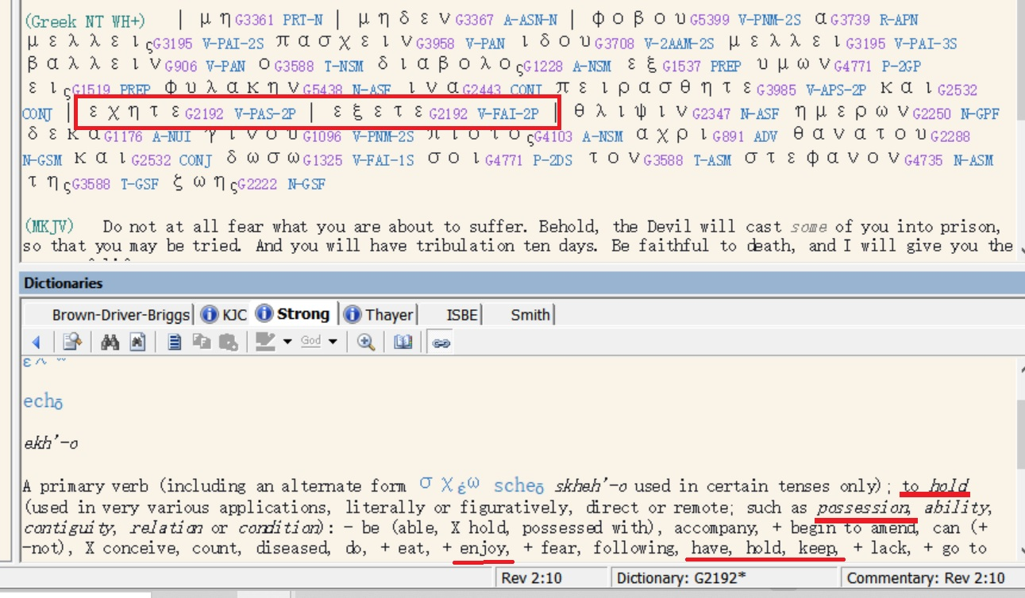

Slide 20
The imperative mood in this verse with the negative forbids the continuation of fear, their initial reaction to suffering, pressure, and disaster.
There is a principle which David enucleated in Psalm 56:3 when he said,
“What time I am afraid, I will trust in you [trusting in the Lord after recovery of fellowship].”
“Even though I walk through the valley of the shadow of death I will fear no evil, for you are with me.” )Psalms 23:3a
เมื่อข้าพระองค์กลัว ข้าพระองค์วางใจในพระองค์ (สดูดี 56:3)
แม้ข้าพระองค์จะเดินไปตามหุบเขาเงามัจจุราช ข้าพระองค์ไม่กลัวอันตรายใดๆ เพราะพระองค์ทรงสถิตกับข้าพระองค์ (สดูดี 23:4ก.)

Slide 21
วิวรณ์ 2:11
‘He who has an ear, let him hear what the Spirit says to the churches. He who overcomes [through suffering] will not be hurt by the second death [Revelation 20:14; namely the Lake of Fire: knowing this should motivate the believers under great suffering to remain faithful to the Lord].’
ὁ ἔχων οὖς ἀκουσάτω τί τὸ πνεῦµα λέγει ταῖς ἐκκλησίαις. ὁ νικῶν οὐ µὴ ἀδικηθῇ ἐκ τοῦ θανάτου τοῦ δευτέρου.
ใครมีหูก็ให้ฟังข้อความซึ่งพระวิญญาณตรัสไว้แก่คริสตจักรทั้งหลาย ผู้ที่มีชัยชนะจะไม่ได้รับอันตรายจากความตายครั้งที่สองเลย

Slide 22
Whatever suffering the believer may experience in life, it cannot be compared to the suffering of the unbeliever in the Lake of Fire for all eternity.
Even if a person should suffer martyrdom, he must bring into remembrance that the Lord has delivered him from the eternal lake of fire.
This should motivate the believer to remain loyal to the Lord Jesus Christ and to endure whatever suffering God’s plan has for him. It amounts to a drop in the ocean compared with spending all eternity in the Lake of Fire.

Slide 23
How you live is determined by your attitude toward death.
Sooner or later death will become a reality and you will discover an amazing thing: things that you thought were important, things that you spent your life doing, the pleasures you sought, your ambition to succeed and to get ahead and become famous and great and to excel above your peers, all of these things when you face death as a reality will not give you one moment of peace or blessing or courage in time of your dying.

