Slide 1
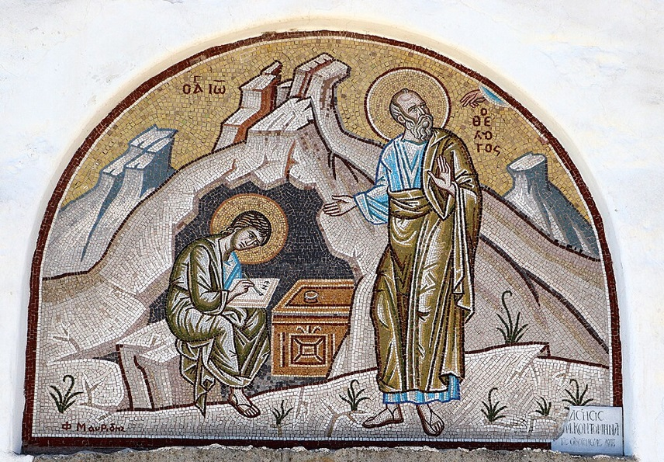
การวิเคราะห์พระธรรมวิวรณ์
สอนโดย อ.Tim จากคำบันทึกของ อ. Max Klein
REVELATION 046 2025 05 27

Slide 2
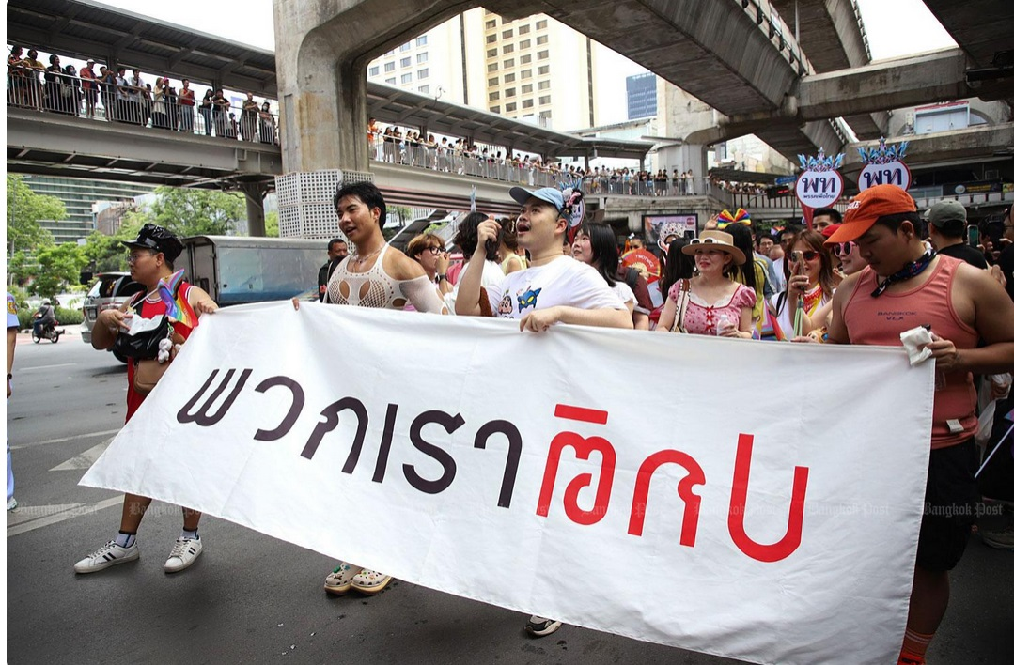

Slide 3


Slide 4
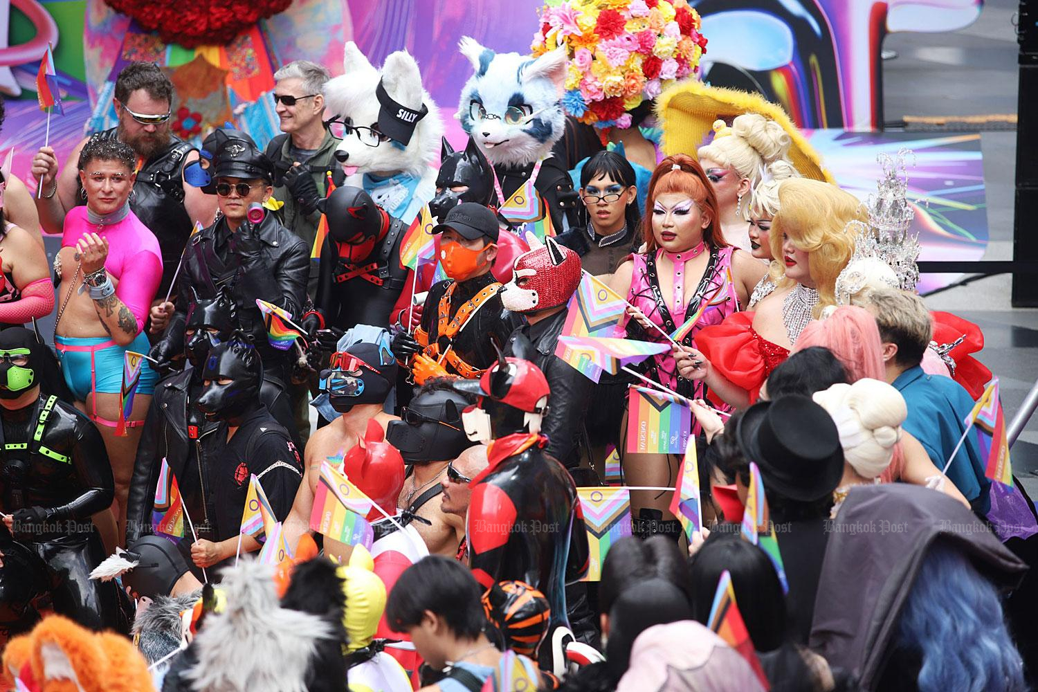

Slide 5
พระธรรมวิวรณ์ 2:10
‘Stop fearing [They were aware of the pending persecution.] that which you are about to suffer. Note that the devil is about to cast some of you into prison in order that you may be tested, and you will have special persecution ten times [ten historical persecutions from 96-305 AD]. Keep on being faithful even until death, and I [Jesus Christ] will give you the Wreath of Life.
µηδὲν φοβοῦ ἃ µέλλεις πάσχειν. ἰδοὺ µέλλει βάλλειν ὁ διάβολος ἐξ ὑµῶν εἰς φυλακὴν ἵνα πειρασθῆτε, καὶ ἕξετε θλῖψιν ἡµερῶν δέκα. γίνου πιστὸς ἄχρι θανάτου, καὶ δώσω σοι τὸν στέφανον τῆς ζωῆς.
อย่ากลัว [หยัดกลัว!]ความทุกข์ทรมานต่างๆซึ่งเจ้ากำลังจะได้รับนั้น ดูเถิด พญามารจะขังพวกเจ้าบางคนไว้ในคุกเพื่อจะลองใจเจ้า และเจ้าทั้งหลายจะได้รับความทุกข์ทรมานถึงสิบวัน แต่เจ้าจงสัตย์ซื่อจนถึงความตาย และเราจะมอบมงกุฎแห่งชีวิตให้แก่เจ้า

Slide 6
TEN DAYS OF SUFFERING:
( ημερων δεκα )
Literal vs. Symbolic Interpretations
The phrase “tribulation for ten days” has prompted debate regarding whether the duration is literal or symbolic:
• Literal Interpretation: Some propose that this was a real, short-term imprisonment-likely around ten actual days-during which believers would suffer before receiving God’s deliverance or entering eternal reward. This aligns with narratives like Daniel 1:12, which mentions a ten-day test for Daniel and his companions, though that test was dietary rather than a life-threatening tribulation.
• Symbolic Interpretation: Others see “ten days” as symbolic of a complete yet limited period of intense trial. The number ten in Scripture can represent fullness (as with the Ten Commandments or the ten plagues in Exodus). Thus, “ten days” may highlight a short but complete season of testing.

Slide 7
5. Possible Historical Fulfillments
Some commentators have attempted to trace specific Roman emperors’ persecutions as tying into ten discrete periods or edicts, citing ten notable waves of persecution in the Roman Empire.
In this case, the ten days of tribulation refer to ten persecutions that began with Emperor Nero and ended with Diocletian in the third century. Some scholars exclude Nero and count from Domitian to Julian.

Slide 8
When John wrote this in 96 AD the persecution of Christians had begun under the Emperor Domitian. From Domitian in 96 A.D. to Diocletian in 305 A.D., there would be persecution of Christians 10 times
The Ten Persecutions:
1.Domitian: 81-96 A.D
2.Marcus Aurelius: 161-180
3.Commodus: 180-192
4.Septimius Severus: 193-211
5.Maximinus Thrax: 235-238
6.Decius: 249-251
7.Gallus: 251-253
8.Valerian: 253-260
9.Aurelian: 270-275
10. Diocletian: 284-305

Slide 9
These persecutions prepared the Christians to evangelize the world, especially the barbarians.
As Tertullian put it, “the blood of the martyrs is the seed of the Church”.
The greatest missionary movement of all time in history would be sown in the blood of martyrs throughout the entire Roman empire over a period of two hundred years.
Many of these people are going to die in the most horrible way, and yet they are the basis of one of the greatest counters to Satan’s administration of the rulership of this world that history has ever known.

Slide 10
Many times, rulers of Rome tried to wipe out Christianity in the empire not realizing that they were attempting to destroy themselves and their empire for as long as there was a pivot of mature believers, Rome would continue to be the client nation to God.
In the midst of these attempts to wipe out Christianity, Christianity not only grew in the Roman Empire, but it expanded beyond its borders.
Rome survived because believers in these seven churches made decisions to reside and function inside of God’s power system, and by making those decisions SPQR as an empire continued until 476 A.D. by which time there were too many cosmic believers in the empire, and missionary activity ceased to exist.

Slide 11
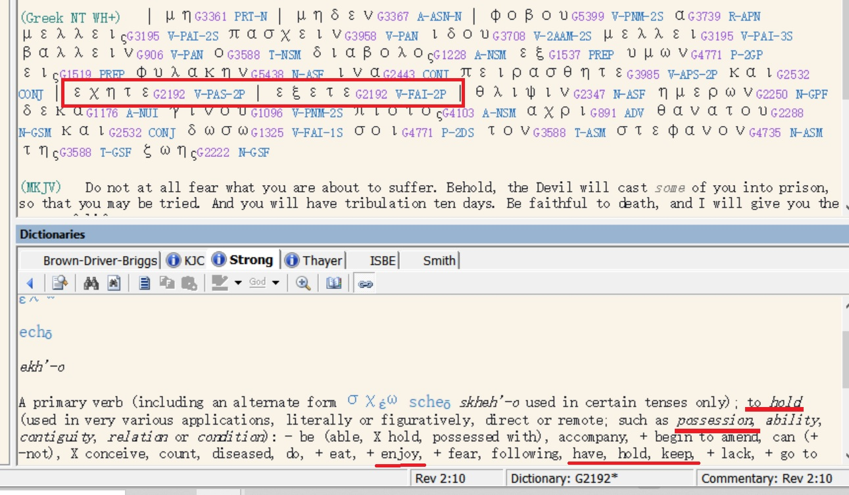

Slide 12
พระธรรมวิวรณ์ 2:10 (repeated)
‘Stop fearing [They were aware of the pending persecution.] that which you are about to suffer. Note that the devil is about to cast some of you into prison in order that you may be tested, and you will have special persecution ten times [ten historical persecutions from 96-305 AD]. Keep on being faithful even until death, and I [Jesus Christ] will give you the Wreath of Life.
µηδὲν φοβοῦ ἃ µέλλεις πάσχειν. ἰδοὺ µέλλει βάλλειν ὁ διάβολος ἐξ ὑµῶν εἰς φυλακὴν ἵνα πειρασθῆτε, καὶ ἕξετε θλῖψιν ἡµερῶν δέκα. γίνου πιστὸς ἄχρι θανάτου, καὶ δώσω σοι τὸν στέφανον τῆς ζωῆς.
อย่ากลัว[หยุดกลัว!]ความทุกข์ทรมานต่างๆซึ่งเจ้ากำลังจะได้รับนั้น ดูเถิด พญามารจะขังพวกเจ้าบางคนไว้ในคุกเพื่อจะลองใจเจ้า และเจ้าทั้งหลายจะได้รับความทุกข์ทรมานถึงสิบวัน แต่เจ้าจงสัตย์ซื่อจนถึงความตาย และเราจะมอบมงกุฎแห่งชีวิตให้แก่เจ้า

Slide 13
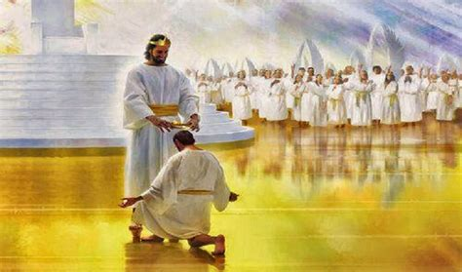

Slide 14
The imperative mood in this verse with the negative forbids the continuation of fear, their initial reaction to suffering, pressure, and disaster.
There is a principle which David enucleated in Psalm 56:3 when he said,
“What time I am afraid, I will trust in you [trusting in the Lord after recovery of fellowship].”
“Even though I walk through the valley of the shadow of death I will fear no evil, for you are with me.” )Psalms 23:3a
เมื่อข้าพระองค์กลัว ข้าพระองค์วางใจในพระองค์ (สดูดี 56:3)
แม้ข้าพระองค์จะเดินไปตามหุบเขาเงามัจจุราช ข้าพระองค์ไม่กลัวอันตรายใดๆ เพราะพระองค์ทรงสถิตกับข้าพระองค์ (สดูดี 23:4ก.)

Slide 15
How you live is determined by your attitude toward death.
Sooner or later death will become a reality and you will discover an amazing thing: things that you thought were important, things that you spent your life doing, the pleasures you sought, your ambition to succeed and to get ahead and become famous and great and to excel above your peers, all of these things when you face death as a reality will not give you one moment of peace or blessing or courage in time of your dying.

Slide 16
Now for the clause found in this verse regarding the Wreath of Life “. . . and I will give you the Wreath of Life.” The Latin ‘Corona’ was the highest decoration in the army and is the exact equivalent of the Greek ‘Stephanos’ (wreath). The Romans had many different crowns as decorations in the military namely, the ‘corona obsidionalis or grammania’, a wreath of golden strands was the highest and rarest decoration. This was given for breaking a blockade or raising a siege.

Slide 17
The ‘corona civica’ was a crown made of golden oak leaves which was awarded to a soldier who saved the life of another citizen in battle and held the ground where this deed occurred for the rest of the day.
The ‘corona navalis’ was the highest decoration in the navy for destroying an enemy fleet or the first marine to board an enemy ship.
The ‘corona muralis’ was awarded to the first soldier who scaled the wall of a besieged city.
The ‘corona vallaris’ was awarded to the first soldier to scale an enemy rampart.
The ‘corona aurea’ was a golden crown for gallantry in battle or any heroic act in battle.
The ‘corona triumphalis’ was awarded to a victorious commander.

Slide 18
Each crown included
1. monetary reward
2. freedom from taxes
3. children educated at public expense
4. a statue of the person erected in the public square
5. a home wherever you wanted it built.
There were also decorations worn around the neck, decorations on a baldric worn over the chest, and various spears as rewards.

Slide 19
When the Christian completes the spiritual life and subsequently receive the fullness of blessing from God, he will wear the both the crown (wreath) of righteousness and the crown (wreath) of life. The crown of righteousness and the crown of life go together. If you have one, you will have the other.

Slide 20
As a result of having obtained maximum capacity righteousness, the Christian will receive the wreath of righteousness as per 2 Timothy 4:7, 8:
(7) “I have fought that honorable fight [advanced through the stages of spiritual growth],
I have finished the course [Paul reached spiritual maturity and had passed Evidence Testing],
I have guarded the doctrine [as first priority in the soul].
ข้าพเจ้าได้ต่อสู้อย่างเต็มกำลัง ข้าพเจ้าได้แข่งขันจนถึงที่สุด ข้าพเจ้าได้รักษาความเชื่อไว้แล้ว

Slide 21
(2 Tim 4:8) In the future a wreath of righteousness [escrow blessings for eternity] is reserved for me [on deposit since eternity past], which the Lord, the righteous judge, will award me on that day [at the Evaluation Throne of Christ] and not only to me but to all those who love His appearing [mature believers, whose thorough understanding of doctrine enables them to be occupied with Christ],”
ตั้งแต่นี้ไป มงกุฎแห่งความชอบธรรมก็เตรียมไว้สำหรับข้าพเจ้าแล้ว ซึ่งองค์พระผู้เป็นเจ้า ผู้พิพากษาอันชอบธรรม จะทรงประทานแก่ข้าพเจ้าในวันนั้น และมิใช่แก่ข้าพเจ้าผู้เดียวเท่านั้น แต่จะทรงประทานแก่คนทั้งปวงที่รักการเสด็จมาของพระองค์

Slide 22
...and the wreath of life as per James 1:12,
“Happy is the believer who endures testing [passes the three categories of undeserved suffering] for having become approved [at his evaluation after the Rapture], he shall receive the wreath of life, which He [the Lord] has promised to those who love Him [enduring devotion and respect for the Lord Jesus Christ].”
ความสุขย่อมมีแก่คนนั้นที่สู้ทนการทดลอง เพราะเมื่อปรากฏว่าผู้นั้นทนได้แล้ว เขาจะได้รับมงกุฎแห่งชีวิต ซึ่งองค์พระผู้เป็นเจ้าได้ทรงสัญญาไว้แก่คนทั้งหลายที่รักพระองค์

Slide 23
วิวรณ์ 2:11
‘He who has an ear, let him hear what the Spirit says to the churches. He who overcomes [through suffering] will not be hurt by the second death [Revelation 20:14; namely the Lake of Fire: knowing this should motivate the believers under great suffering to remain faithful to the Lord].’
ὁ ἔχων οὖς ἀκουσάτω τί τὸ πνεῦµα λέγει ταῖς ἐκκλησίαις. ὁ νικῶν οὐ µὴ ἀδικηθῇ ἐκ τοῦ θανάτου τοῦ δευτέρου.
ใครมีหูก็ให้ฟังข้อความซึ่งพระวิญญาณตรัสไว้แก่คริสตจักรทั้งหลาย ผู้ที่มีชัยชนะจะไม่ได้รับอันตรายจากความตายครั้งที่สองเลย

Slide 24
Whatever suffering the believer may experience in life, it cannot be compared to the suffering of the unbeliever in the Lake of Fire for all eternity.
Even if a person should suffer martyrdom, he must bring into remembrance that the Lord has delivered him from the eternal lake of fire.
This should motivate the believer to remain loyal to the Lord Jesus Christ and to endure whatever suffering God’s plan has for him. It amounts to a drop in the ocean compared with spending all eternity in the Lake of Fire.

Slide 25
Removing Fear from Death:
1. Bible doctrine resident in the soul removes fear of death as well as fear of life.
2. The believer having executed the spiritual life is not afraid of torture and death. That means that martyrdom is never in vain. Martyrdom without renouncing Christ, is one of the greatest rewardable functions in eternity. At the very least, he will receive the Wreath of Life.
3. Before Constantine the Roman empire was many times evangelized through dying testimony; after Constantine it was generally evangelized through living testimony. In history it takes both. Dying testimony requires, like living testimony, that Bible doctrine is more real than anything in life. Otherwise, when called upon to live or die for the Lord Jesus Christ, he can’t do it. .

Slide 26
4. The success standards of life must be replaced by the success standards of God’s plan. And the judgment seat of Christ will reveal that many people who have a comparatively humble station in life in the Lord’s eyes were the great heroes and heroines of history.
5. Only through Bible doctrine can God and His plan be more real than people, ambitions, situations, and pleasures. Beware that you do not function in life according to human viewpoint, on the basis of rationalizing doctrine to fit your ambitions and functions in life. The divine viewpoint must override peer pressure, and arrogant ambition must be replaced by doctrinal perception. When that happens and you fulfil the principle of being faithful, even unto death, there will be a special, super reward for you in heaven.

Slide 27
4. The success standards of life must be replaced by the success standards of God’s plan. And the judgment seat of Christ will reveal that many people who have a comparatively humble station in life in the Lord’s eyes were the great heroes and heroines of history.
5. Only through Bible doctrine can God and His plan be more real than people, ambitions, situations, and pleasures. Beware that you do not function in life according to human viewpoint, on the basis of rationalizing doctrine to fit your ambitions and functions in life. The divine viewpoint must override peer pressure, and arrogant ambition must be replaced by doctrinal perception. When that happens and you fulfil the principle of being faithful, even unto death, there will be a special, super reward for you in heaven.

Slide 28
The doctrine of the Judgment Seat of Christ:
1. The judgment seat of Christ or the evaluation of believers occurs at the termination of the Church Age. It follows the receiving of a resurrection body. (Whether a believer succeeds or fails he will have a resurrection body)
2. The purpose of the Judgment Seat of Christ, 2 Corinthians 5:10, “For we must all appear before the judgment seat of Christ; that each one of us [believers in the royal family of God] may receive what is due him for the things accomplished while in the physical body, whether good or worthless.” If the believer lives his Christian life inside the cosmic system what he accomplishes is worthless or evil or both. On the other hand, if the believer lives his Christian life under the omnipotence of God namely the two power options what he does is categorized as intrinsic good and is rewardable.

Slide 29
3. The loss of reward at the judgment seat of Christ is a major issue. The gain or loss of reward and blessing above and beyond the resurrection body is determined by your personal volition in time, 1 Corinthians 3:11-15,
“For no man can lay a foundation other than the one which is laid which is Jesus Christ [only one way of salvation]. (12) Now if any man builds on the foundation with gold, silver, precious stones, wood, hay, straw, [production of Christian service while out of fellowship], (13) each man’s work [Christian work or production] will become evident; for the day [evaluation seat of Christ after the Rapture] will show it because it is to be revealed by fire, in fact the fire itself will test the quality of each man’s work. (14) If any man’s work which he has built upon it [the foundation] remains, he will receive a reward. (15) If any man’s work is burned up, he will suffer loss [of his escrow blessing for eternity], but he himself will be delivered, yet so as [the believer does not go through, but he will think that he did] through fire.”

Slide 30
4. Loss of reward at the Judgment Seat of Christ does not imply loss of salvation, 2 Timothy 2:11-13:
“Faithful is the Word. If we died with him and we have [retroactive and current positional sanctification], we will live with him. (12). If we endure [keep advancing spiritually through the pressures of life], we will rule with him [in the millennium]. If we deny him [reject the thinking of Christ as found in the Word], he will deny us [rewards in eternity]. (13) If we are unfaithful [no integrity], he remains faithful for he cannot deny himself [our being in union with him; he cannot deny His integrity].”

Slide 31
5. James 1:12, “Happy is the believer who endures testing [passes the three categories of undeserved suffering] for having become approved [at his evaluation after the Rapture], he shall receive the wreath of life, which He [the Lord] has promised to those who love Him [enduring devotion and respect for the Lord Jesus Christ].”

Slide 32
6. Therefore the application of virtue to the judgment seat of Christ. Romans 14:10-13, “You there [the weak believer who lives in the cosmic system], why do you judge your brother? [Principle of the weak controlling the strong] or you also [the strong believer] why do you regard your brother with contempt [lack of toleration and impersonal love]? for all will stand before the Evaluation Seat of God. (11) For it stands written [Isaiah 45:23], For surely as I live, says the Lord, every knee will bow to me [the big genuflect after the Rapture of the Church], and every tongue will give praise to God. (12) So, then each one of us [Church Age believers] shall give an account to God concerning himself [at the Judgment (Evaluation) Seat of Christ]. (13) Therefore, let us no longer judge one another: but rather make up your mind, [determine this] not to place an obstacle or distraction in front of his brother.”

Slide 33
7. An athletic analogy to the judgment seat of Christ. 2 Corinthians 2:5
“Now if anyone really competes in the athletic games, he does not receive a winner’s wreath unless he trains according to the rules.” The Christian is not going to receive the winner’s wreath at the Evaluation Seat of Christ unless he plays according to the rules set-up by the Father for the spiritual life. We have the cosmic believer who doesn’t train according to the rules, and we have the advancing believer who does. Not only did the Roman athlete live inside the gymnasium for ten months but also followed a set of very strict rules which constantly tested his motivation, his decisions, and his momentum. The concept of perception of doctrine in the divine power system is analogous. Once the athletes went back to their hometowns, they received rewards which are analogous to the rewards received by the Christian at the Judgment Seat of Christ.

Slide 34
Then Paul goes on to say in 1 Corinthians 9:24-27, “Do you not know that those who run in a race all run [analogous to the games in the Roman empire], but one receives the prize [in each event]? Run in such a way that you may win. (25) And everyone who competes in the games exercises self-discipline in all things. They [the athletes] do it to receive a perishable wreath [or crown]; but we [mature believers] an imperishable crown. (26) Therefore [Paul’s application] I do not run like a person without an objective; I do not fight like a person beating the air [cosmic believers are shadow boxers] (27) Instead, I discipline my body, and keep it in training [residence and function in God’s power system] lest having preached [communicated doctrine] to others, I myself should be disqualified” [disqualification from both temporal blessing and eternal reward at the judgment seat of Christ].

