Slide 1
神的道是活泼的、是有功效的、比一切两刃的剑更快、
甚至魂与灵、骨节与骨髓、都能刺入剖开、
连心中的思念和主意、都能辨明。
（希伯来书 4:12）
​
圣经都是神所默示的、（或作凡神所默示的圣经）於教训、
督责、使人归正、教导人学义、都是有益的。
叫属神的人得以完全、豫备行各样的善事。
（提摩太后书 3:16-17）
​
你当竭力、在神面前得蒙喜悦、作无愧的工人、
按着正意分解真理的道。
（提摩太后书 2:15）

Slide 2
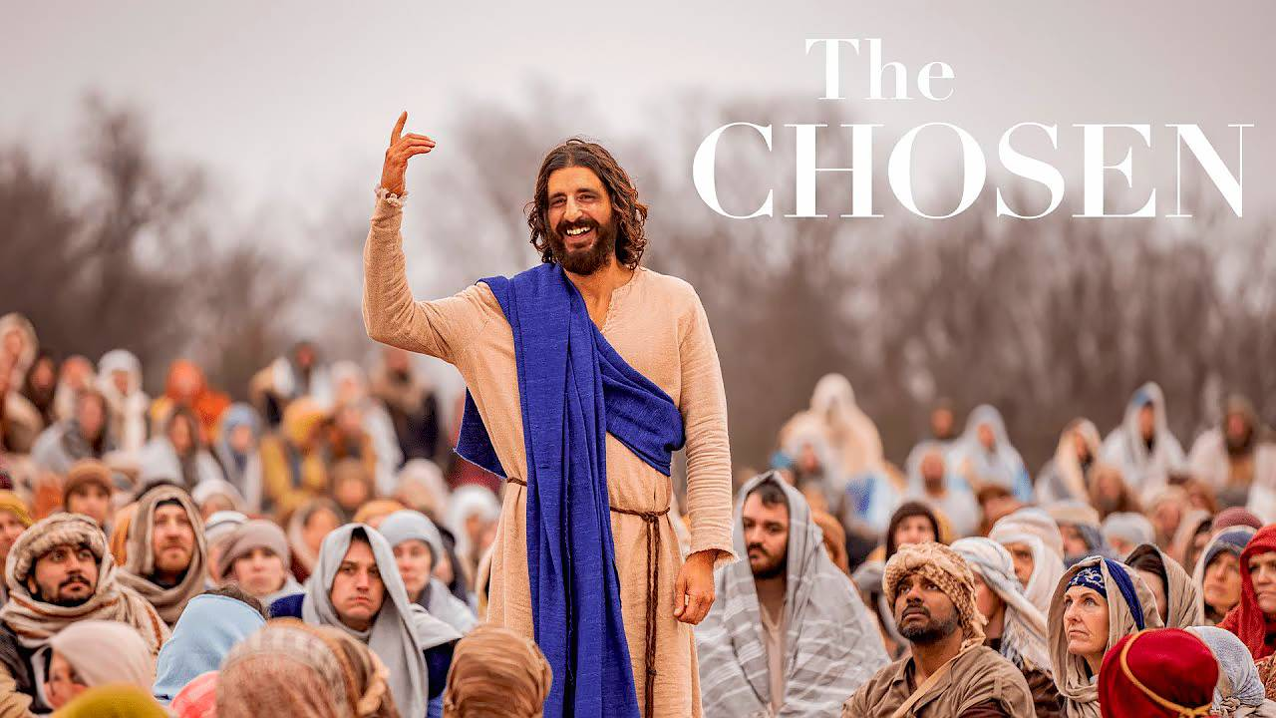

Slide 3
系列：属灵生命概论
Series:
Outline of the Spiritual Life
05 / 2025 05 28

Slide 4
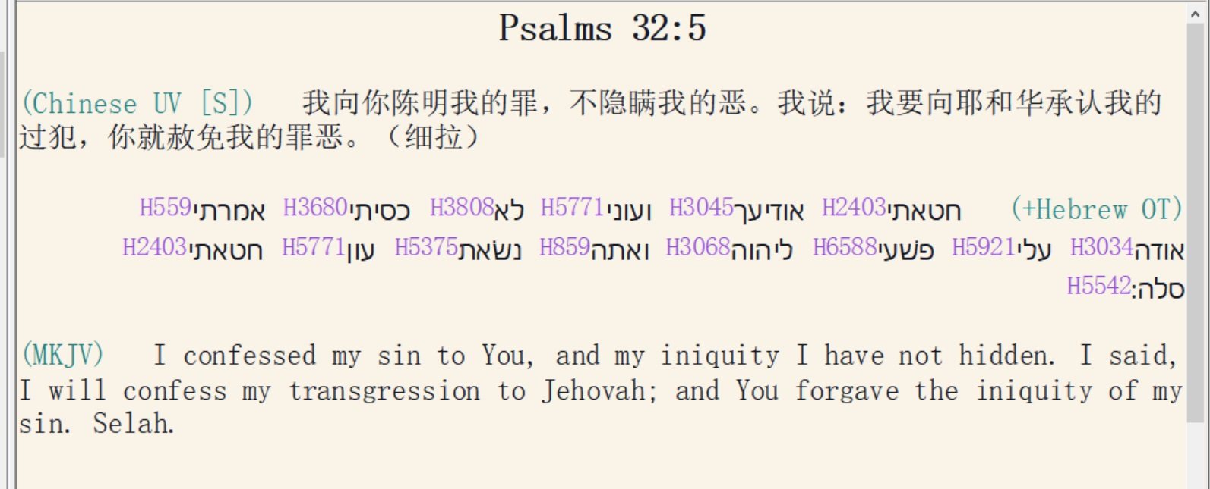

Slide 5
约翰一书 1：9 / 1 John 1:9
我们若认自己的罪，神是信实的，是公义的，因此必要赦免我们的罪，洗净我们一切的不义。
If we name our sins, He is faithful and just to forgive us our sins, and to cleanse us from all unrighteousness.

Slide 6
The Bible is our text book.
圣经就是我们的课本
It is the inerrant Word of God
(Heb. 4:12)
圣经是神的话语，绝对无误
（希伯来书 4:12）

Slide 7
1. Inerrant only in the original manuscripts.
唯有圣经原本是绝对无误
2. Must be correctly exegeted and presented to the hearer.
必须正确地解释并呈现给听者
3. Must be believed to be effective.
必须加以相信才能产生果效

Slide 8
66 Books of the Bible:
Written by men inspired by the Holy Spirit.
“For no prophecy was ever made by an act of human will, but men moved by the Holy Spirit spoke from God” (2 Pet. 1:21)
因为预言从来没有出於人意的，乃是人被圣灵感动，说出神的话来。（彼得后书 1:21）

Slide 9
For the word of God to become effective it must be accepted as true.
要使神的话生效，必须承认神的话就是真理
Faith 信心
Belief 信仰
Making a decision to accept the information.
决定接受信息
“Positive Volition” “积极意志” （+V）

Slide 10

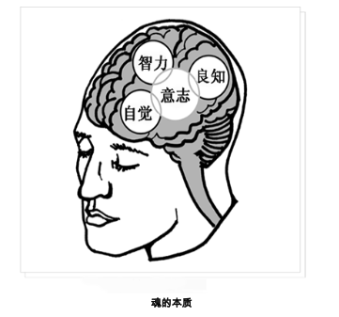
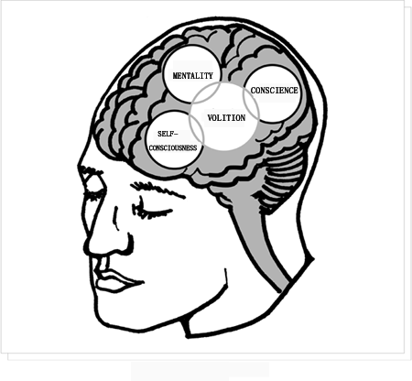

Slide 11
Everybody has faith.

Slide 12
What is important is what you accept
[choose/ +V] as the object of your faith.

Slide 13
With faith, the merit is in the object, not the subject of faith.
With works the merit is in the subject.
[Works = religion, good deeds, ‘making merit’],

