Slide 1
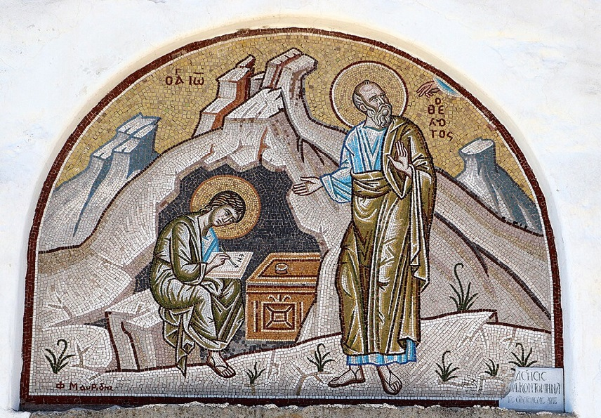
การวิเคราะห์พระธรรมวิวรณ์
สอนโดย อ.Tim จากคำบันทึกของ อ. Max Klein
REVELATION 049 2025 06 10

Slide 2
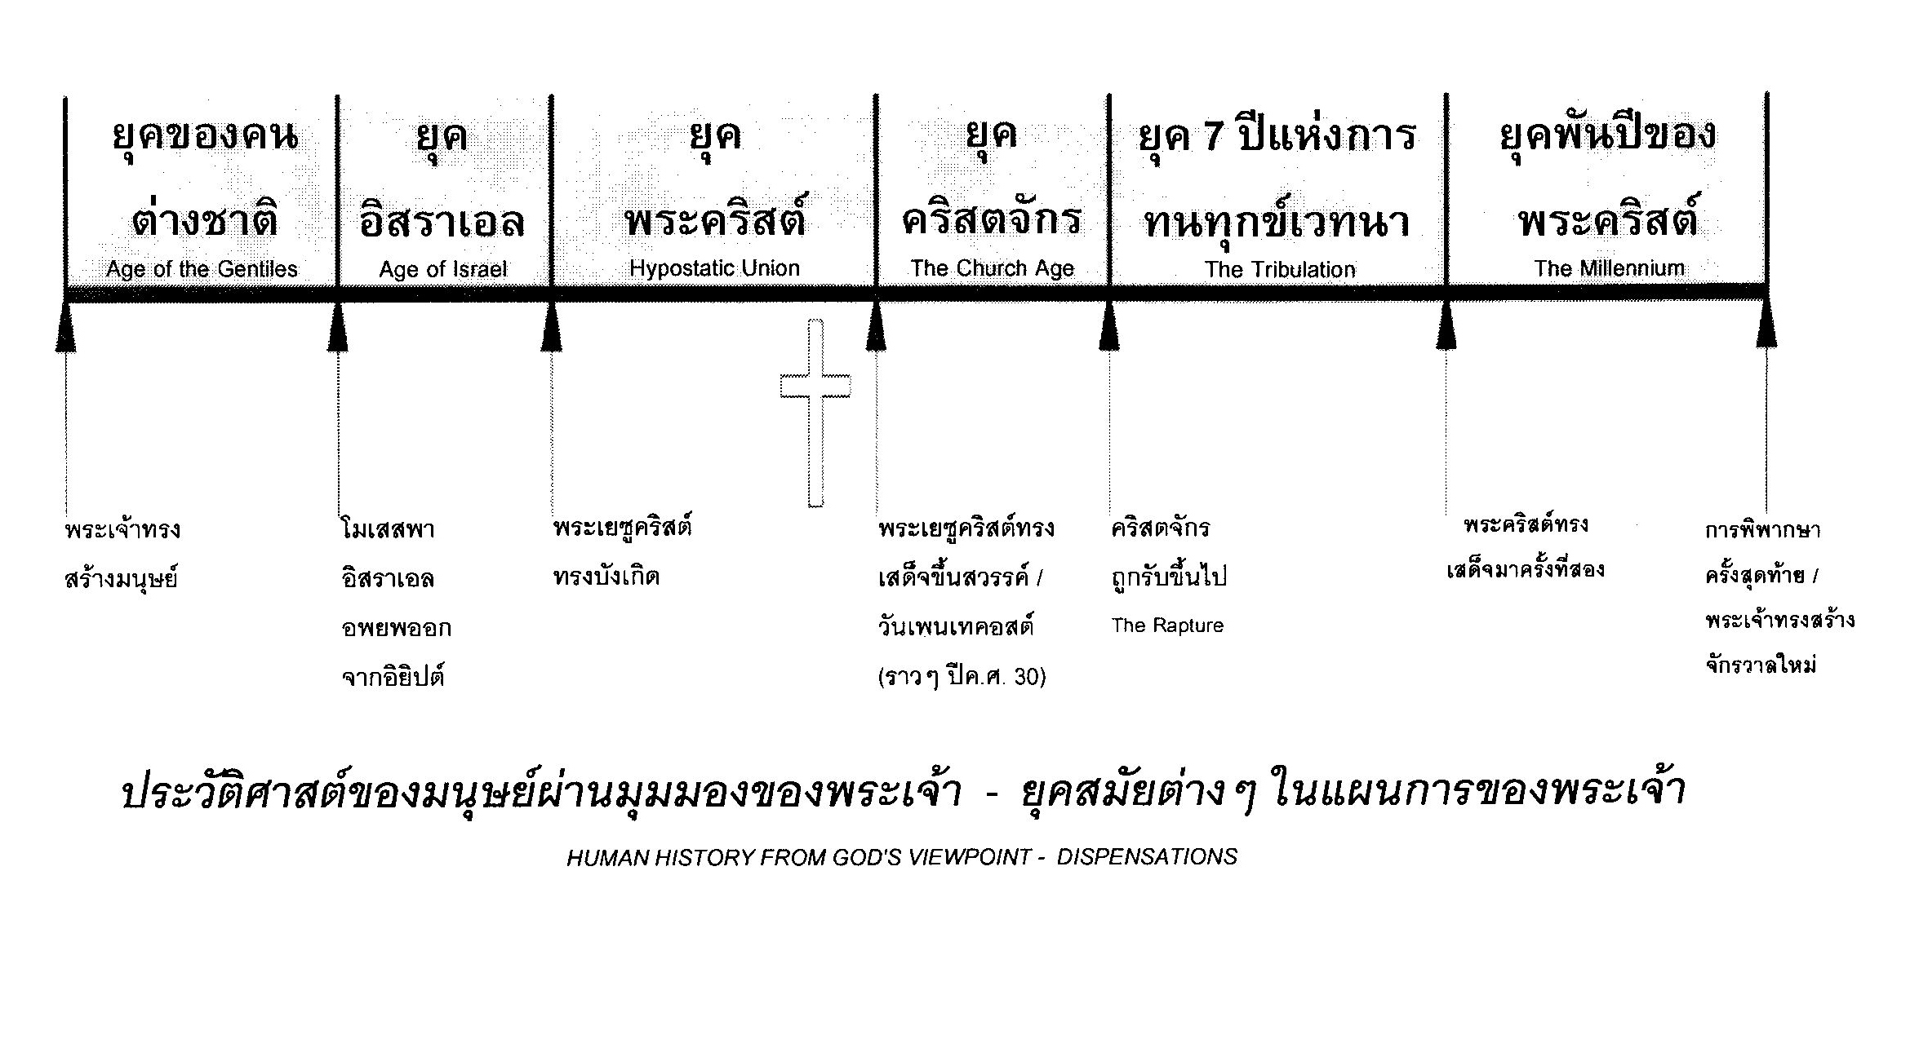

Slide 3
The doctrine of the Judgment Seat of Christ:
1. The judgment seat of Christ or the evaluation of believers occurs at the termination of the Church Age. It follows the receiving of a resurrection body. (Whether a believer succeeds or fails he will have a resurrection body)
2. The purpose of the Judgment Seat of Christ, 2 Corinthians 5:10, “For we must all appear before the judgment seat of Christ; that each one of us [believers in the royal family of God] may receive what is due him for the things accomplished while in the physical body, whether good or worthless.”
“เพราะว่าจำเป็นที่เราทุกคนจะต้องปรากฏตัวที่หน้าบัลลังก์พิพากษา βῆμα / bema บัลลังก์แห่งการฟังผลการประเมิน] ของพระคริสต์ เพื่อทุกคนจะได้รับสมกับการที่ได้ประพฤติในร่างกายนี้ แล้วแต่จะดีหรือชั่ว
If the believer lives his life inside the cosmic system what he accomplishes is worthless or evil or both. On the other hand, if the believer lives his Christian life under the omnipotence of God namely the two power options what he does is categorized as intrinsic good and is rewardable.

Slide 5
3. The loss of reward at the judgment seat of Christ is a major issue. The gain or loss of reward and blessing above and beyond the resurrection body is determined by your personal volition in time (1 Corinthians 3:11-15)
4. Loss of reward at the Judgment Seat of Christ does not imply loss of salvation,
2 Timothy 2:11-13:
“Faithful is the Word. If we died with him and we have [retroactive and current positional sanctification], we will live with him. (12). If we endure [keep advancing spiritually through the pressures of life], we will rule with him [in the millennium]. If we deny him [reject the thinking of Christ as found in the Word], he will deny us [rewards in eternity]. (13) If we are unfaithful [no integrity], he remains faithful for he cannot deny himself [our being in union with him; he cannot deny His integrity].”
2 ทิโมธิ 2:11-13 คำนี้เป็นคำสัตย์จริง คือถ้าเราตายกับพระองค์ เราก็จะมีชีวิตอยู่กับพระองค์เช่นกัน 2:12 ถ้าเราทนความทุกข์ทรมาน เราก็จะได้ครองร่วมกับพระองค์ด้วย ถ้าเราปฏิเสธพระองค์ พระองค์ก็จะปฏิเสธเราเช่นเดียวกัน 13 ถ้าเราไม่เชื่อ พระองค์ก็ยังทรงไว้ซึ่งความสัตย์ซื่อ เพราะพระองค์จะปฏิเสธพระองค์เองไม่ได้

Slide 6
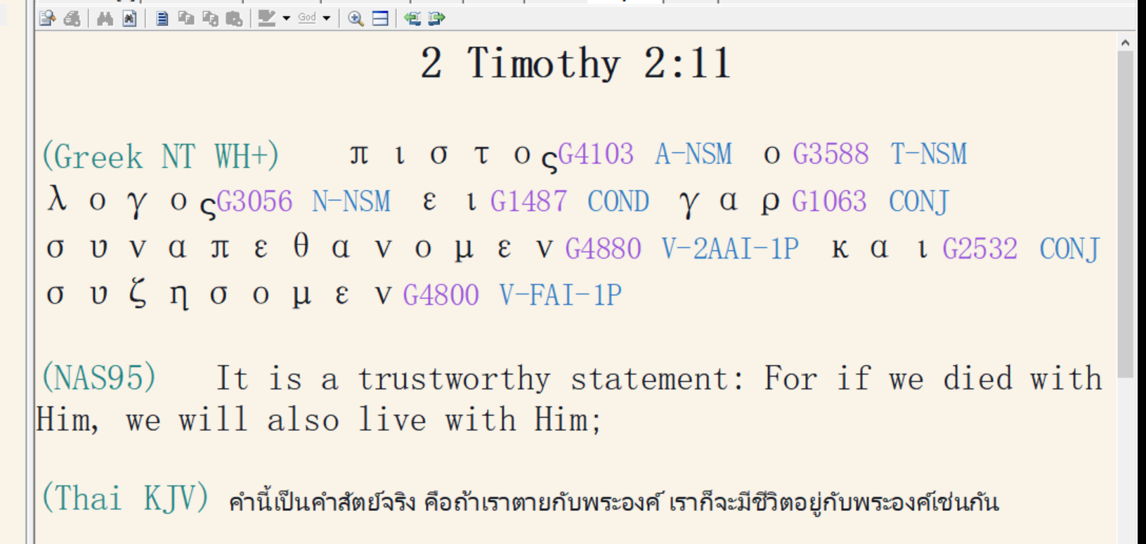

Slide 7
Romans 14:10-13,
“You there [the weak believer who lives in the cosmic system], why do you judge your brother? [Principle of the weak controlling the strong] or you also [the strong believer] why do you regard your brother with contempt [lack of toleration and impersonal love]? for all will stand before the Evaluation Seat of God.
(11) For it stands written [Isaiah 45:23], For surely as I live, says the Lord, every knee will bow to me [the big genuflect after the Rapture of the Church], and every tongue will give praise to God.
โรม 14:10-13
แต่ตัวท่านเล่า เหตุไฉนท่านจึงกล่าวโทษพี่น้องของท่าน หรือเหตุไฉนท่านจึงดูหมิ่นพี่น้องของท่าน เพราะว่าเราทุกคนต้องยืนอยู่หน้าบัลลังก์พิพากษาของพระคริสต์
11 เพราะมีคำเขียนไว้ว่า `องค์พระผู้เป็นเจ้าได้ตรัสว่า "เรามีชีวิตอยู่ฉันใด หัวเข่าทุกหัวเข่าจะต้องคุกกราบลงต่อเรา และลิ้นทุกลิ้นจะต้องร้องสรรเสริญพระเจ้า"'

Slide 8
(12) So, then each one of us [Church Age believers] shall give an account to God concerning himself [at the Judgment (Evaluation) Seat of Christ]. (13) Therefore, let us no longer judge one another: but rather make up your mind, [determine this] not to place an obstacle or distraction in front of his brother.”
โรม 12 ฉะนั้นเราทุกคนจะต้องทูลเรื่องราวของตัวเองต่อพระเจ้า 13 ดังนั้นเราอย่ากล่าวโทษกันและกันอีกเลย แต่จงตัดสินใจเสียดีกว่า คืออย่าให้ผู้หนึ่งผู้ใดวางสิ่งซึ่งให้สะดุด หรือสิ่งซึ่งเป็นเหตุให้ล้มลงไว้ต่อหน้าพี่น้อง

Slide 9
7. An athletic analogy to the judgment seat of Christ. “Now if anyone really competes in the athletic games, he does not receive a winner’s wreath unless he trains according to the rules.”
และถ้าผู้ใดจะเข้าแข่งขันกัน เขาก็คงมิได้สวมมงกุฎ เว้นเสียแต่เขาได้ปฏิบัติตามกฎ
(2 ทิโมธิ 2:5)
The Christian is not going to receive the winner’s wreath at the Evaluation Seat of Christ unless he plays according to the rules [commands of scripture for Church Age believers] set-up by the Father.
Not only did the Roman athlete live inside the gymnasium for ten months but also followed a set of very strict rules which constantly tested his motivation, his decisions, and his momentum.
Once the athletes went back to their hometowns, they received rewards which are analogous to the rewards received by the Christian at the Judgment Seat of Christ.

Slide 10
1Co. 9:24 “Do you not know that those who run in a race [stadios = stadium] all run [analogous to the games in the Roman empire*], but one receives the prize [in each event]? Run in such a way that you may win.
(25) And everyone who competes in the games exercises self-discipline in all things. They [the athletes] do it to receive a perishable wreath [or crown]; but we [mature believers] an imperishable crown.
1 คร. 9:24 ท่านไม่รู้หรือว่าคนเหล่านั้นที่วิ่งแข่งกัน ก็วิ่งด้วยกันทุกคน แต่คนที่ได้รับรางวัลมีคนเดียว เหตุฉะนั้นจงวิ่งเพื่อชิงรางวัลให้ได้
1 คร. 9:25 ฝ่ายนักกีฬาทุกคนก็เคร่งครัดในระเบียบทุกอย่าง แล้วเขากระทำอย่างนั้นเพื่อจะได้มงกุฎใบไม้ซึ่งร่วงโรยได้ แต่เรากระทำเพื่อจะได้มงกุฎที่ไม่มีวันร่วงโรยเลย

Slide 11
To ‘run in a race’ means to run in a stadium literally, and it refers to different areas of athletic games in the ancient world.
1. the Olympic games: Originated around 800 B.C. ‘by Zeus’ though had been dead during the late Roman republic and the early part of the Roman empire but they were revived by Herod the Great, then declared pagan practice and stopped by Christian emporers around 400 A.D. The Olympic games were revived beginning around the early 1800s.
2. the Corinthian games, also called the Isthmus games.
3. the Pythian games
4. the Nemian games.
5. the Panathenaic Games, an ancient Greek athletic festival held in honor of the goddess Athena
Paul is very clear that he is talking about the athletes here because he says, “they which run in the stadium.” The stadium refers to the beautiful stadium just outside of Corinth on the Isthmus.

Slide 12
1Co 9:26 “ Therefore [Paul’s [application] I do not run like a person without an objective; I do not fight like a person beating the air [cosmic believers are shadow boxers] (27) Instead, I discipline my body, and keep it in training [residence and function in God’s power system] lest having preached [communicated doctrine] to others, I myself should be disqualified” [disqualification from both temporal blessing and eternal reward at the judgment seat of Christ].
1 คร. 9:26 ดังนั้นส่วนข้าพเจ้าวิ่งแข่งอย่างนี้โดยมีเป้าหมาย ข้าพเจ้าได้ต่อสู้อย่างนี้ ไม่ใช่อย่างนักมวยที่ชกลม
1 คร. 9:27 แต่ข้าพเจ้าระงับความปรารถนาฝ่ายเนื้อหนังให้อยู่ใต้บังคับ เพราะเกรงว่าโดยทางหนึ่งทางใดเมื่อข้าพเจ้าได้ประกาศแก่คนอื่นแล้ว ตัวข้าพเจ้าเองจะเป็นคนที่ใช้การไม่ได้

Slide 13
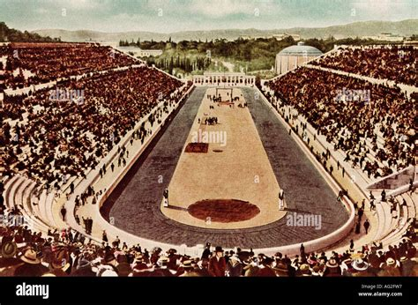

Slide 14
Message to Pergamum:
`2:12. “And to the messenger [the pastor] of the church in Pergamum write: The One who has the sharp two-edged sword [Rhomphaia] says this:
Καὶ τῷ ἀγγέλῳ τῆς ἐν Περγάµῳ ἐκκλησίας γράψον· Τάδε λέγει ὁ ἔχων τὴν ῥοµφαίαν τὴν δίστοµον τὴν ὀξεῖαν·
วิวรณ์ 2:12 จงเขียนถึงทูตสวรรค์แห่งคริสตจักรที่เมืองเปอร์กามัมว่า `พระองค์ผู้ทรงถือดาบสองคมที่คมกริบตรัสดังนี้ว่า

Slide 15
At the time of writing, Pergamos was the medical center of the Roman empire and was a famous university town. It was also the center for the phallic cult in that part of the world.
In addition to the manufacture of its parchment Pergamos was famous for its pottery, its tapestries, and the greatest perfumes in the Roman empire. It was also a source for silver and therefore was a source of coinage for the Roman empire.

Slide 16
The Roman Empire was a confederation of cities.
One thing about the Roman empire: they had literally thousands of cities in the empire, and they allowed the citizens of the city to manage their own affairs. That was Caesar’s idea. They had provincial governors acting as a general supervisor in large cities like Ephesus.
The peoples of the Roman empire considered themselves citizens of a particular city, and thus they lost racial identity and racial prejudice. Therefore, a person considered himself an Alexandrian, an Athenian, a Corinthian, a Philippian, etc.
They were all races and of different colors of skin, but they were all citizens of their city and they just simply had no major problem with racial prejudice.

Slide 17
The state of the cities plus their prosperity was the index for the condition of the Roman empire, and when something went wrong with the cities the empire went down; when the cities prospered the empire went up.
Obviously, the cities are necessary for the existence and the stability of local churches. In those cities you had large groups of people. So, the apostle Paul, the apostle John, and Peter and many others went to the cities where they evangelized and taught the spiritual life. This would eventuate in the Roman empire becoming a strong client nation to God and a base for missionary activity outside the Roman empire to the entire world.
What held the Roman empire together, then, was the triumph of Christianity. Christianity was in the cities, and while in the rural populations they would cling to the ancient religions, generally in all the large cities Christianity became the factor. The country folk had to come to the cities to participate in their religious worship and in the cities, they were evangelized.

Slide 18
2:13. ‘I know where you dwell, where Satan’s throne is [possibly related to the altar of Zeus]; and you hold fast My name and did not deny My doctrine even in the days of Antipas [during the reign of Domitian], My witness [in the Angelic Appeal Trial], My faithful one [he remained faithful in his martyrdom] who was murdered among you, where Satan dwells.
Οἶδα ποῦ κατοικεῖς, ὅπου ὁ θρόνος τοῦ Σατανᾶ, καὶ κρατεῖς τὸ ὄνοµά µου, καὶ οὐκ ἠρνήσω τὴν πίστιν µου καὶ ἐν ταῖς ἡµέραις Ἀντιπᾶς ὁ µάρτυς µου ὁ πιστός µου, ὃς ἀπεκτάνθη παρí ὑµῖν, ὅπου ὁ Σατανᾶς κατοικεῖ.
วิวรร์2:13 เรารู้จักแนวการกระทำของเจ้า เรารู้จักที่อยู่ของเจ้าคือเป็นที่นั่งของซาตาน เจ้ายึดนามของเราไว้มั่น และไม่ปฏิเสธความเชื่อในเรา แม้ในเวลาที่อันทีพาผู้เป็นพยานที่สัตย์ซื่อของเรา ต้องถูกฆ่าในท่ามกลางพวกเจ้าในที่ซึ่งซาตานอยู่

Slide 19
“I know where you dwell” is the function of the omniscience of God in eternity past before man existed. The omniscience of God knew every thought, every motive, every action, every function of every person in history. And the omniscience of God entered that information into the computer of divine decrees. He also knew the alternatives, the things that didn’t happen but could have happened, had each individual made different decisions at different times. But it is the printout for Pergamos that is in view when He says: “I know.” The indicative mood is declarative for an accurate assessment of the situation which contributes to the doctrine of historical trends.

