Slide 1
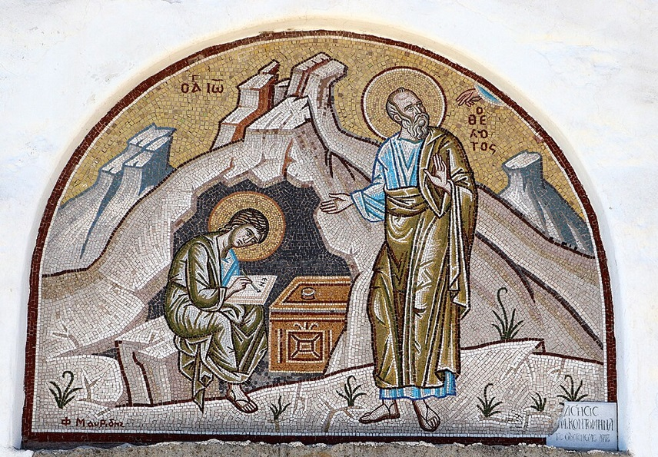
การวิเคราะห์พระธรรมวิวรณ์ สอนโดย อ.Tim จากคำบันทึกของ อ. Max Klein
REVELATION 047 2025 06 03

Slide 2
Now for the clause found in this verse regarding the Wreath of Life “. . . and I will give you the Wreath of Life.” The Latin ‘Corona’ was the highest decoration in the army and is the exact equivalent of the Greek ‘Stephanos’ (wreath). The Romans had many different crowns as decorations in the military namely, the ‘corona obsidionalis or grammania’, a wreath of golden strands was the highest and rarest decoration. This was given for breaking a blockade or raising a siege.

Slide 3
The ‘corona civica’ was a crown made of golden oak leaves which was awarded to a soldier who saved the life of another citizen in battle and held the ground where this deed occurred for the rest of the day.
The ‘corona navalis’ was the highest decoration in the navy for destroying an enemy fleet or the first marine to board an enemy ship.
The ‘corona muralis’ was awarded to the first soldier who scaled the wall of a besieged city.
The ‘corona vallaris’ was awarded to the first soldier to scale an enemy rampart.
The ‘corona aurea’ was a golden crown for gallantry in battle or any heroic act in battle.
The ‘corona triumphalis’ was awarded to a victorious commander.

Slide 4
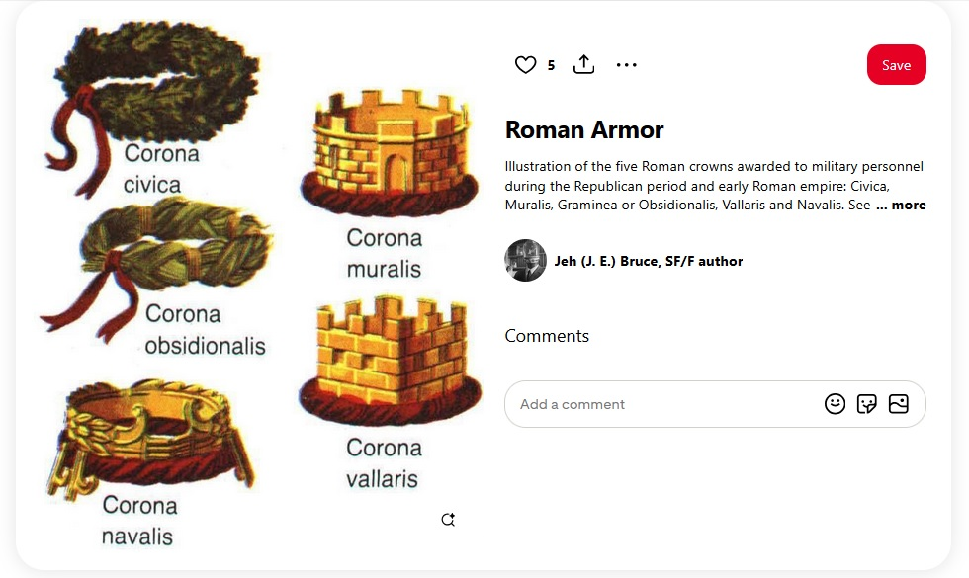

Slide 5
Each crown included
1. monetary reward
2. freedom from taxes
3. children educated at public expense
4. a statue of the person erected in the public square
5. a home wherever you wanted it built.
There were also decorations worn around the neck, decorations on a baldric worn over the chest, and various spears as rewards.

Slide 6
When the Christian completes the spiritual life and subsequently receive the fullness of blessing from God, he will wear the both the crown (wreath) of righteousness and the crown (wreath) of life. The crown of righteousness and the crown of life go together. If you have one, you will have the other.

Slide 7
As a result of having obtained maximum capacity righteousness, the Christian will receive the wreath of righteousness as per 2 Timothy 4:7, 8:
(7) “I have fought that honorable fight , I have finished the course, I have guarded the doctrine .
ข้าพเจ้าได้ต่อสู้อย่างเต็มกำลัง ข้าพเจ้าได้แข่งขันจนถึงที่สุด ข้าพเจ้าได้รักษาความเชื่อไว้แล้ว

Slide 8
2 Timothy 4:7 (expanded)
1. I have fought that honorable fight / ข้าพเจ้าได้ต่อสู้อย่างเต็มกำลัง / τον καλον αγωνα ηγωνισμαι = advanced through the stages of spiritual growth
2. I have finished the course / ข้าพเจ้าได้แข่งขันจนถึงที่สุด / τον δρομον τετελεκα = Paul reached spiritual maturity and had passed Evidence Testing,
3. I have guarded the doctrine / ข้าพเจ้าได้รักษาความเชื่อไว้แล้ว / την πιστιν τετηρηκα = remained faithful to the principles and commands of Scripture.

Slide 9
(2 Tim 4:8) In the future a wreath of righteousness [escrow blessings for eternity] is reserved for me [on deposit since eternity past], which the Lord, the righteous judge, will award me on that day [at the Evaluation Throne of Christ] and not only to me but to all those who love His appearing [mature believers, whose thorough understanding of doctrine enables them to be occupied with Christ],”
ตั้งแต่นี้ไป มงกุฎแห่งความชอบธรรมก็เตรียมไว้สำหรับข้าพเจ้าแล้ว ซึ่งองค์พระผู้เป็นเจ้า ผู้พิพากษาอันชอบธรรม จะทรงประทานแก่ข้าพเจ้าในวันนั้น และมิใช่แก่ข้าพเจ้าผู้เดียวเท่านั้น แต่จะทรงประทานแก่คนทั้งปวงที่รักการเสด็จมาของพระองค์

Slide 10
...and the wreath of life as per James 1:12,
“Happy is the believer who endures testing [passes the three categories of undeserved suffering] for having become approved [at his evaluation after the Rapture], he shall receive the wreath of life, which He [the Lord] has promised to those who love Him [enduring devotion and respect for the Lord Jesus Christ].”
ความสุขย่อมมีแก่คนนั้นที่สู้ทนการทดลอง เพราะเมื่อปรากฏว่าผู้นั้นทนได้แล้ว เขาจะได้รับมงกุฎแห่งชีวิต ซึ่งองค์พระผู้เป็นเจ้าได้ทรงสัญญาไว้แก่คนทั้งหลายที่รักพระองค์

Slide 11
วิวรณ์ 2:11
‘He who has an ear, let him hear what the Spirit says to the churches. He who overcomes [through suffering] will not be hurt by the second death [Revelation 20:14; namely the Lake of Fire: knowing this should motivate the believers under great suffering to remain faithful to the Lord].’
ὁ ἔχων οὖς ἀκουσάτω τί τὸ πνεῦµα λέγει ταῖς ἐκκλησίαις. ὁ νικῶν οὐ µὴ ἀδικηθῇ ἐκ τοῦ θανάτου τοῦ δευτέρου.
ใครมีหูก็ให้ฟังข้อความซึ่งพระวิญญาณตรัสไว้แก่คริสตจักรทั้งหลาย ผู้ที่มีชัยชนะจะไม่ได้รับอันตรายจากความตายครั้งที่สองเลย

Slide 12
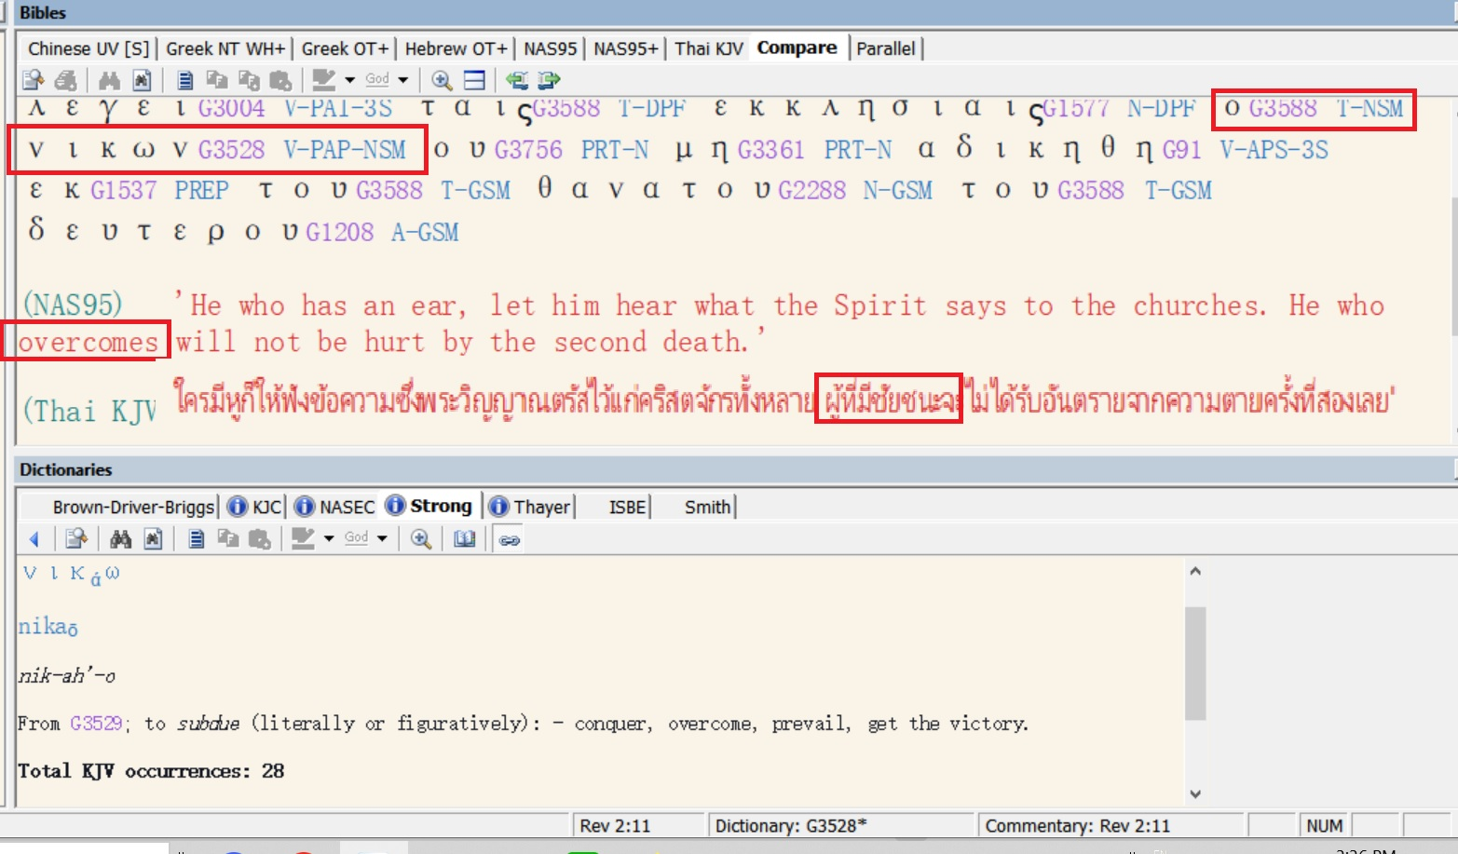

Slide 13

God is always Victorious
We are on the Winning Side!
1. God is Love. God wins.
2. The rainbow can also be interpreted as a symbol of God’s victory over the enemies of God.
3. 2 Peter 2:4-6; Jude 1:6, 7 help us understand that both the angels, and the homosexuals ‘left their proper abode’ (sexual perversion, i.e. having sex outside of the bounds of God’s commands) and were wiped off the face of the earth.

Slide 14
Whatever suffering the believer may experience in life, it cannot be compared to the suffering of the unbeliever in the Lake of Fire for all eternity.
Even if a person should suffer martyrdom, he must bring into remembrance that the Lord has delivered him from the eternal lake of fire.
This should motivate the believer to remain loyal to the Lord Jesus Christ and to endure whatever suffering God’s plan has for him. It amounts to a drop in the ocean compared with spending all eternity in the Lake of Fire.

Slide 15
Removing Fear from Death:
1. Bible doctrine resident in the soul removes fear of death as well as fear of life.
2. The believer having executed the spiritual life is not afraid of torture and death. That means that martyrdom is never in vain. Martyrdom without renouncing Christ, is one of the greatest rewardable functions in eternity. At the very least, he will receive the Wreath of Life.
3. Before Constantine the Roman empire was many times evangelized through dying testimony; after Constantine it was generally evangelized through living testimony. In history it takes both. Dying testimony requires, like living testimony, that Bible doctrine is more real than anything in life. Otherwise, when called upon to live or die for the Lord Jesus Christ, he can’t do it. .

Slide 16
4. The success standards of life must be replaced by the success standards of God’s plan. And the judgment seat of Christ will reveal that many people who have a comparatively humble station in life in the Lord’s eyes were the great heroes and heroines of history.
5. Only through Bible doctrine can God and His plan be more real than people, ambitions, situations, and pleasures. Beware that you do not function in life according to human viewpoint, on the basis of rationalizing doctrine to fit your ambitions and functions in life. The divine viewpoint must override peer pressure, and arrogant ambition must be replaced by doctrinal perception. When that happens and you fulfil the principle of being faithful, even unto death, there will be a special, super reward for you in heaven.

Slide 17
4. The success standards of life must be replaced by the success standards of God’s plan. And the judgment seat of Christ will reveal that many people who have a comparatively humble station in life in the Lord’s eyes were the great heroes and heroines of history.
5. Only through Bible doctrine can God and His plan be more real than people, ambitions, situations, and pleasures. Beware that you do not function in life according to human viewpoint, on the basis of rationalizing doctrine to fit your ambitions and functions in life. The divine viewpoint must override peer pressure, and arrogant ambition must be replaced by doctrinal perception. When that happens and you fulfil the principle of being faithful, even unto death, there will be a special, super reward for you in heaven.

Slide 18
The doctrine of the Judgment Seat of Christ:
1. The judgment seat of Christ or the evaluation of believers occurs at the termination of the Church Age. It follows the receiving of a resurrection body. (Whether a believer succeeds or fails he will have a resurrection body)
2. The purpose of the Judgment Seat of Christ, 2 Corinthians 5:10, “For we must all appear before the judgment seat of Christ; that each one of us [believers in the royal family of God] may receive what is due him for the things accomplished while in the physical body, whether good or worthless.”
“เพราะว่าจำเป็นที่เราทุกคนจะต้องปรากฏตัวที่หน้าบัลลังก์พิพากษา βῆμα / bema บัลลังก์แห่งการฟังผลการประเมิน] ของพระคริสต์ เพื่อทุกคนจะได้รับสมกับการที่ได้ประพฤติในร่างกายนี้ แล้วแต่จะดีหรือชั่ว
If the believer lives his life inside the cosmic system what he accomplishes is worthless or evil or both. On the other hand, if the believer lives his Christian life under the omnipotence of God namely the two power options what he does is categorized as intrinsic good and is rewardable.

Slide 19
3. The loss of reward at the judgment seat of Christ is a major issue. The gain or loss of reward and blessing above and beyond the resurrection body is determined by your personal volition in time (1 Corinthians 3:11-15)
4. Loss of reward at the Judgment Seat of Christ does not imply loss of salvation, 2 Timothy 2:11-13:
“Faithful is the Word. If we died with him and we have [retroactive and current positional sanctification], we will live with him. (12). If we endure [keep advancing spiritually through the pressures of life], we will rule with him [in the millennium]. If we deny him [reject the thinking of Christ as found in the Word], he will deny us [rewards in eternity]. (13) If we are unfaithful [no integrity], he remains faithful for he cannot deny himself [our being in union with him; he cannot deny His integrity].”
2Timothy 2:11-13 คำนี้เป็นคำสัตย์จริง คือถ้าเราตายกับพระองค์ เราก็จะมีชีวิตอยู่กับพระองค์เช่นกัน 2:12 ถ้าเราทนความทุกข์ทรมาน เราก็จะได้ครองร่วมกับพระองค์ด้วย ถ้าเราปฏิเสธพระองค์ พระองค์ก็จะปฏิเสธเราเช่นเดียวกัน 13 ถ้าเราไม่เชื่อ พระองค์ก็ยังทรงไว้ซึ่งความสัตย์ซื่อ เพราะพระองค์จะปฏิเสธพระองค์เองไม่ได้

Slide 20
5. James 1:12, “Happy is the believer who endures testing [passes the three categories of undeserved suffering] for having become approved [at his evaluation after the Rapture], he shall receive the wreath of life, which He [the Lord] has promised to those who love Him [enduring devotion and respect for the Lord Jesus Christ].”

Slide 21
6. Therefore the application of virtue to the judgment seat of Christ. Romans 14:10-13, “You there [the weak believer who lives in the cosmic system], why do you judge your brother? [Principle of the weak controlling the strong] or you also [the strong believer] why do you regard your brother with contempt [lack of toleration and impersonal love]? for all will stand before the Evaluation Seat of God. (11) For it stands written [Isaiah 45:23], For surely as I live, says the Lord, every knee will bow to me [the big genuflect after the Rapture of the Church], and every tongue will give praise to God. (12) So, then each one of us [Church Age believers] shall give an account to God concerning himself [at the Judgment (Evaluation) Seat of Christ]. (13) Therefore, let us no longer judge one another: but rather make up your mind, [determine this] not to place an obstacle or distraction in front of his brother.”

Slide 22
โรม 14:10-13 แต่ตัวท่านเล่า เหตุไฉนท่านจึงกล่าวโทษพี่น้องของท่าน หรือเหตุไฉนท่านจึงดูหมิ่นพี่น้องของท่าน เพราะว่าเราทุกคนต้องยืนอยู่หน้าบัลลังก์พิพากษาของพระคริสต์ 11 เพราะมีคำเขียนไว้ว่า `องค์พระผู้เป็นเจ้าได้ตรัสว่า "เรามีชีวิตอยู่ฉันใด หัวเข่าทุกหัวเข่าจะต้องคุกกราบลงต่อเรา และลิ้นทุกลิ้นจะต้องร้องสรรเสริญพระเจ้า"' 12 ฉะนั้นเราทุกคนจะต้องทูลเรื่องราวของตัวเองต่อพระเจ้า 13 ดังนั้นเราอย่ากล่าวโทษกันและกันอีกเลย แต่จงตัดสินใจเสียดีกว่า คืออย่าให้ผู้หนึ่งผู้ใดวางสิ่งซึ่งให้สะดุด หรือสิ่งซึ่งเป็นเหตุให้ล้มลงไว้ต่อหน้าพี่น้อง

Slide 23
7. An athletic analogy to the judgment seat of Christ. 2 Corinthians 2:5
“Now if anyone really competes in the athletic games, he does not receive a winner’s wreath unless he trains according to the rules.” The Christian is not going to receive the winner’s wreath at the Evaluation Seat of Christ unless he plays according to the rules set-up by the Father for the spiritual life. We have the cosmic believer who doesn’t train according to the rules, and we have the advancing believer who does. Not only did the Roman athlete live inside the gymnasium for ten months but also followed a set of very strict rules which constantly tested his motivation, his decisions, and his momentum. The concept of perception of doctrine in the divine power system is analogous. Once the athletes went back to their hometowns, they received rewards which are analogous to the rewards received by the Christian at the Judgment Seat of Christ.

Slide 24
Then Paul goes on to say in 1 Corinthians 9:24-27, “Do you not know that those who run in a race all run [analogous to the games in the Roman empire], but one receives the prize [in each event]? Run in such a way that you may win. (25) And everyone who competes in the games exercises self-discipline in all things. They [the athletes] do it to receive a perishable wreath [or crown]; but we [mature believers] an imperishable crown. (26) Therefore [Paul’s application] I do not run like a person without an objective; I do not fight like a person beating the air [cosmic believers are shadow boxers] (27) Instead, I discipline my body, and keep it in training [residence and function in God’s power system] lest having preached [communicated doctrine] to others, I myself should be disqualified” [disqualification from both temporal blessing and eternal reward at the judgment seat of Christ].

