Slide 1
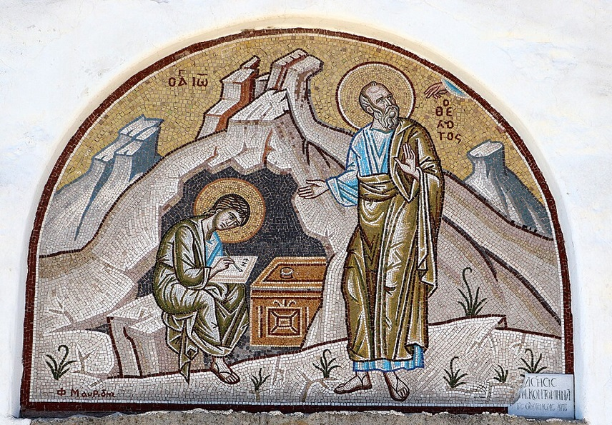
การวิเคราะห์พระธรรมวิวรณ์ สอนโดย อ.Tim จากคำบันทึกของ อ. Max Klein
REVELATION 58
2025 08 19

Slide 2
วิวรณ์ 2:20.
‘But I have this against you namely that you tolerate the woman Jezebel, who calls herself a prophetess, and she teaches and leads My bond-servants astray so that they commit acts of immorality and eat things sacrificed to idols [the immorality and feasting is part of their worship of demons].
ἀλλὰ ἔχω κατὰ σοῦ ὅτι ἀφεῖς τὴν γυναῖκα Ἰεζάβελ, ἡ λέγουσα ἑαυτὴν προφῆτιν, καὶ διδάσκει καὶ πλανᾷ τοὺς ἐµοὺς δούλους πορνεῦσαι καὶ φαγεῖν εἰδωλόθυτα.
แต่เรามีข้อที่จะต่อว่าเจ้าบ้างเล็กน้อย คือพวกเจ้ายอมให้ผู้หญิงชื่อเยเซเบล ที่ยกตัวขึ้นเป็นผู้พยากรณ์หญิง หญิงนั้นสอนและล่อลวงพวกผู้รับใช้ของเรา ให้ล่วงประเวณีและให้กินของที่บูชาแก่รูปเคารพแล้ว

Slide 3
The present active indicative of the verb aphiemi means “to tolerate” Toleration can be a virtue when related to impersonal love, or it can be a sign of living in the cosmic system.
Remember that in the cosmic system there is a great deal of toleration for Satanic ideas and concepts and that is exactly what we have here. The Christians in Thyatira are tolerating Jezebel and her evil cult. Tolerating evil is supporting evil.

Slide 4
Why did she call herself a prophetess?
She was alleging to have a gift from God that did not exist in 96 A.D. which brings her into focus as a very arrogant and ambitious woman.
She knew that with a title she would gain the following of a segment of the Christians in the church at Thyatira. Titles mean everything to the idiot, but nothing to a person who can think.

Slide 5
A few points related to this woman who called herself, Jezebel.
1. Jezebel is not her real name. It is a pseudonym for a woman living in the city of Thyatira as the head of a phallic cult.
2. She had succeeded in luring believers away from doctrine into the phallic cult in a manner similar with the historical Jezebel.
3. Jezebel in Thyatira was controlling believers, luring them from the blessing of God’s plan into the cursing of the cosmic system. Many of these believers were like spiritually weak King Ahab who was led astray by his evil wife, Jezebel.
1 Corinthians 15:33, “Do not be deceived, evil companions corrupt good morals”.
“อย่าหลงเลย การคบกับคนชั่วย่อมทำให้นิสัยที่ดีเสียไป”

Slide 6
2:21. ‘I gave her time to change her thinking, and she does not want to change her thinking [She refused to use the Recovery Procedure. Then to learn and execute the spiritual life] and depart from her immorality.
καὶ ἔδωκα αὐτῇ χρόνον ἵνα µετανοήσῃ, καὶ οὐ θέλει µετανοῆσαι ἐκ τῆς πορνείας αὐτῆς.
เราได้ให้โอกาสหญิงนั้นกลับใจจากการล่วงประเวณีของนาง แต่นางก็ไม่ได้กลับใจเลย

Slide 7
2:22. ‘Behold, I will throw her on a bed of sickness, and those who commit adultery with her into great tribulation [disaster, affliction: intensive divine discipline], unless they change their thinking of her deeds [unless they use the Recovery Procedure and leave this phallic cult].
ἰδοὺ βάλλω αὐτὴν εἰς κλίνην, καὶ τοὺς µοιχεύοντας µετí αὐτῆς εἰς θλῖψιν µεγάλην, ἐὰν µὴ µετανοήσωσιν ἐκ τῶν ἔργων αὐτῆς·
ดูเถิด เราจะทิ้งหญิงนั้นไว้บนเตียง และคนทั้งหลายที่ล่วงประเวณีกับนาง เราก็จะทิ้งไว้ให้ผจญกับความระทมทุกข์ เว้นไว้แต่ว่าคนเหล่านั้นจะกลับใจจากการกระทำของตน

Slide 8
Jezebel fornicated around Thyatira as a form of religion, not just as a sin. In this way, she parlayed the sin of fornication into the evil of fornication. As a result, the Lord will intensify her discipline, “I will cast her into a bed.” This is a sick-bed of intense punishment culminating in the Sin unto Death.
Promiscuity results in both total frustration and unhappiness as well as added divine discipline. The road to happiness goes through the Word of God, not through the bedroom of Jezebel.
She was seeking pleasure, but she found self-induced misery and unhappiness to which God eventually added divine punishment, the bed of illness, disease, incapacitation.
God designed sex as an expression of category two love between one man and one woman, He will not permit the distortion of sex into sin and evil.

Slide 9
The Christians of Thyatira tolerated this phallic cult. By application, when a large part of the population of any nation are practicing and condoning fornication it is the beginning of social degeneration.
It eventuates in fornication being turned into homosexuality and other degeneracies.
There is a whole area of social degeneration that starts with fornication between a man and a woman and ends up with all the distortions. (By the way, social degeneration always precedes military disaster. You can’t fight a war with socially degenerate people.)

Slide 10


Slide 11
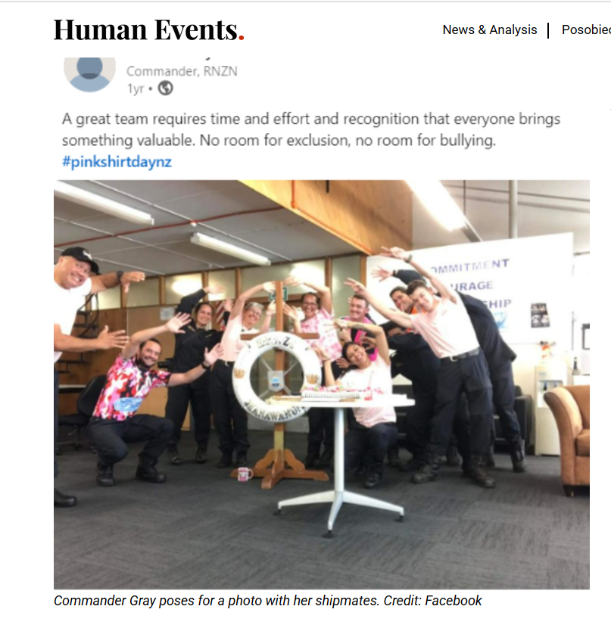

Slide 12
Sexual degeneracy leads to destruction on a large scale, as happened at the Great Flood and Sodom and Gommorah:
Luke 17:26-29; 2 Peter 2:4-6; Jude 1:6-7

Slide 13
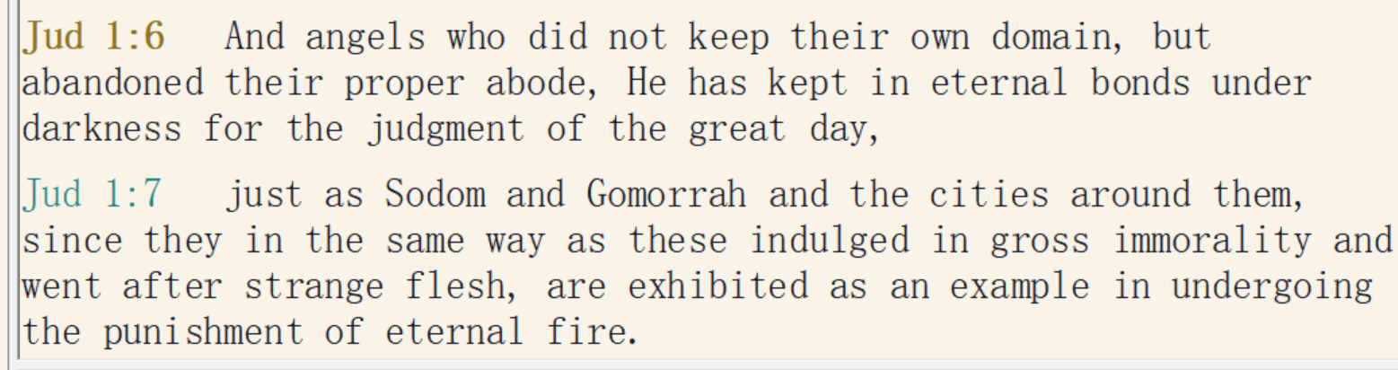
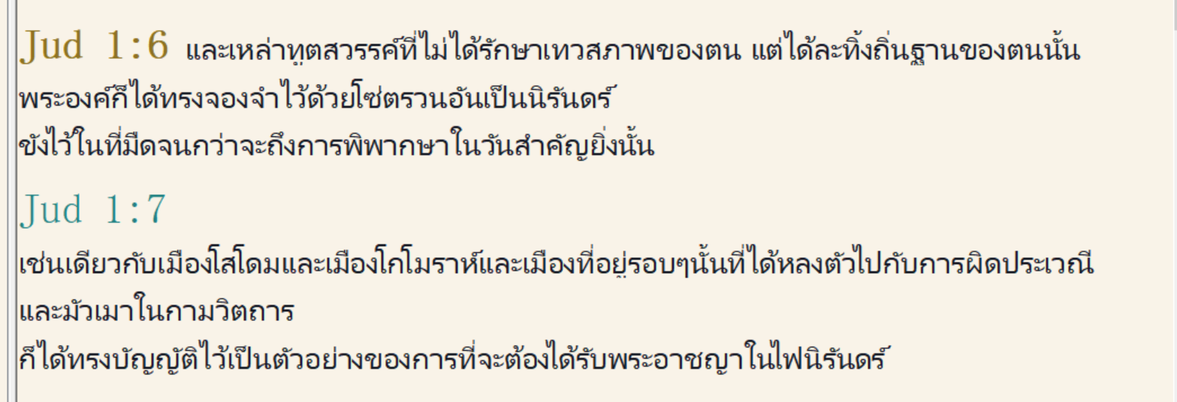

Slide 14
วิวรณ์ 2:23
‘And I will kill her followers with death [her followers will be executed under the Sin unto Death], and all the [believers in the] churches will know that I am He who investigates the emotions [nephros: literally kidneys but used for emotion] and hearts [the stream of consciousnesses where thought exist]; and I will give to each one of you according to your activities [whether good or bad].
καὶ τὰ τέκνα αὐτῆς ἀποκτενῶ ἐν θανάτῳ· καὶ γνώσονται πᾶσαι αἱ ἐκκλησίαι ὅτι ἐγώ εἰµι ὁ ἐραυνῶν νεφροὺς καὶ καρδίας, καὶ δώσω ὑµῖν ἑκάστῳ κατὰ τὰ ἔργα ὑµῶν.
เราจะประหารลูกทั้งหลายของหญิงนั้นเสียให้ตาย และคริสตจักรทั้งหลายจะได้รู้ว่าเราเป็นผู้พินิจพิจารณาจิตใจ และเราจะให้สิ่งตอบแทนแก่เจ้าทั้งหลายทุกคนให้เหมาะสมกับการงานของเจ้า

Slide 15
The Sin unto Death is explained in 1 John 5. 1 John 5:16, “If anyone sees his brother committing a sin not leading to death [the Sin unto Death], he may ask [pray for him] and he [the Father] will give life [restore his physical well-being] to him, to the ones committing sins not leading to death [the Sin unto Death]. There is a sin unto death [the believer being executed by the Lord], and I do not say that you should pray concerning this one [for example, Saul died the Sin unto Death as per 1 Chronicles 10:13, 14].
ถ้าผู้ใดเห็นพี่น้องของตนกระทำบาปอย่างหนึ่งอย่างใดที่ไม่นำไปสู่ความตาย ผู้นั้นจงทูลขอ และพระองค์ก็จะทรงประทานชีวิตแก่ผู้นั้นที่ได้กระทำบาปซึ่งไม่ได้นำไปสู่ความตาย บาปที่นำไปสู่ความตายก็มี ข้าพเจ้ามิได้ว่าให้เขาอธิษฐานสำหรับบาปอย่างนั้น

Slide 16
If you know doctrine well enough to discern whether a fellow Christian is “growing in grace and knowledge” (2 Peter 3:18), and you discover that he is very sick and dying, you may pray for his recovery. However, if a Christian is dying from ‘the sin unto death’, you may not pray for him.
How do you know if a Christian is dying the ‘sin unto death?’ If a Christian knows nothing about the spiritual life because he has failed for 40 years to learn the Word of God and is dying, or if a Christian full of fear comes to you screaming “Help, help, I am dying – pray for me please!” then he is obviously dying ‘the sin unto death’.

Slide 17
Every time a Christian, sins, he loses fellowship with the Spirit and begins the stages of Reversionism. However, as long as he recovers fellowship before getting locked into negative volition through the stages of Emotional Revolt of the Soul and Locked in Negative Volition, he will be able to continue his spiritual advance.
However, if the believer doesn’t recover fellowship through naming his sins to the Father, he is in deep trouble. Keep in mind that everything the believer does out of fellowship with God is wrongdoing, adikia (sin, good and evil). Thus, the believer who spends his entire life out of fellowship with God, will die the sin unto death.

Slide 18
Job’s friends [note: sincere, moral believers with some amount of truth] nearly died the Sin unto Death because they interfered with Job’s Evidence Testing:
Job 42:7-8, “It came about after the Lord had spoken these words to Job that the Lord said to Eliphaz, the Temanite, ‘My wrath is kindled against you and against your two friends [Bildad and Zophar. They were all very close to being executed under the concept of the Sin unto Death] because you have not spoken of Me what is right as My servant Job has. Now therefore, take for yourselves seven bulls and seven rams, and go to My servant Job, and offer up a burnt offering for yourselves, and My servant Job will pray for you. For I will accept him so that I may not do with you according to your folly, because you have not spoken of Me what is right, as My servant Job has." ’”
โยบ 42:7 เมื่อพระเยโฮวาห์ตรัสพระวจนะเหล่านี้แก่โยบแล้ว พระเยโฮวาห์ตรัสกับเอลีฟัสชาวเทมานว่า "ความพิโรธของเราพลุ่งขึ้นต่อเจ้า และต่อสหายทั้งสองของเจ้า เพราะเจ้ามิได้พูดถึงเราอย่างที่ถูก ดังโยบผู้รับใช้ของเราได้พูด 42:8 เพราะฉะนั้นจงเอาวัวผู้เจ็ดตัว และแกะผู้เจ็ดตัว ไปหาโยบผู้รับใช้ของเรา และถวายเครื่องเผาบูชาสำหรับเจ้าทั้งหลาย และโยบผู้รับใช้ของเราจะอธิษฐานเพื่อเจ้า เพราะเราจะยอมรับเขา เกรงว่าเรากระทำกับเจ้าตามความโง่ของเจ้า เพราะเจ้าทั้งหลายมิได้พูดถึงเราอย่างที่ถูก ดังโยบผู้รับใช้ของเราได้พูด"
(see also Numbers 12:1-15, re. Moses and Miriam)

Slide 19
Though he may die the Sin unto Death through bad decisions, John explains that because each Christian is in union with Christ, he cannot lose his salvation.
You understand that the only way a Christian could lose his position in Christ would be through sin. So, since the believer cannot sin in positional sanctification (in union with Christ), he cannot lose his position in Christ.
The believer’s volition only functions in the matter of Experiential Sanctification, only in his experience on this earth can he fail and sin.
The Christian cannot sin or fail in any way in Positional Sanctification (in union with Christ) or in Ultimate Sanctification (in his resurrection body).

Slide 20
This concept John explains in 1 John 5:18, “We [those who understand that the Christian cannot fail in union with Christ] know that everyone who has been born from God [born again, and placed in union with Christ] does not sin [in union with Christ], but He [Jesus] who has been born from God [the Holy Spirit provided the 23 chromosomes at the point of Mary’s conception], keeps watch over him [the believer] and the evil one [Satan] does not snatch him away [Cannot remove his salvation].

Slide 21
In summary, all Christians sin; none of us are perfect in our experience and never will be (1 John 1:8, 10).
So, just because you sin, doesn’t mean that you will die ‘the sin unto death.’ In order for the believer to die ‘the sin unto death’ he must reject learning and applying the Word of God and consequently proceed through the 8 Stages of Reversionism.

Slide 22
วิวรณ์ 2:24.
‘But I say to you, the rest who are in Thyatira, who do not hold this teaching [the revival of the Baal cult], who have not known the deep things of Satan [sarcasm], as they call them—I place no other burden on you.
ὑµῖν δὲ λέγω τοῖς λοιποῖς τοῖς ἐν Θυατίροις, ὅσοι οὐκ ἔχουσιν τὴν διδαχὴν ταύτην, οἵτινες οὐκ ἔγνωσαν τὰ βαθέα τοῦ Σατανᾶ, ὡς λέγουσιν, οὐ βάλλω ἐφí ὑµᾶς ἄλλο βάρος·
สำหรับพวกเจ้า และคนอื่นที่เหลืออยู่ที่เมืองธิยาทิรา ผู้ไม่ถือคำสอนนี้ และไม่รู้จักสิ่งที่เขาเรียกว่า ความล้ำลึกของซาตานนั้น เราขอบอกว่า เราจะไม่มอบภาระอื่นให้เจ้า

