Slide 1
四十种绝对恩赐
The 40 absolutes
Lesson Four
2025 08 28

Slide 2
三十九种不可撤销的绝对恩赐
39 IRREVOCABLE Absolutes

Slide 3
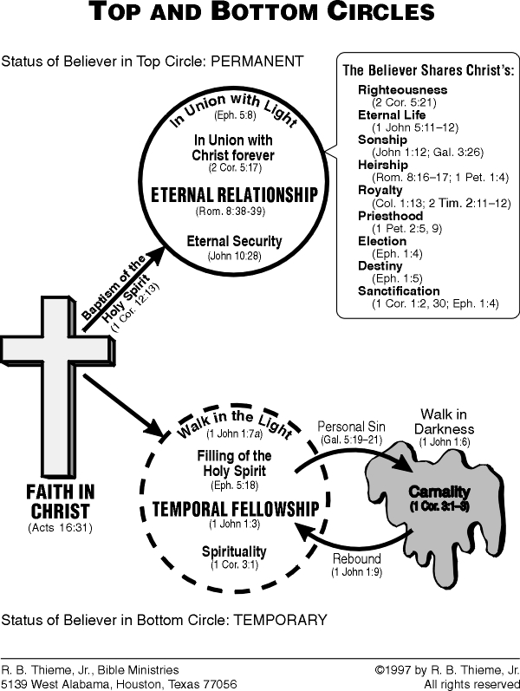

Slide 4
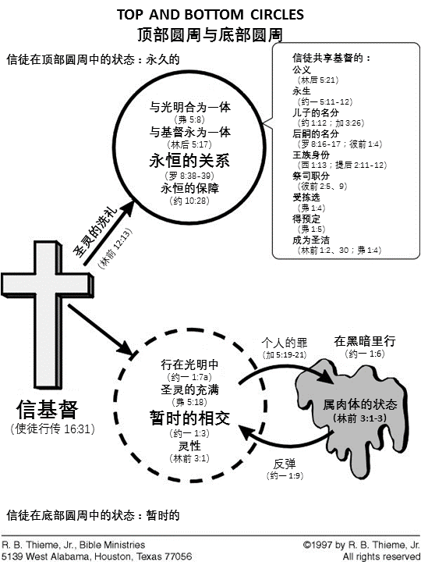

Slide 5
The believer is reconciled (removal of the barrier between man and God):
信徒得以和好（人与神之间的障碍被除去）：
By God (2 Cor. 5:18–19; Col. 1:20).
蒙神和好（哥林多后书 5:18-19；歌罗西书 1:20）。
To God (Rom. 5:10; 2 Cor. 5:20; Eph. 2:14–17).
与神和好（罗马书 5:10；哥林多后书 5:20；以弗所书 2:14-17）。

Slide 6
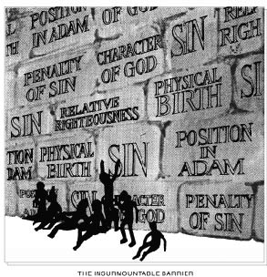

Slide 7
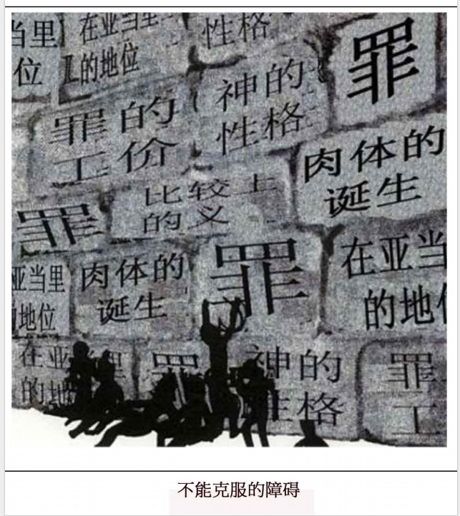

Slide 8
The believer is redeemed, purchased from the slave market of sin (Rom. 3:24; Col. 1:14; 1 Pet. 1:18).
信徒从罪的奴隶市场被赎回、买回 （罗马书 3:24；歌罗西书 1:14；彼得前书 1:18）。

Slide 9
The believer’s condemnation, or eternal judgment, is removed (John 3:18; 5:24; Rom. 8:1).
信徒的定罪或永恒的审判已被除去（约翰福音 3:18，5:24；罗马书 8:1）。

Slide 10
V. The substitutionary spiritual death of Christ on the cross paid the penalty for all sins (Rom. 4:25; Eph. 1:7; 1 Pet. 2:24).
基督在十架上的替代性属灵死亡付清了所有罪的惩罚（罗马书 4:25；以弗所书 1:7；彼得前书 2:24）。

Slide 11
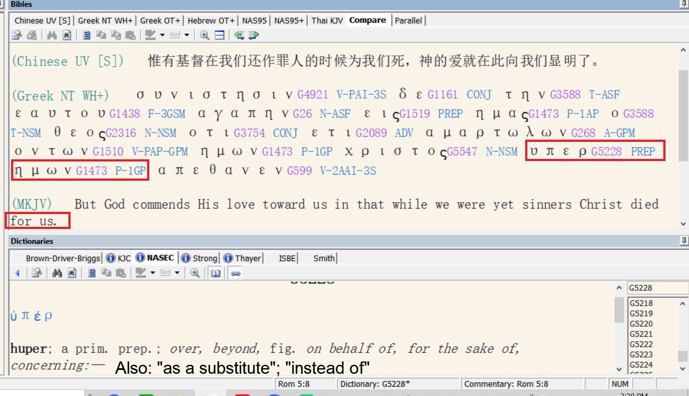

Slide 12
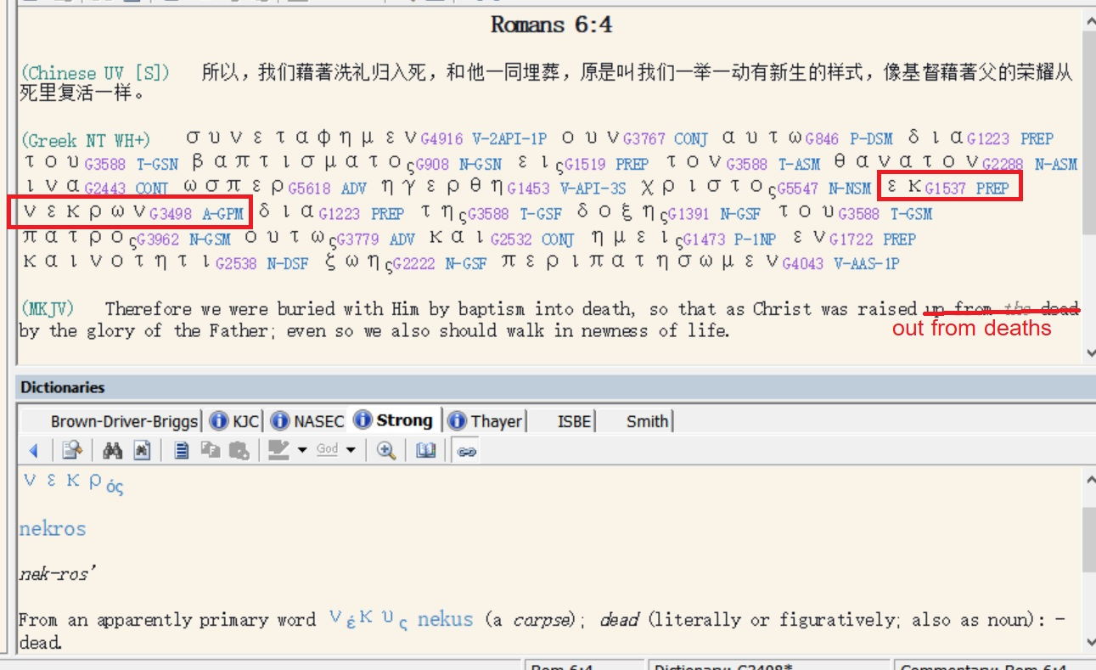
Romans 6:4

Slide 13
VI. Every believer receives propitiation for sins; God is satisfied with the work of His Son (Rom. 3:25–26; 1 John 2:2; 4:10).
每个信徒都领受了罪的挽回祭；上帝对祂儿子的工作感到满意（罗马书 3:25-26；约翰一书 2:2，4:10）。

Slide 14
The believer is dead to old life, the sin nature, but alive to God, retroactive positional truth. He is:
信徒对旧生命、对罪性是死的，对上帝、对追溯性的位份真理则是活的。信徒是：
Crucified with Christ (Rom. 6:6; Gal. 2:20).
与基督同钉十字架（罗马书 6:6；加拉太书 2:20）。
Dead with Christ (Rom. 6:8; Col. 3:3; 1 Pet. 2:24).
与基督同死（罗马书 6:8；歌罗西书 3:3；彼得前书 2:24）。
Buried with Christ (Rom. 6:4; Col. 2:12).
与基督一同埋葬（罗马书 6:4；歌罗西书 2:12）。
Raised with Christ, current positional truth (Rom. 6:4; 7:4; Col. 2:12; 3:1).
与基督一同复活，这是当前的位份真理（罗马书 6:4，7:4；歌罗西书 2:12，3:1）。

Slide 15
Retroactive positional truth (Romans 6:1-6)
回溯性位分真理（罗马书 6:1-6）
Rom 6:1 What shall we say then? Are we to continue in sin so that grace may increase?
Rom 6:1 这样，我们要怎么说呢？我们可以仍在罪中使恩典增多吗？
Rom 6:2 May it never be! How shall we who died to sin still live in it?
Rom 6:2 绝对不可！我们向罪死了的人，岂可仍在罪中活着呢？

Slide 16
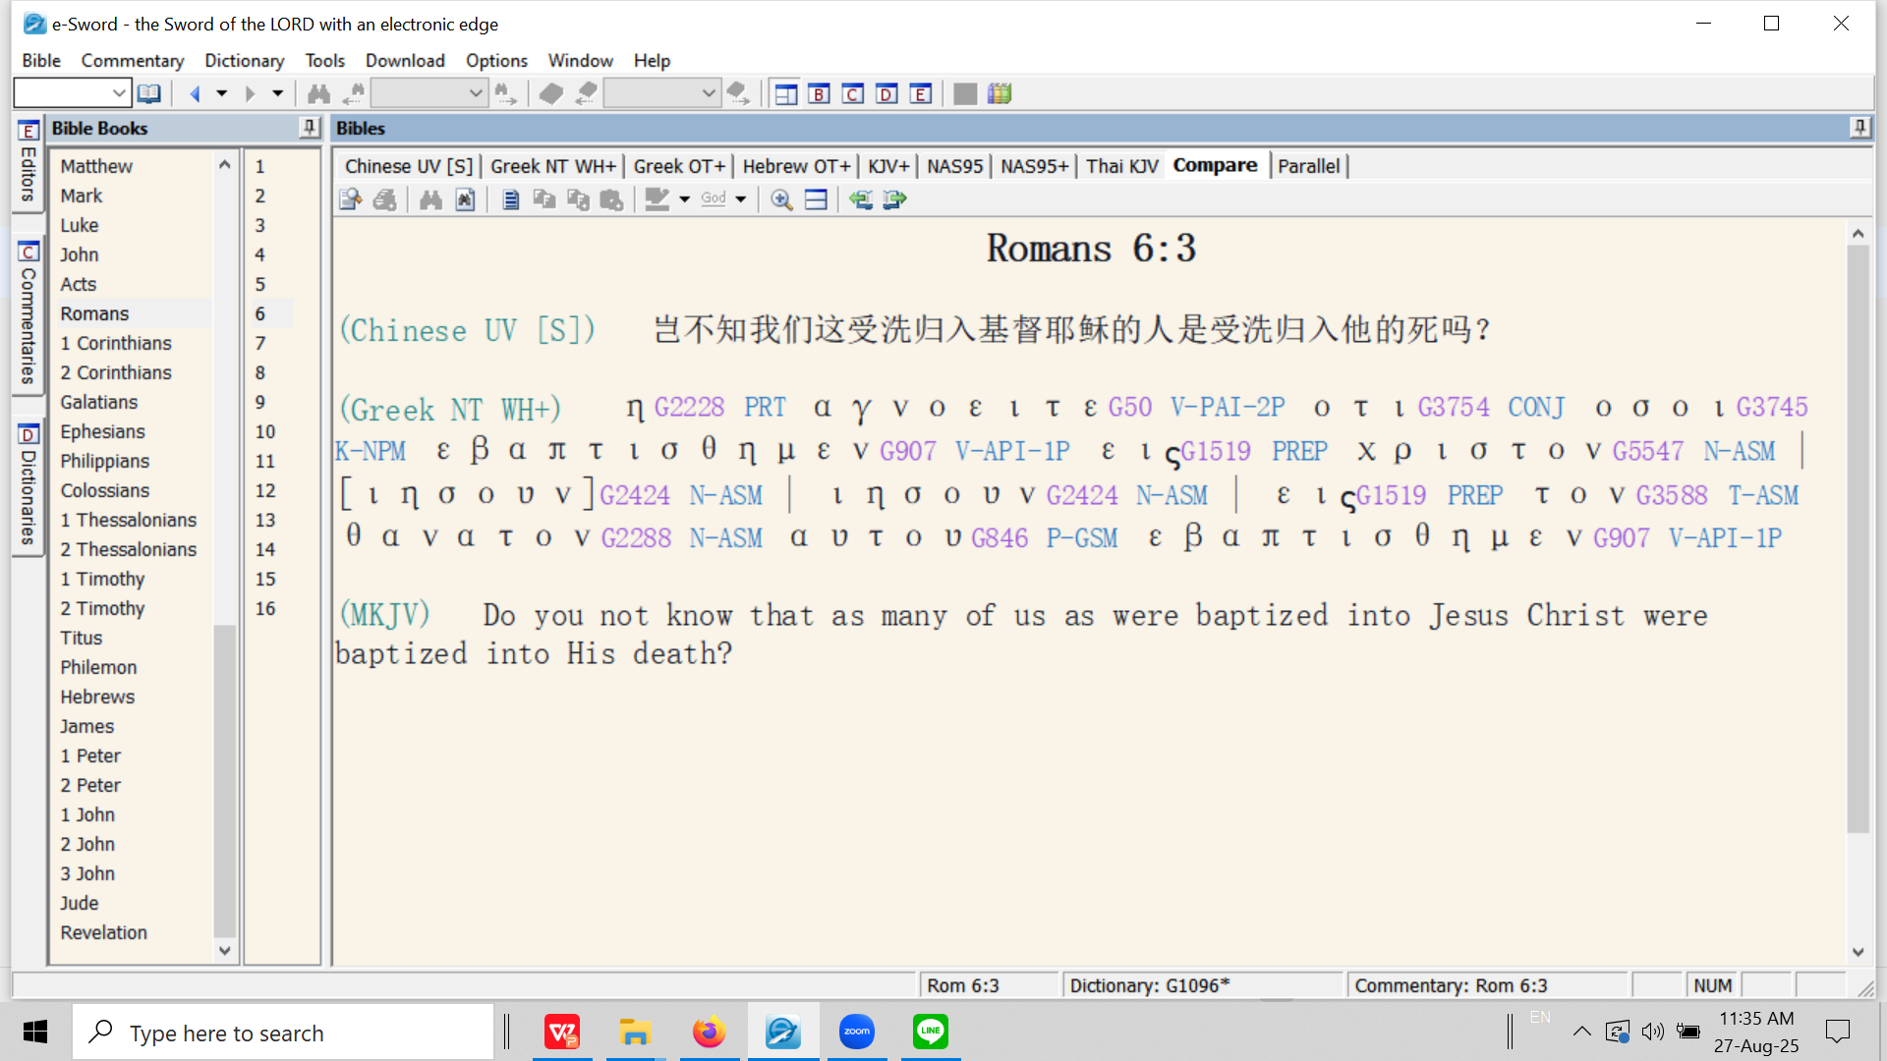
罗马书 6:3 难道你们不知道，我们这受洗归入基督耶稣的人，就是受洗归入他的死吗？（和合本修订版）

Slide 17
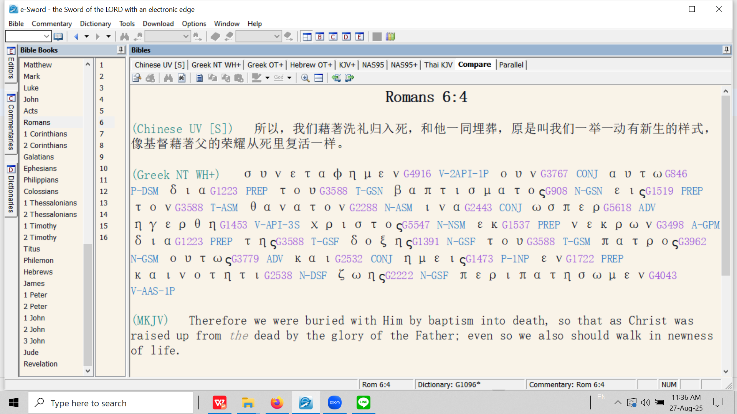
罗马书 6:4 所以，我们藉着洗礼归入死，和他一同埋葬，是要我们行事为人都有新生的样子，像基督藉着父的荣耀从死人中复活一样。（和合本修订版）

Slide 18
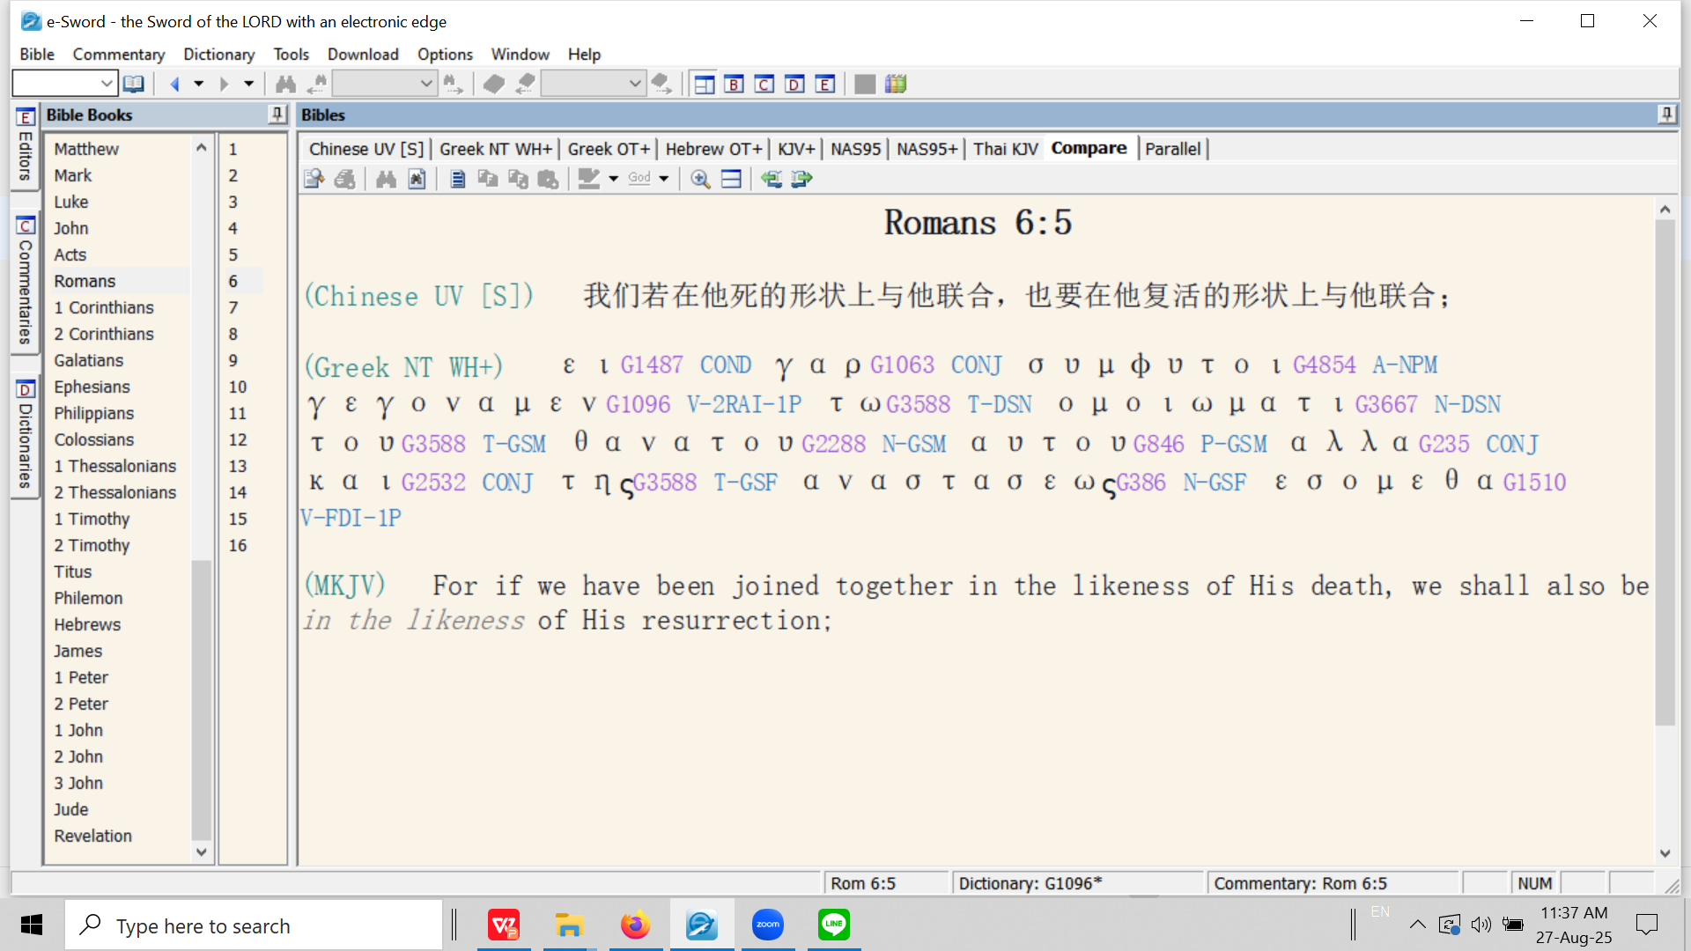
罗马书 6:5 我们若在他死的样式上与他联合，也要在他复活的样式上与他联合。（新译本）

Slide 19
συμφυτος / sumphutos
​
The word σύμφυτος / sumphutos is a compound word from “sum” = together (later appearing in English as: “sum” as in the result of two addends in an equation, ‘sum total’ etc.) and the verb φύω (also: φυτεύω) meaning ‘to plant’. The meaning is “plant together”.
2. The word ‘sumphutos’ is a hapaxlegomenon, i.e., it appears only one time in the entire New Testament. This is a very specific and technical event – Christ and the believer are both bought into ‘newness of life’ through His burial and resurrection. In this case, it is because of our union [baptism] into Christ that we are buried and resurrected with Him.
The Holy Spirit choses to use this word as a synonym for ‘baptizo.’ ​
3. Therefore, we see the analogy of the seed: first it must be planted [‘buried’] before it can spring to newness of life - the resurrection (Rom. 6:4).
4. Other planting analogies related to being in union with Christ found in the New Testament: Matt. 15:13; John 12:24, 32, John 15:1-8

Slide 20
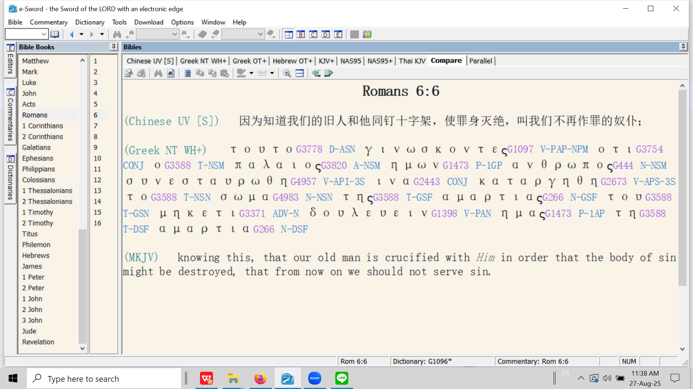
罗马书 6:5 我们知道，我们的旧人和他同钉十字架，使罪身灭绝，叫我们不再作罪的奴隶。（和合本修订版）

Slide 21
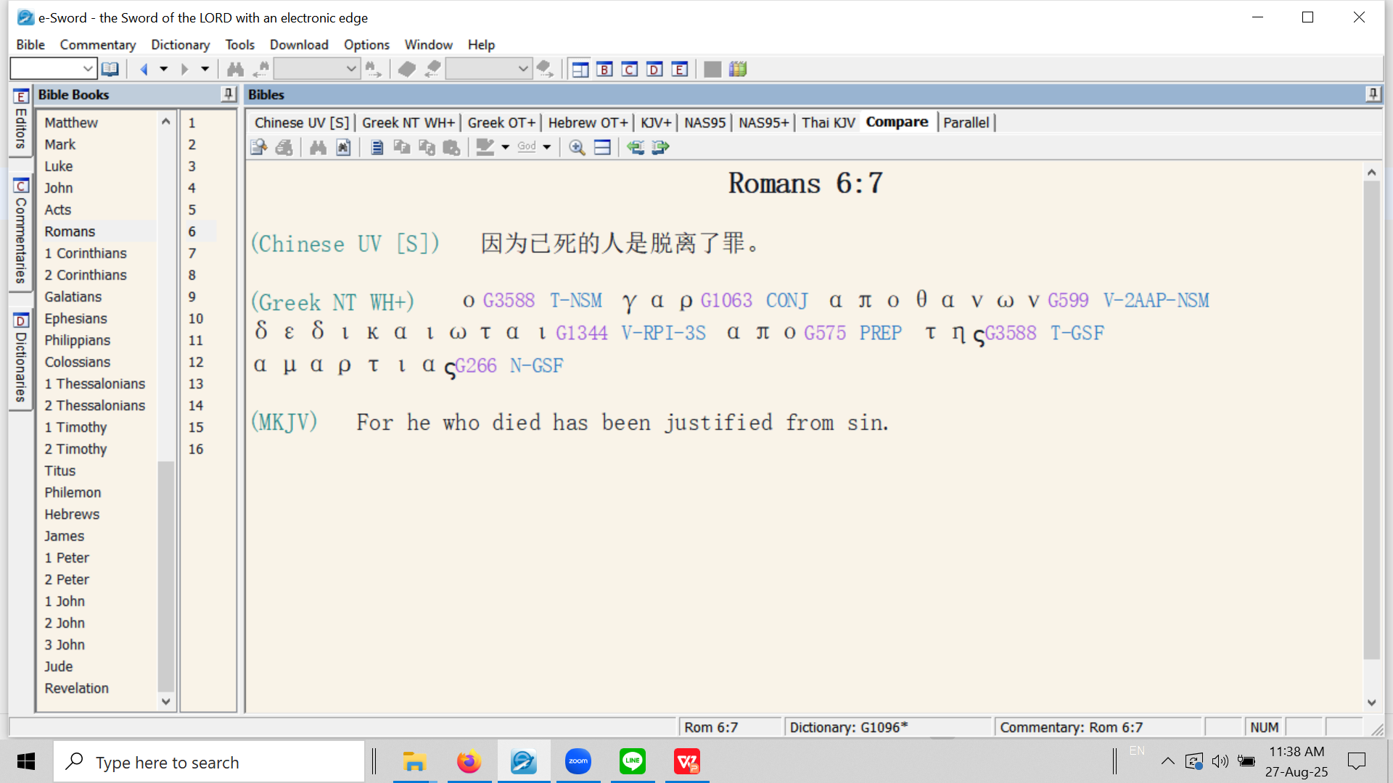

Slide 22
The believer is free from the Mosaic Law. He is:
信徒不再受摩西律法的约束。信徒是：
Dead to the Law (Rom. 7:4).
对律法是死的（罗马书 7:4）。
Delivered from the Law (Rom. 6:14; 7:6; 2 Cor. 3:6–11; Gal. 3:25).
得蒙拯救（罗马书 6:14，7:6；哥林多后书 3:6-11；加拉太书 3:25）。

