Slide 1
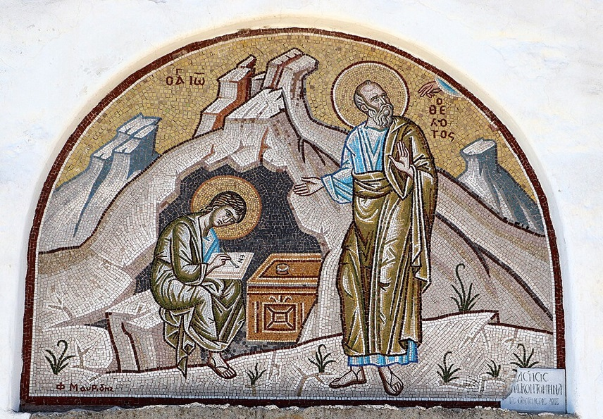
การวิเคราะห์พระธรรมวิวรณ์
สอนโดย อ.Tim จากคำบันทึกของ อ. Max Klein
REVELATION 53
2025 07 04

Slide 2
Rev. 2:17. ‘He who has an ear, must hear what the Spirit says to the churches. To him who overcomes [to the spiritual winner], to him [dative of advantage] I will give [blessing] from the hidden manna [metabolized doctrine hidden in the soul], and I will give him a white pebble, and a new title written on the pebble which no one knows but he who receives it [in time, but in eternity all will know].’
ὁ ἔχων οὖς ἀκουσάτω τί τὸ πνεῦµα λέγει ταῖς ἐκκλησίαις. τῷ νικῶντι δώσω αὐτῷ τοῦ µάννα τοῦ κεκρυµµένου, καὶ δώσω αὐτῷ ψῆφον λευκὴν καὶ ἐπὶ τὴν ψῆφον ὄνοµα καινὸν γεγραµµένον ὃ οὐδεὶς οἶδεν εἰ µὴ ὁ λαµβάνων.
วิวรณ์ 2:17 ใครมีหูก็ให้ฟังข้อความซึ่งพระวิญญาณตรัสไว้แก่คริสตจักรทั้งหลาย ผู้ที่มีชัยชนะ เราจะให้ผู้นั้นกินมานาที่ซ่อนอยู่ และจะให้หินขาวแก่ผู้นั้นด้วย ที่หินนั้นมีชื่อใหม่จารึกไว้ซึ่งไม่มีผู้ใดรู้เลยนอกจากผู้ที่รับเท่านั้น'

Slide 3
Ears become the analogy to the supernatural perceptive system our Lord has established for learning Bible doctrine, and from learning that Bible doctrine to grow in grace. The ears become the illustration for volition and motivation in learning.
R.B.Thieme: “Ear gate” and “Eye gate” are the entry ways for perception of academic information.

Slide 4
In John’s day most people learned not by reading, but by hearing, whereas today both systems are used.
What is the difference between them? When listening to a communicator, the authority of the communicator is obvious.
When reading theological material, the authority of the writer is less apparent. This is why God requires the believer to listen to Bible teaching in order to grow spiritually as per Romans 10:17, “So, faith comes from hearing and hearing by the Word of Christ.”

Slide 5
The ear refers to teachability, therefore to learnability. (Both of these require humility, the willingness to learn (legitimate curiosity about God’s plan for your life), and the willingness to accept the teaching authority of a qualified minister (pastor-teacher).
If you have ears, and you do, you can learn the Word of God. All kind of people have ears for perception, and no one earns or deserves ears. Just as you come equipped with ears from birth, so from the second birth you come equipped with a system of perception necessary to learn doctrine. However, no one hears (listens) apart from his own volition, and therefore the importance of positive volition in learning doctrine.

Slide 6
Just as the visible manna was stored in the ark as a permanent memorial to God’s grace, so Bible doctrine is stored in the soul as a permanent memorial to God’s grace. All blessing to the believer is related to the hidden manna, the manna that is preserved as Bible doctrine in the ark of his soul.
Bible doctrine is the thinking/the mind of Jesus Christ:

Slide 7
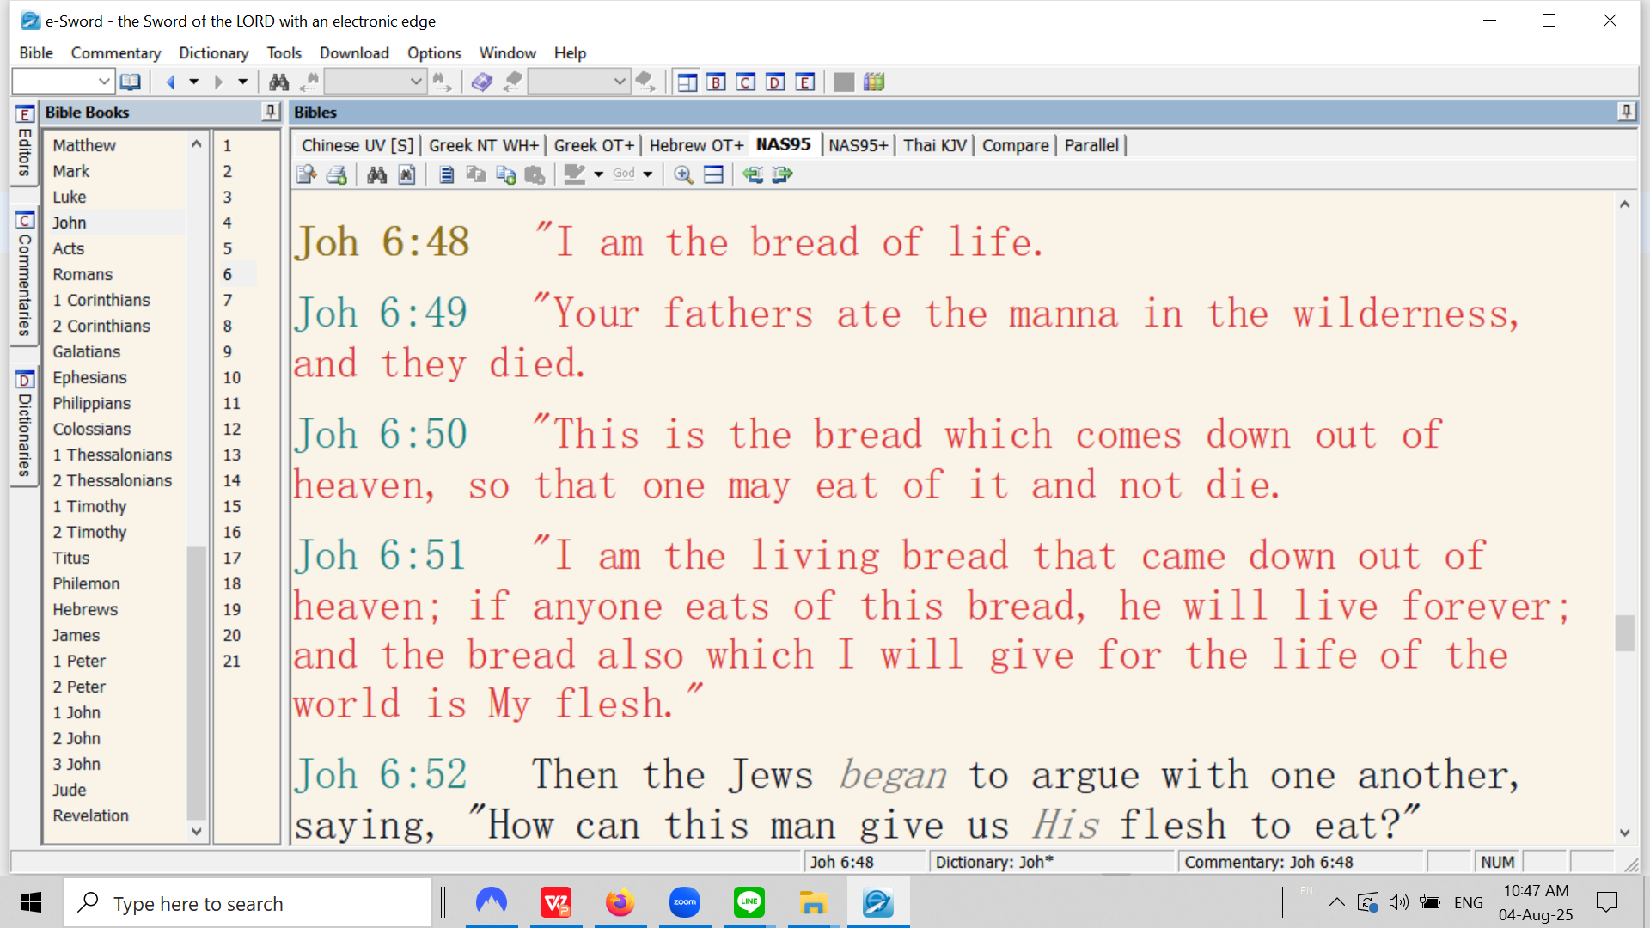
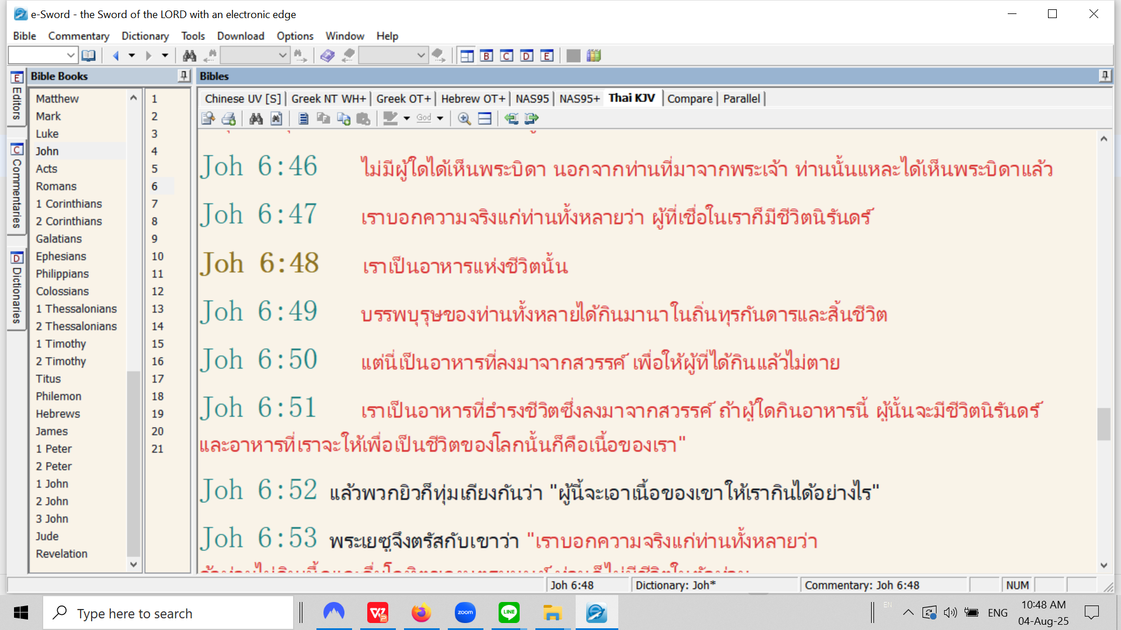

Slide 8
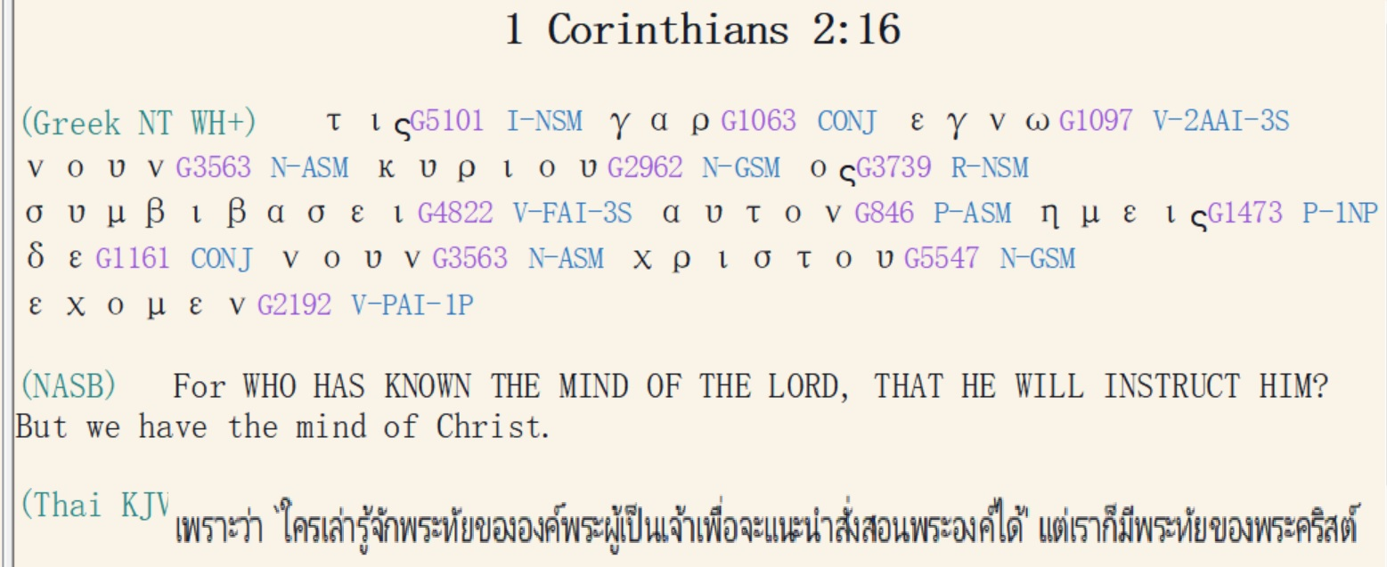

Slide 9
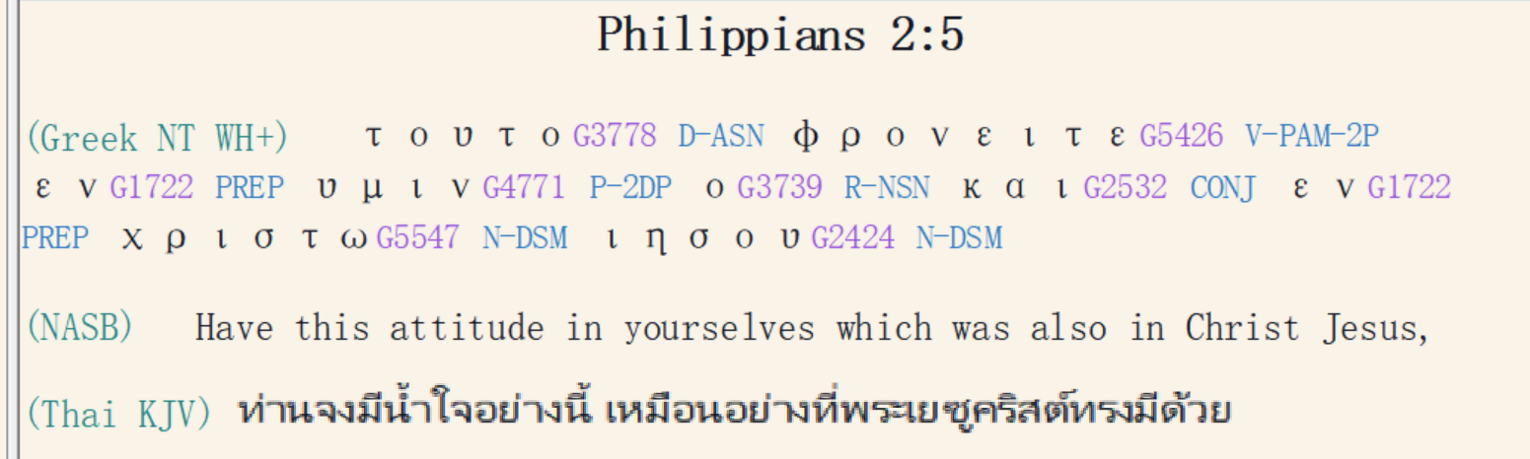

Slide 10
The juries in the ancient world had a box which was passed around in which were black pebbles and white pebbles, and each one selected a pebble and put it on the table.
A black pebble was guilty; a white pebble was a vote for acquittal.
The white pebble here is the Lord’s vote for acquittal for the believer. There is no condemnation, no lake of fire for the believer in Christ as per Romans 8:1; we are acquitted because we have personally believed in Jesus Christ.
Either a white pebble with no title (adopted into God’s family with a resurrection body, but not into the elite aristocracy of the eternal state) or a white pebble with a title written on it (a title of eternal aristocracy).

Slide 11

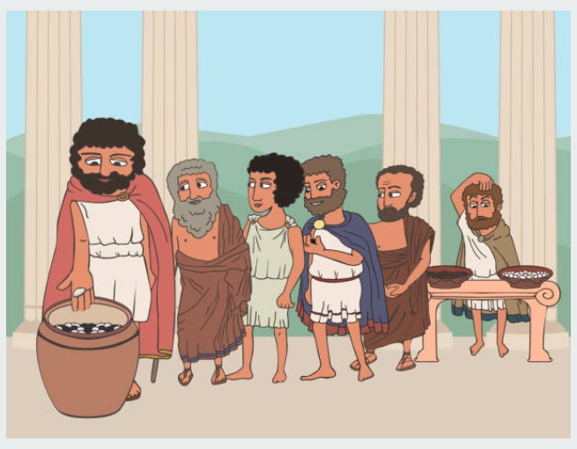

Slide 12
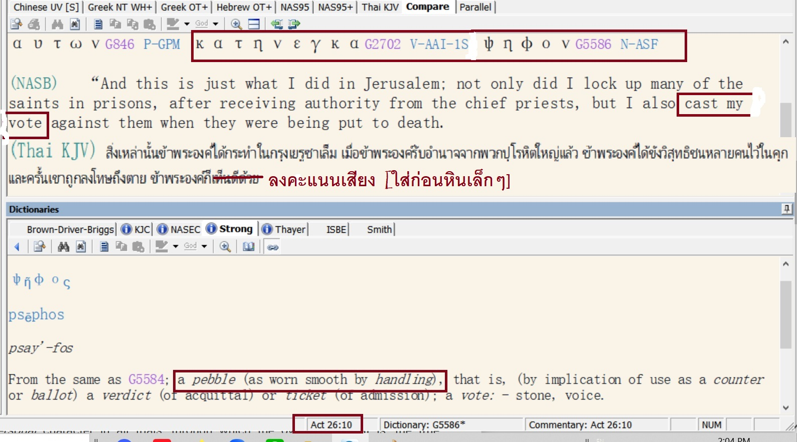

Slide 13
Every aristocratic Roman would adopt a son at age 14 whether it be his own natural son or another young man with great integrity and ability.
Once the adoption ceremony was complete, the adopted son was given a new name of aristocracy and had the right of marriage, military service, and had the right to access his father’s fortune.
Even the Roman emperors used this system of adoption to guarantee greatness in succession. For example, Emperor Nerva began the golden age of Rome in 96 A.D. He adopted Trajan, and Trajan adopted Hadrian, and Hadrian adopted Antonius Pius, and Antonius Pius adopted Marcus Aurelius, the last great emperor of the golden age. None of these adoptions involved their own sons.

Slide 14
On this white pebble is the title that Jesus Christ will bestow on the winner-believers at the Evaluation Seat of Christ.
This title means that the believer will be part of an elite eternal knighthood.
To have a white pebble with a new title of knighthood on it is about as high an honor as one could possibly obtain based upon one’s impact on both human and angelic history, not only an honor, but many wonderful privileges and rewards related to it.
(The only higher honor would be the ‘Order of the Morning Star’ to be explained later.)

Slide 15
วิวรณ์ 2:18.
“And to the messenger [the pastor] of the church in Thyatira write: The Son of God, who has eyes like a flame of fire [His integrity demands discipline for the believers who reject His spiritual life], and His feet are like burnished bronze, communicates this:
Καὶ τῷ ἀγγέλῳ τῆς ἐν Θυατίροις ἐκκλησίας γράψον· Τάδε λέγει ὁ υἱὸς τοῦ θεοῦ, ὁ ἔχων τοὺς ὀφθαλµοὺς αὐτοῦ ὡς φλόγα πυρός, καὶ οἱ πόδες αὐτοῦ ὅµοιοι χαλκολιβάνῳ·
จงเขียนถึงทูตสวรรค์แห่งคริสตจักรที่เมืองธิยาทิรา ว่า `พระองค์ผู้ซึ่งเป็นพระบุตรของพระเจ้า ผู้ทรงมีพระเนตรดุจเปลวไฟ และมีพระบาทดุจทองสัมฤทธิ์เงางาม ได้ตรัสดังนี้ว่า

