Slide 1
神的道是活泼的、是有功效的、比一切两刃的剑更快、
甚至魂与灵、骨节与骨髓、都能刺入剖开、
连心中的思念和主意、都能辨明。
（希伯来书 4:12）
​
圣经都是神所默示的、（或作凡神所默示的圣经）於教训、
督责、使人归正、教导人学义、都是有益的。
叫属神的人得以完全、豫备行各样的善事。
（提摩太后书 3:16-17）
​
你当竭力、在神面前得蒙喜悦、作无愧的工人、
按着正意分解真理的道。
（提摩太后书 2:15）

Slide 2
系列：属灵生命概论
Series:
Outline of the Spiritual Life
06 / 2025 06 04 www.ibdoctrine.org

Slide 3
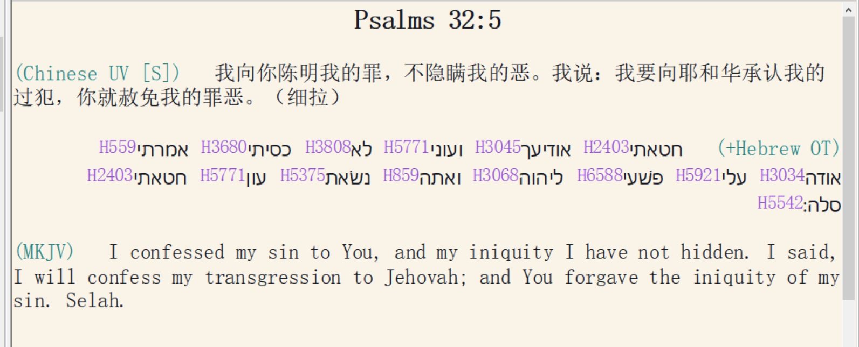

Slide 4
约翰一书 1：9 / 1 John 1:9
我们若认自己的罪，神是信实的，是公义的，因此必要赦免我们的罪，洗净我们一切的不义。
If we name our sins, He is faithful and just to forgive us our sins, and to cleanse us from all unrighteousness.

Slide 5
For the word of God to become effective it must be accepted as true.
要使神的话生效，必须承认神的话就是真理
Faith 信心
Belief 信仰
Making a decision to accept the information.
决定接受信息
“Positive Volition” “积极意志” （+V）

Slide 6

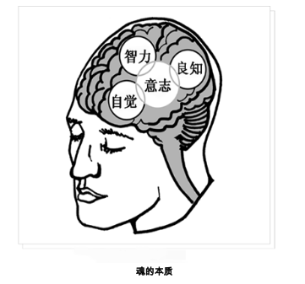
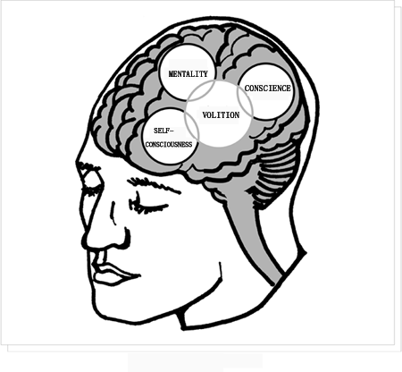

Slide 7
With faith, the merit is in the object, not the subject of faith.
With works the merit is in the subject.
[Works = religion, good deeds, ‘making merit’],

Slide 8
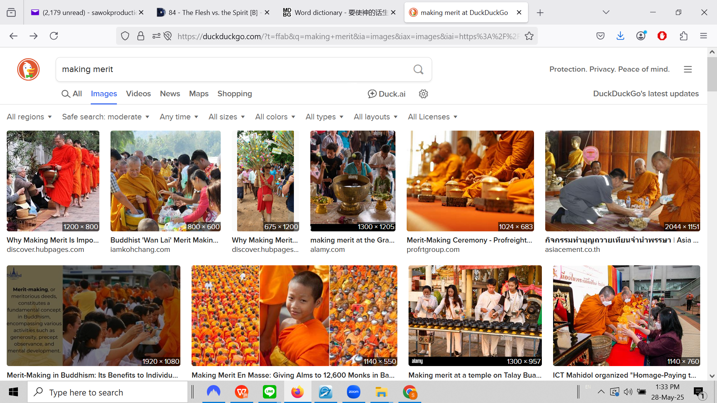

Slide 9
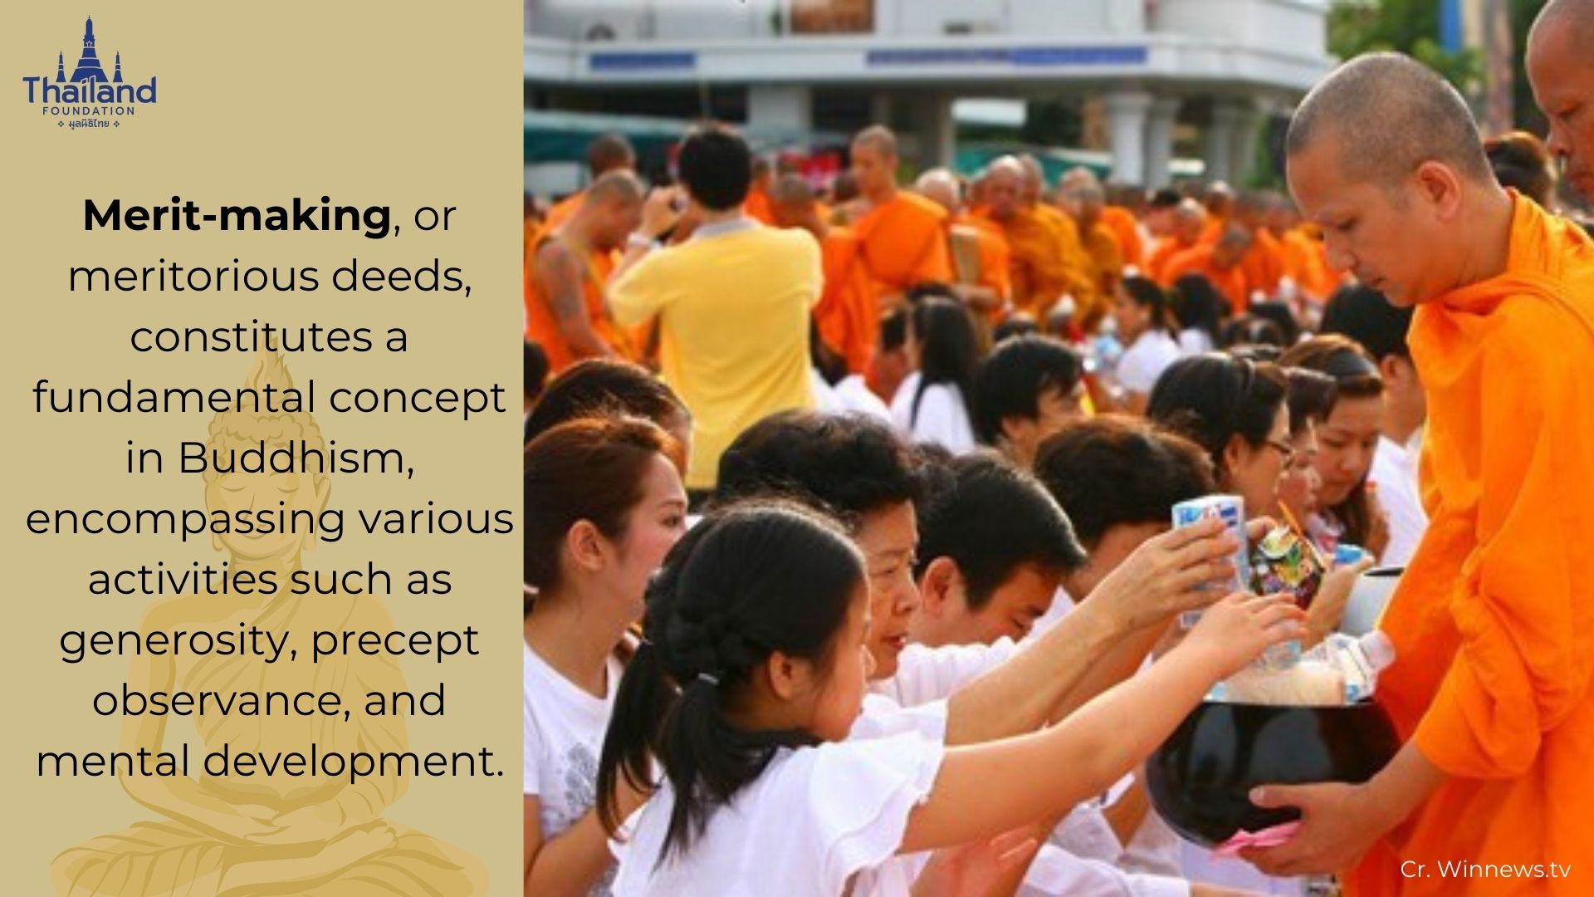

Slide 10
Jesus says:
“Believe in Me.”
(John 11:25,26; 14:1; 12:44,46
and many other verses and concepts in the OT and NT…)

Slide 11
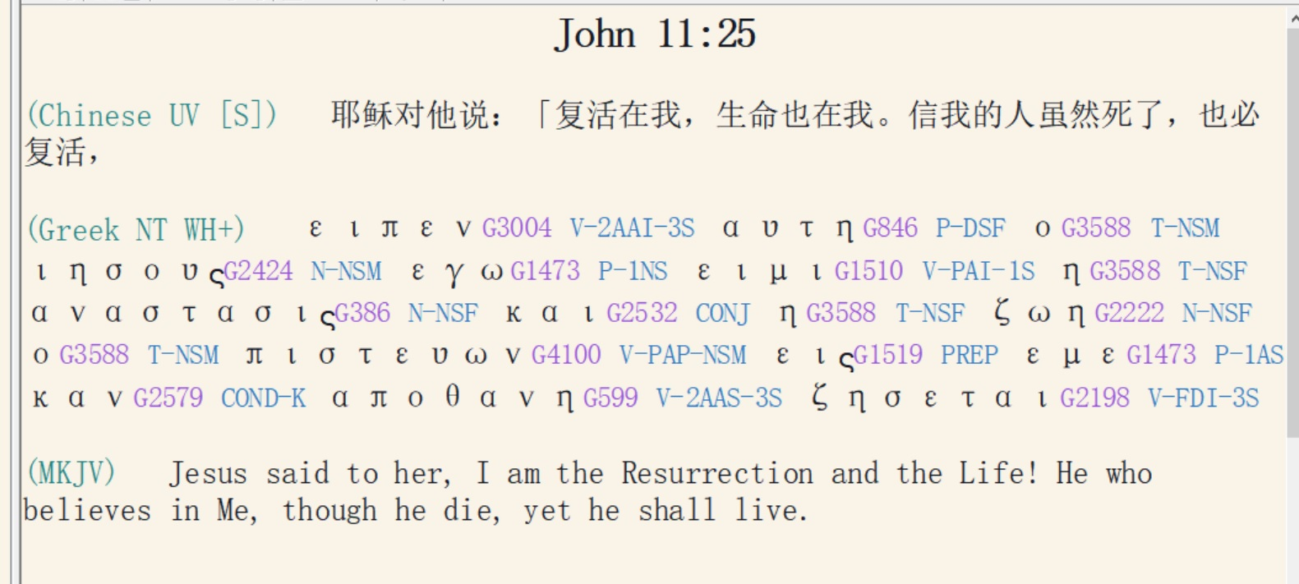

Slide 12
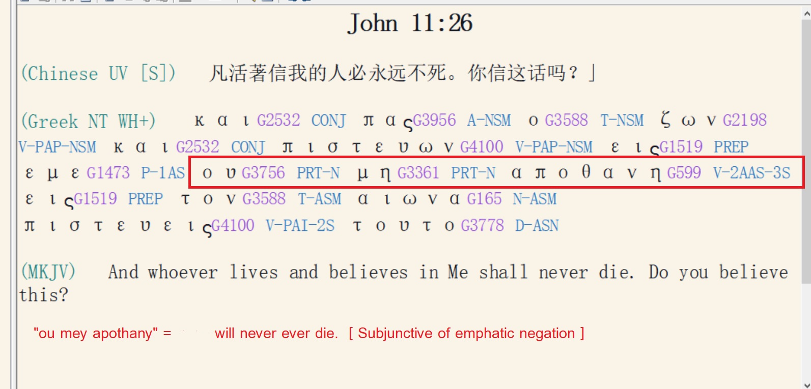

Slide 13
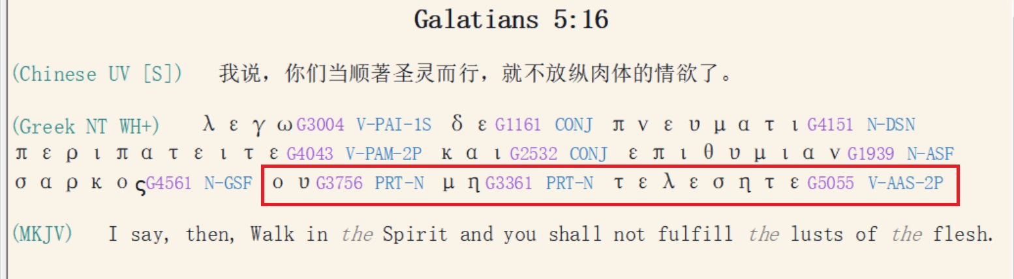

Slide 14
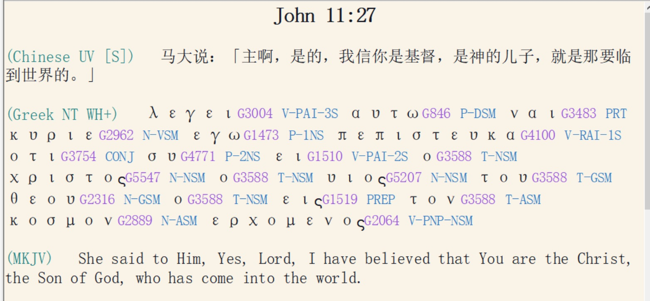

Slide 15
Romans 4:1-3 / 罗马书 4:1-3
What then shall we say that Abraham, our forefather according to the flesh, discovered in this matter? If, in fact, Abraham was justified by works, he had something to boast about—but not before God. What does Scripture say? “Abraham believed God, and it was credited to him as righteousness.”
如此说来，我们的祖宗亚伯拉罕凭著肉体得了什麽呢？ 倘若亚伯拉罕是因行为称义，就有可夸的；只是在神面前并无可夸。
经上说什麽呢？说：
「亚伯拉罕信神，这就算为他的义。」
Footnote: Paul is quoting from Gen. 15:6, using Abraham as an example of applying faith to receive imputed righteousness [salvation]. James 2:20-24 uses the same verse as an example of applying to attain experiential righteousness [‘Abraham became a friend of God’].

Slide 16
Romans 4:4,5 / 罗马书 4:4,5
Now to the one who works, wages are not credited as a gift but as an obligation. However, to the one who does not work but trusts God who justifies the ungodly, their faith is credited [ as righteousness.
做工的得工价，不算恩典，乃是该得的；
惟有不做工的，只信称罪人为义的神，
他的信就算为义。
[Imputed Righteousness / +R]

Slide 17
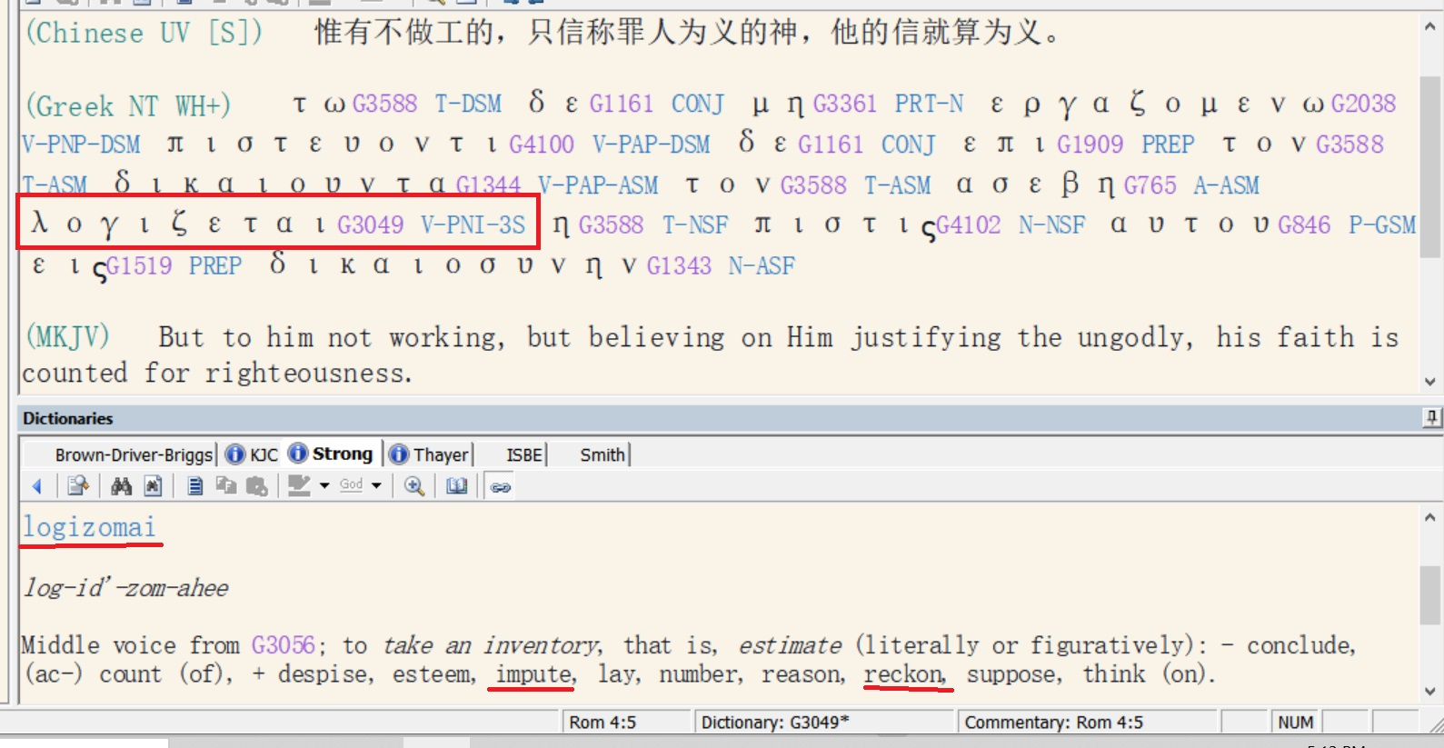

Slide 18
“And without faith [πίστις / pistis] it is impossible to please Him, for he who comes to God must believe that He is and that He is a rewarder of those who seek Him.”
人非有信，就不能得神的喜悦；因为到神面前来的人必须信有神，且信他赏赐那寻求他的人。
(Hebrews / 希伯来书 11:6 ）

Slide 19
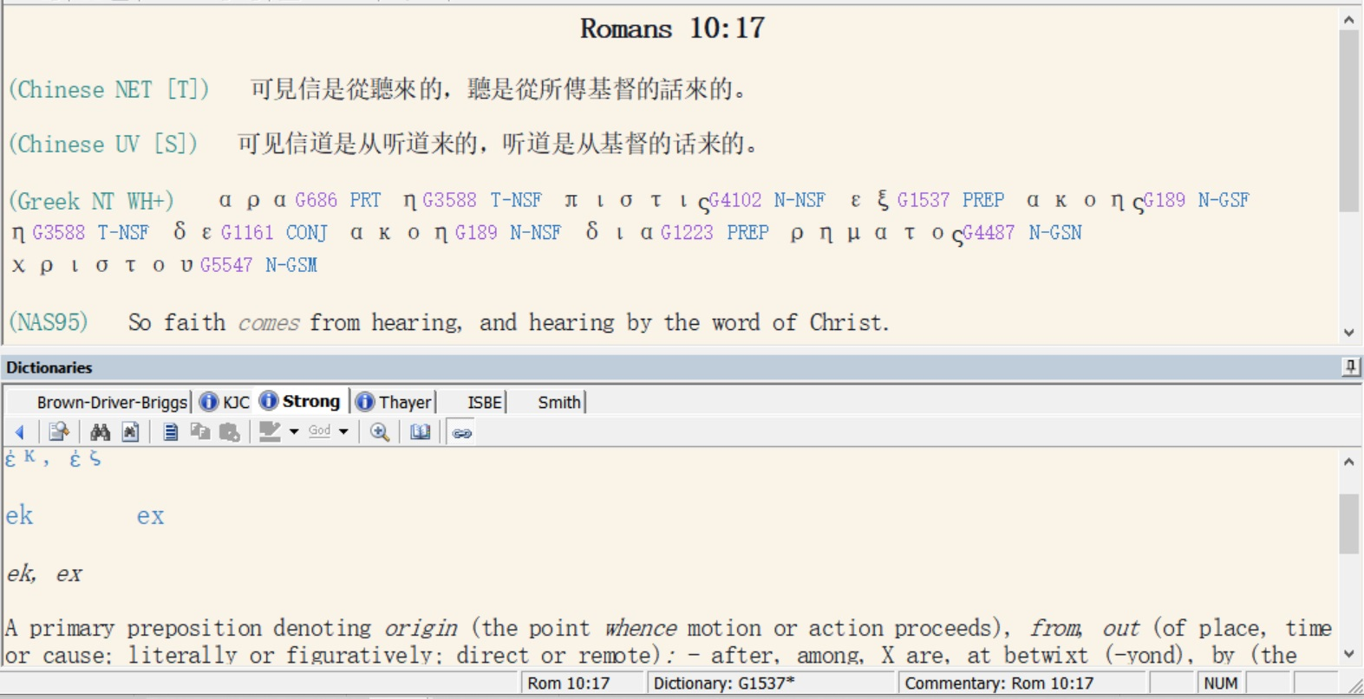

Slide 20
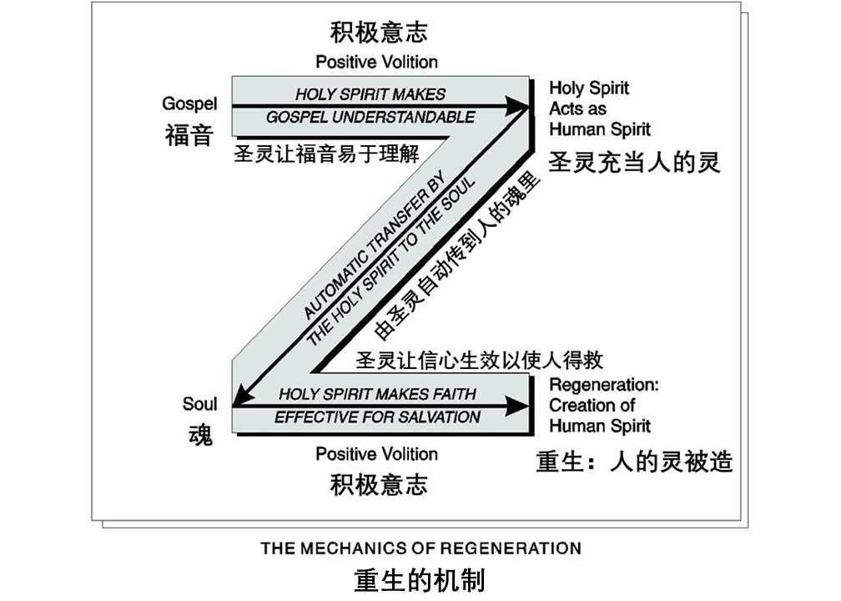

Slide 21
Mark 1:15 / 马可福音 1:15
“…and saying, the time is fulfilled, and the kingdom of God is at hand; repent [μετανοέω / metanoeo] and believe in the Gospel.”
说：「日期满了，神的国近了。你们当悔改 [μετανοέω / metanoeo]
，信福音！」

Slide 22
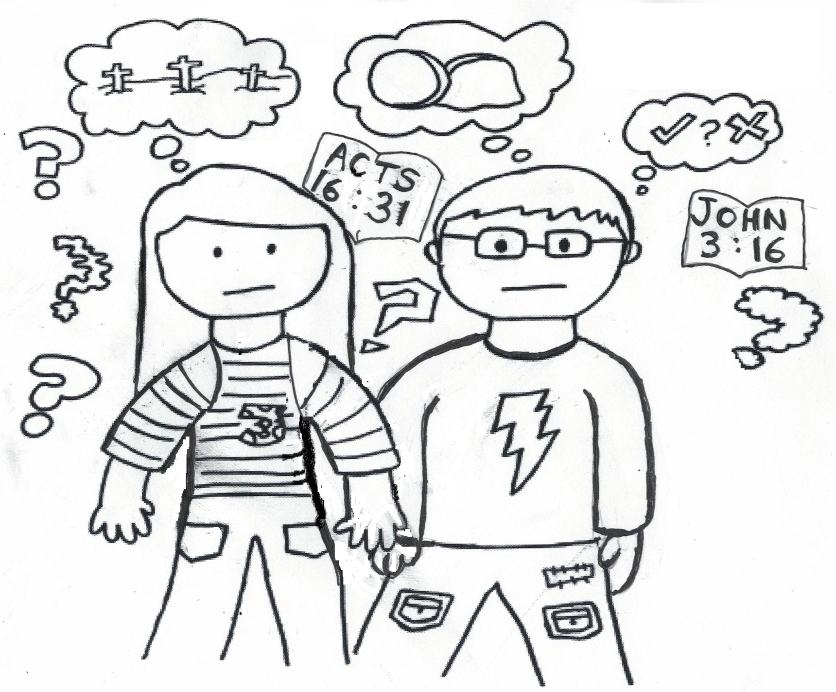

Slide 23
Mark 1:15 / 马可福音 1:15
“…and saying, the time is fulfilled, and the kingdom of God is at hand; repent change your thinking and believe in the Gospel.”
说：「日期满了，神的国近了。你们当悔改改变你的思想 [μετανοέω / metanoeo]当悔改
，信福音！」

Slide 24
We must make a clear distinction between being a [newborn, immature] “child of God” and a [mature, fully grown] “son of God.
child: young, immature, natural offspring:
teknon
son: mature,

Slide 25
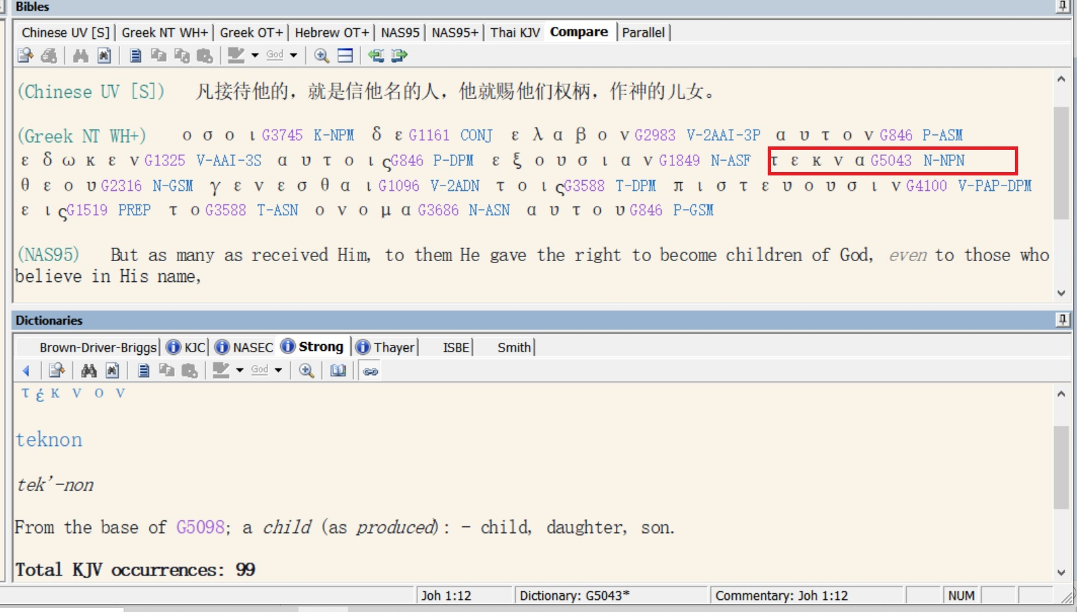

Slide 26
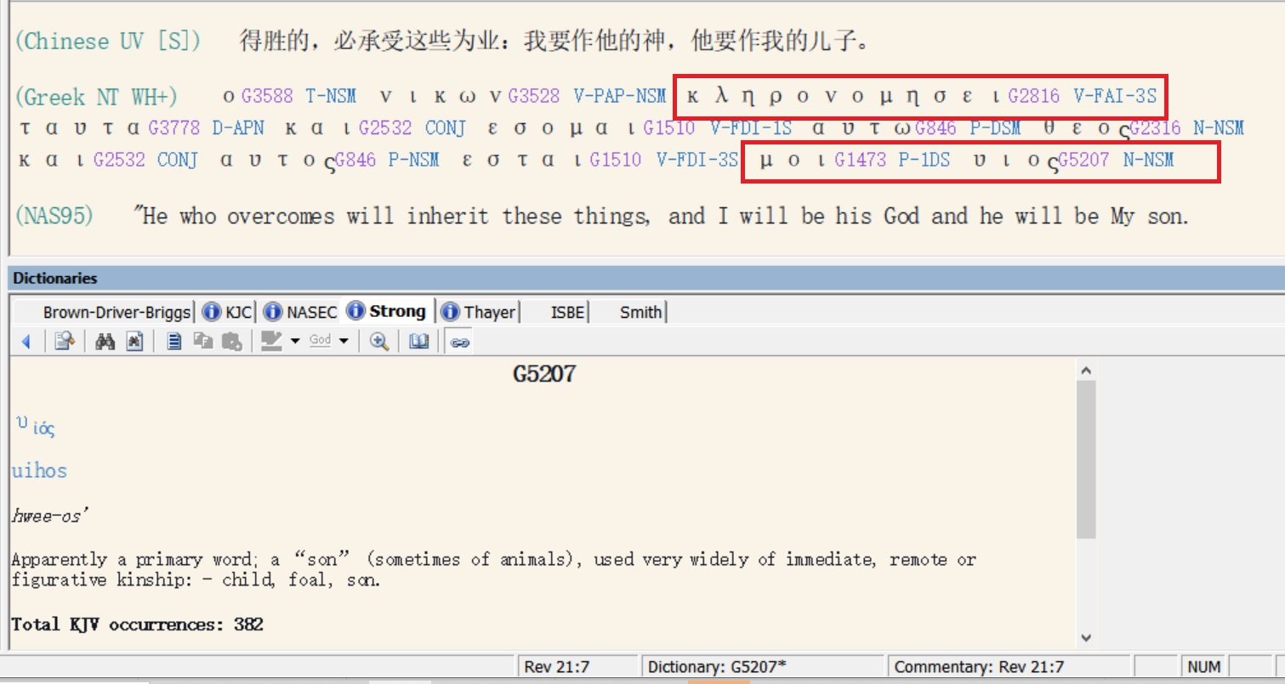

Slide 27
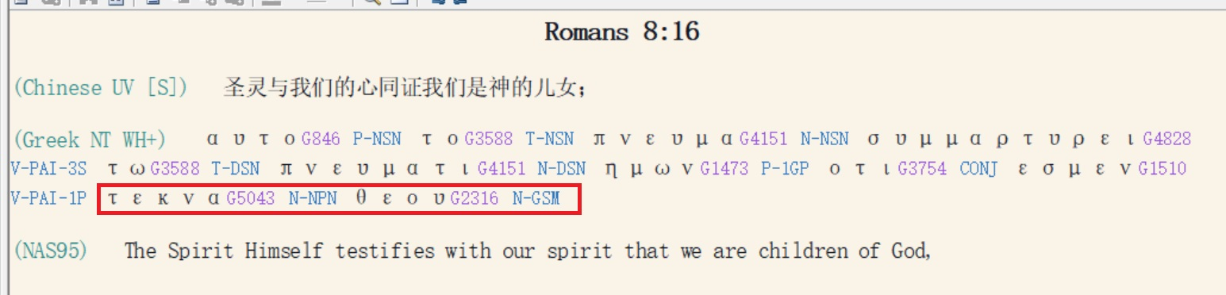
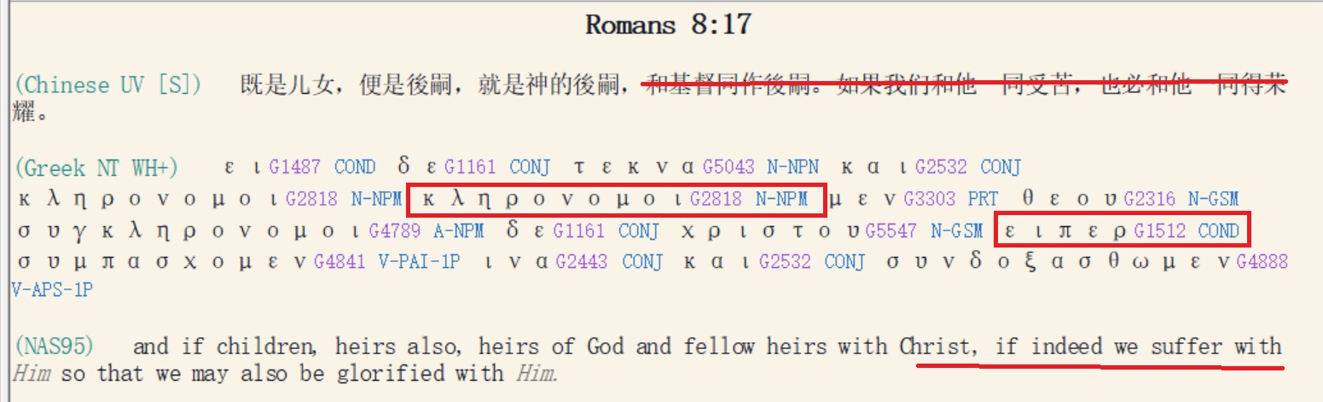

Slide 28
Three Phases of the Christian Life:
Phase | Description | Duration | Attained and Maintained by:
One | Salvation | 0.7 of a second (approx. time to make a ‘metanoeo’ decision) | Faith Alone in Christ Alone
Two | The Spiritual Life | From the moment of salvation to physical death or Rapture of Church | Consistent study and application of Bible doctrine under the power of the Holy Spirit.
Three | Eternity | Begins at the time of physical death or Rapture, continues forever. | Soul is first transferred into interim body then eternal body at Rapture.

Slide 29
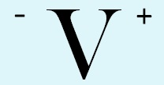
Life’s Important Decisions
Knowledge of God’s plan
+ (Greater) Arrogance
(i.e. refusal to apply)
= (Greater) Self Induced Misery
and Divine Discipline
Glorification of God
Escrow Blessings in Time and Eternity
(1 Cor. 3:12-14 /James 1:12)
Application of Doctrine
to Life and Circumstances
(James 3:18; 2:20-22)
Knowledge of God
and His Plan
(e.g. The 40 Absolutes / 10 Problem Solving Devices etc.)
Ignorance of God’s plan
+ Arrogance
= Self Induced Misery
and Divine Discipline
Study of Doctrine
(Rom 12:2; 2 Tim. 2:15)
Regenerate: Eternal Security
Unregenerate: Unsaved
40 Absolutes received at Salvation
Gospel Hearing
(John 3:16; Mar. 1:15; Acts 16:31)
God Consciousness
(Jer. 33:3; Ps. 14:1; Rom. 1:18-23; Acts 17:27)
The Great White
Throne Judgment
Cast into the lake of fire
(Matt. 25:41; Rev. 20:15)
“-V” = “Negative Volition”
“V+” = “Positive Volition”
Condemnation
(John 3:18/Rom. 3:23)
Physical Death /
Torments
www.ibdoctrine.com

Slide 30
人生中的重要决定
对神的计划一无所知
+ （更严重的）傲慢
= （更严重的）自我导致的痛苦和神的管教
荣耀神
世上的与永恒中的
由第三者代管的祝福
（哥林多前书 3:12-14/雅各书 1:12）
将教义应用至生命与境况中
（雅各书 3:18，2:20-22）
对神和神的计划的了解
（例如：40个绝对/10个问题解决方法等）
对神的计划一无所知 + 傲慢
= 自我导致的痛苦和神的管教
学习教义
（罗马书 12:2；提摩太后书 2:15）
重生：永恒的保障
未重生：未得救
在得救时所得的
四十个绝对
听见福音
（约翰福音 3:16；马太福音 1:15；使徒行传 16:31）
认识到神的存在的那一刻
（耶利米书 33:3；诗篇 14:1；
罗马书 1:18-23；使徒行传 17:27）
“-V” = “Negative Volition”
“-V” = “消极意志”
“V+” = “Positive Volition”
“V+” = “积极意志”
定罪
（约翰福音 3:18/罗马书 3:23）
身体死亡/
阴间
白色大宝座的审判
被扔在火湖里
（马太福音 25:42；启示录 20:15）
www.ibdoctrine.org

