Slide 1
四十种绝对恩赐
The 40 absolutes
Lesson Ten
2025 10 01

Slide 2
The believer is regenerated (John 13:10; 1 Cor. 6:11; Titus 3:5). He is:
信徒得以重生（约翰福音 13:10；哥林多前书 6:11；提多书 3:5）。信徒是：
Born again (John 3:3-8; 1 Pet. 1:23).
蒙了重生（约翰福音 3:3-8；彼得前书 1:23）。
A child of God (Rom. 8:16; Gal. 3:26).
神的孩子（罗马书 8:16；加拉太书 3:26）。
A son of God (John 1:12; 2 Cor. 6:18; 1 John 3:2).
神的儿子（约翰福音 1:12；哥林多后书 6:18；约翰一书 3:2）。
A new creation (2 Cor. 5:17; Gal. 6:15; Eph. 2:10).
新造的人（哥林多后书 5:17；加拉太书 6:15；以弗所书 2:10）。

Slide 3
John 3:4 尼哥底母说：「人已经老了，如何能重生呢？岂能再进母腹生出来吗？」
Nicodemus *said to Him, "How can a man be born when he is old? He cannot enter a second time into his mother's womb and be born, can he?"
John 3:5 耶稣说：「我实实在在的告诉你，人若不是从水和圣灵生的，就不能进神的国。
Jesus answered, "Truly, truly, I say to you, unless one is born of water [from amniotic fluid at physical birth] and the Spirit [spiritual birth] he cannot enter into the kingdom of God.
John 3:6 从肉身生的就是肉身；从灵生的就是灵。
"That which is born of the flesh [physical birth] is flesh, and that which is born of the Spirit [spiritual birth] is spirit.
John 3:7 我说：『你们必须重生』，你不要以为希奇。
"Do not be amazed that I said to you, 'You must be born again.'

Slide 4
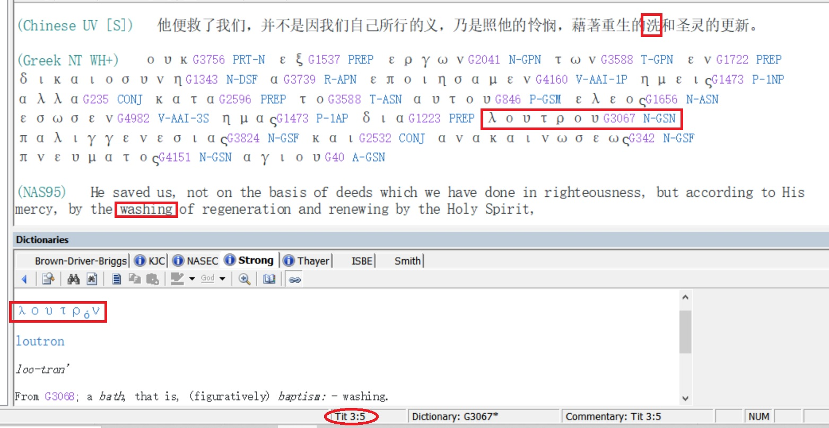

Slide 5
John 13:6 挨到西门彼得，彼得对他说：「主啊，你洗 [νίπτω / nipto] 我的脚吗？」
So He *came to Simon Peter. He *said to Him, "Lord, do You wash [νίπτω / nipto] my feet?"
John 13:7 耶稣回答说：「我所做的，你如今不知道，後来必明白。」
Jesus answered and said to him, "What I do you do not realize now, but you will understand hereafter."
John 13.8 彼得说：「你永不可洗 [νίπτω / nipto] 我的脚！」耶稣说：「我若不洗 [νίπτω / nipto] 你，你就与我无分了。」
Peter *said to Him, "Never shall You wash my feet!" Jesus answered him, "If I do not wash you, you have no part with Me."

Slide 6
John 13:9 西门彼得说：「主啊，不但我的脚，连手和头也要洗。」
(NAS95) Simon Peter *said to Him, "Lord, then wash not only my feet, but also my hands and my head."
John 13:10 (go to E-sword) 耶稣说：「凡洗过澡 [λούω / louo] 的人，只要把脚一洗 [νίπτω / nipto]，全身就乾净 [καθαρός / katharos]了。你们是乾净 [καθαρός / katharos]的，然而不都是乾净的。」
Jesus *said to him, "He who has bathed [λούω / louo] needs only to wash [νίπτω / nipto] his feet, but is completely clean [καθαρός / katharos]; and you are clean [καθαρός / katharos] , but not all of you."
1 John 1:9
我们若认自己的罪，神是信实的，是公义的，必要赦免我们的罪，洗净 [καθαρός / katharos] 我们一切的不义。
If we confess our sins, He is faithful and righteous to forgive us our sins and to cleanse [καθαρός / katharos] us from all unrighteousness.

Slide 7
John 13:6-10
Without criticizing them, Jesus decided to clean their feet not only to solve the immediate problem of their filthy feet, but primarily to teach by analogy that his work on the cross would be the basis for the confession of sins.
1. All twelve disciples had bathed before departing from Bethany and coming to Jerusalem where the Last Supper would take place. This cleansing of the whole body is analogous to their salvation with emphasis on the forgiveness of pre-salvation-sins.
2. On the way to the location where the Last Supper would take place, they had to walk through a number of filthy streets, for in those times they did not have plumbing as we do now and people would just throw their bowls of excrement onto the street. The apostles should have washed their feet (as was custom) before entering the home where the supper would take place. Washing the filth (representing sins) from their feet would be analogous to the confession of their sins.
3. Dining at the table was fellowship with the Lord (Revelation 3:20). The believer cannot have fellowship with the Lord with filth on his feet! (in a state of sin and carnality).
4. The feet are analogous to service (Isaiah 52:7). One cannot serve the Lord with filthy feet (while in carnality).

Slide 8
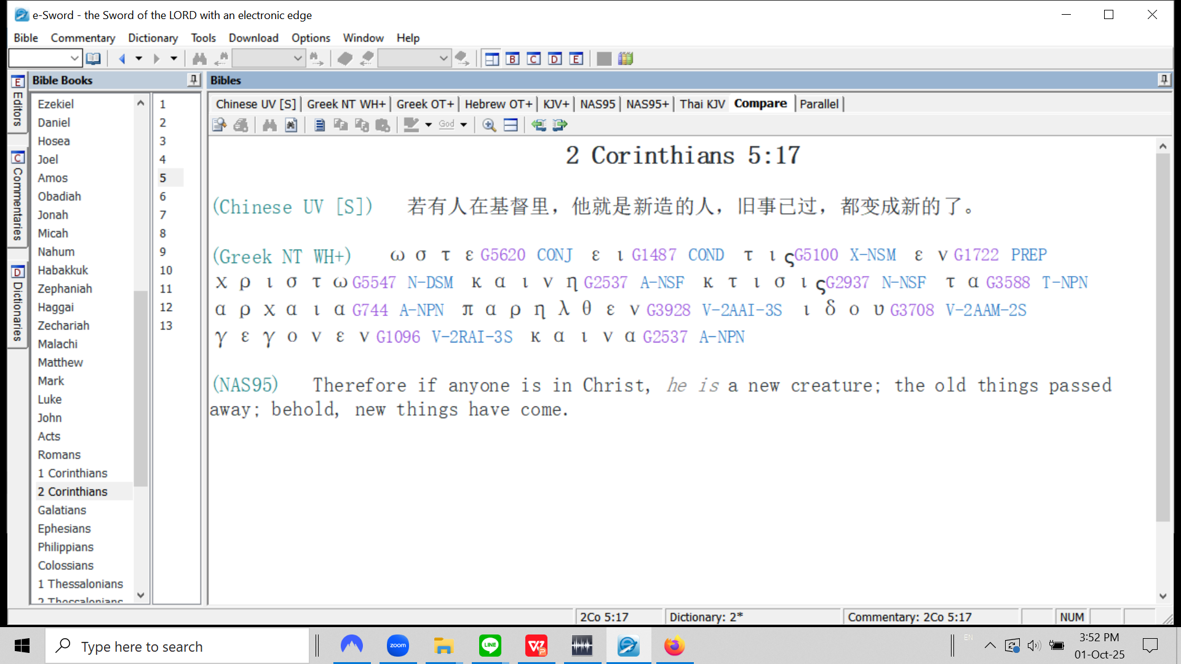

Slide 9
The believer is adopted by God, placed as an adult son because of positional truth (Rom. 8:15, 23 at resurrection; Eph. 1:5).
信徒蒙上帝收养，因着位分上的真理而被置于成年儿子的地位（罗马书 8:15、23（罗 8:23指复活时得收养）；以弗所书 1:5）。

Slide 10
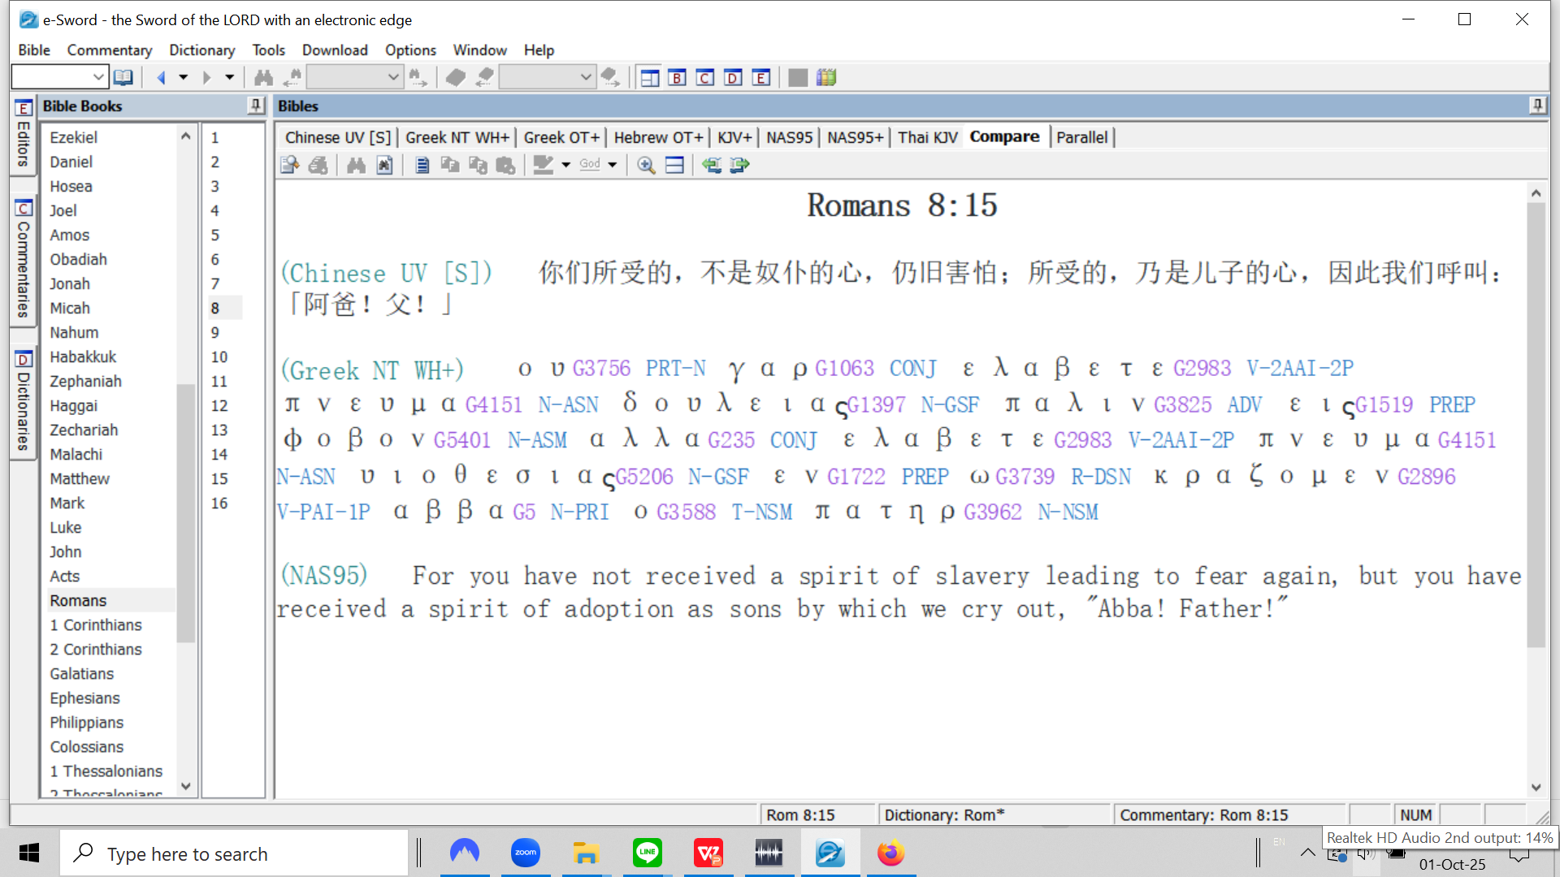

Slide 11
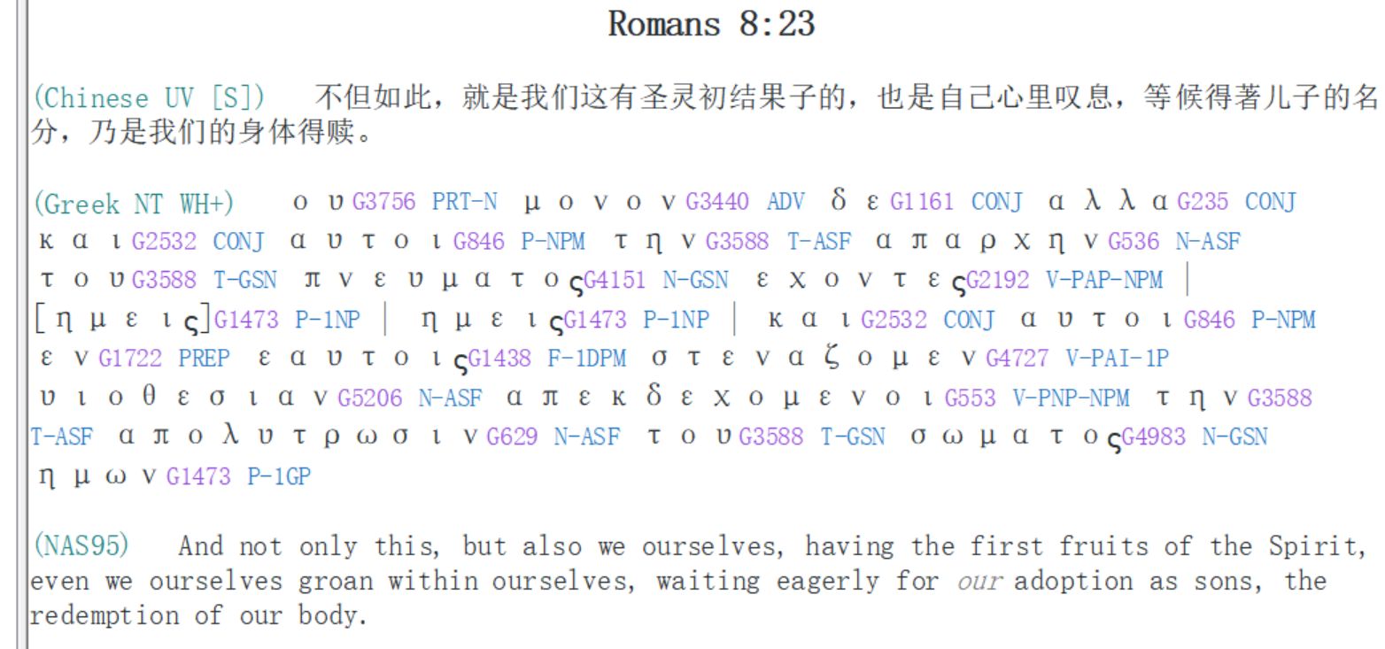

Slide 12
