Slide 1
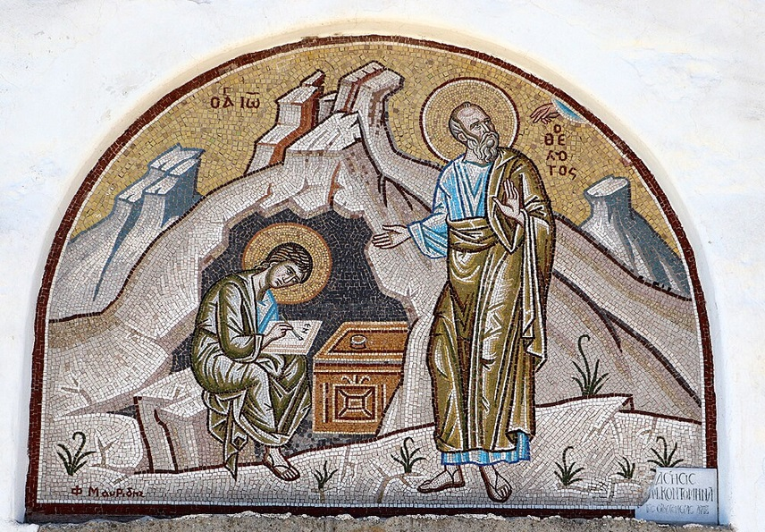
การวิเคราะห์พระธรรมวิวรณ์
สอนโดย อ.Tim จากคำบันทึกของ อ. Max Klein
REVELATION 036
2025 04 01

Slide 2
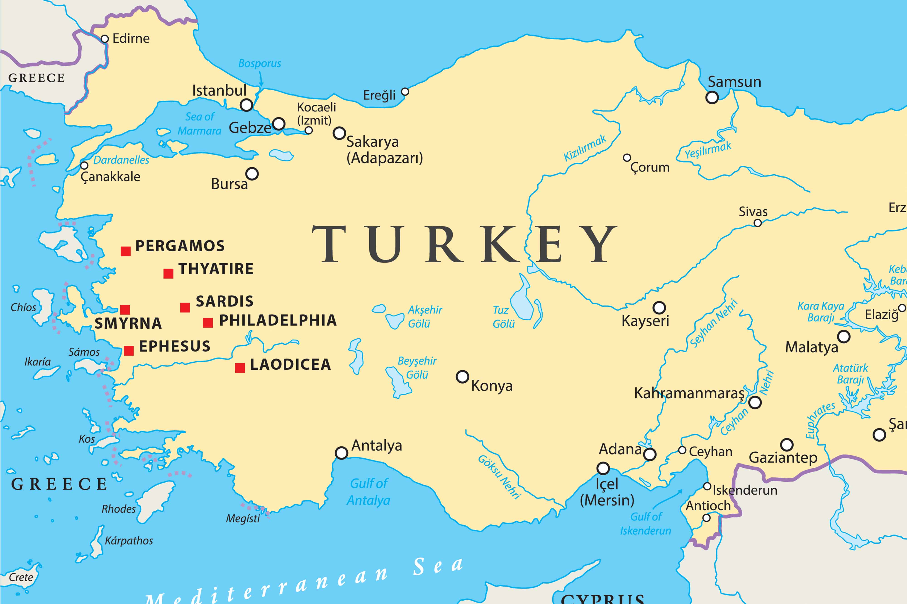

Slide 3
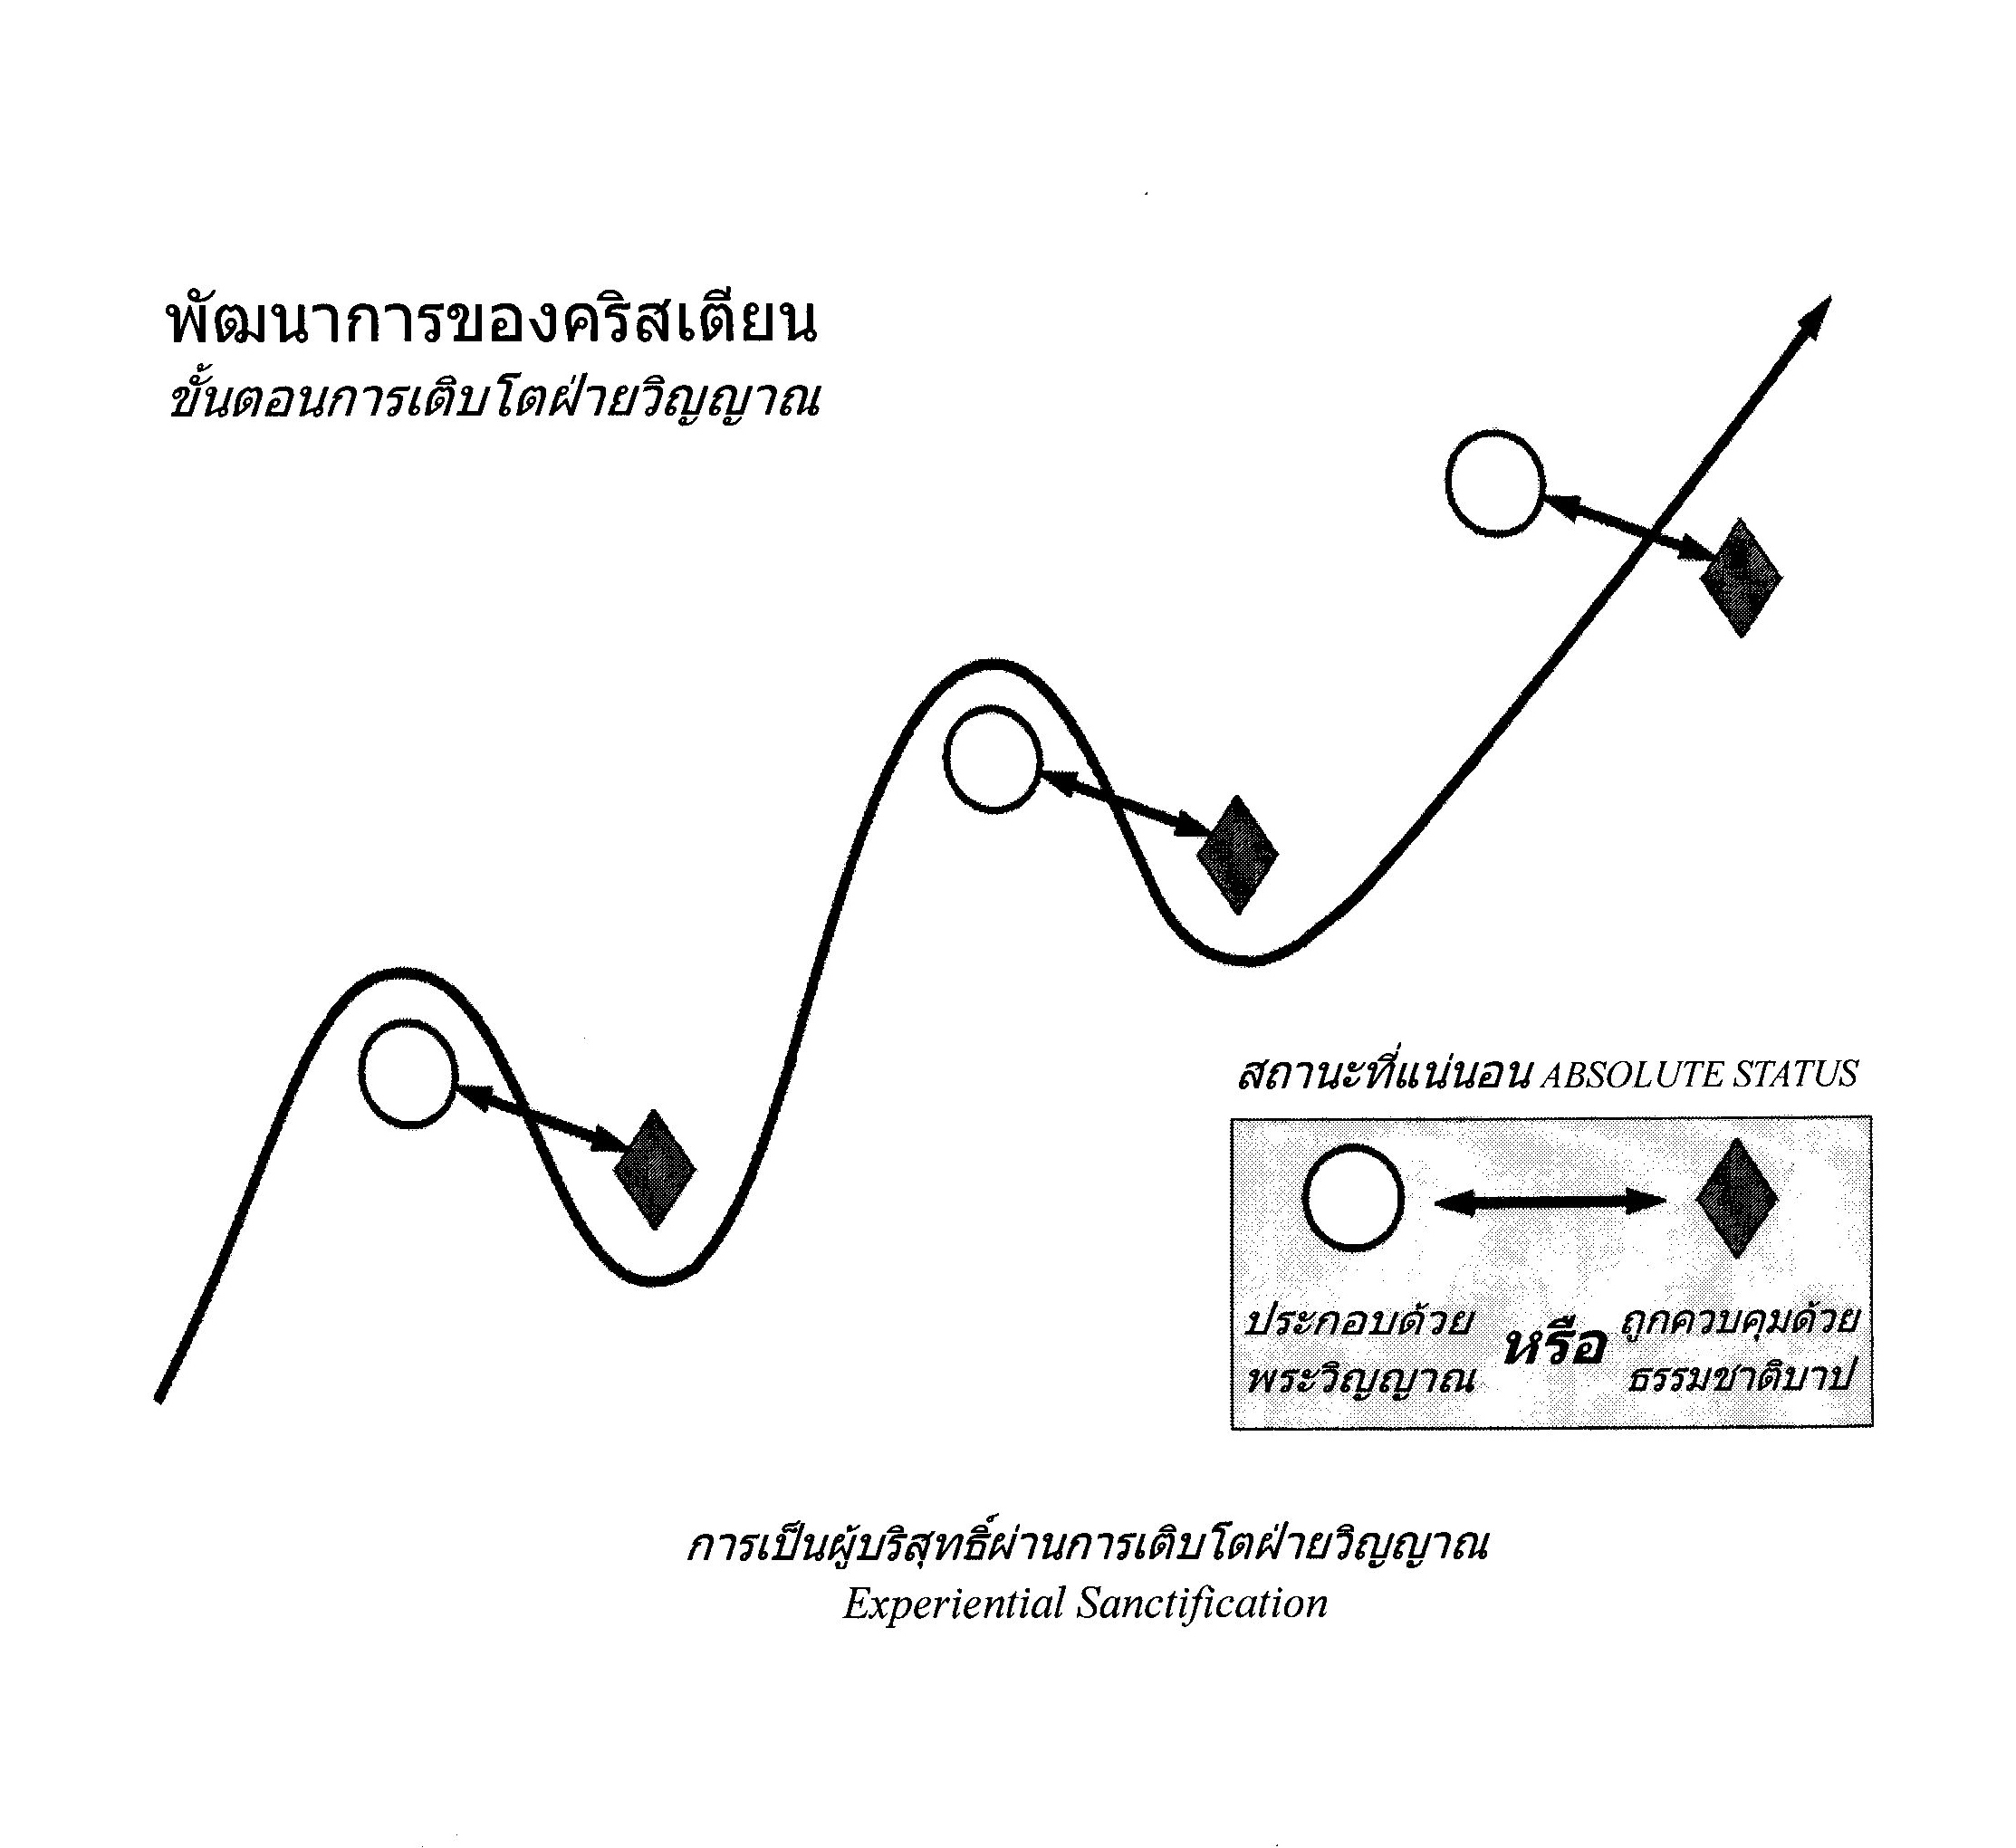
1. Spiritual growth should be constant over time.
2. There is an ultimate goal(s): Spiritual maturity, love for God, occupation with Christ, passing of evidence testing (telos/telios)
3. If studying and applying every day, every new day should be an improvement on the previous day regardless of circumstances.

Slide 4
Distractions:
Religion : “Satan’s ace trump” (see next slide for explanation)
Materialism
Liberalism, leading not to freedom but totalitarian control
Promotion of lust (monetary, power, approbation, sex, drugs, entertainment etc.)
Socialism / Globalism / Environmentalism
Anti-semitism
“Emotional revolt of the soul” - incl. Society (social life, time-wasting friendships or relationships)

Slide 5
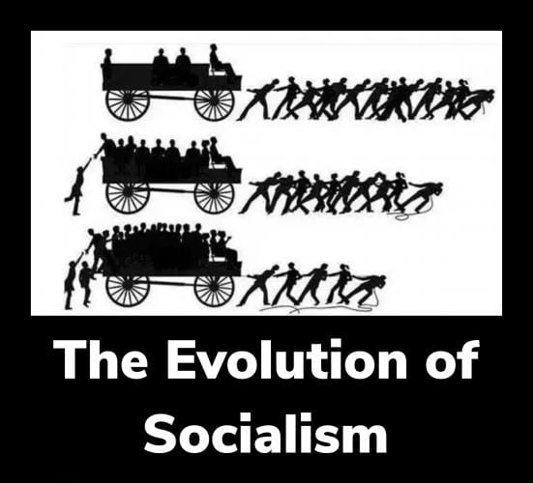

Slide 6
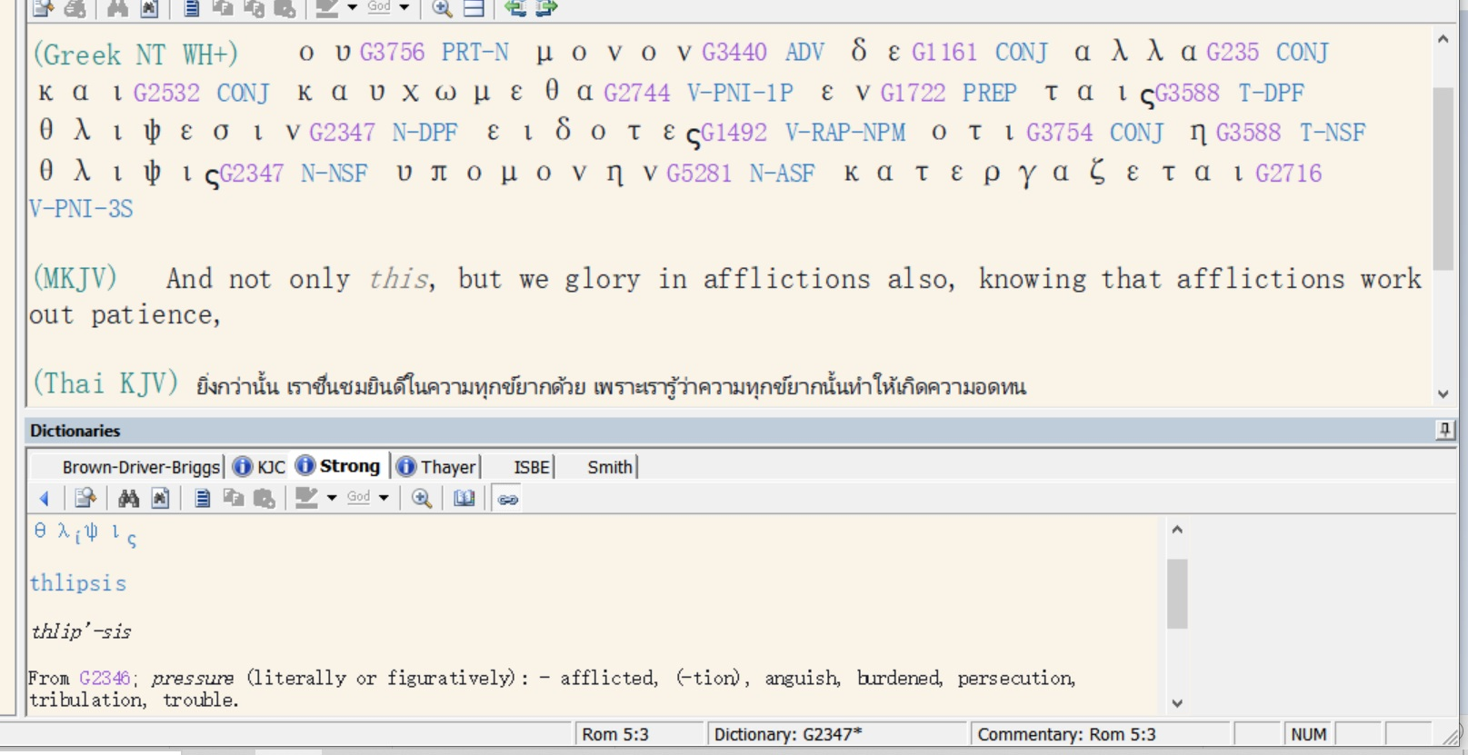

Slide 7
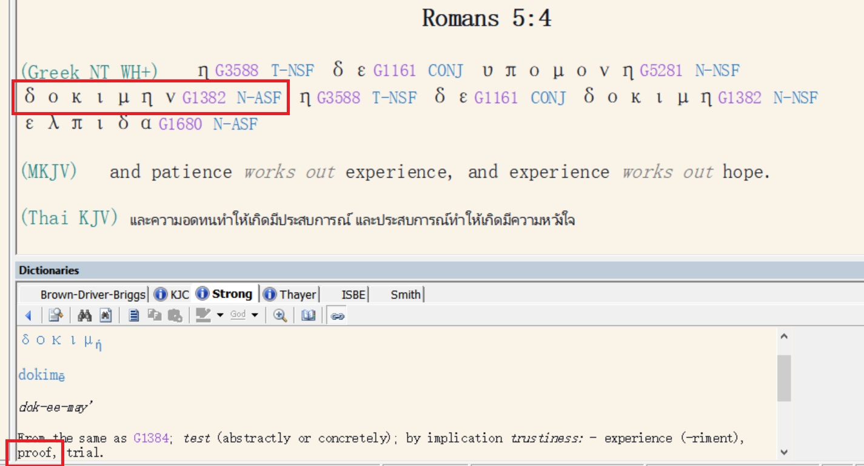

Slide 8
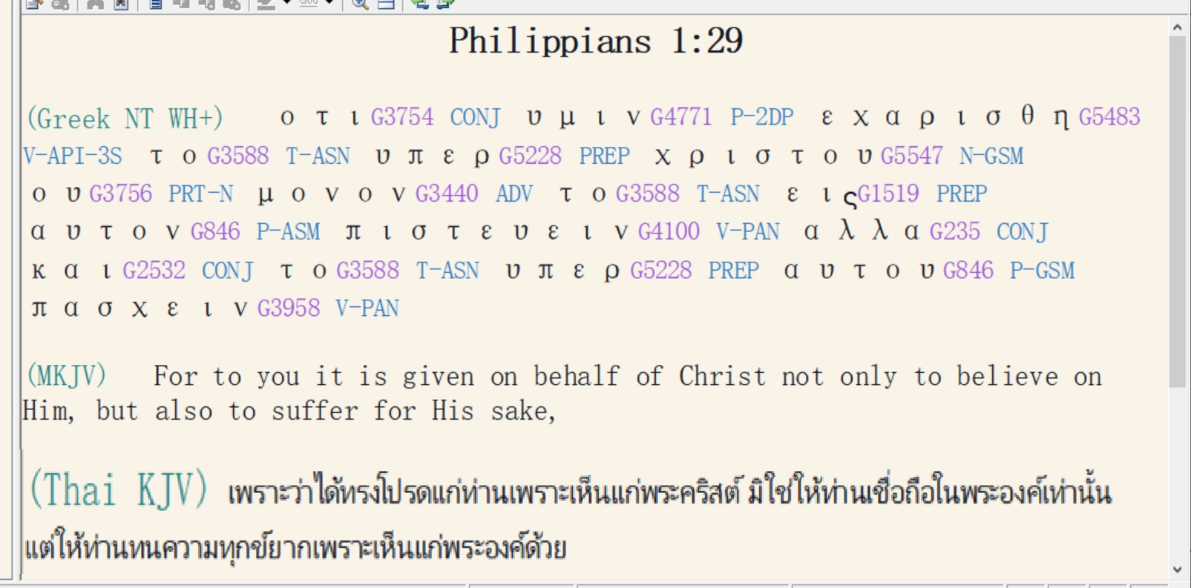

Slide 9
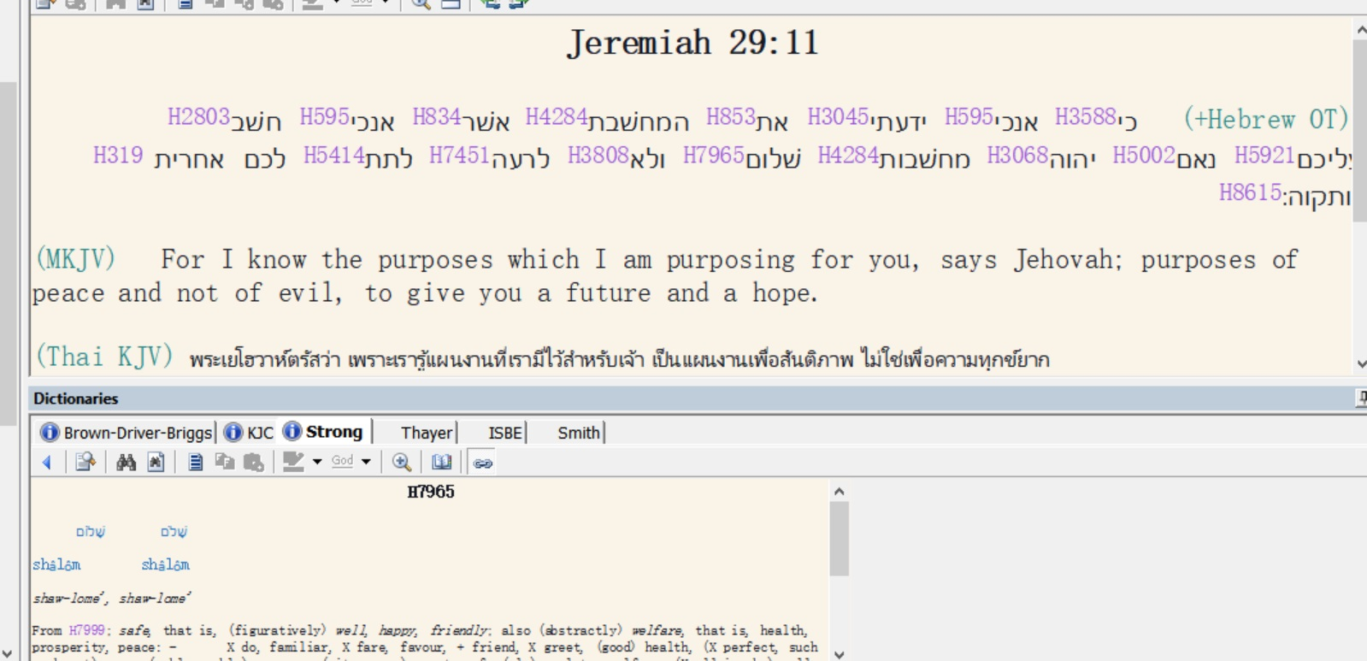

Slide 10
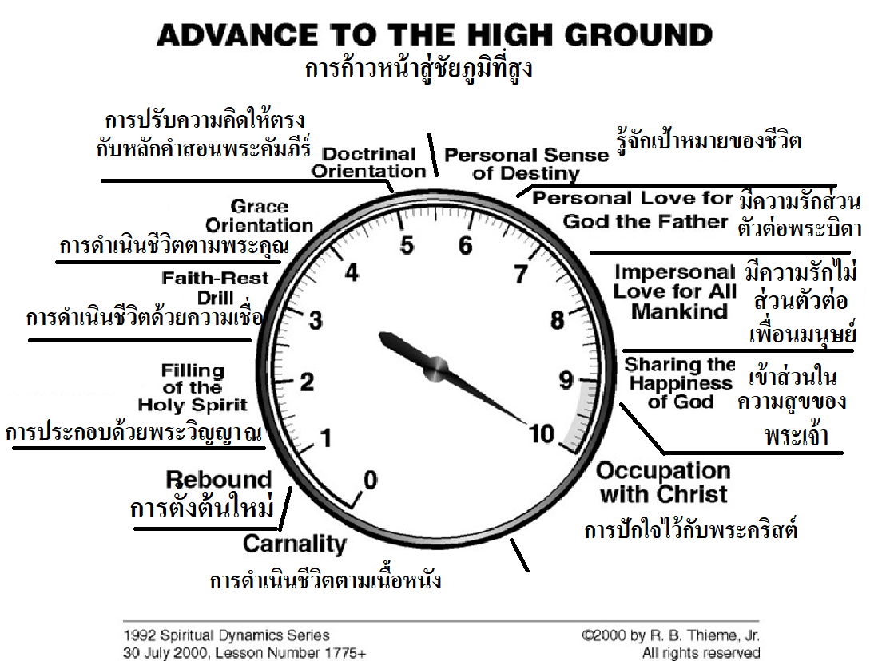

Slide 11
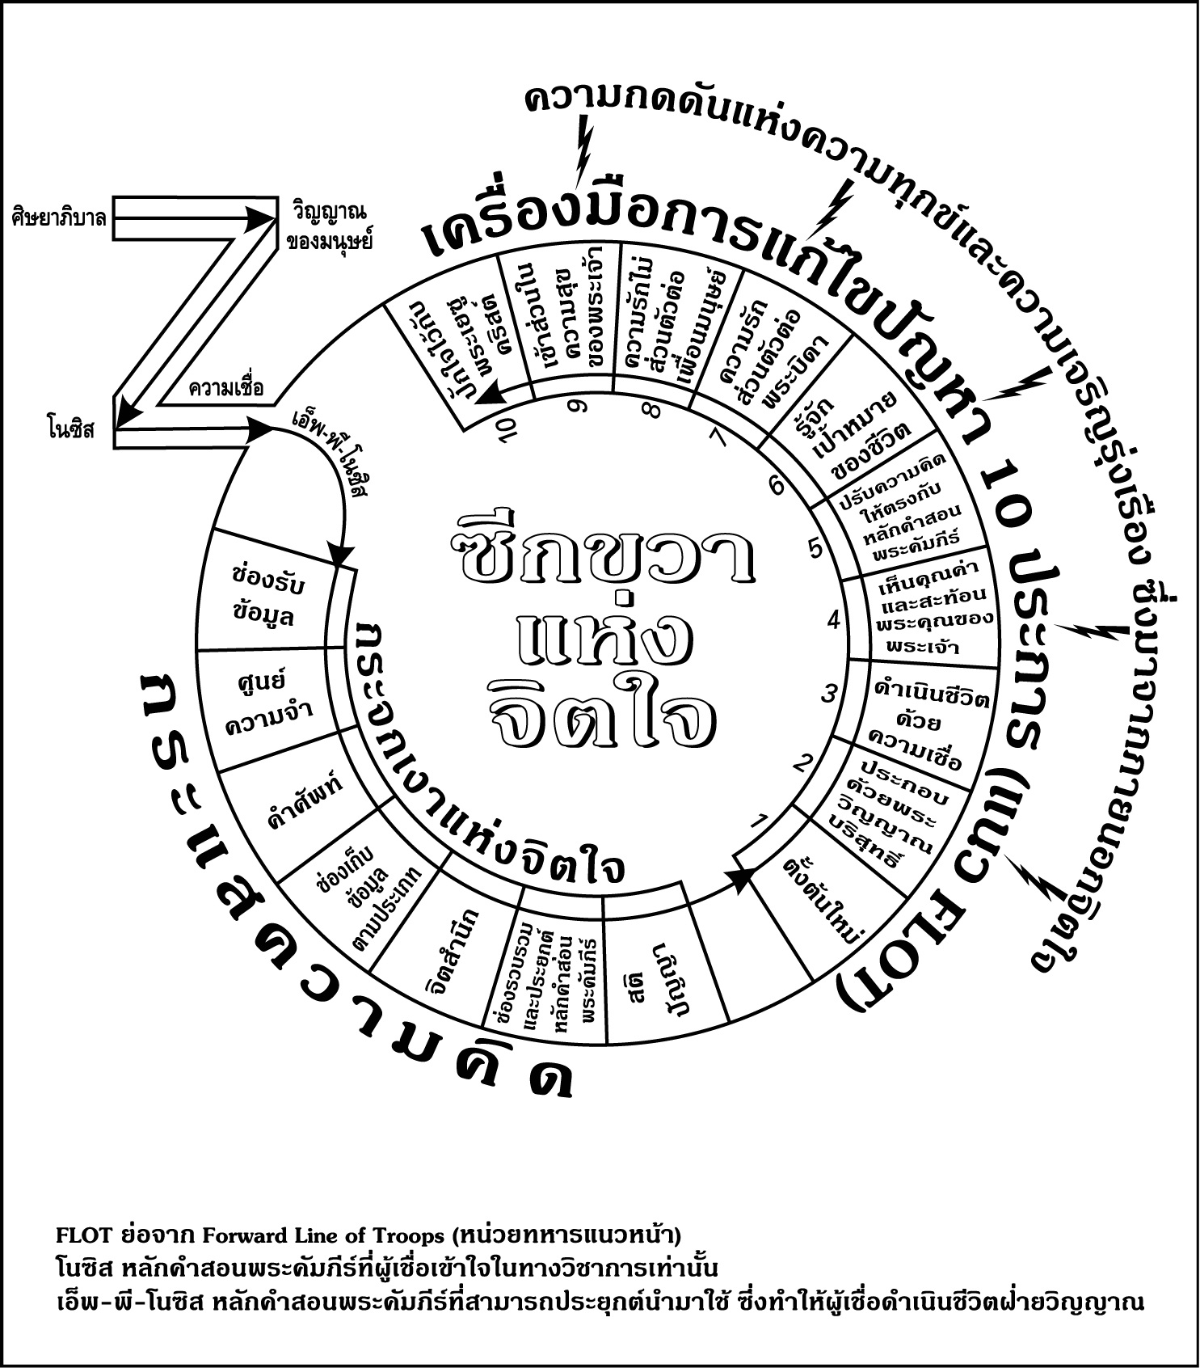

Slide 12
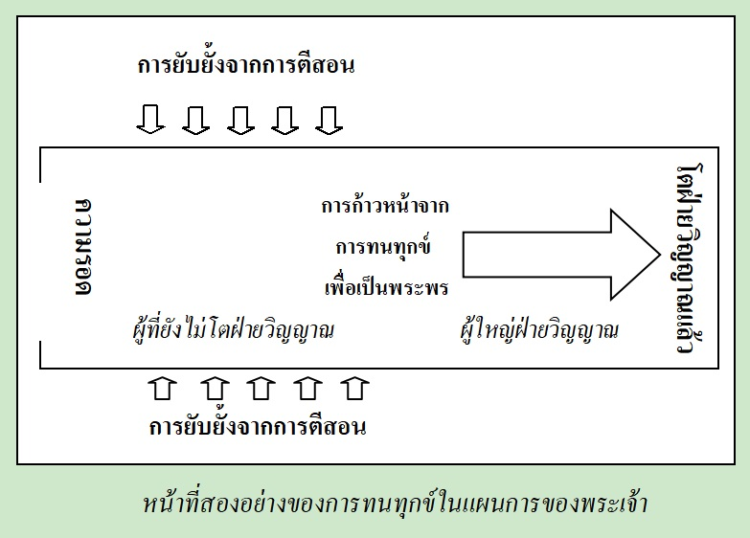
จากหนังสือ การทนทกุข์ของคริสเตียน หน้าที่ 3

Slide 13
วิวรณ์ 2:8.
Καὶ τῷ ἀγγέλῳ τῆς ἐν Σµύρνῃ ἐκκλησίας γράψον· Τάδε λέγει ὁ πρῶτος καὶ ὁ ἔσχατος, ὃς ἐγένετο νεκρὸς καὶ ἔζησεν·
And to the messenger [a reference to the pastor] of the church in Smyrna write: The first and the last, who was dead, and has come to life, says this:
จงเขียนถึงทูตสวรรค์แห่งคริสตจักรที่เมืองสเมอร์นาว่า `พระองค์ผู้ทรงเป็นเบื้องต้นและเป็นเบื้องปลาย ผู้ซึ่งสิ้นพระชนม์แล้ว และกลับฟื้นขึ้นอีก ได้ตรัสดังนี้ว่า

Slide 14
Smyrna (current day: “Izmir - the Pearl of the Aegean” ), a large Ionian city on the west coast of Asia Minor was at the head of the Gulf of Smyrna which reached 30 miles inland from the Aegean Sea, and just 40 miles north of Ephesus. Anciently, it was one of the finest cities of Asia and was called “the lovely—the crown of Ionia—the ornament of Asia.”
Because of its magnificent port, it became a prosperous trading center. Along with Ephesus and Pergamum, Smyrna became one of the most brilliant and prosperous cities of Anotalia (Asian Minor). The population of the city at the time that John wrote was about 200,000.
To its credit, it was the only one of the seven churches in Revelation 2 & 3 which received no word of reproach from the Lord.

Slide 16
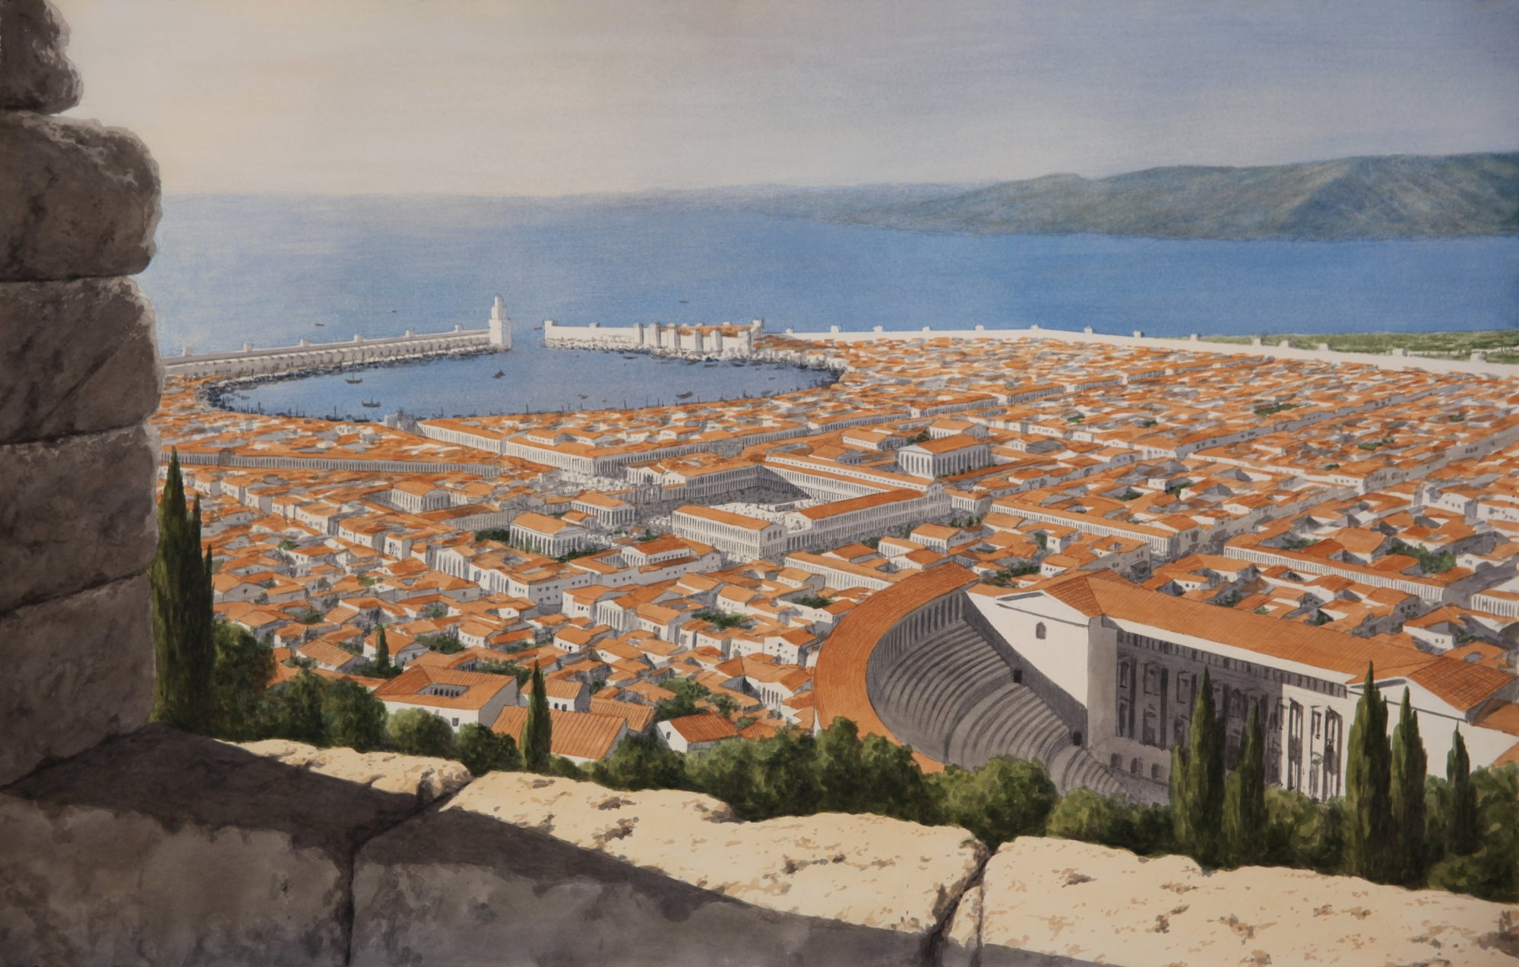

Slide 17
บทเรียนต่อไป :
ความหมายสีรูแบปของวลี “เบื้องต้นและเป็นเบื้องปลาย”
Four meanings to the phrase, “The first and the last”

