Slide 1
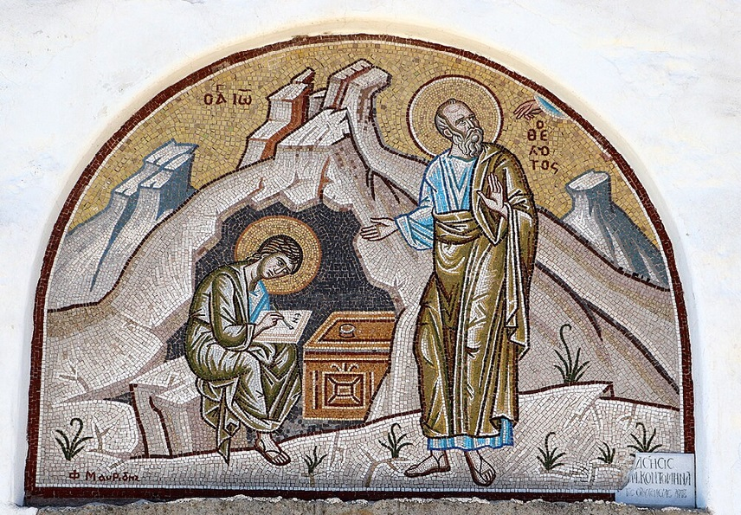
การวิเคราะห์พระธรรมวิวรณ์ สอนโดย อ.Tim จากคำบันทึกของ อ. Max Klein
REVELATION 042 2025 04 07

Slide 2
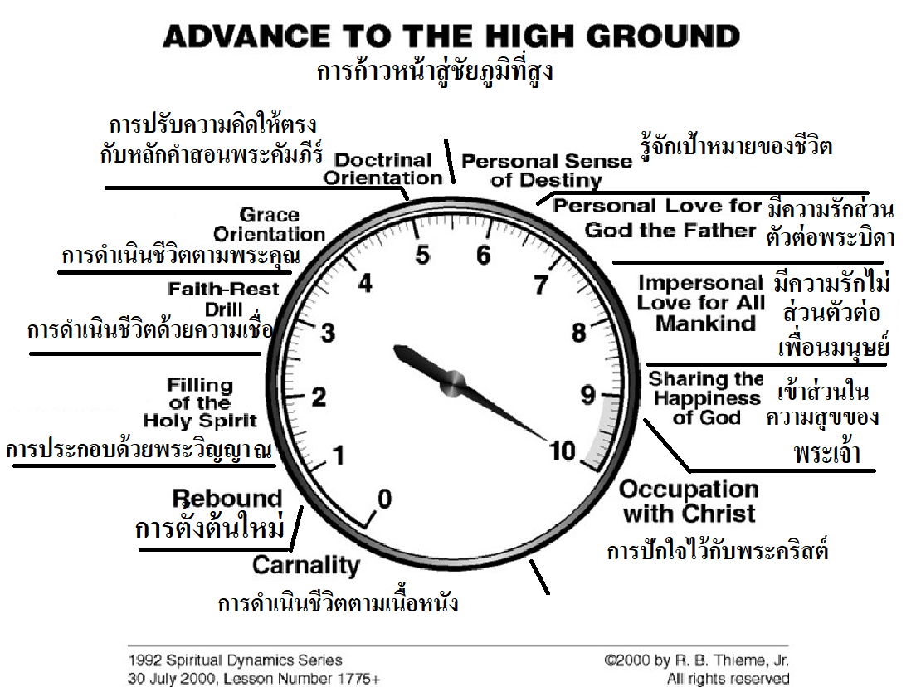

Slide 3
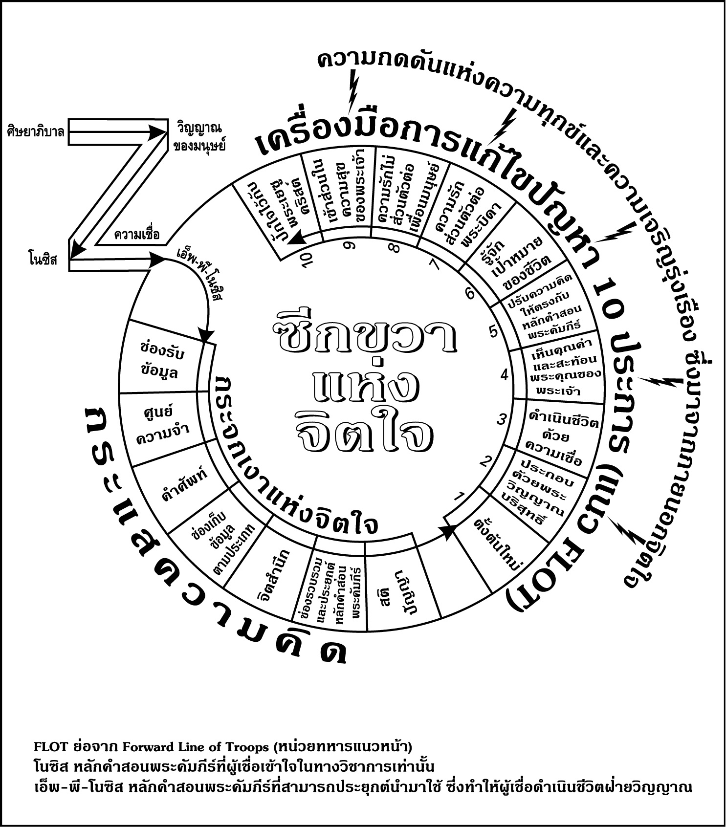

Slide 4
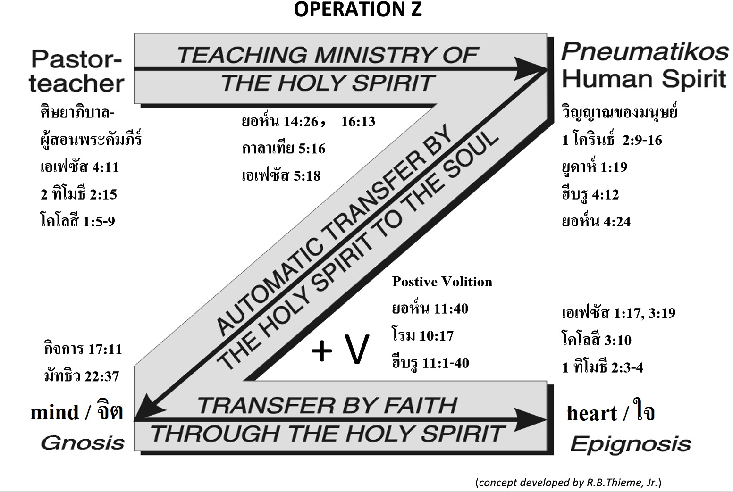

Slide 5
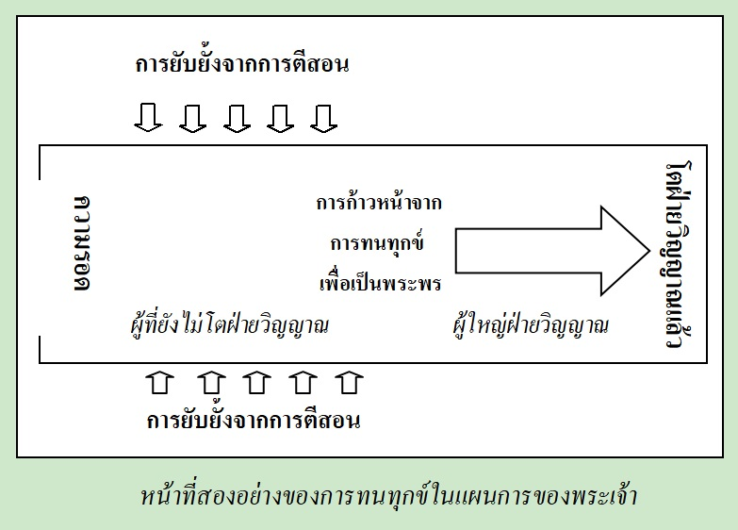
จากหนังสือ การทนทกุข์ของคริสเตียน หน้าที่ 3

Slide 6
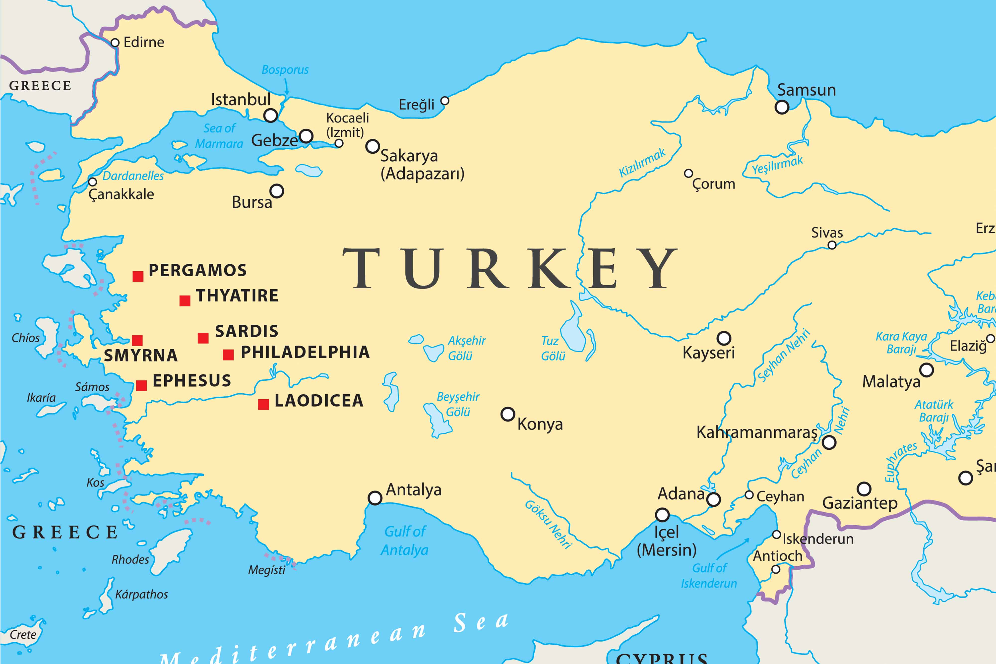

Slide 7
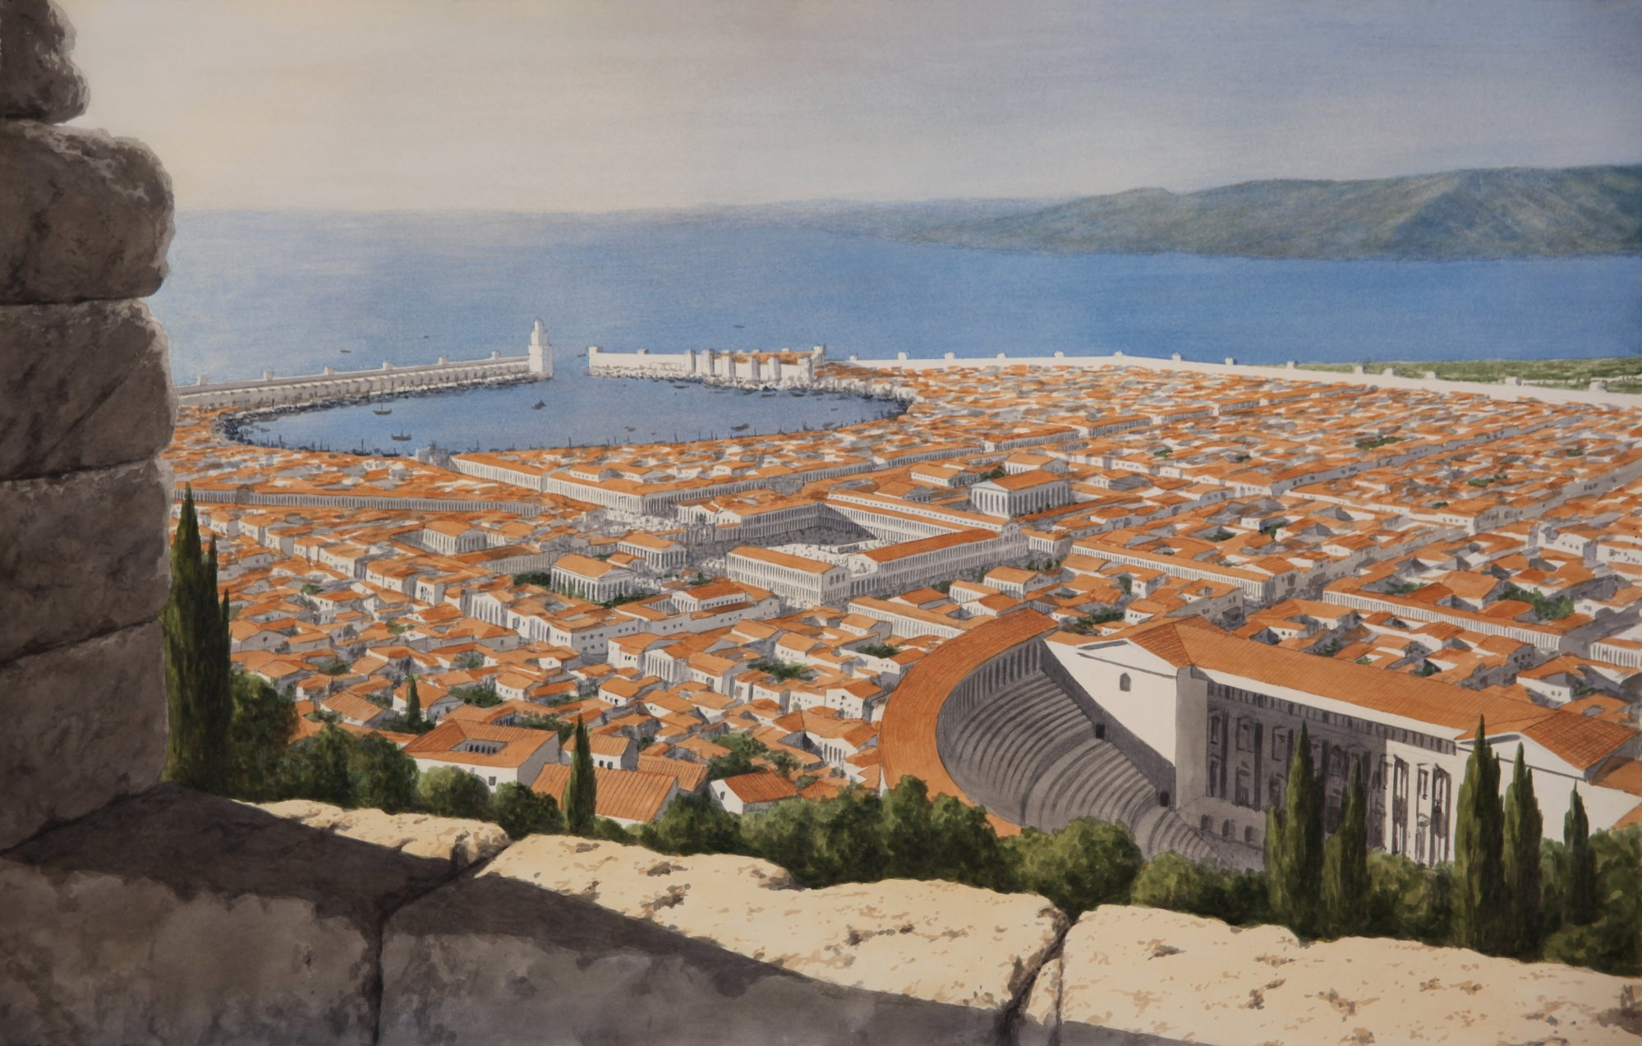

Slide 8
From R.B.Thieme, Jr. (Notes on Revelation)
Why the western coast of Turkey? Why the seven churches located in that area? Why not something in historical trends written to Rome or to Antioch or to Jerusalem? Why these? Because these seven churches, through residence and function in the divine dynasphere, carried client nation SPQR for a record time for any nation which has been a client nation to God. And for a period of time, from 96-180 AD, thanks to the mature believers who advanced to spiritual maturity and formed a pivot, we have one of the greatest periods of prosperity in all of human history.

Slide 9
Smyrna (current day: “Izmir - the Pearl of the Aegean” ), a large Ionian city on the west coast of Asia Minor was at the head of the Gulf of Smyrna which reached 30 miles inland from the Aegean Sea, and just 40 miles north of Ephesus. Anciently, it was one of the finest cities of Asia and was called “the lovely—the crown of Ionia—the ornament of Asia.”
Because of its magnificent port, it became a prosperous trading center. Along with Ephesus and Pergamum, Smyrna became one of the most brilliant and prosperous cities of Anotalia (Asian Minor). The population of the city at the time that John wrote was about 200,000.
To its credit, it was the only one of the seven churches in Revelation 2 & 3 which received no word of reproach from the Lord.

Slide 10
วิวรณ์ 2:8.
Καὶ τῷ ἀγγέλῳ τῆς ἐν Σµύρνῃ ἐκκλησίας γράψον· Τάδε λέγει ὁ πρῶτος καὶ ὁ ἔσχατος, ὃς ἐγένετο νεκρὸς καὶ ἔζησεν·
And to the messenger [a reference to the pastor] of the church in Smyrna write: The first and the last, who was dead, and has come to life, says this:
จงเขียนถึงทูตสวรรค์แห่งคริสตจักรที่เมืองสเมอร์นาว่า `พระองค์ผู้ทรงเป็นเบื้องต้นและเป็นเบื้องปลาย ผู้ซึ่งสิ้นพระชนม์แล้ว และกลับฟื้นขึ้นอีก ได้ตรัสดังนี้ว่า

Slide 11
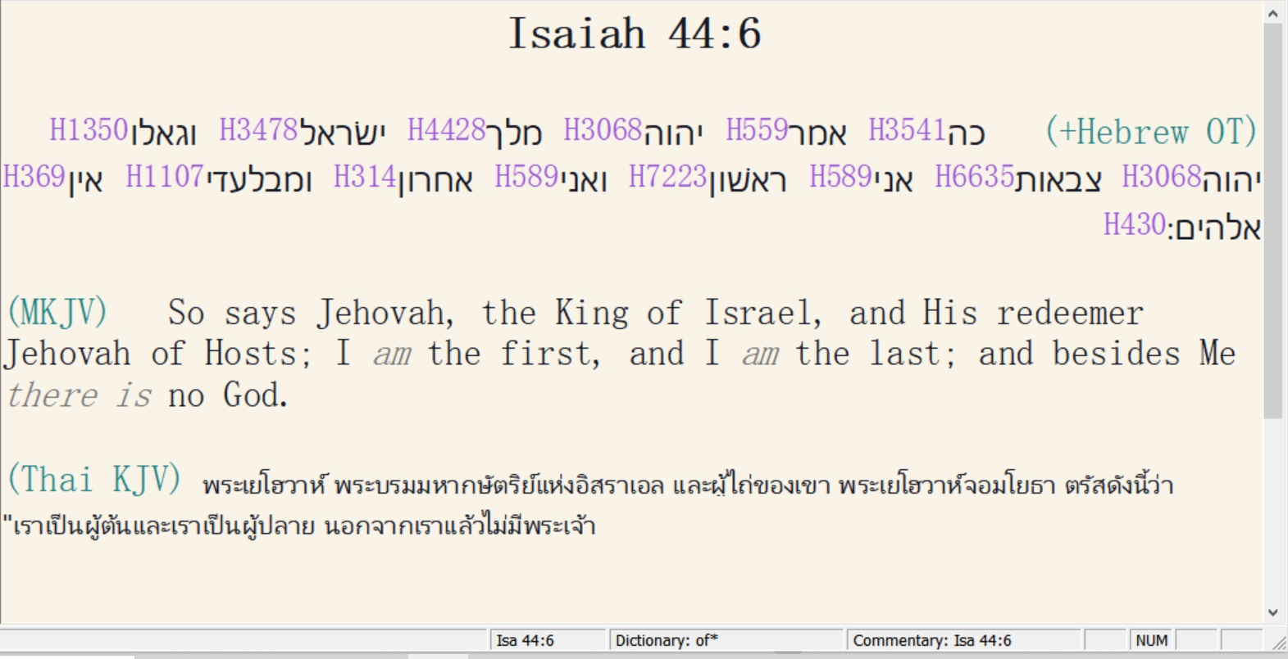

Slide 12
บทเรียนต่อไป :
ความหมายสีรูแบปของวลี “เบื้องต้นและเป็นเบื้องปลาย”
Four meanings to the phrase, “The first and the last”

Slide 13
1.
A. Jesus Christ as “the first” is eternal God, coequal and co-eternal with God the Father and God the Holy Spirit.
B. As eternal and infinite God, Jesus Christ pre-existed history and was the original creator of all things (John 1:3).
C. Jesus Christ in hypostatic union also concludes history as “the last”. He began history by personally creating man namely Adam. And as the last Adam He will personally conclude history with the destruction of the earth and stellar space.
D. Even though history is the record of man’s thoughts, motives, decisions, and actions, it is Jesus Christ, the first and the last, who controls history.
E. Therefore, there are two sources of judgements and disasters in history: the sovereign decisions of our Lord Jesus Christ and the erroneous decisions of mankind.

Slide 14
2.
A. The second meaning has to do with the two great prophecies of history. They are the first and second advents.
B. So, many prophecies in the Old Testament deal with the details of our Lord’s first advent, all of which are a part of “the first.”
C. Everything pertaining to the First Advent was fulfilled prior to the beginning of the Church Age namely the virgin birth, the incarnation, the hypostatic union, our Lord’s residence and function in the prototype spiritual life, His resultant impeccability, His saving work on the cross, His death on the cross, His physical resurrection, ascension, and session.
D. Therefore, Christ as the first is related to the first advent and the strategic victory of the cross. Christ as the last is related to His victory at the second advent. The first and the last, then, is a title of our Lord Jesus Christ as the prophetical key to human history.

Slide 15
3.
A. The third meaning of our subject by application refers to the uptrends and downtrends of history depending upon the decisions of Christians.
B. Christ is either first or last to every believer dependent upon whether the believer is executing the spiritual life or living in the Cosmic System.
C. In other words, as goes the believer in Christ so goes human history in any generation.
D. When the believer puts Christ first in his scale of values, it contributes to the uptrend of history; when the believer puts Christ last in his scale of values it contributes to the downtrend of history.
E. Therefore, “the First and Last” emphasizes the function of human volition in history especially that of the Christian.

Slide 16
4.
A. “First and last” also by application refers to the source of both temporal and eternal blessing for the believer.
B. Our first blessing relates to time while our last blessing relates to eternity.
C. “First and last” is the fulfilment of the Christian way of life resulting in our Lord distributing Escrow Blessings in time and eternal blessing and reward at the judgment seat of Christ.

