Slide 1
四十种绝对恩赐
The 40 absolutes
Lesson Seven
2025 09 10

Slide 2
三十九种不可撤销的绝对恩赐
39 IRREVOCABLE Absolutes

Slide 3
The believer is dead to old life, the sin nature, but alive to God, retroactive positional truth. He is:
信徒对旧生命、对罪性是死的，对上帝、对追溯性的位分真理则是活的。信徒是：
Crucified with Christ (Rom. 6:6; Gal. 2:20).
与基督同钉十字架（罗马书 6:6；加拉太书 2:20）。
Dead with Christ (Rom. 6:8; Col. 3:3; 1 Pet. 2:24).
与基督同死（罗马书 6:8；歌罗西书 3:3；彼得前书 2:24）。
Buried with Christ (Rom. 6:4; Col. 2:12).
与基督一同埋葬（罗马书 6:4；歌罗西书 2:12）。
Raised with Christ, current positional truth (Rom. 6:4; 7:4; Col. 2:12; 3:1).
与基督一同复活，这是当前的位分真理（罗马书 6:4，7:4；歌罗西书 2:12，3:1）。

Slide 4
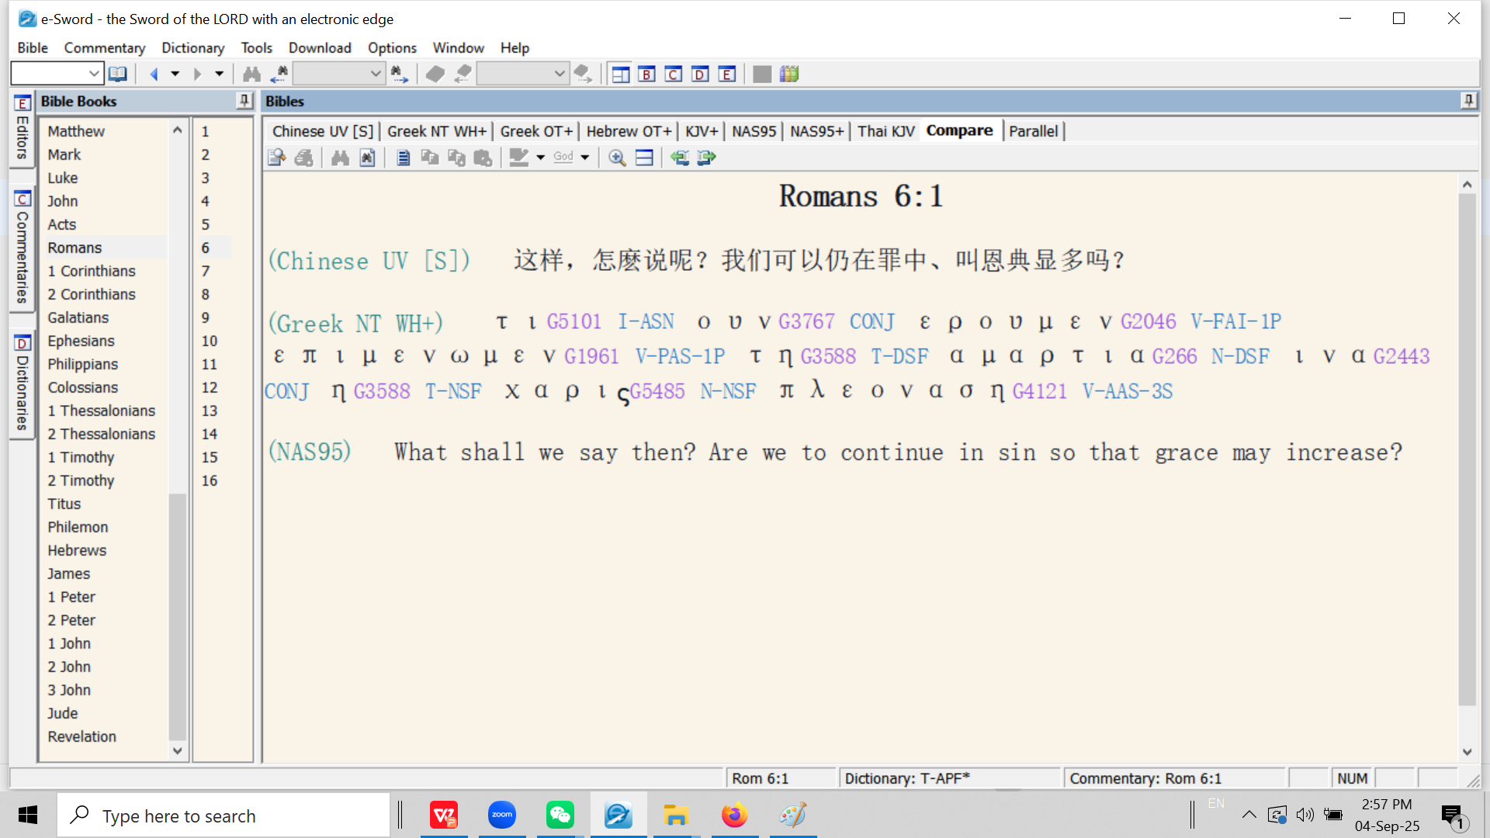
Retroactive positional truth (Romans 6:1-6)
回溯性位分真理（罗马书 6:1-6）
Rom 6:1 What shall we say then? Are we to continue by means of the sin nature so that grace may increase?
Rom 6:1 这样，我们要怎么说呢？我们可以仍在罪中藉着罪性使恩典增多吗？
DSF = Dative (case) Singular (number) Feminine (gender)

Slide 5

Rom 6:2 May it never be! How shall we who died to the sin nature still live in it?
Rom 6:2 绝对不可！我们向罪罪性死了的人，岂可仍在罪中藉着罪性活着呢？

Slide 6
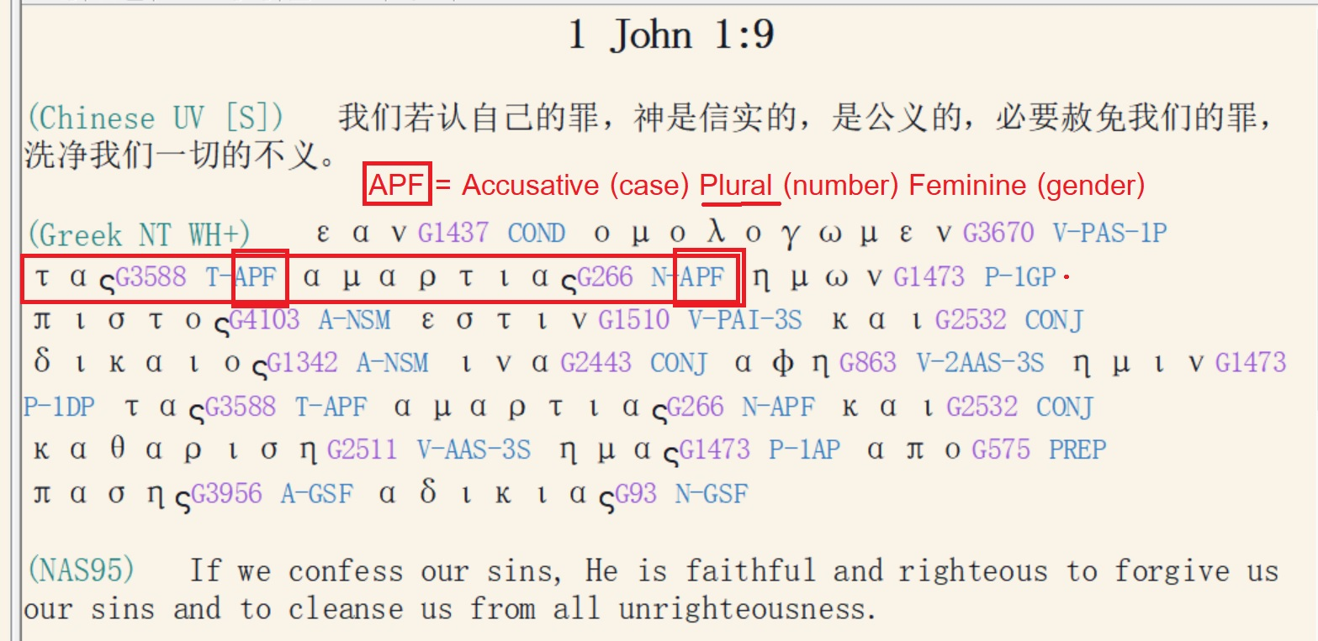

Slide 7
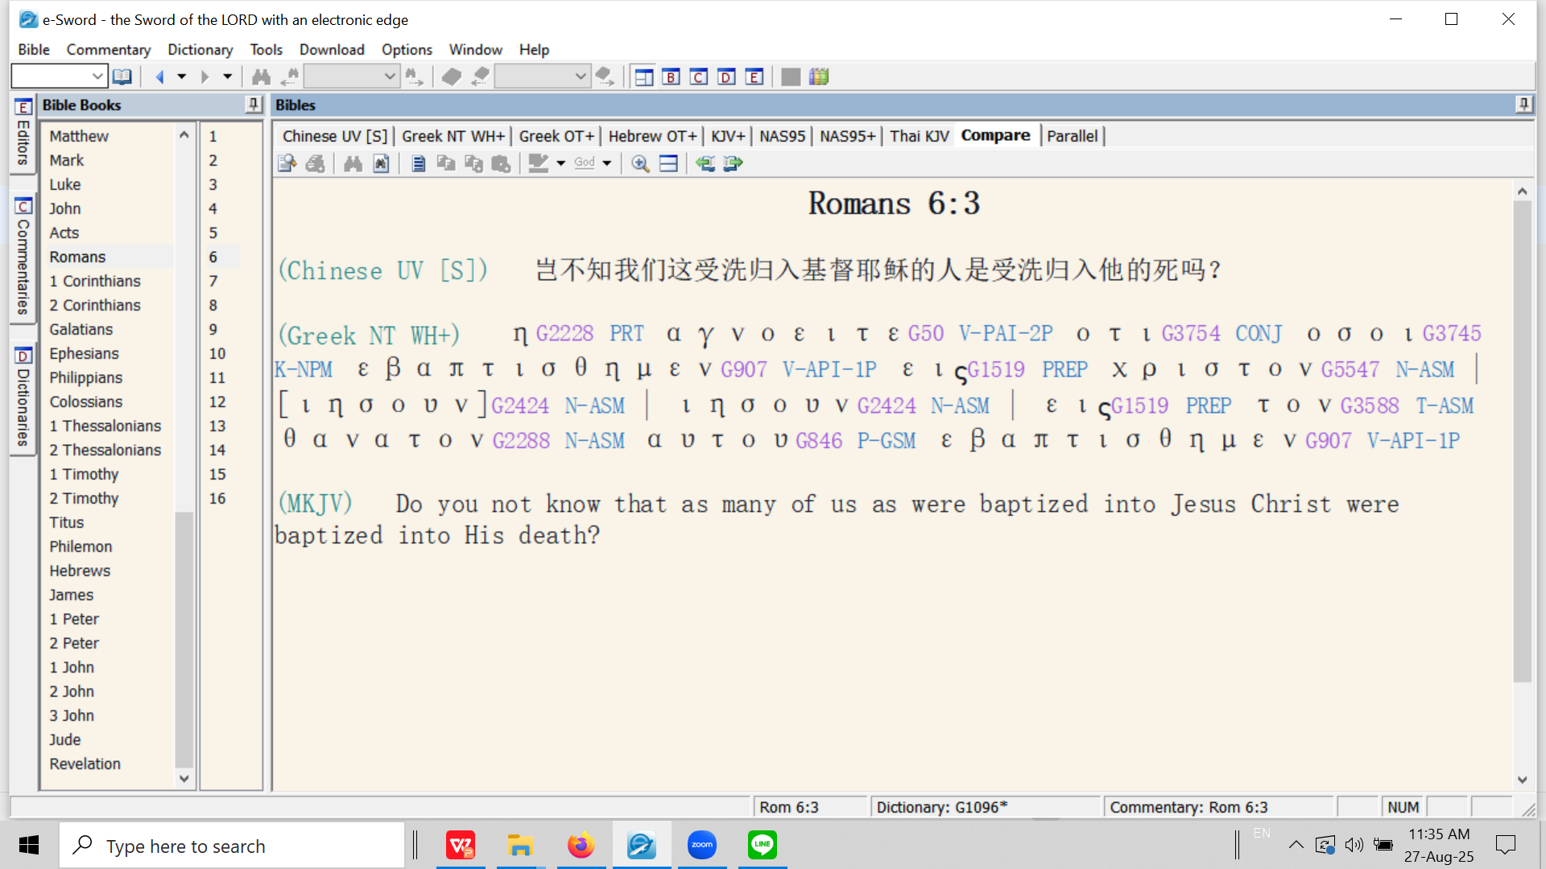
罗马书 6:3 难道你们不知道，我们这受洗归入基督耶稣的人，就是受洗归入他的死吗？（和合本修订版）

Slide 8
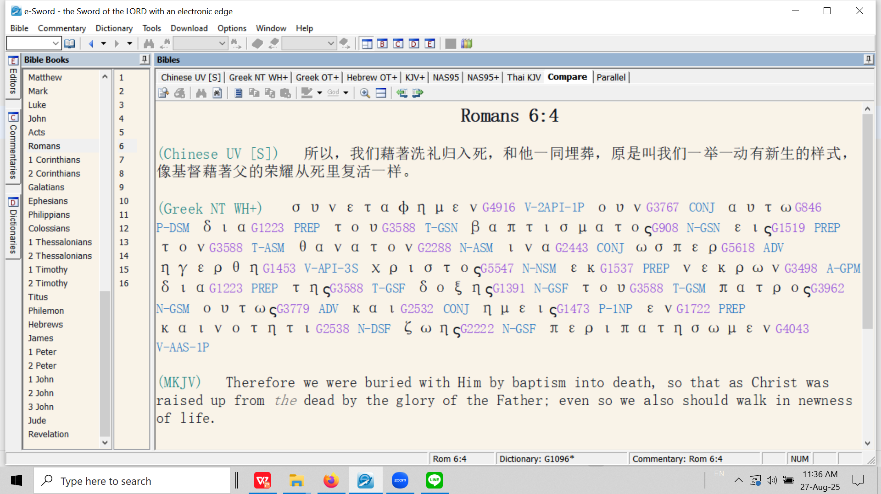
罗马书 6:4 所以，我们藉着洗礼归入死，和他一同埋葬，是要我们行事为人都有新生的样子，像基督藉着父的荣耀从死人中复活一样。（和合本修订版）

Slide 9
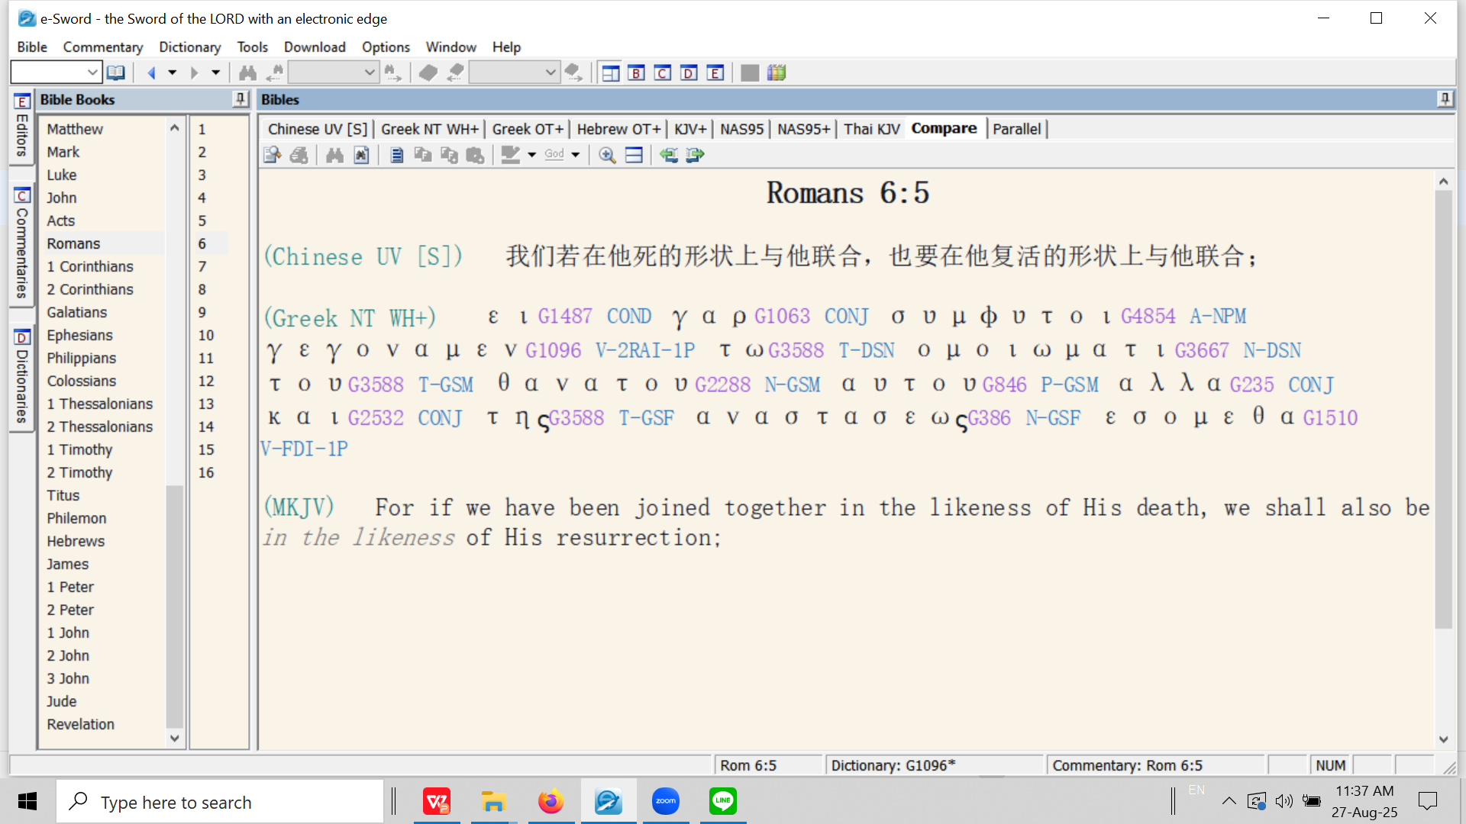
罗马书 6:5 我们若在他死的样式上与他联合，也要在他复活的样式上与他联合。（新译本）

Slide 10
συμφυτος / sumphutos
​
1. The word σύμφυτος / sumphutos is a compound word from “sum” = together (later appearing in English as: “sum” as in the result of two addends in an equation, ‘sum total’ etc.) and the verb φύω (also: φυτεύω) meaning ‘to plant’. The meaning is “plant together”.
sumphutos是一个复合词，由sum和动词phuó（ phuteuó ）共同组成，意为“栽种在一起”。
sum的意思是“一起/一同”（后来演变为英语单词sum，意为“和”或“总和”，即两个加数相加的结果；sum total也是同样的意思）。动词phuó（ phuteuó ）的意思则是“栽种”。
2. The word ‘sumphutos’ is a hapaxlegomenon, i.e., it appears only one time in the entire New Testament. This is a very specific and technical event – Christ and the believer are both bought into ‘newness of life’ through His burial and resurrection. In this case, it is because of our union [baptism] into Christ that we are buried and resurrected with Him.
sumphutos是一个孤例词，意思是在整本新约中，这个词只出现过一次。这是一件极其独特、巧妙的事件——基督和信徒一同藉着基督的埋葬和复活得以进入“新生”。在这起事件中，我们因着与基督合为一体[受洗合一]而得以与祂一同埋葬且一同复活。

Slide 11
3. The Holy Spirit choses to use this word as a synonym for ‘baptizo.’
圣灵选择使用sumphutos这个词作为baptizo（意为“洗礼”或“合一”）的同义词。
4. Therefore, we see the analogy of the seed: first it must be planted [‘buried’] before it can spring to newness of life - the resurrection (Rom. 6:4).
因此，我们见到种子的比喻：种子必须先经过栽种[“埋葬”]，才能获得新生——即复活（罗马书 6:4）。
5. Other planting analogies related to being in union with Christ found in the New Testament: Matt. 15:13; John 12:24, 32, John 15:1-8.
新约中其他有关“与基督合一”的栽种的比喻：马太福音 15:13；约翰福音 12:24、32；约翰福音 15:1-8。

Slide 12
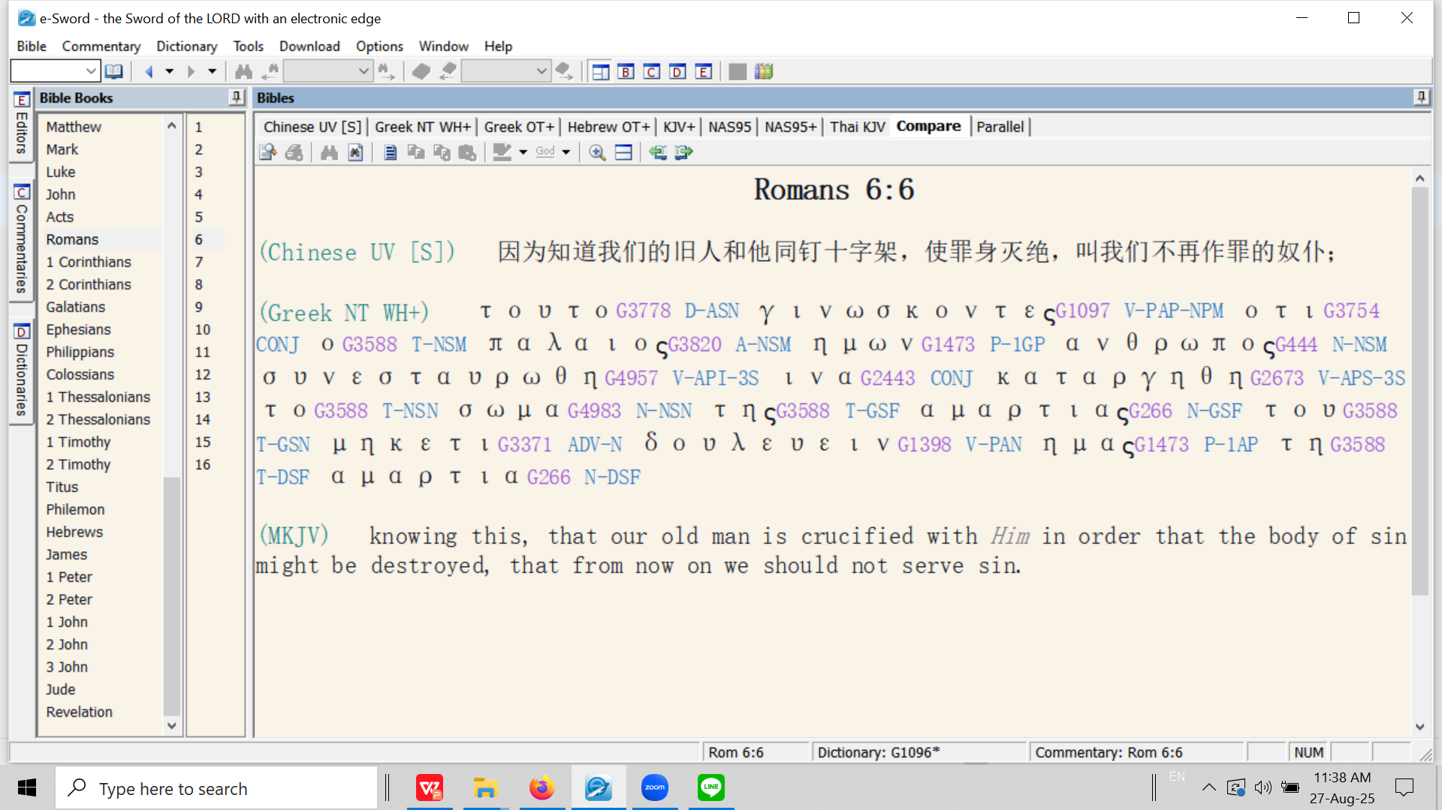
罗马书 6:5 我们知道，我们的旧人和他同钉十字架，使罪身灭绝，叫我们不再作罪的奴隶。（和合本修订版）

Slide 13
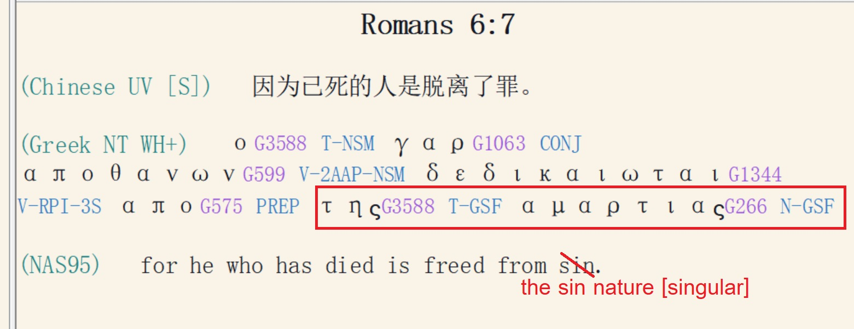

Slide 14
The believer is free from the Mosaic Law. He is:
信徒不再受摩西律法的约束。信徒是：
Dead to the Law (Rom. 7:4).
对律法是死的（罗马书 7:4）。
Delivered from the Law (Rom. 6:14; 7:6; 2 Cor. 3:6–11; Gal. 3:25).
得蒙拯救（罗马书 6:14，7:6；哥林多后书 3:6-11；加拉太书 3:25）。

Slide 15
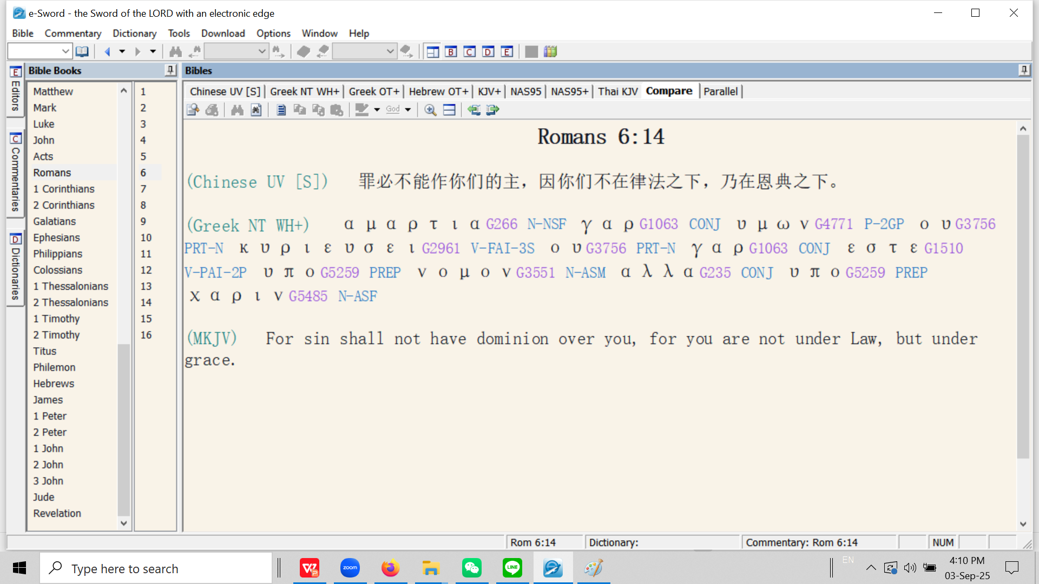

Slide 16
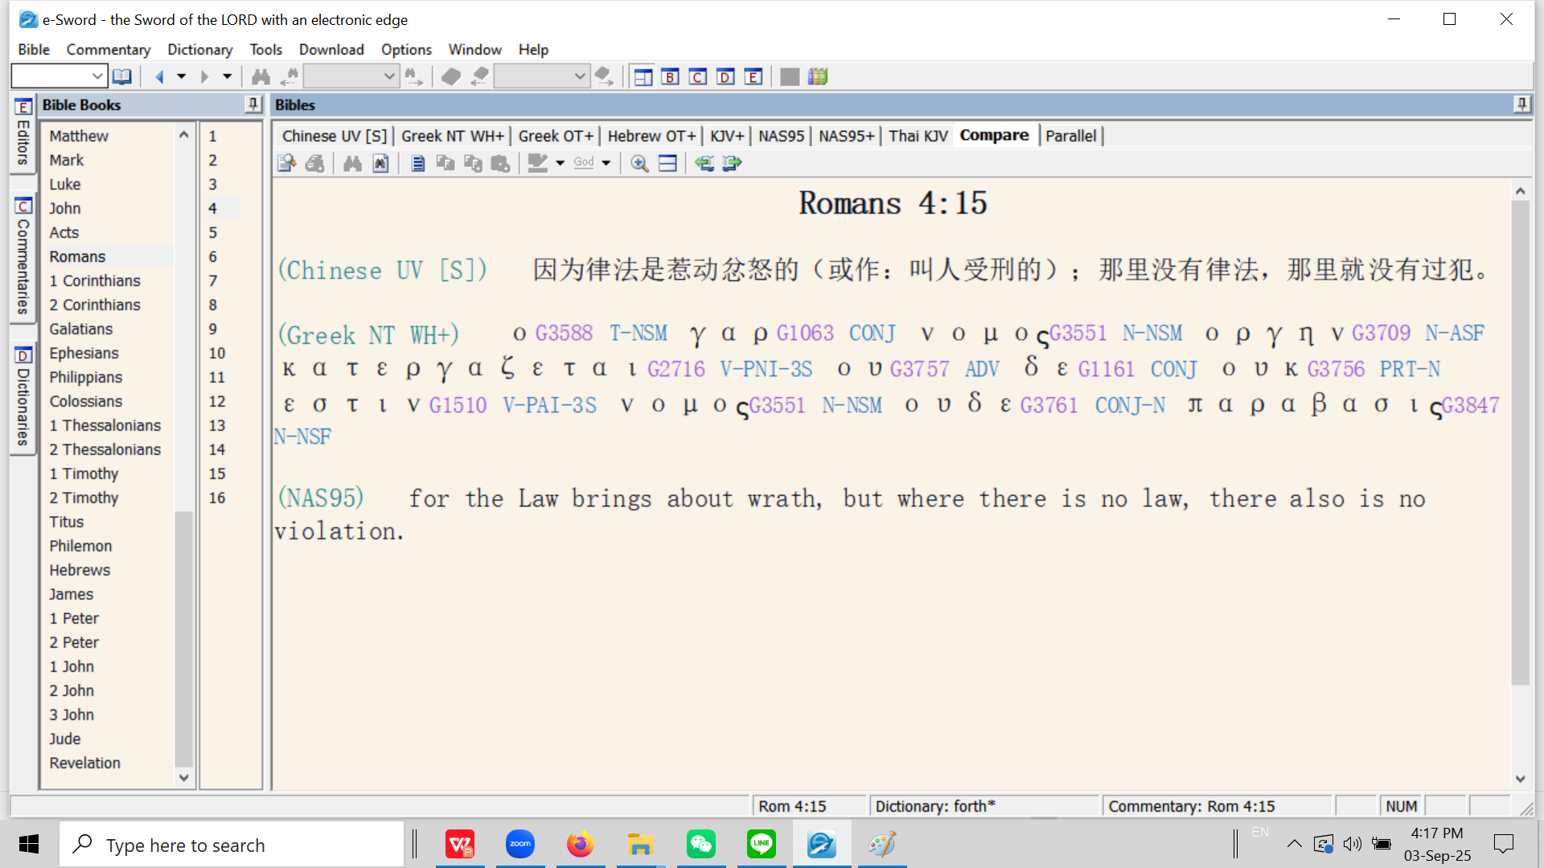
属灵生命概论
By analogy: “How can a wife be disobedient to her ex-husband if she is divorced from him?”

Slide 17
Romans 7 罗马书 7
Outline: four paragraphs. 大纲：分为4段
a) The key to interpretation: the two marriages, verses 1-6.
解读关键：第1-6节经文所提及的两段婚姻
b) The function of the law as a marriage counsellor, verses 7-14.
第7-14节经文所提及的律法充当婚姻咨询的作用
c) The attacks of the first husband, verses 15-21.
第15-21节经文所提及的来自第一任丈夫的攻击
d) The great inner conflict, verse 22-25.
第22-25节经文所提及的内在矛盾

Slide 18
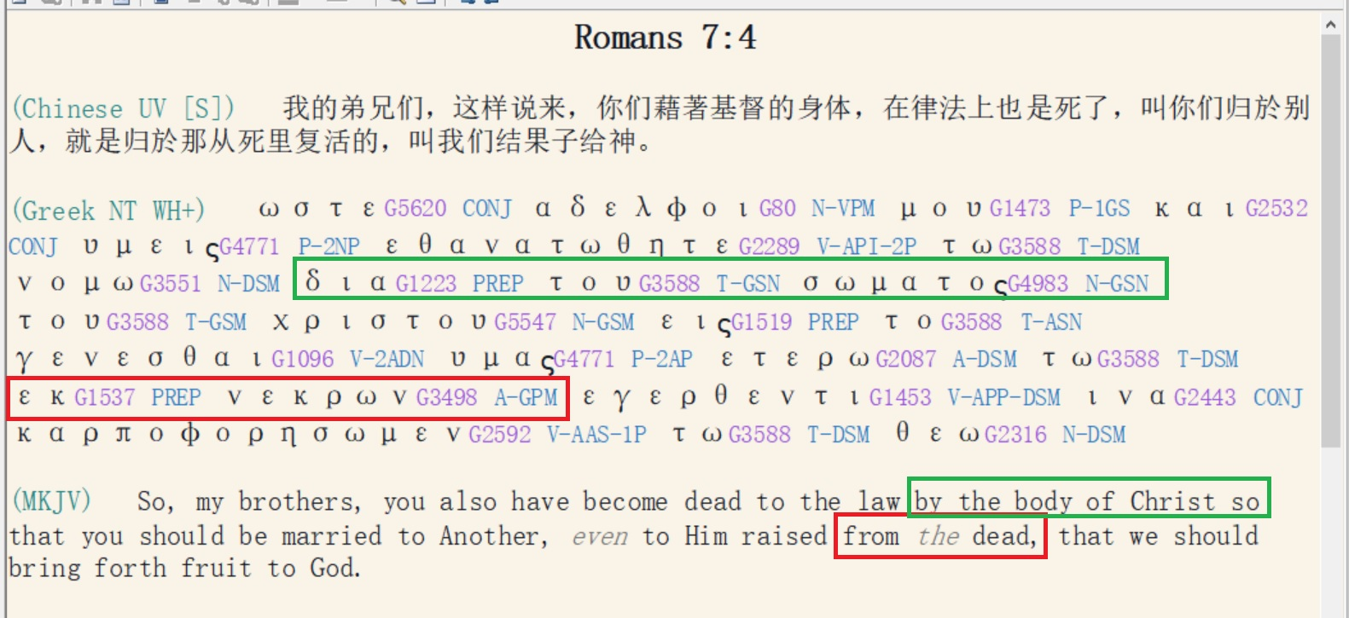

Slide 19
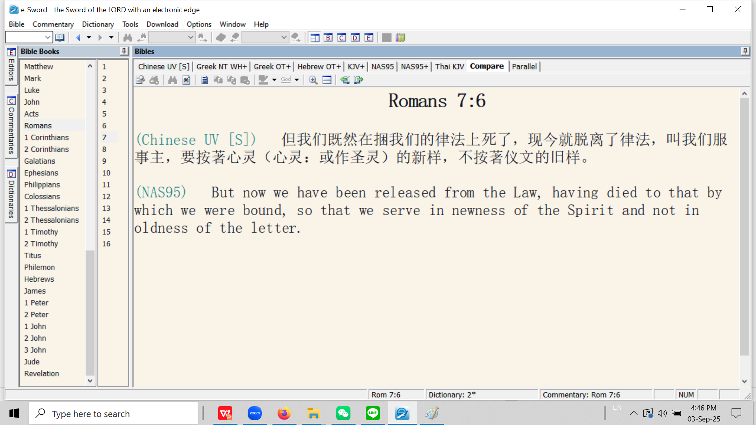

Slide 20
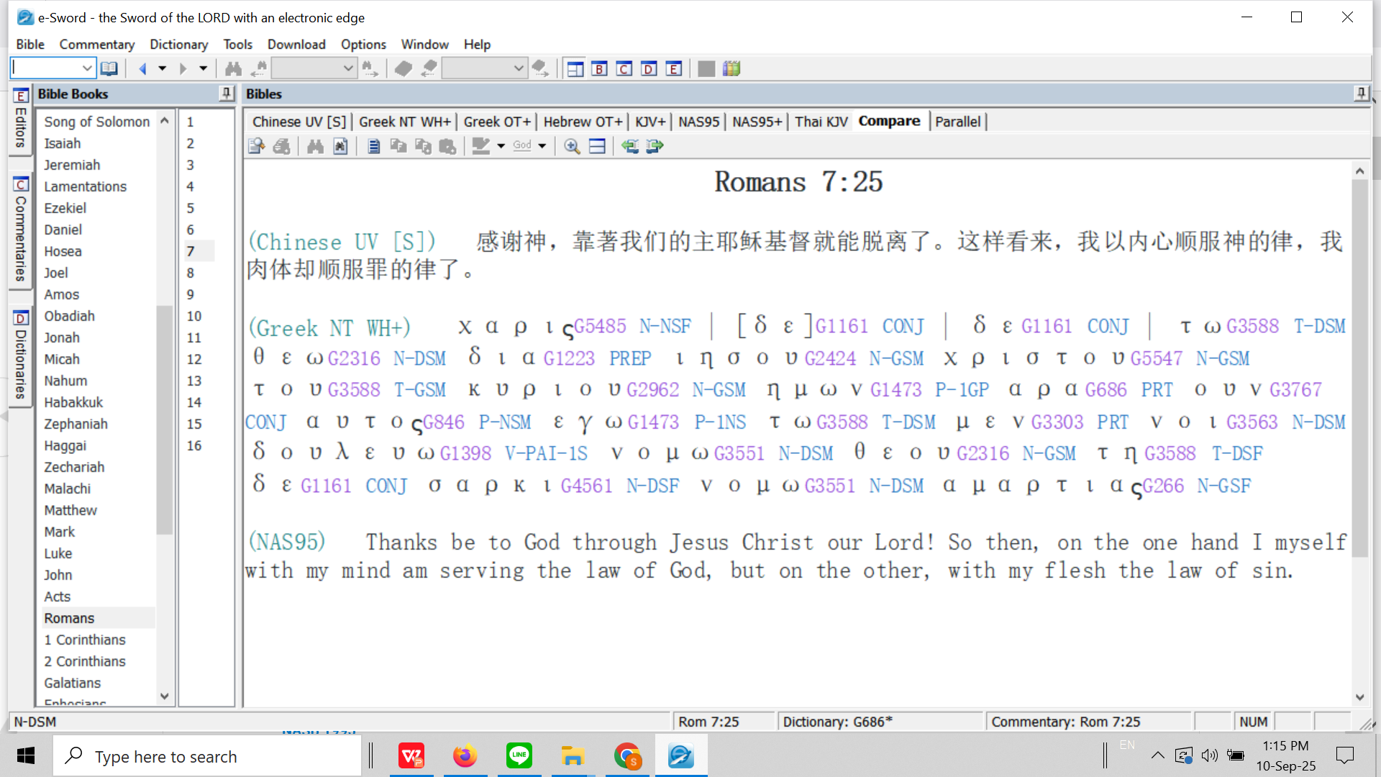

Slide 22
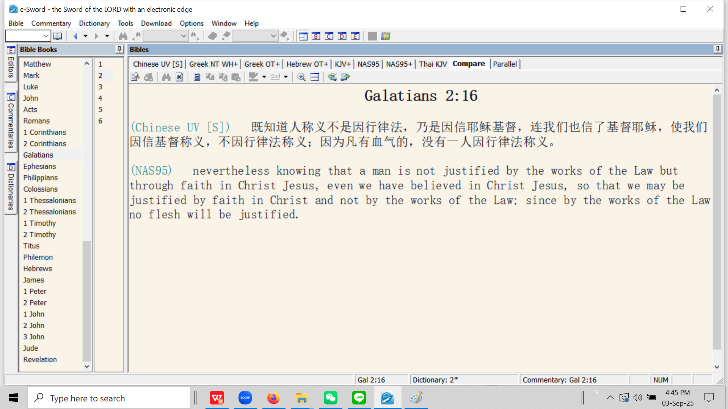

Slide 23
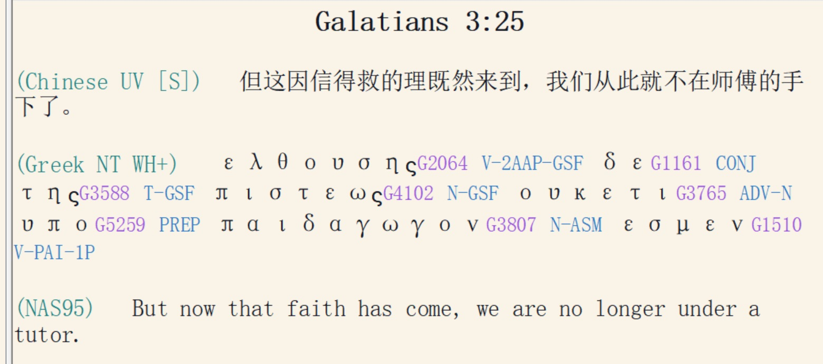

Slide 24
The believer is regenerated (John 13:10; 1 Cor. 6:11; Titus 3:5). He is:
信徒得以重生（约翰福音 13:10；哥林多前书 6:11；提多书 3:5）。信徒是：
Born again (John 3:7; 1 Pet. 1:23).
蒙了重生（约翰福音 3:7；彼得前书 1:23）。
A child of God (Rom. 8:16; Gal. 3:26).
神的孩子（罗马书 8:16；加拉太书 3:26）。
A son of God (John 1:12; 2 Cor. 6:18; 1 John 3:2).
神的儿子（约翰福音 1:12；哥林多后书 6:18；约翰一书 3:2）。
A new creation (2 Cor. 5:17; Gal. 6:15; Eph. 2:10).
新造的人（哥林多后书 5:17；加拉太书 6:15；以弗所书 2:10）。

Slide 25
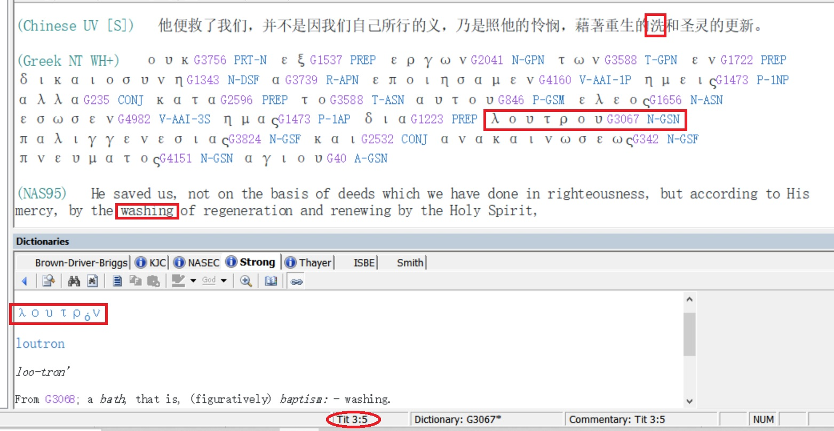

Slide 26
Without criticizing them, Jesus decided to clean their feet not only to solve the immediate problem of their filthy feet, but primarily to teach by analogy that his work on the cross would be the basis for the confession of sins.
All twelve disciples had bathed before departing from Bethany and coming to Jerusalem where the Last Supper would take place. This cleansing of the whole body is analogous to their salvation with emphasis on the forgiveness of pre-salvation-sins.
On the way to the location where the Last Supper would take place, they had to walk through a number of filthy streets, for in those times they did not have plumbing as we do now and people would just throw their bowls of excrement onto the street. The apostles should have washed their feet (as was custom) before entering the home where the supper would take place. Washing the filth (representing sins) from their feet would be analogous to the confession of their sins.
Dining at the table was fellowship with the Lord (Revelation 3:20). The believer cannot have fellowship with the Lord with filth on his feet! (in a state of sin and carnality).
The feet are analogous to service (Isaiah 52:7). One cannot serve the Lord with filthy feet (while in carnality).

Slide 27
John 13:6 挨到西门彼得，彼得对他说：「主啊，你洗 [νίπτω / nipto] 我的脚吗？」
So He *came to Simon Peter. He *said to Him, "Lord, do You wash [νίπτω / nipto] my feet?"
John 13:7 耶稣回答说：「我所做的，你如今不知道，後来必明白。」
Jesus answered and said to him, "What I do you do not realize now, but you will understand hereafter."
John 13.8 彼得说：「你永不可洗 [νίπτω / nipto] 我的脚！」耶稣说：「我若不洗 [νίπτω / nipto] 你，你就与我无分了。」
Peter *said to Him, "Never shall You wash my feet!" Jesus answered him, "If I do not wash you, you have no part with Me."

Slide 28
John 13:9 西门彼得说：「主啊，不但我的脚，连手和头也要洗。」
(NAS95) Simon Peter *said to Him, "Lord, then wash not only my feet, but also my hands and my head."
John 13:10 耶稣说：「凡洗过澡 [λούω / louo] 的人，只要把脚一洗 [νίπτω / nipto]，全身就乾净 [καθαρός / katharos]了。你们是乾净 [καθαρός / katharos]的，然而不都是乾净的。」
Jesus *said to him, "He who has bathed [λούω / louo] needs only to wash [νίπτω / nipto] his feet, but is completely clean [καθαρός / katharos]; and you are clean [καθαρός / katharos] , but not all of you."
1 John 1:9
我们若认自己的罪，神是信实的，是公义的，必要赦免我们的罪，洗净 [καθαρός / katharos] 我们一切的不义。
If we confess our sins, He is faithful and righteous to forgive us our sins and to cleanse [καθαρός / katharos] us from all unrighteousness.

Slide 29
John 3:4 尼哥底母说：「人已经老了，如何能重生呢？岂能再进母腹生出来吗？」
Nicodemus *said to Him, "How can a man be born when he is old? He cannot enter a second time into his mother's womb and be born, can he?"
John 3:5 耶稣说：「我实实在在的告诉你，人若不是从水和圣灵生的，就不能进神的国。
Jesus answered, "Truly, truly, I say to you, unless one is born of water [from amniotic fluid at physical birth] and the Spirit [spiritual birth] he cannot enter into the kingdom of God.
John 3:6 从肉身生的就是肉身；从灵生的就是灵。
"That which is born of the flesh [physical birth] is flesh, and that which is born of the Spirit [spiritual birth] is spirit.
John 3:7 我说：『你们必须重生』，你不要以为希奇。
"Do not be amazed that I said to you, 'You must be born again.'

