Slide 1

Charlie Kirk
(October 14, 1993 – September 10, 2025)

Slide 2
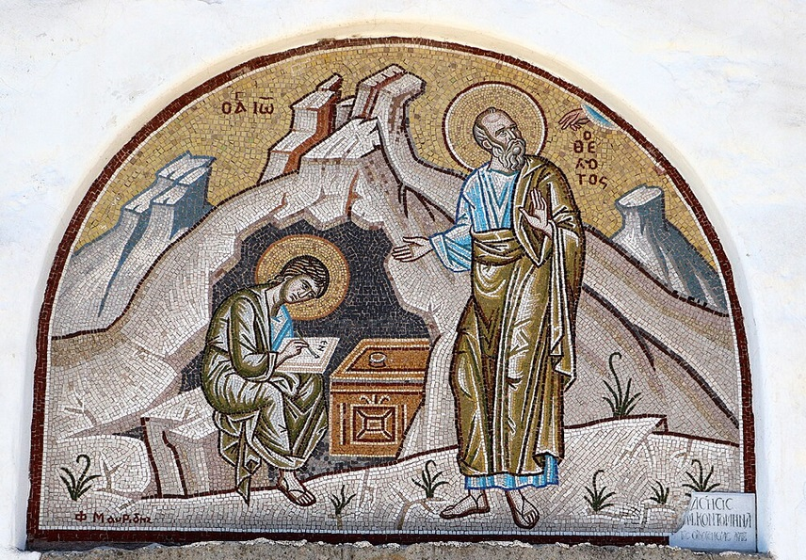
การวิเคราะห์พระธรรมวิวรณ์
สอนโดย อ.Tim จากคำบันทึกของ อ. Max Klein
REVELATION 63
2025 09 15

Slide 3
Sardis was the capital of the ancient Kingdom of Lydia which produced kings like Croesus who was the first to coin money from precious metals.
Sardis was destroyed by a great earthquake in BC 17. The Emperor Tiberias rebuilt it with the finest boulevards and wide streets.
The city of Sardis was famous for the gold taken out of the river which flowed through it, and it became a center for making settings for jewelry.
Sardis became the world center for textile industries, from its wool it produced famous textiles and carpets.
It was also the wine center of the world at that time. When Cicero visited Sardis, he was impressed with its beauty. Three hundred years later Longus compared it to Venice in its beauty. It was the number one city for the manufacturing and the dying of woolen clothes throughout the world.

Slide 4
ลิเดีย ลิเดีย (Lydia) เป็นอาณาจักรโบราณ ตั้งอยู่ทางทิศตะวันตกของอานาโตเลีย (หรือ เอเชียไมเนอร์) มีเมืองหลวงชื่อซาร์ดิส ตั้งอยู่ระหว่างจังหวัดอิชมีร์และจังหวัดมานิซา ในประเทศตุรกีในปัจจุบัน
ในช่วงศตวรรษที่ 7 ก่อนคริสตกาล ครอบคลุมพื้นที่อนาโตเลียตะวันตกทั้งหมด ใน 546 ปีก่อนคริสตกาล ลิเดียกลายเป็น satrapy ของจักรวรรดิ Achaemenid ใน 133 ปีก่อนคริสตกาล ลิเดียกลายเป็นส่วนหนึ่งของจังหวัดเอเชียของโรมัน

Slide 5
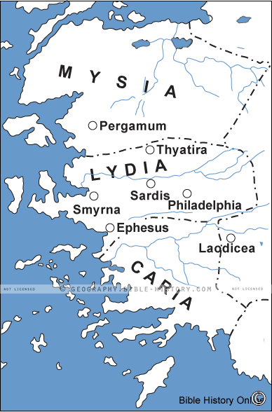

Slide 6
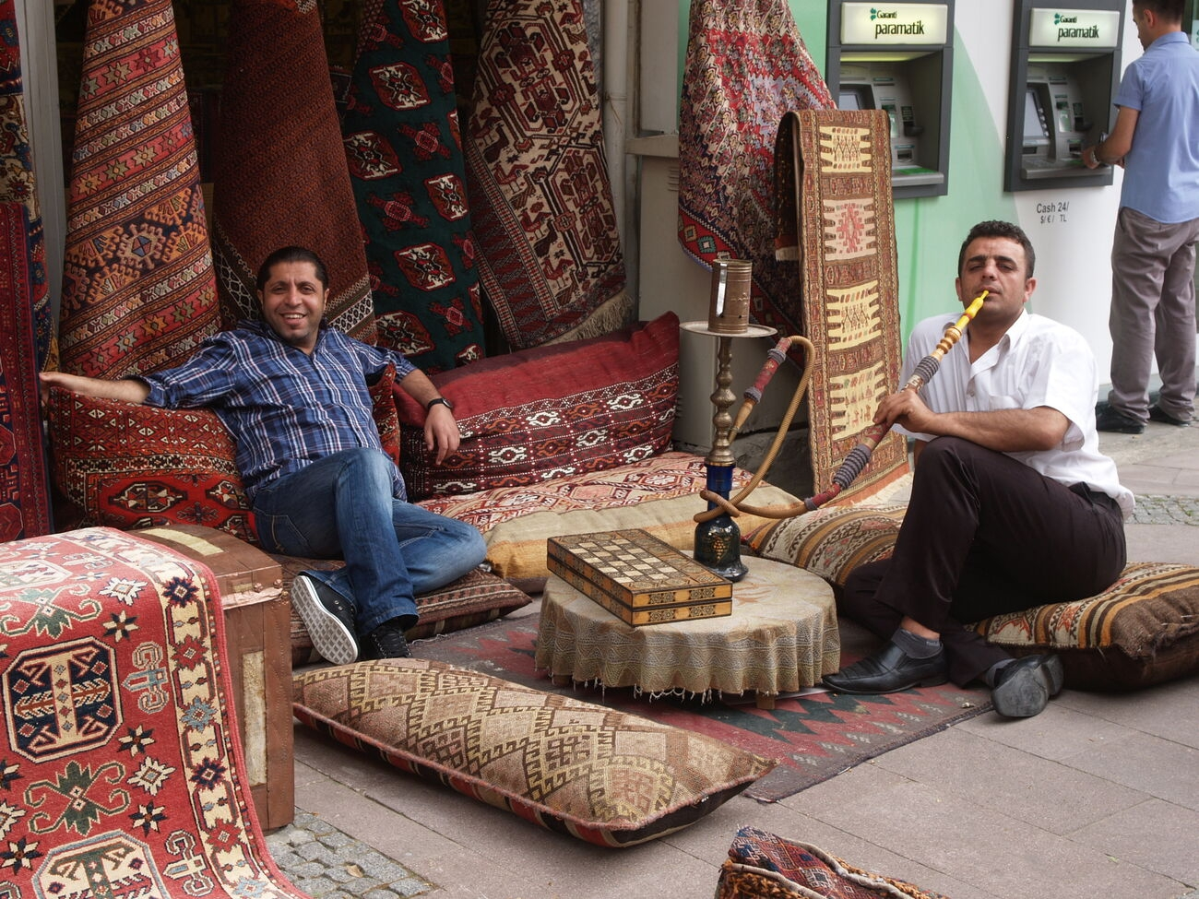

Slide 7
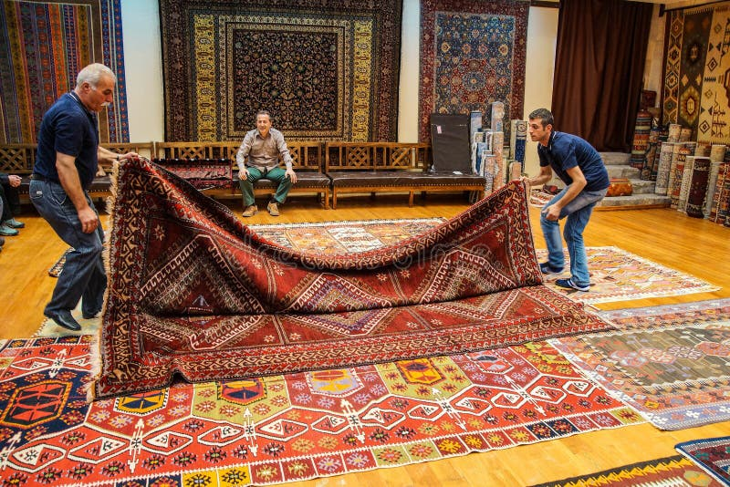

Slide 8
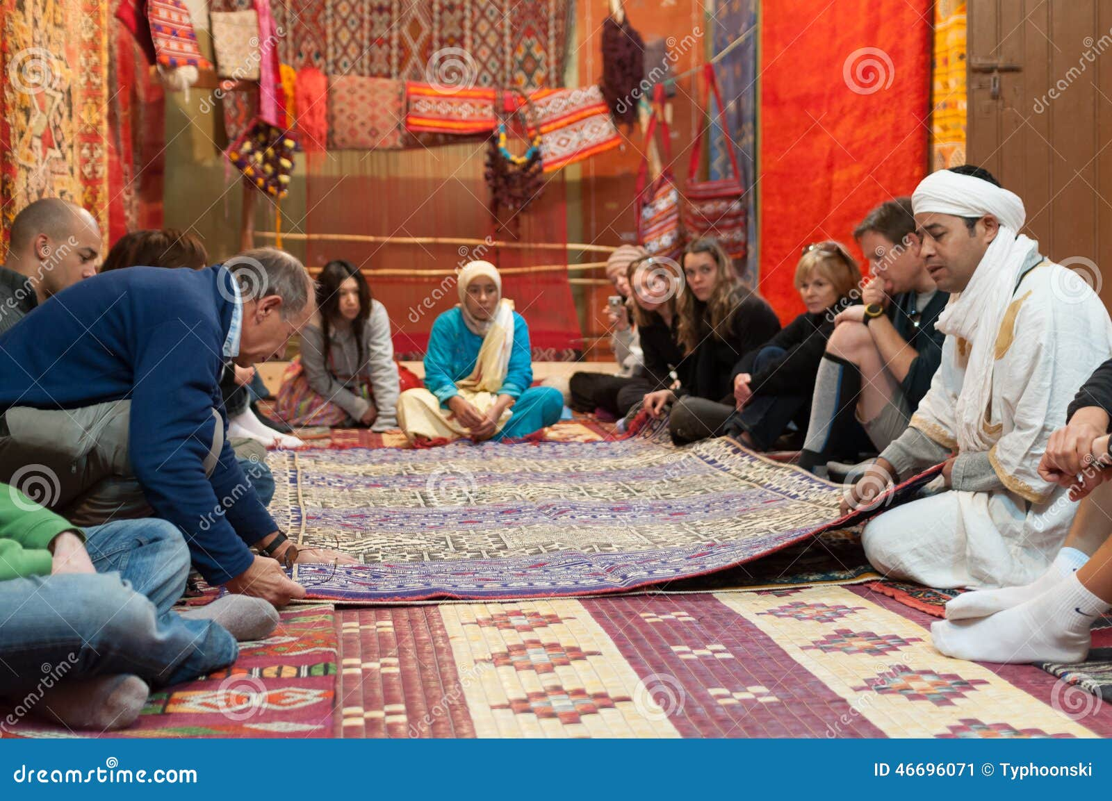

Slide 9
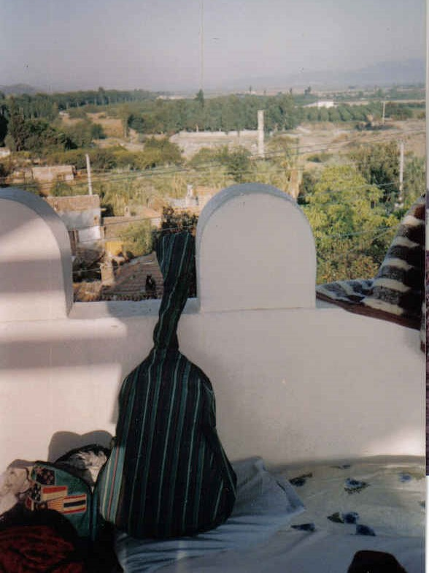

Slide 10
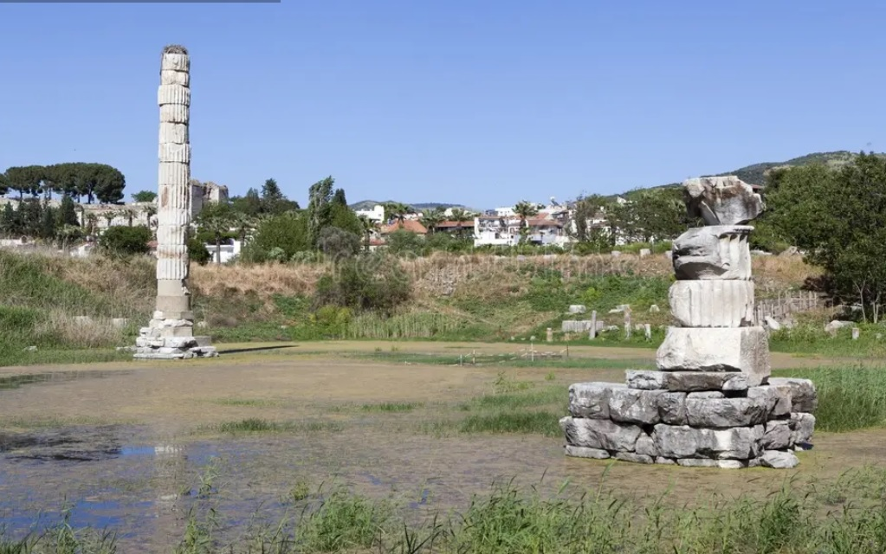
“The Pillar of Artemis” (Selcuk, Ephesus). It was built entirely from marble, listed as one of the Seven Wonders of the Ancient World (เป็นหนึ่งในเจ็ดสิ่งมหัศจรรย์ของโลกโบราณ). Today it's often topped by a stork's nest. At its zenith, the temple counted 127 columns. (cf. Acts 19:27)

Slide 11
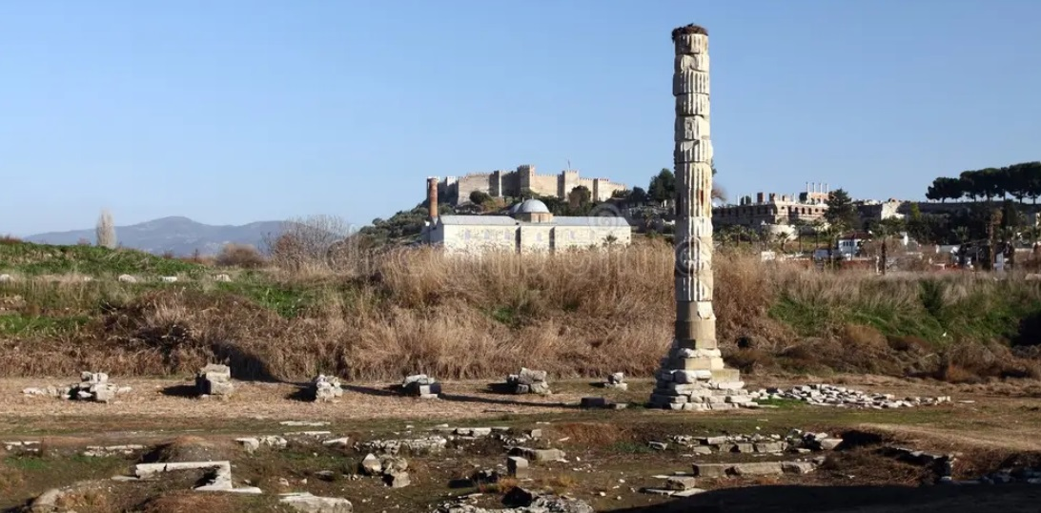

Slide 12
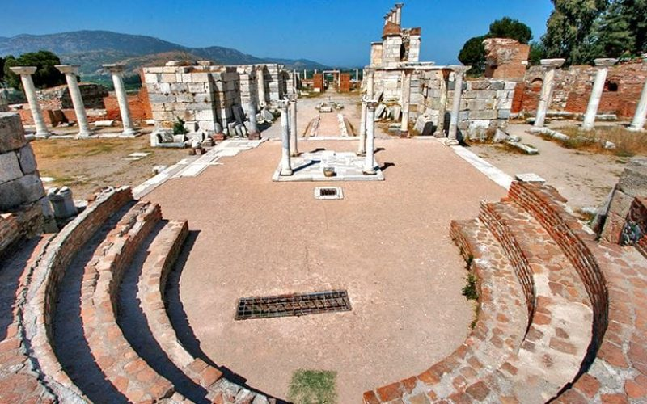
“Basilica of Saint John” (Selcuk, Ephesus)

Slide 13
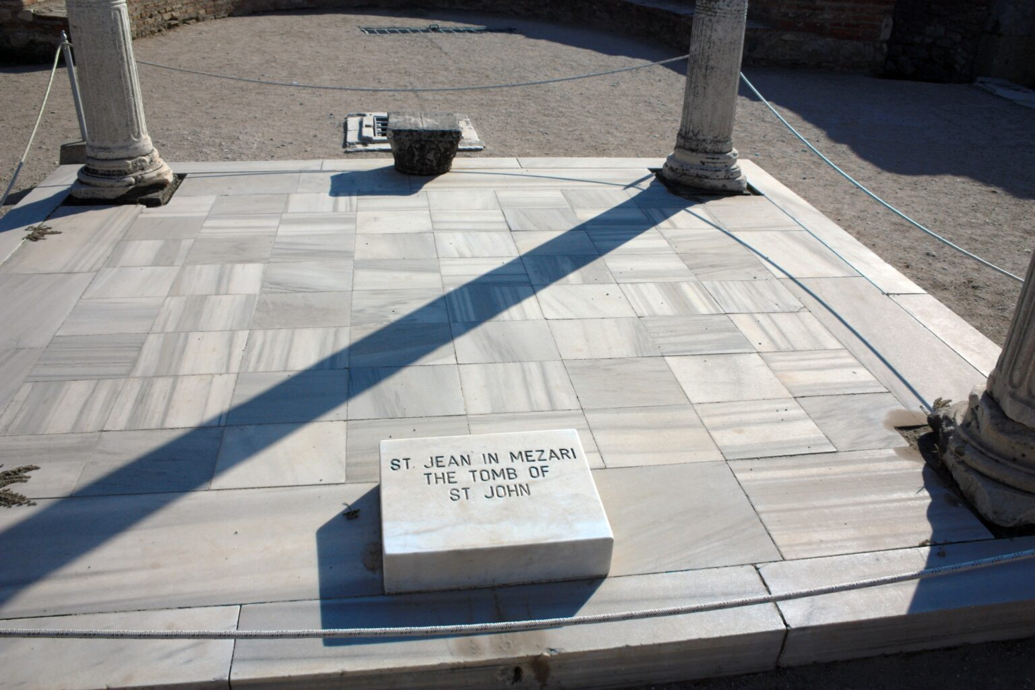

Slide 14
วิวรณ์ 3:1
Message to Sardis:
And to the messenger [future pastors] of the [local] church in Sardis write: He who has the seven Spirits of God [God the Holy Spirit who provided the prototype spiritual life for the humanity of Christ: Isaiah 11:2] and the seven stars [orthodox pastors], communicates these things: 'I have known your works namely that you have a reputation that you are alive [false reputation], but in spite of that reputation, you are dead [functioning in the cosmic system: cosmic or carnal death]
Καὶ τῷ ἀγγέλῳ τῆς ἐν Σάρδεσιν ἐκκλησίας γράψον· Τάδε λέγει ὁ ἔχων τὰ ἑπτὰ πνεύµατα τοῦ θεοῦ καὶ τοὺς ἑπτὰ ἀστέρας· Οἶδά σου τὰ ἔργα, ὅτι ὄνοµα ἔχεις ὅτι ζῇς, καὶ νεκρὸς εἶ.
จงเขียนถึงทูตสวรรค์แห่งคริสตจักรที่เมืองซาร์ดิสว่า `พระองค์ผู้ทรงมีพระวิญญาณทั้งเจ็ดของพระเจ้า และทรงมีดาราเจ็ดดวงนั้น ได้ตรัสดังนี้ว่า เรารู้จักแนวการกระทำของเจ้า เจ้าได้ชื่อว่ามีชีวิตอยู่ แต่ว่าเจ้าได้ตายเสียแล้ว

Slide 15
“He who has the seven Spirits of God,”
Isaiah 11:1, “Then a shoot [a root that buds, a root shoot] will spring up from the stem of Jessie, and a branch from his roots [Christ at the second advent] will bear fruit [ Heb: “yiphrah = bear fruit” His rule in the Millennium].”
จะมีหน่อแตกออกมาจากตอแห่งเจสซี จะมีกิ่งงอกออกมาจากรากทั้งหลายของเขา และเกิดผล
Here is prophecy of the first advent. The root-shoot will spring up from a dynasty which is no longer ruling in Israel, the dynasty of David. Since the fifth cycle of discipline was administered by Nebuchadnezzar no member of the royal family has ruled in Israel, so it is called “the stump,” “from the stump of Jesse,” that is David’s line defunct from the fifth cycle of discipline;

Slide 16
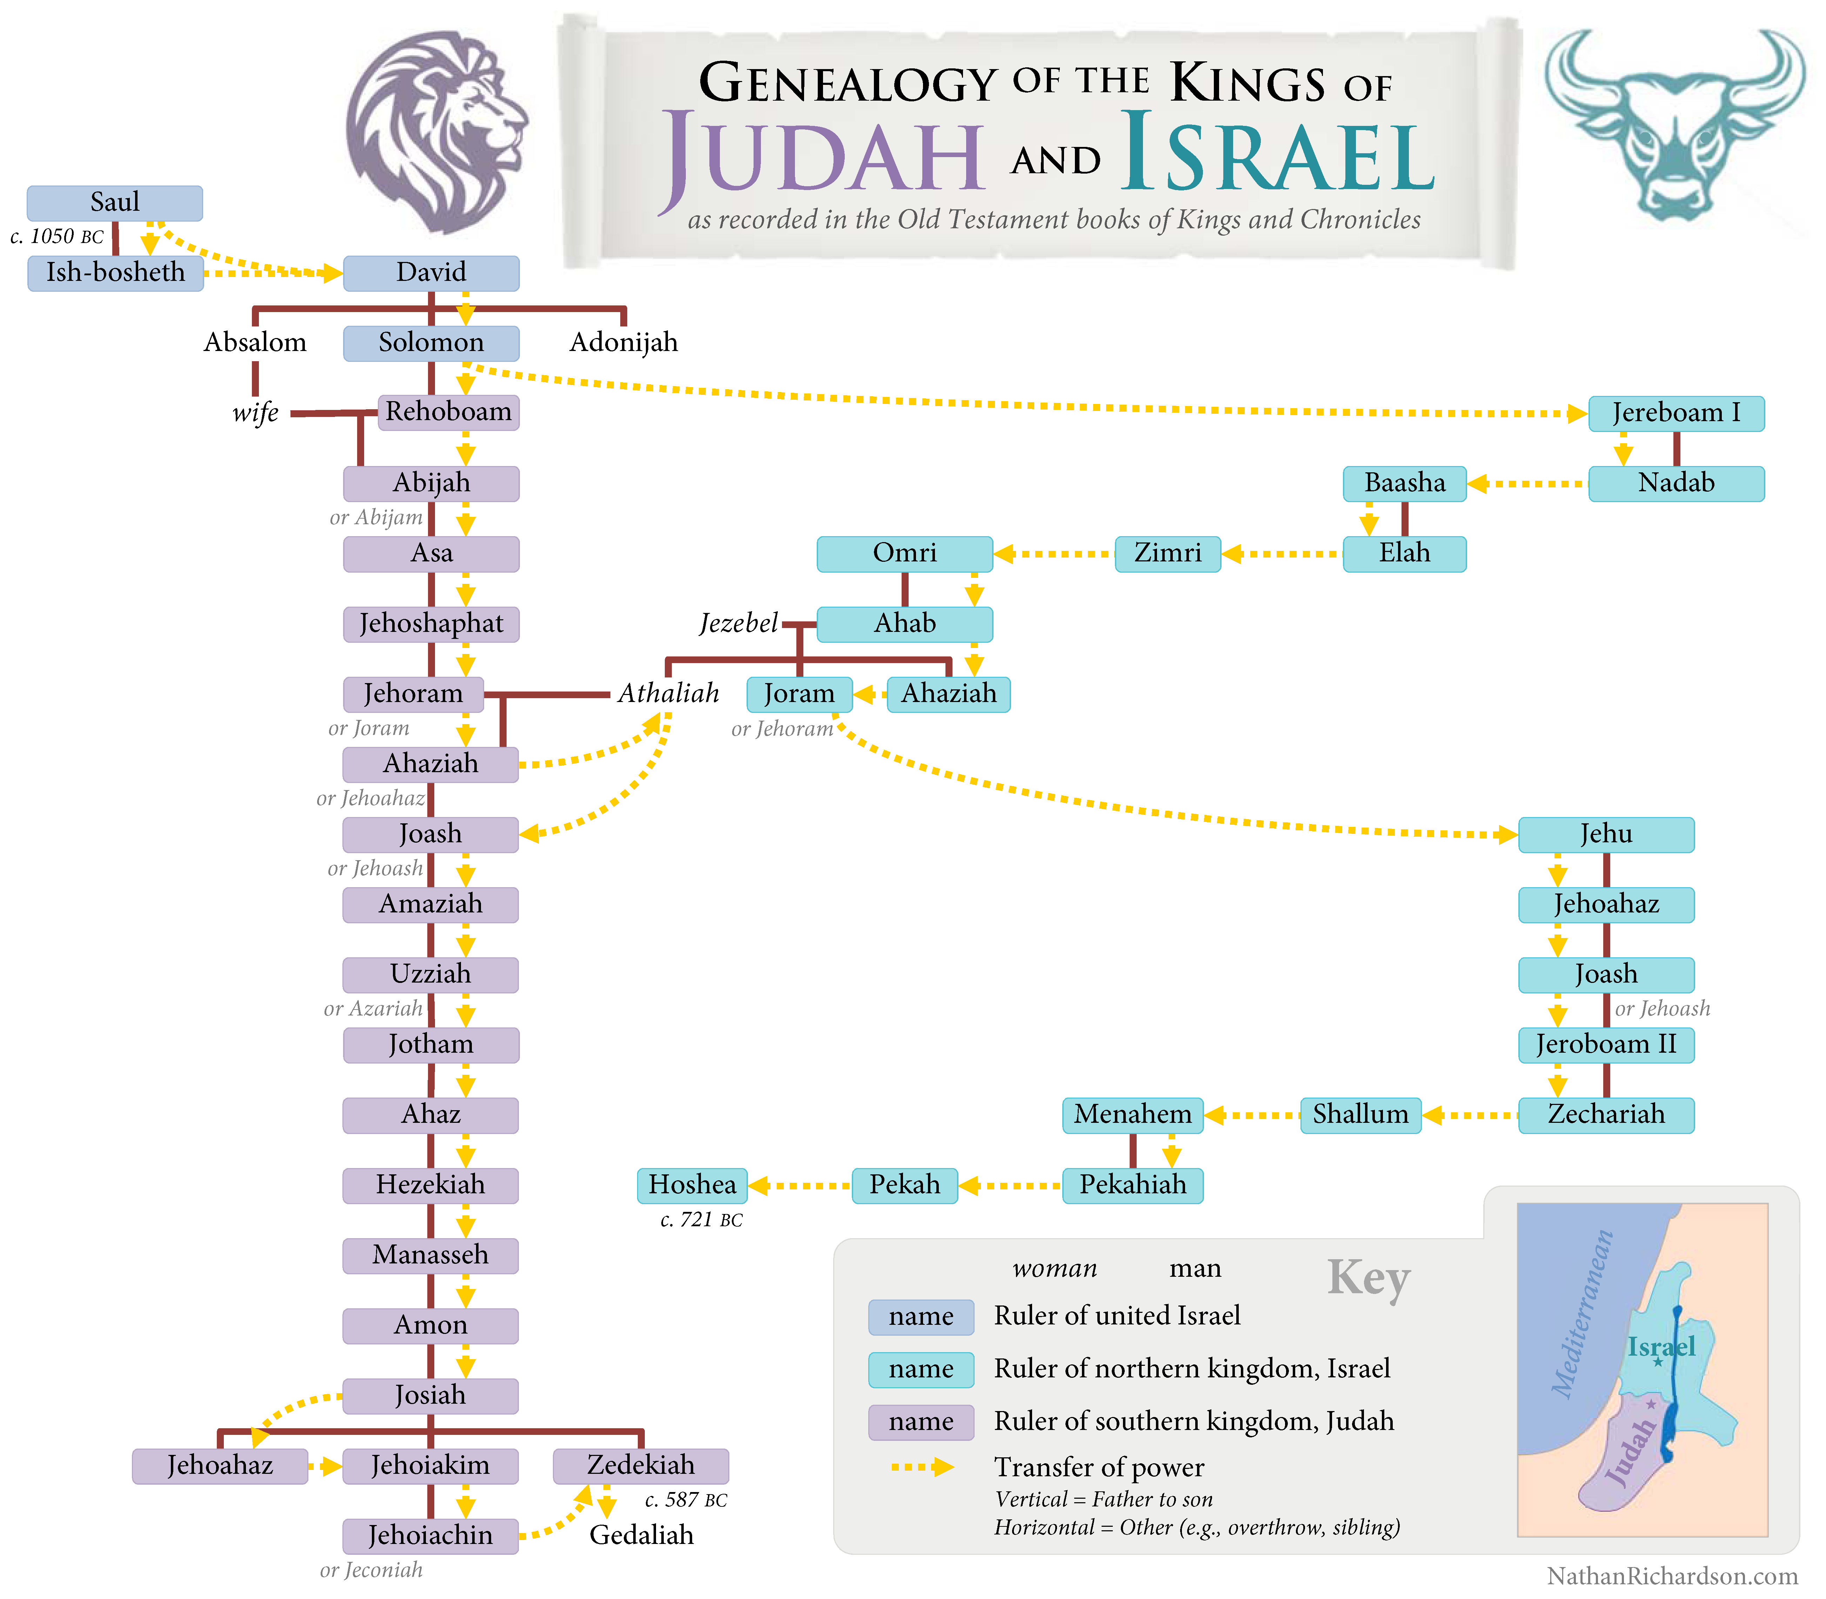

Slide 17
“And a branch from his roots [Christ at the second advent] will bear fruit [His rule in the Millennium].” (จะมีกิ่งงอกออกมาจากรากทั้งหลายของเขา)
So, from verse one we have a prophecy of the two advents. It is because of a failure to properly interpret verse one that Jews have got into so much trouble in the 2000 years since Christ came the first time.
Their failure to distinguish between the first and the second advents as in this passage is a part of their trouble. They can’t tell the difference between the root-shoot and the branch, and yet the root-shoot and the branch are one person, Jesus Christ, the God of Israel, the founder of Israel as the root-shoot. In the first advent He manifests Himself to Israel; in the second advent He comes back as the branch of a tree, the root-shoot grows into a great tree.

Slide 18
The seven spirits are titles related to the teaching ministry of God the Holy Spirit, first to the humanity of Christ and then to the Church Age believers. These 7 titles are found in Isaiah 11:2 and are as follows:
1.The Spirit of the Lord will rest [ נוּחַ ] on Him (The Holy Spirit’s power) วิญญาณของพระเยโฮวาห์จะอยู่บนท่านนั้น
2. חכמה רוח The Spirit of wisdom วิญญาณแห่งปัญญา (wisdom extrapolated from truth and applied to people, circumstances, sufferings etc.)
3. בינה רוח The Spirit of perception วิญญาณแห่งความเข้าใจ (the means of learning doctrine)

Slide 19
4. עֵצָה רוח The Spirit of counsel วิญญาณแห่งการวินิจฉัย (the Spirit counsels through metabolized doctrine)
5. גְּבוּרָה רוח The Spirit of strength วิญญาณแห่งอานุภาพ (the Spirit produces strength in the soul)
6. דַּעַת רוח The Spirit of knowledge “cunning” วิญญาณแห่งความรู้ (the Spirit, the teacher of divine knowledge)
7. יִרְאָה רוח The Spirit who provides respect/fear of the Lord วิญญาณแห่งความยำเกรงพระเยโฮวาห์

Slide 20
The Lord communicates these things (Τάδε λέγει). These two Greek words were used originally as the introductory formula for the Greek translation of the decrees of Persian kings. It is used here as an introductory formula to our Lord’s estimate of the situation in Sardis. This church has cosmic involvement related to hypocrisy.
The present tense is a descriptive present for what is now going on, a false reputation assigned to the church in Sardis. They have given a false impression to the world, but their false reputation is about to be exposed.
1. A false reputation for spirituality and maturity is a sign of cosmic involvement related to the function of hypocrisy.
2. To live by one’s reputation with people apart from integrity and virtue is to be a cosmic believer, the most miserable person on planet earth.

Slide 21
3. The only reputation that counts is the believer’s reputation with God who cannot be deceived.
4. It is impossible to have a good name or reputation with God apart from consistent residence and function inside the divine power system, and that includes consistent perception of Bible doctrine.
5. The majority of the believers of Sardis involved in the cosmic system talk a good fight, which means they have been exposed to excellent doctrinal teaching, but there was no application.

Slide 22
6. To talk a good fight, the believer only needs to know the doctrinal vocabulary, but to fight a good fight, as per 2 Timothy 4:7,8, the believer must be consistent in functioning under the two power options.
7. It is easy for the cosmic believer to talk a good fight, but it is impossible for him to fight a good fight. Talking a good fight is exposure to doctrine, while living in the cosmic system growing in arrogance and functioning under the principle of hypocrisy. Fighting a good fight is learning doctrine, living in the divine power system, growing in grace, applying doctrine to experience.
8. The believer who talks a good fight makes bad decisions. He is spiritually and mentally lazy, and negative toward doctrine, but gives the impression of being a spiritual giant. His arrogance is stimulated by approbation from other believers which only stabilizes and crystallizes his facade of hypocrisy.

Slide 23
Many believers in this church were suffering from carnal death. So, let’s briefly cover the eight different categories of death mentioned in Scripture.
1. The first and most obvious death is physical death which is defined as separation of the soul from the body. (Romans 8:38-39)
2. The second category of death in the Bible is spiritual death. Spiritual death is the penalty of sin and is so given as a warning to our original parents in the garden. They were warned in Genesis 2:17 that if they disobeyed God and His prohibition, “dying [spiritual death] you will die [physical death]”. Adam’s original sin is imputed to our genetically formed old sin nature at birth, and so when it says the wages of sin is death in Romans 6:23, it is talking about Adam’s sin imputed to each member of mankind at birth. We are born physically alive, and simultaneously we are born spiritually dead. (Romans 5:12; 1 Cor. 15:22)
3. Positional death of the believer is the third category of death in the Bible. Through the baptism of the Holy Spirit at salvation the believer is identified with Christ in His deaths namely His substitutionary spiritual death, followed by physical death, burial and resurrection. (Romans 6:1-8)

Slide 24
5. Operational death is operating on human power resulting in the production of dead works. This category combines the arrogance of Christian service with the function of human good. (Hebrews 6:1) James 2:26, “Faith without production is dead [non-operative].”
6. Sexual death, the inability to copulate. It is only used in connection with men, and only one man in the Bible, Abraham. (Romans 4:17-21)
7. The second death is for the unbeliever only. It is the final judgment of those who reject the Lord Jesus Christ as personal savior; it is eternal separation from God in a literal lake of fire. It is described as judgment in Hebrews 9:27, “And inasmuch as it is destined for mankind to die once [physical death], but after this death the judgment [the second death].” That is why it is called the second death in Revelation 20:14.
8. The Sin unto Death: 1 John 5:16

Slide 25
วิวรณ์ 3:2
Be constantly alert [command to the pastor and the members of the congregation] and strengthen [support, stabilize; a command to the pastor] the rest who are about to die for I have not found [intensive perfect] your accomplishments completed [the execution of God’s plan] in the sight of My God.
γίνου γρηγορῶν, καὶ στήρισον τὰ λοιπὰ ἃ ἔµελλον ἀποθανεῖν, οὐ γὰρ εὕρηκά σου [τὰ] ἔργα πεπληρωµένα ἐνώπιον τοῦ θεοῦ µου·
เจ้าจงระแวดระวังให้ดี และกระตุ้นส่วนที่เหลืออยู่ซึ่งจวนจะตายอยู่แล้วนั้นให้แข็งแรงขึ้น เพราะว่าเราไม่พบการประพฤติของเจ้าดีพร้อมต่อพระพักตร์พระเจ้า

Slide 26
“the rest who are about to die” refers to those who are being won over by their association with other losers and if this continues, they will die the Sin unto Death

